Slide 1
Discussion on WLAN Sensing Roles
Date: 2020-11-09
Authors:
Name | Affiliation | Address | Phone | Email
Insun Jang | LG Electronics | 19, Yangjae-daero 11gil, Seocho-gu, Seoul 137-130, Korea |  | insun.jang@lge.com
Jinsoo Choi |  |  |  | js.choi@lge.com
Jeongki Kim |  |  |  | jeongki.kim@lge.com
Dongguk Lim |  |  |  | dongguk.lim@lge.com
Sang Kim |  | 10225 Willow Creek Rd, San Diego, CA, USA |  | sanggook.kim@lge.com

Slide 2
Introduction
We have discussed some points [1], [2], i.e., 1) Procedure of WLAN Sensing [1],[2] and 2) Roles of STAs participating WLAN sensing
In terms of Procedure of WLAN Sensing,
  Setup phase – Negotiation phase – Sensing phase – Tear down phase
In terms of Roles for WLAN Sensing,
  Sensing initiator / Sensing responder / Sensing transmitter / Sensing receiver
In this contribution, we discuss the potentially agreed WLAN Sensing Roles with Phases during WLAN sensing procedure in terms of specification further

Slide 3
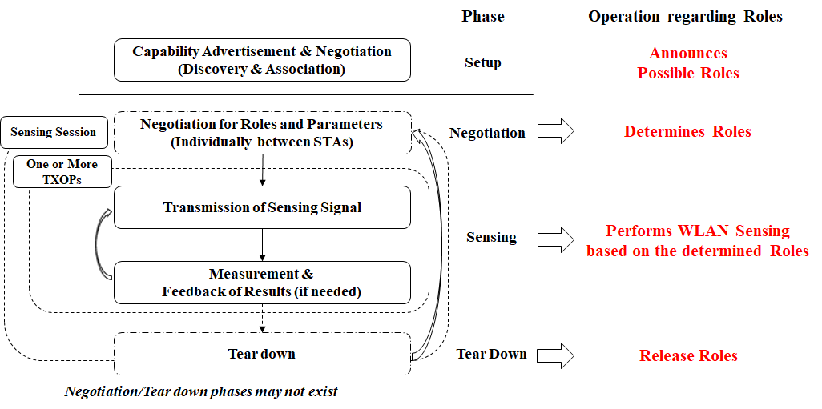
WLAN Sensing Procedure and Roles [1]

Slide 4
Recap [2]: WLAN Sensing Roles
Sensing initiator is an STA that initiates a WLAN sensing session
Sensing responder is an STA that participates in a WLAN sensing session initiated by a sensing initiator
Sensing transmitter is an STA that transmits PPDUs used for sensing measurements in a sensing session
Sensing receiver is an STA that receives PPDUs sent by a sensing transmitter and performs sensing measurements
Note: In a sensing session, there is one sensing initiator, one or more sensing responders, one or more sensing transmitters, and one or more sensing receivers

Slide 5
Sensing Initiator & Responder
In general, an STA as a sensing initiator would want to operate a sensing application and then try to initiate several operations during Negotiation phase and Sensing phase
During the phases, the STA will obtain an initial TXOP by transmitting a particular frame, e.g.,
  SENS Request frame with an individual sensing negotiation presented in [1] to begin negotiating sensing parameters
  Beacon or a sensing initiation frame (if needed during sensing phase) without an individual sensing negotiation presented in [1] to announce sensing parameters
    The sensing initiation frame can be used to begin a sensing phase with the announcement
  Such procedures are needed to discuss further

Slide 6
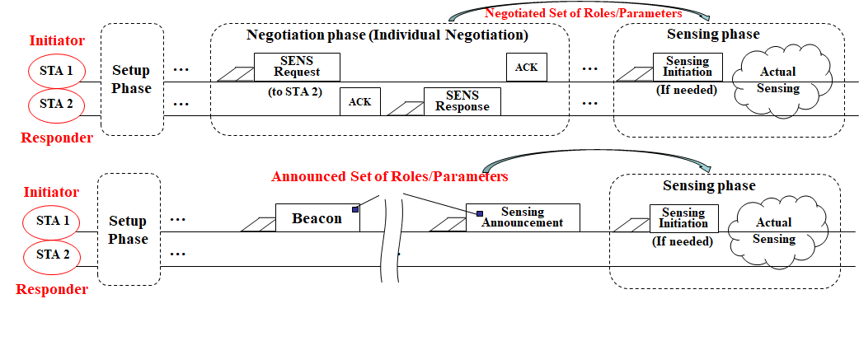
Sensing Initiator & Responder: Example
STA 1 obtaining an initial TXOP for transmitting a particular frame to negotiate or announce sensing parameters should be a sensing initiator. STA 2 becomes a sensing responder

Slide 7
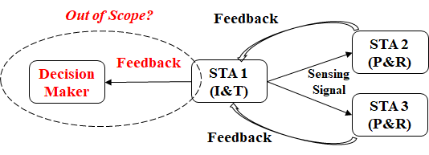
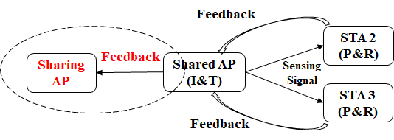
Sensing Initiator & Responder
(Decision Maker for WLAN Sensing)
It is straightforward for a sensing initiator to receive measurement results finally since it tried to initiate the WLAN sensing
The sensing initiator always decides some things (e.g., detection) through its application?
  We may have 3rd party STA, called a decision maker
  The sensing initiator can deliver the results to the decision maker
If we can have the decision maker in the scope of 802.11, it can be considered; Otherwise, the connection between the initiator and the decision maker may be out of scope of 802.11
I: Initiator
P: resPonder
T: Transmitter
R: Receiver

Slide 8
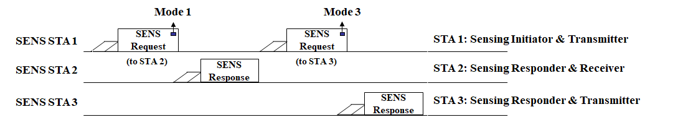
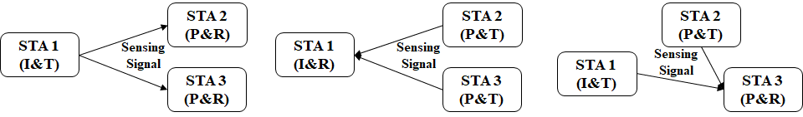
Sensing Transmitter & Receiver
With individual negotiation phase, a sensing initiator can negotiate the roles of sensing transmitter/receiver with sensing responders
We may define modes, e.g., Mode (Role of initiator, Role of responder): M_1 (T,R), M_2 (R,T), M_3 (T,T), M_4 (R,R)
  Protocol Example (ACK is omitted)
  Negotiation between a pair of STAs can support various collaboration
I: Initiator
P: resPonder
T: Transmitter
R: Receiver

Slide 9
Summary
We discussed WLAN sensing roles with phases during WLAN sensing procedure in terms of specification further
Sensing Initiator
  Obtains an initial TXOP to transmit a particular frame for negotiating or announcing sensing parameters, or beginning a sensing phase
  Obtains the measurement results if sensing receivers except for itself exist
  The connection between the initiator and the decision maker may be out of scope of 802.11
Individual Negotiation between a pair of STAs can support various collaboration in terms of sensing transmitter and sensing receiver efficiently

Slide 10
SP #1
Do you agree that when an STA as a sensing responder which is a sensing receiver, the STA shall transmit the measurement results to another STA as a sensing initiator?

Slide 11
References
[1] 20/1804r0, Overview of WLAN Sensing Procedure
[2] 20/807r3, WLAN Sensing Definitions
[3] 20/1232r0, Overview of WLAN sensing protocol
[4] 20/1266r0, WLAN Sensing Procedures and Use Cases
[5] 20/1533r0, Collaborative WLAN Sensing

