Slide 1
Discussion on WLAN Sensing Procedure
Date: 2020-11-09
Authors:
Name | Affiliation | Address | Phone | Email
Insun Jang | LG Electronics | 19, Yangjae-daero 11gil, Seocho-gu, Seoul 137-130, Korea |  | insun.jang@lge.com
Jinsoo Choi |  |  |  | js.choi@lge.com
Jeongki Kim |  |  |  | jeongki.kim@lge.com
Dongguk Lim |  |  |  | dongguk.lim@lge.com
Sang Kim |  | 10225 Willow Creek Rd, San Diego, CA, USA |  | sanggook.kim@lge.com

Slide 2
Introduction
With the increasing attention of WLAN Sensing, we have discussed use cases [1]-[5], WLAN sensing definitions [6], and procedures/protocols [7]-[9]
Moreover, it seems to have some agreements regarding the definition of roles and sensing session
In this contribution, we discuss some considerations for phases needed during WLAN Sensing Procedure
We refer to phases proposed in [7] on some level

Slide 3
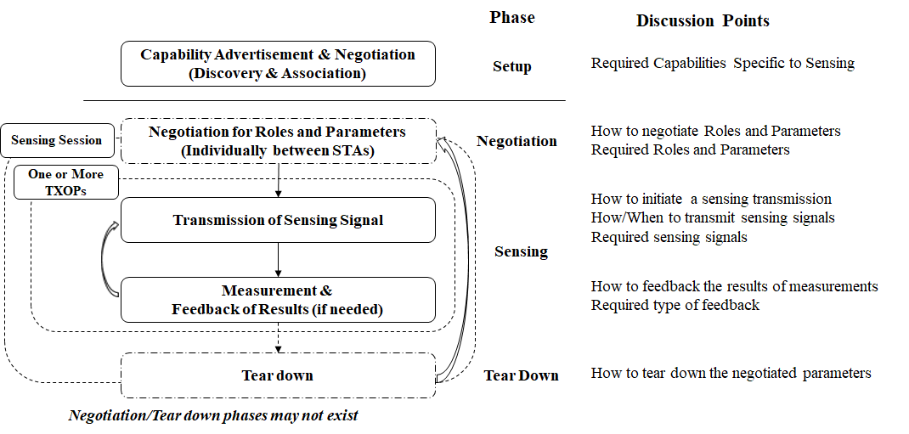
Overview of WLAN Sensing Procedure

Slide 4
Setup Phase for Capability Advertisement & Negotiation
Capabilities regarding WLAN sensing would be advertised and negotiated during the procedure of discovery and association
We need to discuss What Capabilities should be considered for WLAN sensing
We may reuse existing capabilities for WLAN sensing and may have additional capabilities, e.g., New capabilities for WLAN sensing (e.g., (maximum) transmit/receive/feedback parameters)
If sensing STA can support either Sub-7GHz or 60GHz band only, the capabilities IE are indicated independently per supported band
If sensing STA can support both of Sub-7GHz and 60Ghz band, we may have a hierarchical structure of capabilities IE for WLAN sensing depending on supported band
Example

Slide 5
Negotiation Phase
Whether we need an individual negotiation between STAs for WLAN sensing can be a discussion point
Individual Sensing Negotiation
Before a sensing session begins, STAs may need to negotiate Roles and Parameters for WLAN sensing [7]
Parameters can include transmit/measurement/feedback parameters set, scheduling info,…
Designing New frames can be required for negotiation (e.g., SENS Request/Response frames [7])
Since associated, this would support flexible changes of roles and parameters
Otherwise, before sensing session begins, an STA may need to announce roles and parameters for actual sensing (e.g., through Beacon, a particular frame)

Slide 6
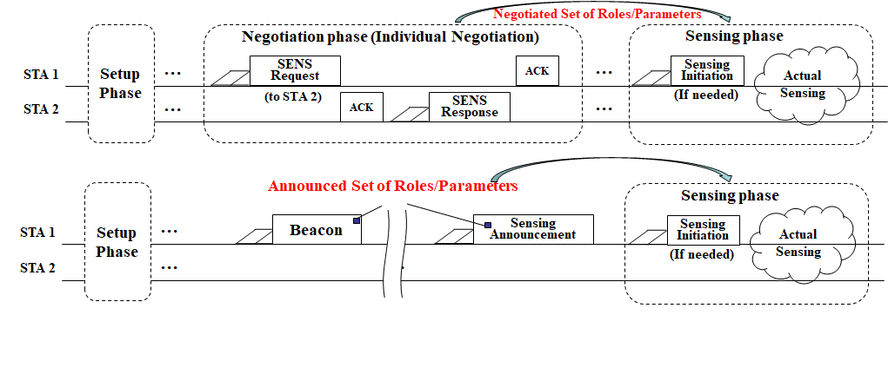
Negotiation Phase: Example

Slide 7
Negotiation Phase: Roles (with individual negotiation)
STAs need to negotiate 4 sensing roles [3], i.e., Sensing initiator/responder/transmitter/receiver
Sensing Initiator and Responder
E.g., Simple Way: A SENS STA transmitting SENS Request frame (initiating the negotiation and obtaining an initial TXOP) can be Sensing Initiator while SENS STAs transmitting SENS Response frame can be Sensing Responder
Sensing Transmitter (T) and Receiver (R)
E.g., we may define modes, e.g., Mode (Role of requester, Role of responder)
Mode 1 (T,R), Mode 2 (R,T), Mode 3 (T,T), Mode 4 (R,R)
Example

Slide 8
Negotiation Phase: Parameters
STAs need to negotiate (or announce) necessary Parameters for WLAN sensing including Roles (slide 7)
It would depend on the maximum sensing capabilities that are negotiated during association
Example (needed to discuss further)
STA info-related Parameters
E.g., Session ID, Group ID (if assigned)
Measurement/Feedback Parameters set (for sensing receiver)
E.g., Type of feedback/measurement
Transmit parameters set (for sensing transmitter)
E.g., Spatial stream, Beamforming-related
Scheduling Information
E.g., Sensing period, timeout values until no frame exchange or completion of phases

Slide 9
Sensing Phase
During a sensing session, sensing STAs would obtain one or more TXOPs to perform channel measurement (and feedback) based on negotiated (or announced) roles/parameters
We may define an initiation frame to trigger Sensing (see slide 7)
The initiation frame needs to be recognized by sensing responders as sensing transmitter(s) or sensing receiver(s) and 3rd STAs for protection
The initiation frame may include some parameters (e.g., IDs of STAs participating in a TXOP, determined set of parameters)
Without the initiation frame, scheduling which is already determined (e.g., like period) may be used

Slide 10
Tear Down Phase
Tear Down Phase releases the negotiated roles and parameters
For example, it may be performed by some parameters (e.g., Timeout or explicit indication)

Slide 11
Summary
We discussed the overview and some considerations for phases needed during WLAN Sensing Procedure
Setup phase
Negotiation phase
Sensing phase
Tear-down phase
We believe the phases are required for WLAN sensing; However, we need to discuss “each phase is necessary and what points should be addressed” further

Slide 12
SP #1
Do you support that 802.11bf amendment shall define mechanism(s) that enables the following in a sensing session:
Negotiates operational parameters for sensing measurements and reporting
Identifies sensing transmitter(s) and sensing receiver(s)

Slide 13
References
[1] 11-19/1725r0, Usage models for WLAN Sensing
[2] 11-19/1772r0, Presence and Proximity Detection Using WLAN Sensing
[3] 11-19/1852r0, In-Car-Sensing-a-60GHz-Usage-example
[4] 11-20/936r0, Usage-Model-Document
[5] 11-20/1239r0, Use Cases for Wireless LAN Sensing
[6] 20/807r3, WLAN Sensing Definitions
[7] 20/1232r0, Overview of WLAN sensing protocol
[8] 20/1266r0, WLAN Sensing Procedures and Use Cases
[9] 20/1533r0, Collaborative WLAN Sensing
[10] 19/2103r12, 802.11 SENS SG Proposed PAR

