Slide 1
DL Architecture
Date: 2020-11-04
Authors:

Slide 2
Abstract
This presentation is a slide for joint telco with ARC addressing downlink eBCS.

Slide 3
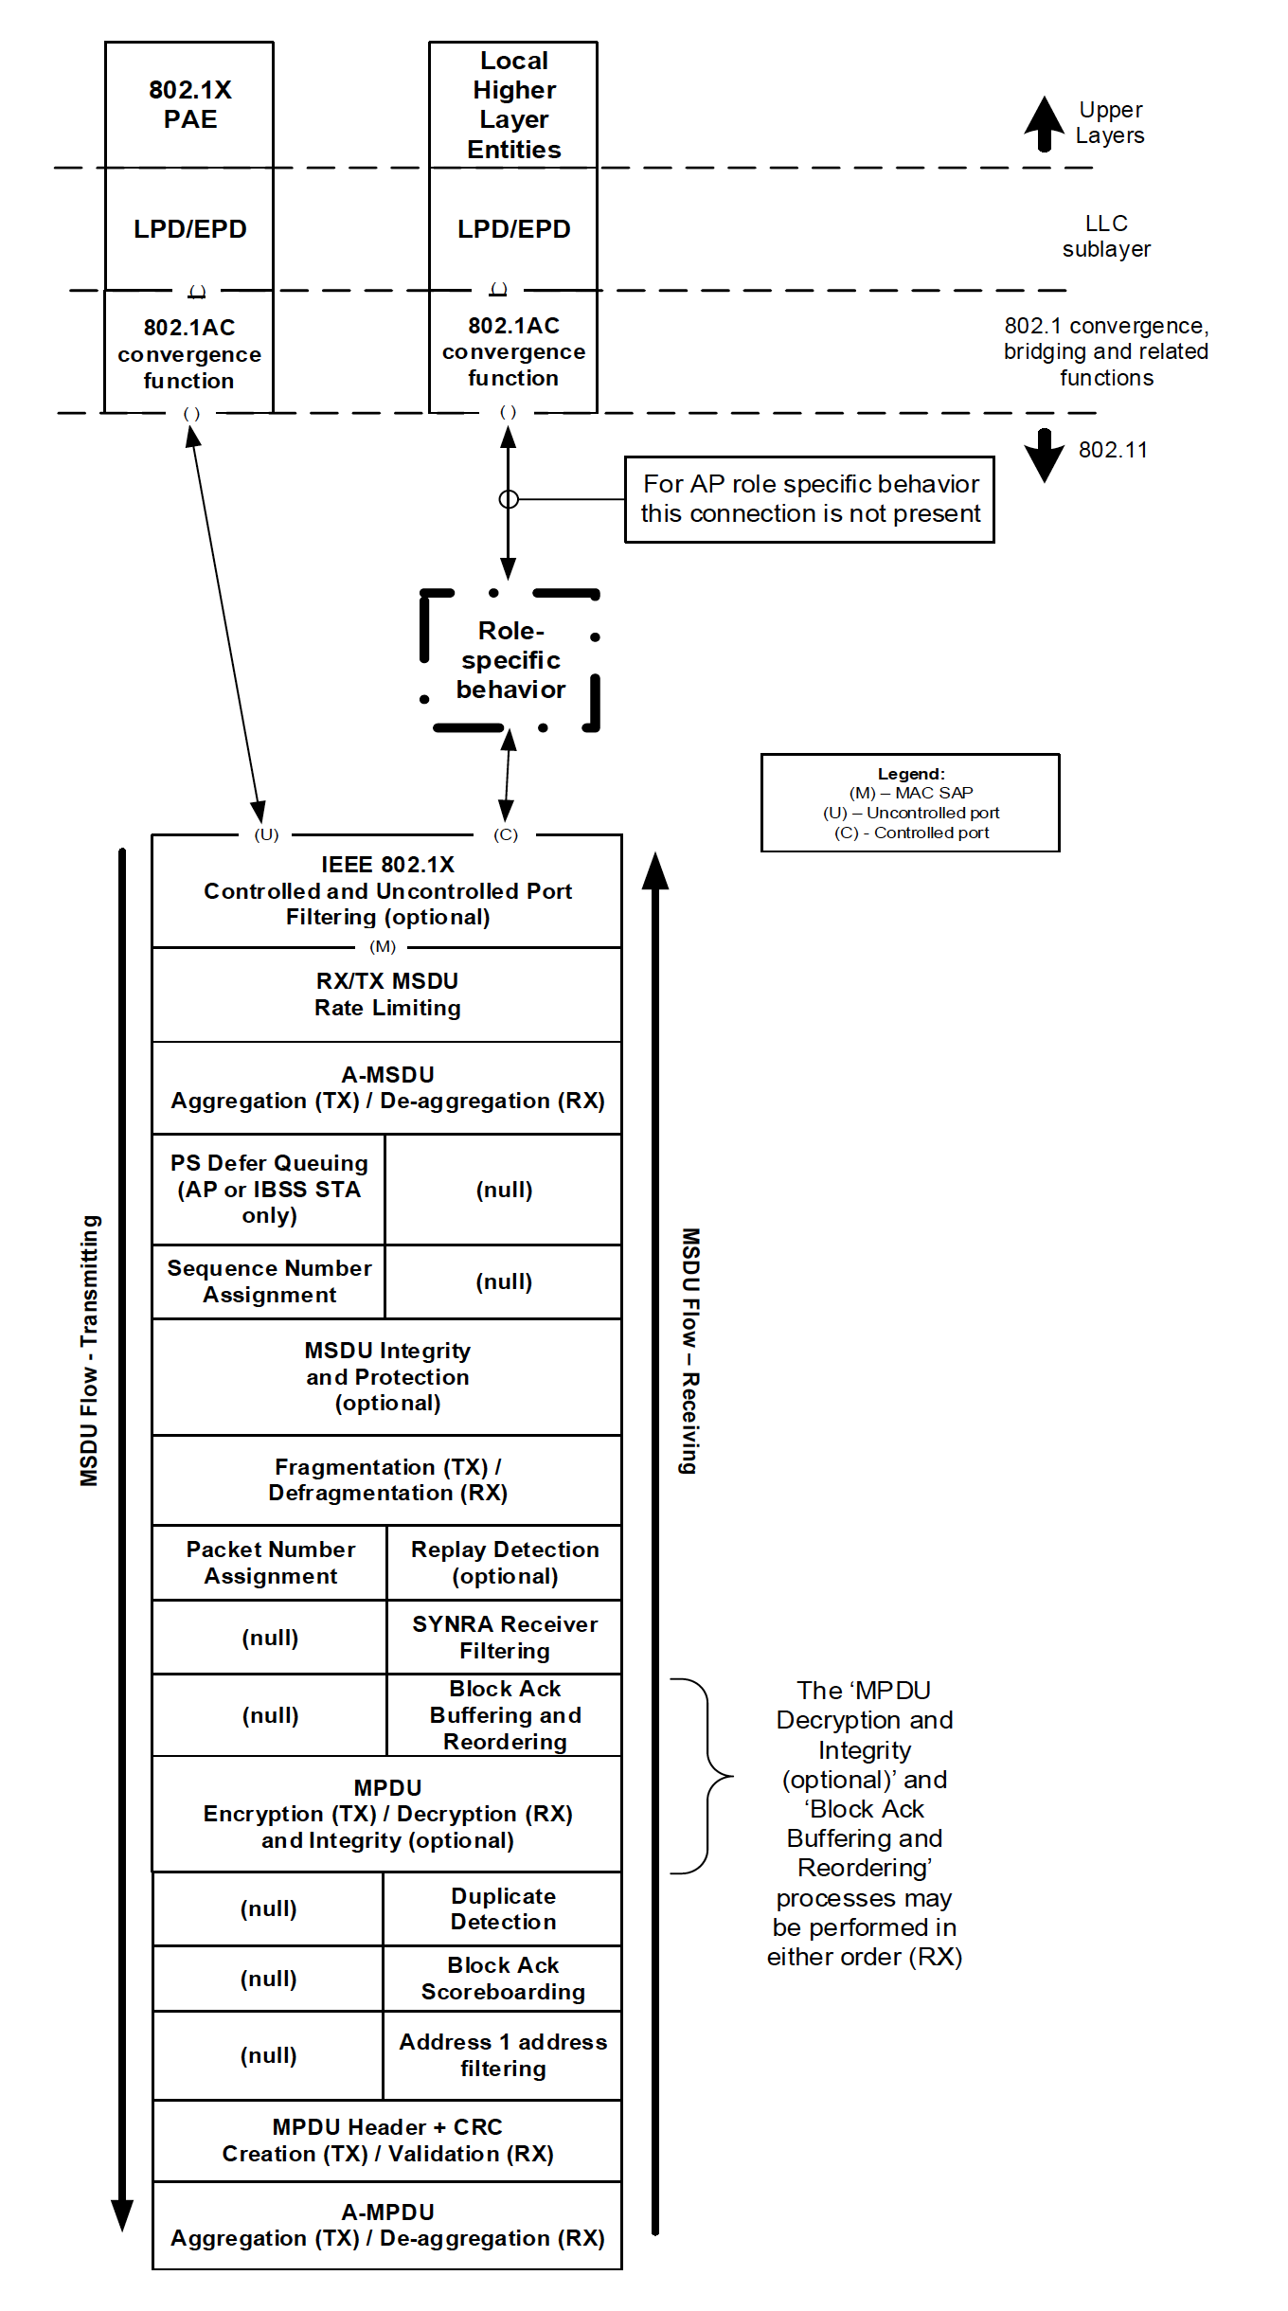
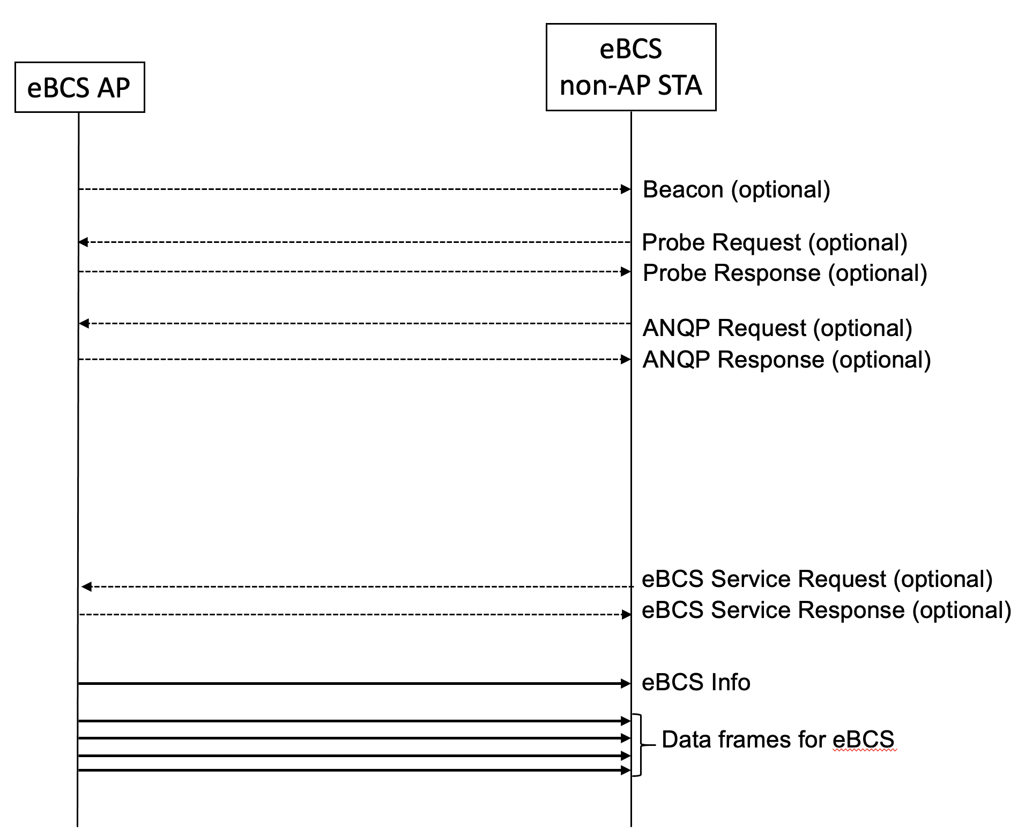
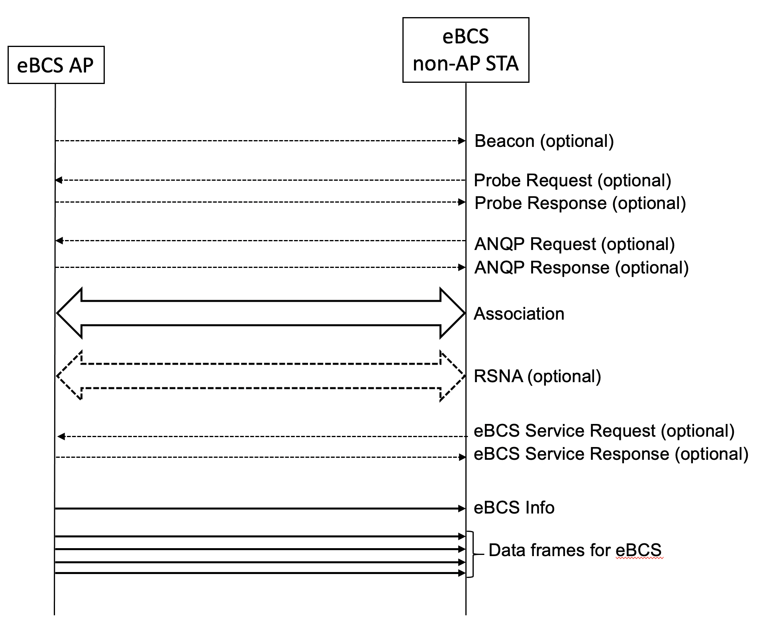
DL Architecture
eBCS DL supports both associated and non-associated STAs.
eBCS DL uses both eBCS Info frame (Public Action frame) and Data frame (HCFA MPDU and PKFA MPDU).
HLSA uses existing MPDU format.
Common to PKFA and HCFA
No encryption / decryption
Integrity check only
PKFA
Key is set by MLME-EBCSINFO.request (TX) and and is gotten from eBCS Info frame (RX)
HCFA
Keys are generated in MAC (TX) and are gotten from MPDU (RX)
Figure 5-1—MAC data plane architecture

