Slide 1
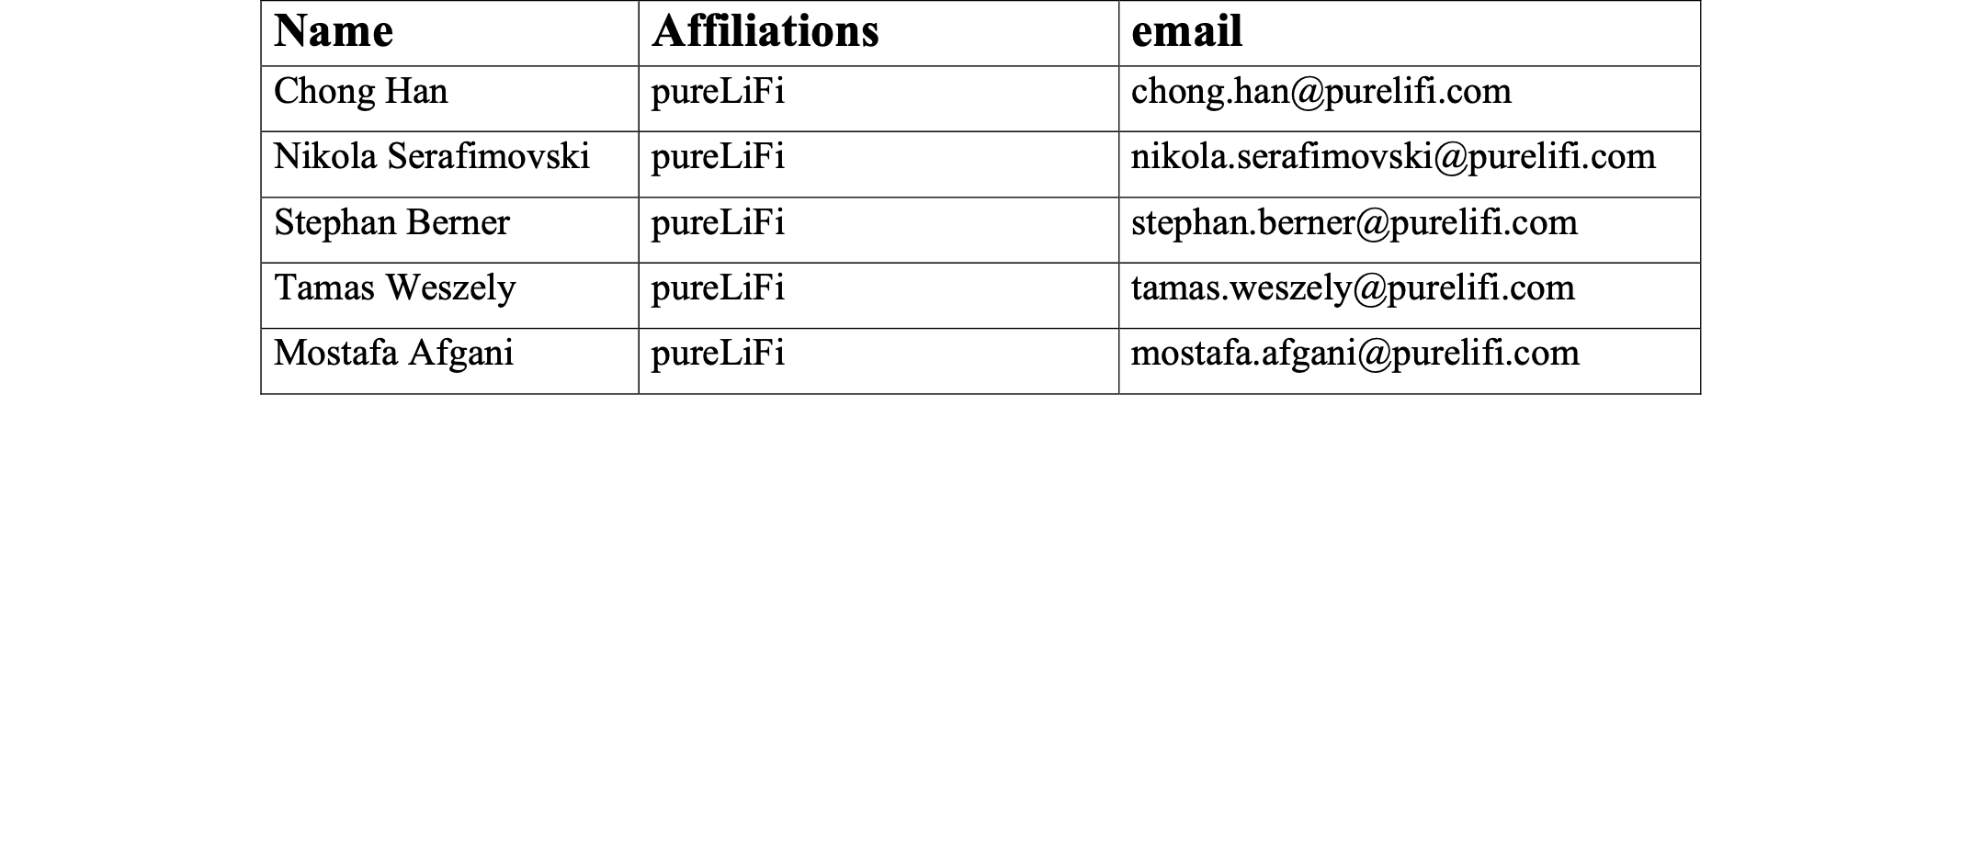
Recommended requirements for TGbb MAC supporting LC HE PHY
November 2020
Date: 2020-11
Authors:
Chong Han (pureLiFi)

Slide 2
Abstract
November 2020
The presentation provides the review of recommended requirements of the LC HE MAC for TGbb.
The clauses/subclauses referred in the slides come from IEEE P802.11axD7.0.
Chong Han (pureLiFi)

Slide 3
LC HE MAC
November 2020
Unchanged text from IEEE P802.11ax:
  Clause 26 (except 26.5)
Modifications:
  26.5 MU operation
    …
    26.5.2 UL MU operation——Modifications proposed on Slide
    …
    26.5.4 UL OFDMA-based random access (UORA) —— LC HE STAs set the OFDMA RA Support subfield to 0
Chong Han (pureLiFi)

Slide 4
UL Random Access
November 2020
Disable the optional UORA (UL OFDMA-based Random Access)
  In the context of TGbb, association/reassociation is not expected to be as frequent as in IEEE P802.11ax.
  The UORA is designed to serve large amount of users, which is also not the case in TGbb.
  Channel sensing in WiFi cannot easily migrate to TGbb.
LC HE STAs set the OFDMA RA Support subfield to 0
Chong Han (pureLiFi)

Slide 5
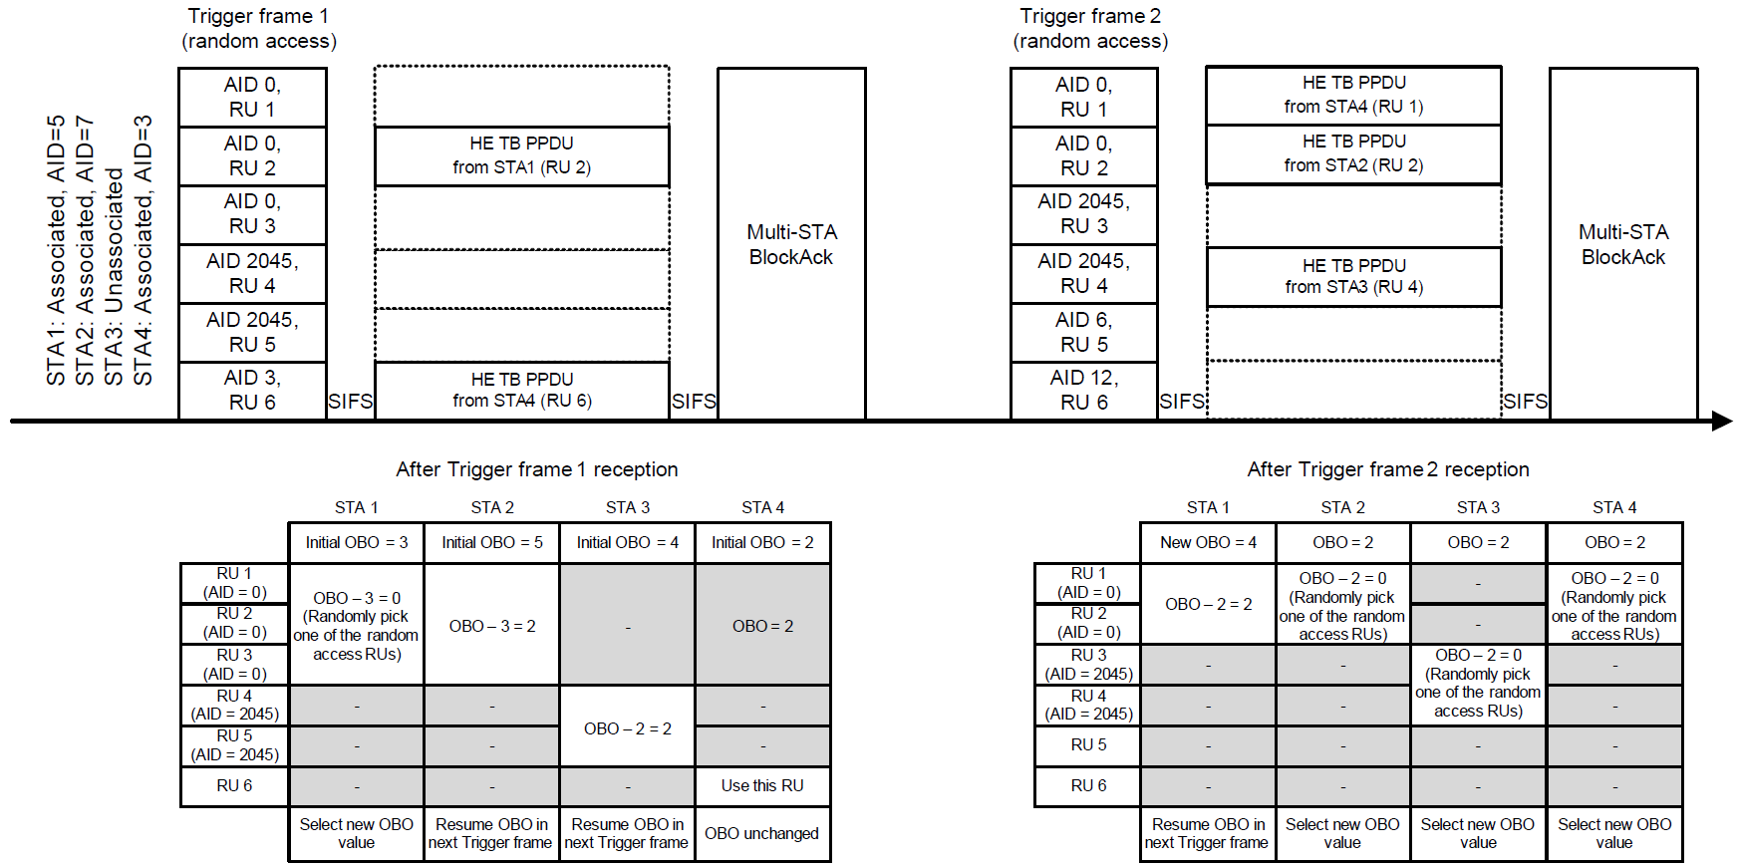
UORA (UL OFDMA-based Random Access)
November 2020
No dedicated resource allocation for all; flexibility; uncertainty
Eligible STAs with OBO counter number (<= Available RUs for AID0/2045/2046) compete for RA-RUs
Random selection of AID0(for associated STAs)/2045or2046(for unassociated STAs) RUs causes collisions
Chong Han (pureLiFi)

Slide 6
Modified UL MU operation
November 2020
Reserve a Resource Unit for Random Access in UL MU operation
  STAs know where to do Random Access.
  Reduce collision probability, wasted resources, and retransmissions.
SIFS
SIFS
Trigger frame
AID 0,
RU 1
RU 1 is reserved for Random Access
Multi-STA BlockAck
AID 4,
RU 2
HE TB PPDU from STA of AID 4
AID 4,
RU 3
HE TB PPDU from STA of AID 4
AID 9,
RU 4
HE TB PPDU from STA of AID 9
AID 3,
RU 5
HE TB PPDU from STA of AID 3
AID 3,
RU 6
HE TB PPDU from STA of AID 3
Backoff
Chong Han (pureLiFi)

Slide 7
Conclusion
November 2020
The document provides a guidance for the recommended requirements on MAC sub-layer running LC HE PHY.
The random access UL function UORA is disabled to reduce collisions; UL MU operation is modified to provide UL Random Access.
Chong Han (pureLiFi)

