Slide 1
Feasibility Study of Human Pose and Occupancy Classification using mmWave WiFi Beam Attributes
Date: 2020-11-03
Authors:
Name | Affiliation | Address | Phone | Email
Pu (Perry) Wang | Mitsubishi Electric Research Laboratories (MERL) | 201 Broadway, Cambridge, MA 02139, USA |  | pwang@merl.com
Jianyuan Yu |  |  |  | jyu@merl.com
Toshiaki Koike-Akino |  |  |  | koike@merl.com
Ye Wang |  |  |  | ywang@merl.com
Philip V. Orlik |  |  |  | porlik@merl.com
Notes:
September 2012

Slide 2
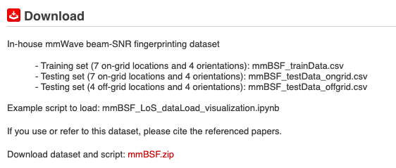
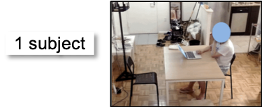
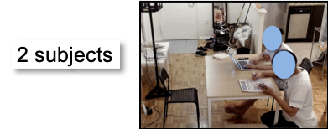
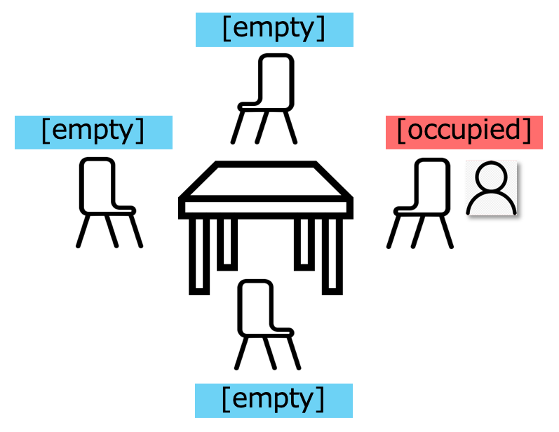
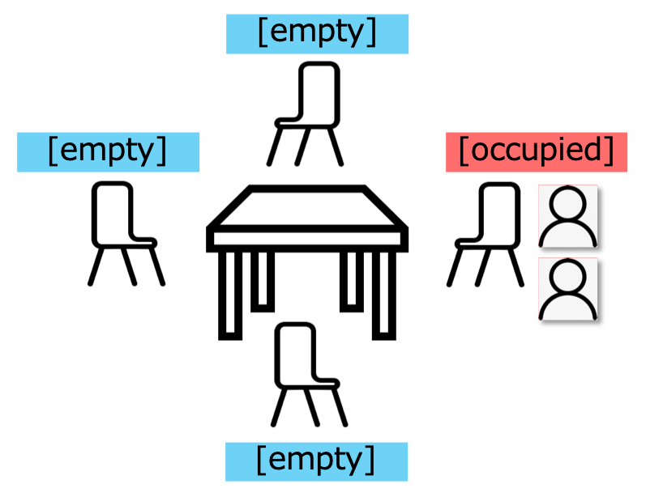
Abstract
This contribution is a continuation of
20/1074r1 WLAN Localization and Sensing With Mid-Grained Channel Measurements
which adopts mid-grained channel measurement – mmWave beam attributes (e.g., beam SNRs) for indoor sensing and monitoring applications
This contribution reports feasibility study of indoor device-free sensing (e.g., human pose & seat occupancy) using beam SNRs from commercial 60-GHz WiFi routers.
https://www.merl.com/demos/mmBSF
(Seat) Occupancy
Sensing
Pose Classification

Slide 3
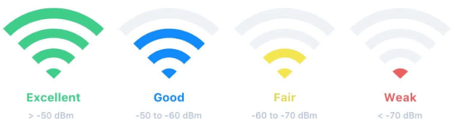
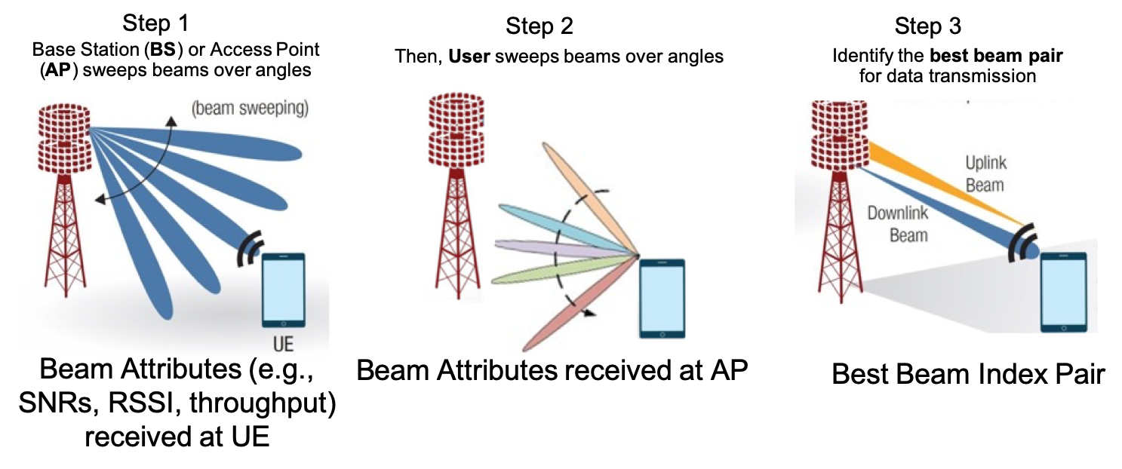
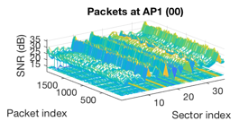
Background
RSSI
WLAN sensing mainly uses two kinds of WiFi channel measurements
Coarse-grained RSSI (received signal strength indicator)
In the unit of dBm, easy to access, coarse channel information
Fine-grained CSI (channel state information)
Complex amplitudes at freq.-domain OFDM subcarriers (802.11g/n/ac at sub-6 GHz)
WiFi CSI can be accessible from commercial routers in earlier 2010s
The CSI-based fingerprinting outperforms the RSSI-based fingerprinting
(DeepFi’16, PhaseFi’17, BiLoc’18, CSI-Net’19, Person-in-WiFi’19)
Picture source: https://www.netspotapp.com
CSI sequences for 2 Tx & 3 Rx
Mid-grained beam attributes (e.g., beam SNRs)
Data collection and exchange (between AP and User) are already defined in 802.11ad standards during beam training (therefore, minimal additional overhead)
Spatial-domain channel measurements at mmWave bands, weighted by beam patterns
Can be accessed from commercial 60-GHz WiFi routers [10, 11]
Picture sources: [7]
Beam SNRs over 36 probing beams
Picture copyright@MERL
Picture sources: https://www.netspotapp.com/ and [7]

Slide 4
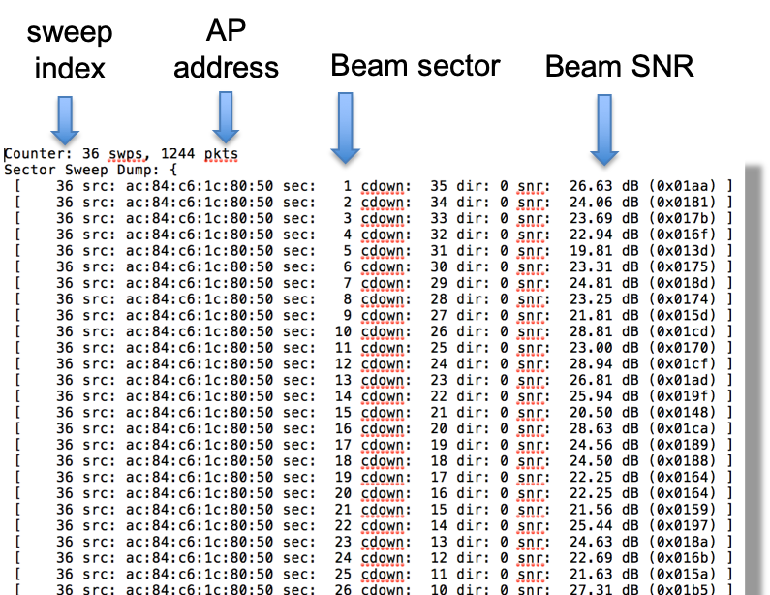
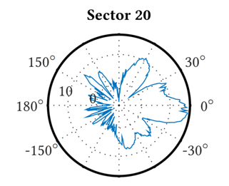
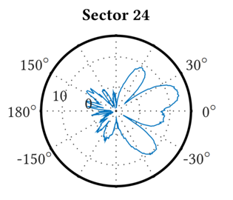
(mmWave) Beam SNRs
2-D illustration
Two Sweeping Beam Patterns
(Irregular beampatterns measured in a chamber – TU Darmstadt [9])
h₂₀
h₂₄=22.69 dB

Slide 5
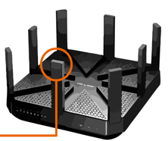
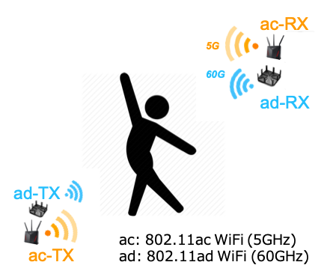
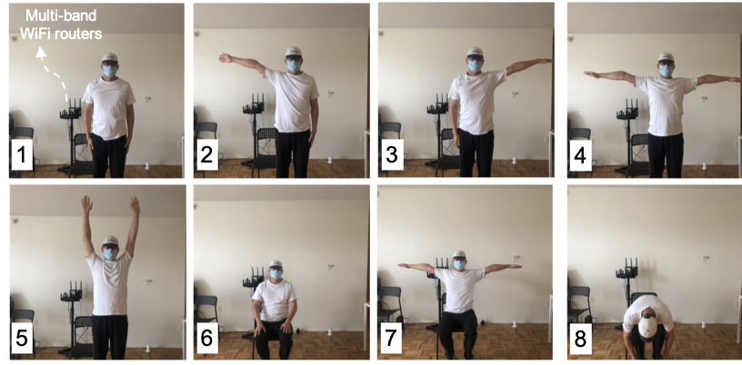
Feasibility Study (I): Pose Classification
One router as Tx and the other Rx using commercial-off-the-shelf 802.11ad routers [10,11]
One subject performing 8 poses
Beam SNRs were collected for different poses
5 independent data sessions for cross-session performance evaluation
Picture source: TP-Link
32-element array in one of its fingers
30+ highly irregular probing beams for mmWave beam training
Picture source: [10, 11]
Picture sources: MERL
Picture sources: MERL

Slide 6
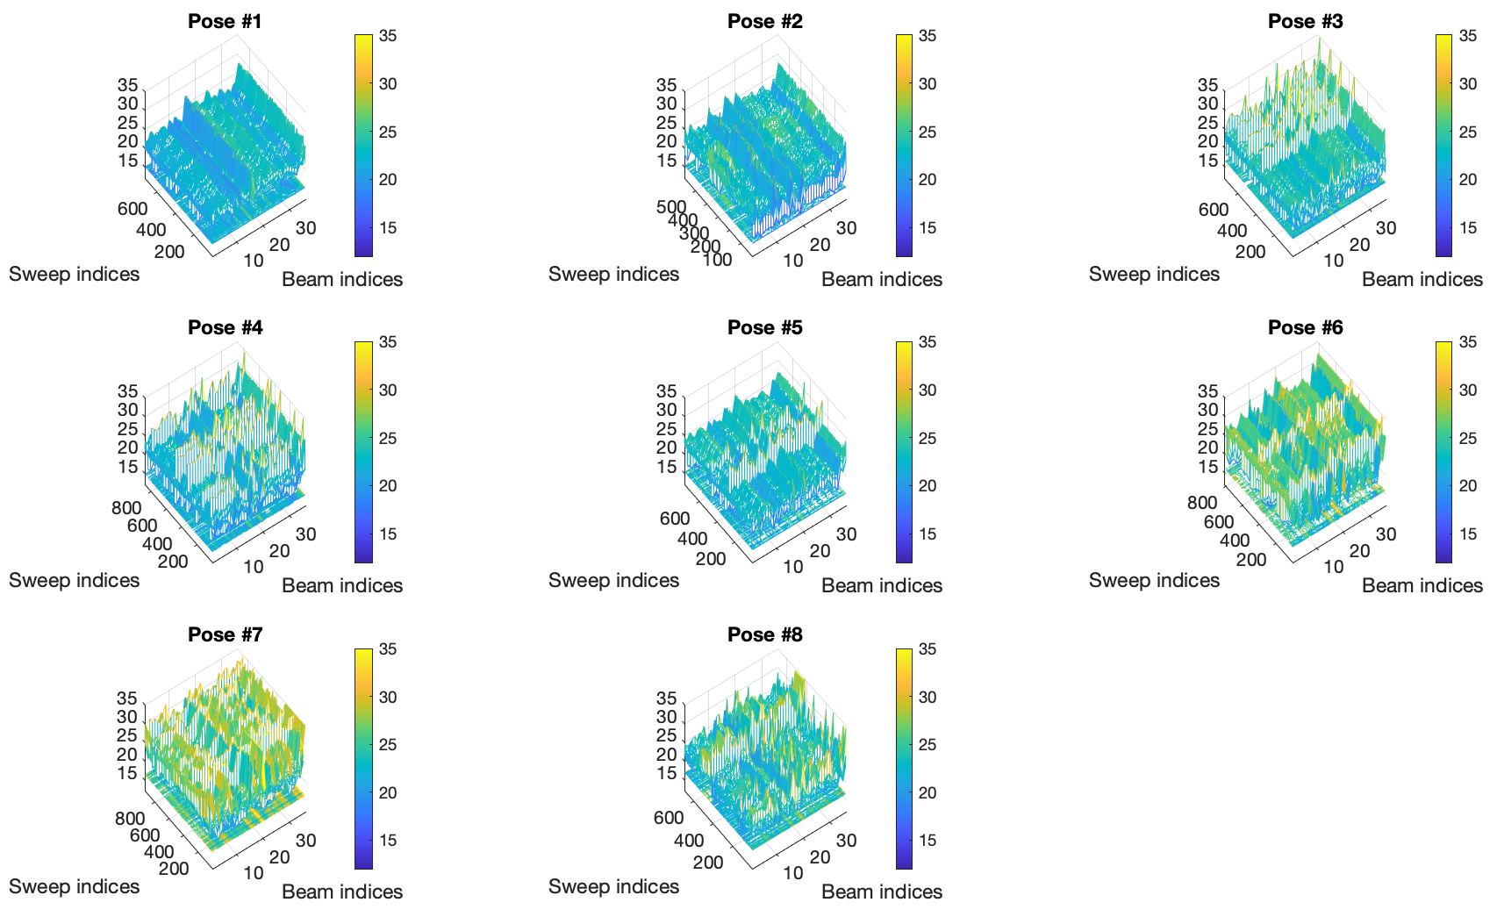
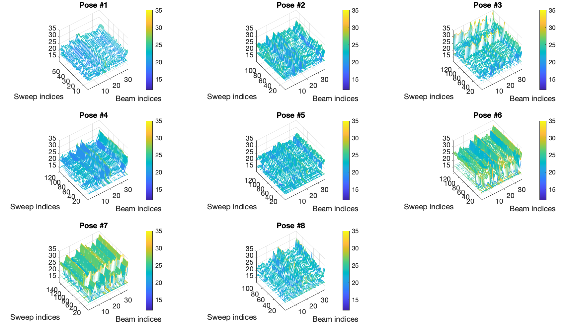
60-GHz Beam SNR Measurements
Data Session A
There is a magnitude variance (jump)
The beam SNR patterns preserve the feature for each pose over different sessions
Less impacted by environmental changes (people movements in nearby rooms)
Less sensitive to minor motions (e.g., finger).
Data Session D
Picture sources: MERL

Slide 7
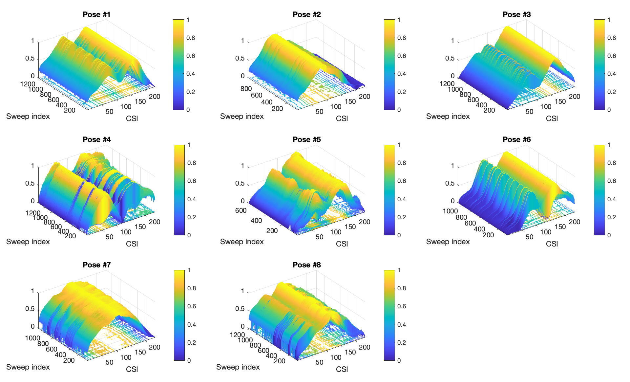
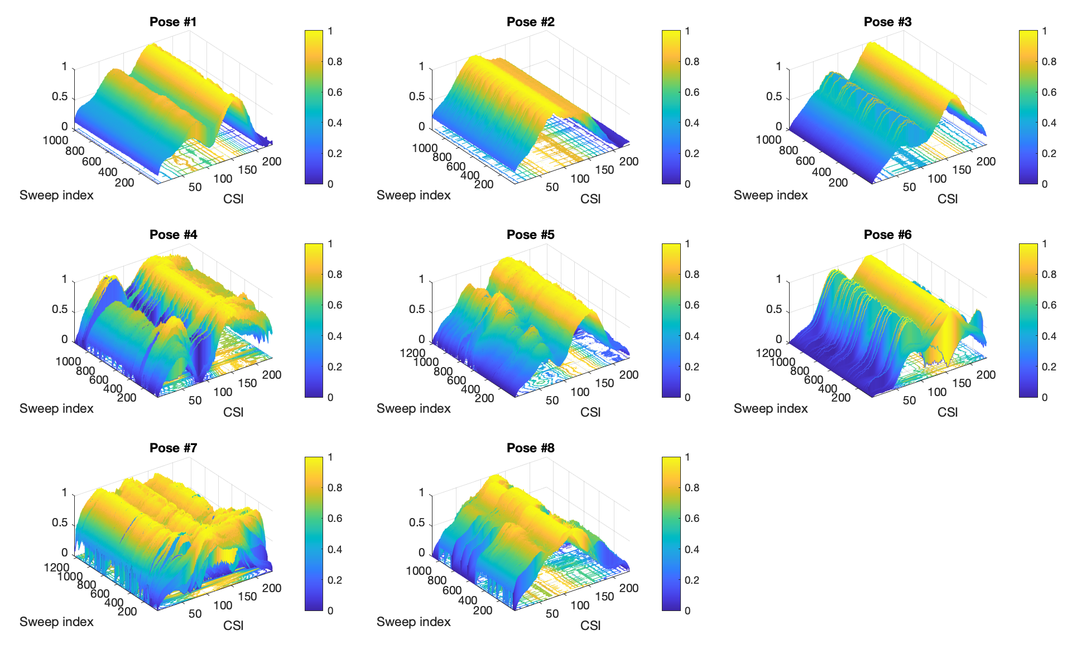
5-GHz CSI Measurements
Data Session B
Significantly larger amount of data: 16 streams x 234 subcarriers with a 100-Hz frame rate
Easy recognizable patterns for different poses
For Poses 4 & 7, CSI patterns are changed over different data sessions
Potentially due to environmental changes, e.g., people movement in nearby room, which cannot be always labeled in the data.
More sensitive to minor motions (e.g., finger)
Data Session D
Picture sources: MERL
16

Slide 8
4-Layer MLP
CSI-MLP (79.74%)
beamSNR-MLP (88.8%)
Performance can be further improved by other NN architectures (e.g., ResNet, Autoencoder-based classification). Will be introduced in future contributions.
Picture sources: MERL
16

Slide 9
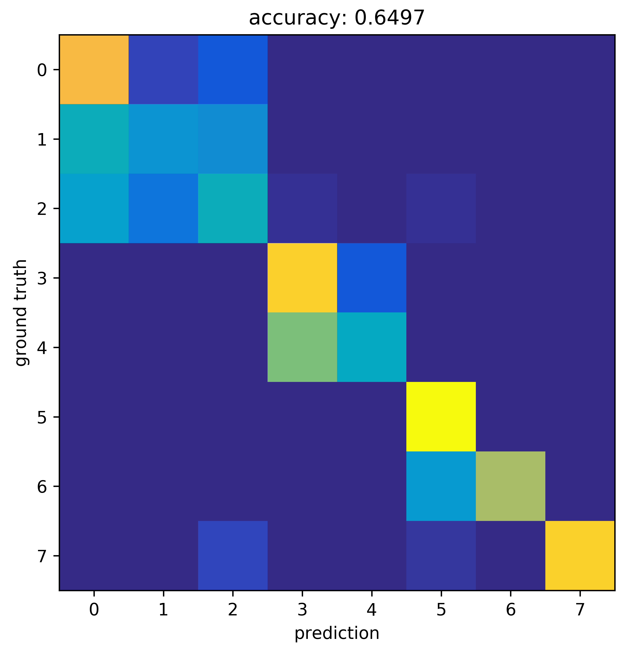
Impact of Subject Body Size
The same subject in the training and test dataset
Confusion matrix is averaged over cross-session validation
One subject in the training data
A different subject (smaller body size) in the test dataset
Confusion matrix is averaged over cross-session validation
beamSNR-MLP (88.8%)
beamSNR-MLP (64.97%)
Performance can be improved by including more subjects in the training dataset
Pose classification that is robust to subject variation and environmental changes will be valuable
Picture sources: MERL
16

Slide 10
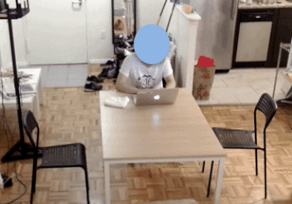
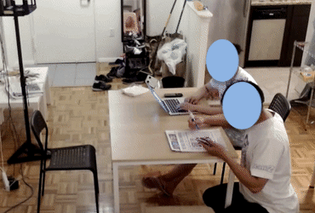
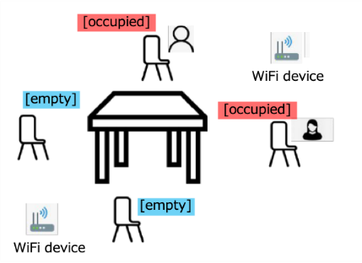
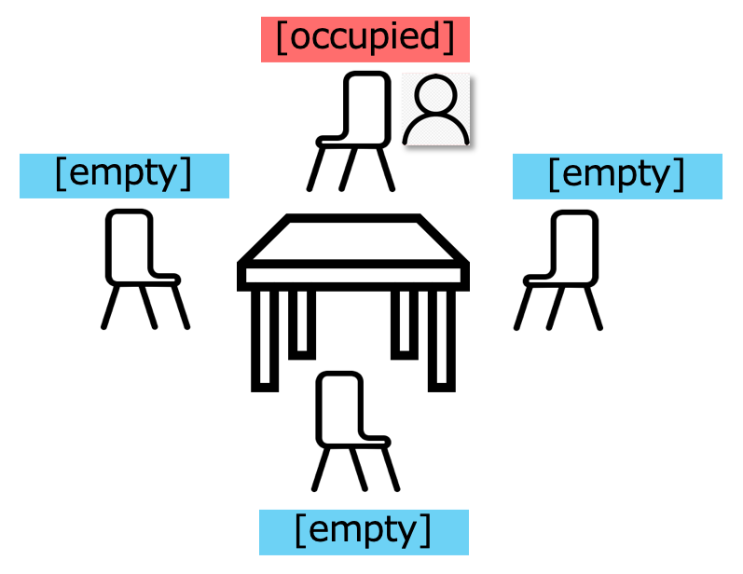
Feasibility Study (II): Seat Occupancy
One router as Tx and the other Rx using commercial-off-the-shelf 802.11ad routers [10,11]
One subject occupied one of 4 chairs + 2 subjects occupied two of 4 chairs
Beam SNRs were collected for different seat occupancy patterns
5 independent data sessions for cross-session performance evaluation
Picture source: TP-Link
Picture sources: MERL

Slide 11
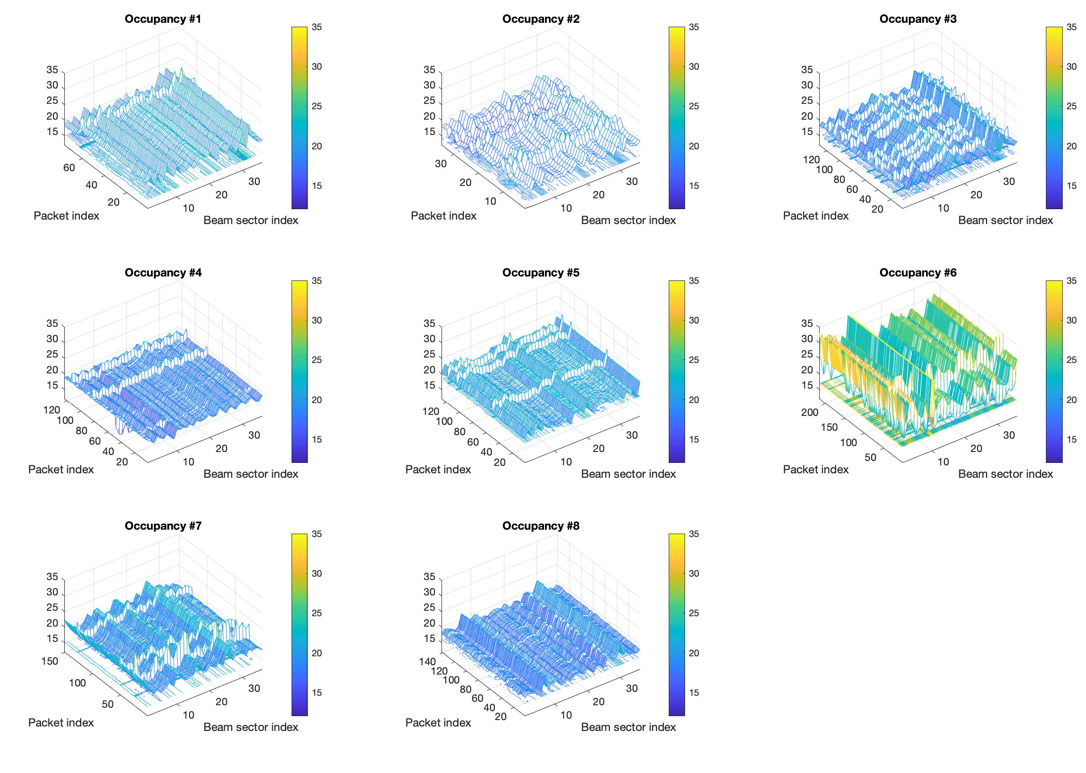
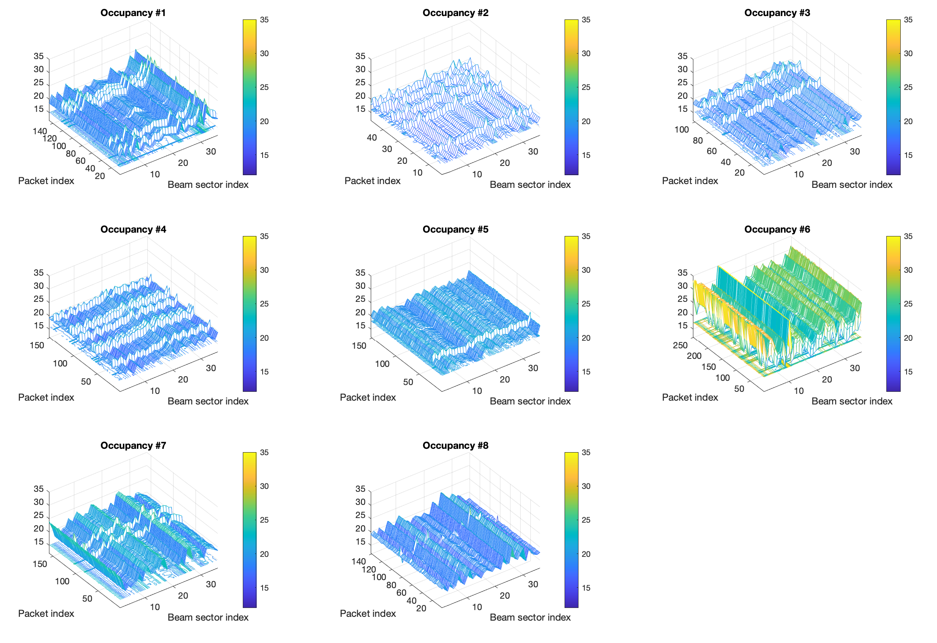
60-GHz Beam SNR Measurements

Slide 12
CSI-MLP (80.93%)
beamSNR-MLP (91.2%)
Picture sources: MERL
16

Slide 13
Conclusions
This contribution demonstrated the potential of a mid-grained channel measurements (beam attributes, e.g., SNRs) for device-free indoor sensing and monitoring (pose classification & seat occupancy sensing).
Subject and environmental invariance will be valuable for robust WLAN sensing.

Slide 14
References
[1] CSI-based Wi-Fi Sensing: Results and Standardization Challenges, IEEE 802.11-19/1769r1
[2] 802.11 sensing: Applications, feasibility, standardization, IEEE 802.11-19/1626r1
[3] Wi-Fi sensing in 60GHz band, IEEE 802.11-19/1551r1
[4] Wi-Fi sensing, IEEE 802.11-19/1164
[5] Wi-Fi sensing: cooperation and standard support, IEEE 802.11-19/1416
[6] “Spotfi: Decimeter Level Localization using WiFi”, Manikanta Kotaru, Kiran Joshi, Dinesh Bharadia, Sachin Katti
[7] X. Wang, L. Gao, S. Mao and S. Pandey, "DeepFi: Deep learning for indoor fingerprinting using channel state information," WCNC, New Orleans, LA, 2015, pp. 1666-1671
[8] "Towards Context-assisted Indoor Navigation", Ayyalasomayajula Roshan, Aditya Arun, Chenfeng Wu, Sanatan Sharma, Deepak Vasisht, Abhishek Sethi, Dinesh Bharadia
[9] D. Steinmetzer, D. Wegemer, M. Schulz, J. Widmer, and M. Hollick, ‘‘Compressive millimeter-wave sector selection in off-the-shelf IEEE 802.11ad devices,’’ in Proc. 13th Int. Conf. Emerg. Netw. EXperiments Technol., Nov. 2017
[10] D. Steinmetzer D. Wegemer and M. Hollick Talon Tools: The Framework for Practical IEEE 802.11ad Research 2018 [online] Available: https://seemoo.de/talon-tools/
[11] M. Schulz D. Wegemer and M. Hollick Nexmon: The C-Based Firmware Patching Framework 2017
[12] Z. Wang, K. Jiang, Y. Hou, W. Dou, C. Zhang, Z. Huang, et al., "A survey on human behavior recognition using channel state information" IEEE Access vol. 7 pp. 155986-156024 2019. 32.
[13] M. Pajovic, P. Wang, T. Koike-Akino, H. Sun and P. V. Orlik "Fingerprinting-based indoor localization with commercial mmWave WiFi—Part I: RSS and beam indices" GLOBECOM 2019, pp. 1-6, Dec. 2019.
[14] P. Wang, M. Pajovic, T. Koike-Akino, H. Sun and P. V. Orlik "Fingerprinting-based indoor localization with commercial mmWave WiFi—Part II: Spatial beam SNRs" GLOBECOM 2019, pp. 1-6 Dec. 2019.
[15] T. Koike-Akino, P. Wang, M. Pajovic, H. Sun and P. V. Orlik "Fingerprinting-based indoor localization with commercial mmWave WiFi: A Deep Learning Approach”, IEEE Access, Vol. 8, pp. 84879-84892, 2020.
[16] J. Yu, P. Wang , T. Koike-Akino, Y. Wang, and P. V. Orlik " Human Pose and Seat Occupancy Classification with Commercial mmWave WiFi”, GLOBECOM Workshop on JSAC, December, 2020.
[17] W. Wu, N. Cheng, N. Zhang, P. Yang, W. Zhuang, and X. Shen "Fast mmWave beam alignment via correlated bandit learning" IEEE Trans. Wireless Comm., vol. 18 no. 12 pp. 5894-5908 Dec 2019.

