Slide 1
802.11bd NGV Ranging Status and Types
Date: 2020-11-03
Authors:

Slide 2
Abstract
We review contributions on ranging for 802.11bd NGV and summarize the different ranging types. This leads to straw polls asking:
What preferences does the group have on the different ranging types?

Slide 3
802.11bd NGV Documents Addressing Ranging
PAR/FRD [1], [2]: “amendment defines procedures for at least one form of positioning in conjunction with V2X communications”
UC Doc [3]: UC5 Vehicular Positioning & Location, UC8 Train-to-Train, UC9 Vehicle-to-Train
SFD [4]: “11bd supports round-trip-time (RTT) ranging for 10 MHz and 20 MHz bandwidth PPDUs.”
Draft 0.4: “An NGV PHY shall support the following features:
  Round trip time (RTT) based ranging using 10 and 20 MHz bandwidth PPDUs”

Slide 4
802.11bd NGV Contributions Addressing Ranging
Positioning Use Cases for NGV [5]
NGV Ranging Discussions [6]: FTM, NTB, TB, and passive TB ranging
Ranging Performance in 11bd [7] : Performance results NTB ranging
Considerations on Ranging in NGV [8]: Performance results one-way TOF & RTT ranging, 60 GHz
On ranging methods for NGV [9]: First comparison one-way TOF, two-way RTT, FTM EDCA, and NTB ranging
Ranging Protocol in 11bd [10]: Ranging advertisement & NTB ranging
Influence of Delay-Close Multi Path Components on FTM-RTT [11]: Performance results RTT ranging

Slide 5
Ranging type | One-Way TOF [8,9] | Two-way RTT [8,9,11] | FTM EDCA [6,9,11] | NTB [6,7, 9,10] | Passive TOF/RTT/ FTM EDCA /NTB | TB [6] | Passive TB [6]
Standard | - | - | 802.11-2016 | 802.11az | - | 802.11az | 802.11az
Challenges | accurate absolute timing at each STA; TOD (sub ns accuracy) & TX location included in measurement frame | TODs (sub ns accuracy) & TX location included in measurement frame and/or fixed timing for reply ACK | high channel load (≥ 6 frames), 30 ms ➔ 100 ms position (no parallel ex-change) | 1 request + ACK frame, 5 frames in one TXOP, 0.6 ms, ➔ 2 ms position | additional measurement reports depending on ranging type | 9-11 frames in one TXOP, AP based, spatial streams UL and DL, not OCB | 15 frames in one TXOP, based on TB
Transmitted frames | 1 | 2 | ≥ 6 | 6-7 | 1-2 add. meas. report | 9-11 | ≥ 15
Security/ Privacy | - | - | - | optionally | depending on type | optionally | -
11bd Changes | strict timing synchronization, TOD in measure-ment frame | TOD in measurement frame, exchange in one TXOP | None, optional: reduce frames, parallel ranging ex-change | NDPA/NDP frame using NGV PPDU | depending on type | adaptation to OCB | Only with TB, adaptation to OCB

Slide 6
Ranging type | One-Way TOF [8,9] | Two-way RTT [8,9,11] | FTM EDCA [6,9,11] | NTB [6,7, 9,10] | Passive two-way RTT/ FTM EDCA /NTB | TB [6] | Passive TB [6]
Standard | - | - | 802.11-2016 | 802.11az | - | 802.11az | 802.11az
Challenges | accurate absolute timing at each STA; TOD (sub ns accuracy) & TX location included in measurement frame | TODs (sub ns accuracy) & TX location included in measurement frame and/or fixed timing for reply ACK | high channel load (≥ 6 frames), 30 ms ➔ 100 ms position (no parallel ex-change) | 1 request + ACK frame, 5 frames in one TXOP, 0.6 ms, ➔ 2 ms position | additional measurement reports depending on ranging type | 9-11 frames in one TXOP, AP based, spatial streams UL and DL, not OCB | 15 frames in one TXOP, based on TB
Transmitted frames | 1 | 2 | ≥ 6 | 6-7 | 1-2 add. meas. report | 9-11 | ≥ 15
Security/ Privacy | - | - | - | optionally | depending on type | optionally | No
11bd Changes | strict timing synchronization, TOD in measure-ment frame | TOD in measurement frame, exchange in one TXOP | None, optional: reduce frames, parallel ranging ex-change | NDPA/NDP frame using NGV PPDU | depending on type | adaptation to OCB | Only with TB, adaptation to OCB
Not feasible
time sync
OCB requires
significant rework

Slide 7
Ranging type | One-Way TOF [8,9] | Two-way RTT [8,9,11] | FTM EDCA [6,9,11] | NTB [6,7, 9,10] | Passive FTM EDCA /NTB | TB [6] | Passive TB [6]
Standard | - | - | 802.11-2016 | 802.11az | - | 802.11az | 802.11az
Challenges | accurate absolute timing at each STA; TOD (sub ns accuracy) & TX location included in measurement frame | TODs (sub ns accuracy) & TX location included in measurement frame and/or fixed timing for reply ACK | high channel load (≥ 6 frames), 30 ms ➔ 100 ms position (no parallel ex-change) | 1 request + ACK frame, 5 frames in one TXOP, 0.6 ms, ➔ 2 ms position | additional measurement reports depending on ranging type | 9-11 frames in one TXOP, AP based, spatial streams UL and DL, not OCB | 15 frames in one TXOP, based on TB
Transmitted frames | 1 | 2 | ≥ 6 | 6-7 | 1-2 add. meas. report | 9-11 | ≥ 15
Security/ Privacy | - | - | - | optionally | depending on type | optionally | No
11bd Changes | strict timing synchronization, TOD in measure-ment frame | TOD in measurement frame, exchange in one TXOP | None, optional: reduce frames, parallel ranging ex-change | NDPA/NDP frame using NGV PPDU | depending on type | adaptation to OCB | Only with TB, adaptation to OCB
Not feasible
time sync
Feasibility
not tested
OCB requires
significant rework

Slide 8
Ranging type |  |  | FTM EDCA [6,9,11] | NTB [6,7, 9,10]
Standard |  |  | 802.11-2016 | 802.11az
Challenges |  |  | high channel load (≥ 6 frames), 30 ms ➔ 100 ms position (no parallel ex-change) | 1 request + ACK frame, 5 frames in one TXOP, 0.6 ms, ➔ 2 ms position
Transmitted frames |  |  | ≥ 6 | 6-7
Security/ Privacy |  |  | - | optionally
11bd Changes |  |  | None, optional: reduce frames, parallel ranging ex-change | NDPA/NDP frame using NGV PPDU
Highly dynamic V2X environment: latency critical
High channel load:
DCC may delay next TXOP by 1 second [12]
FTM EDCA:
3 separate frames with ACKs
➔ FTM measurement exchange including LMRs several seconds
➔ High latency
Highly dynamic V2X environment: latency critical
High channel load:
DCC may delay next TXOP by 1 second [12]
➔ NTB measurement
exchange including LMRs in
one TXOP only 0.6 ms
➔ Low latency
Support for authentication, integrity check, and privacy of ranging message

Slide 9
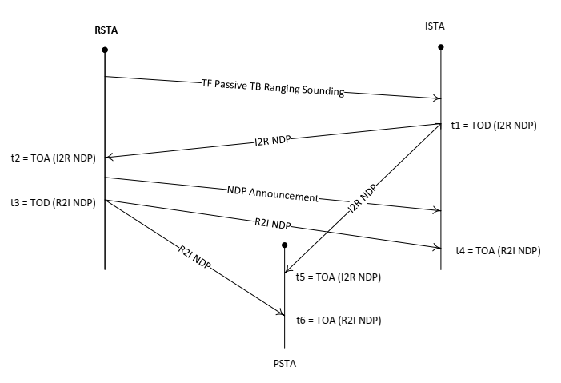
Passive Ranging
11az defines passive TB ranging:
Relative range (TDOA) of
arbitrary number of
passive STAs (PSTAs)
No additional measurement
exchanges needed
In addition to LMR reports
two RSTA broadcast passive
TB ranging measurement
report frames
➔ Scalability

Slide 10
Passive Ranging Proposal
Passive NTB ranging:
Relative range (TDOA) of
arbitrary number of
passive STAs (PSTAs)
No additional measurement
exchanges needed
In addition to LMR reports
two report frames e.g.
  LCI or
  R/ISTA broadcast passive ranging measurement
➔ Scalability
NDP Announcement

Slide 11
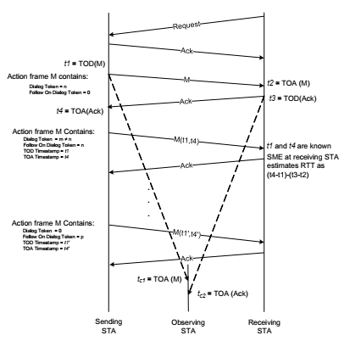
REVmd D5.0 P.3 Differential Distance Computation using Fine Timing Measurement frames (informative)
STAs listening to FTM frame exchange:
➔ purely receiver design, no protocol change required✓

Slide 12
11bd Differential Distance Computation using FTM frames and NTB Measurement Exchange (informative)
STAs listening to FTM & NTB frame exchange: LMR I/RSTA specified✓
➔ purely receiver design, no protocol change required✓
Relative location benefit:
Collision avoidance✓
Absolute location: Higher layer✓
➔ Update P.3 for NTB if necessary, add note e.g. subclause 4.3.17a on capability✓

Slide 13
11bd Differential Distance Computation using FTM frames and NTB Measurement Exchange (informative)
STAs listening to FTM & NTB frame exchange: LMR I/RSTA specified✓
➔ purely receiver design, no protocol change required✓
Relative location benefit:
Collision avoidance✓
Absolute location: Higher layer✓
➔ Update P.3 for NTB if necessary, add note e.g. subclause 4.3.17a on capability✓
NDP Announcement
SIFS
SIFS

Slide 14
11bd Differential Distance Computation using FTM frames and NTB Measurement Exchange (informative)
STAs listening to FTM & NTB frame exchange: LMR I/RSTA specified✓
➔ purely receiver design, no protocol change required✓
Relative location benefit:
Collision avoidance✓
Absolute location: Higher layer✓
➔ Update P.3 for NTB if necessary, add note e.g. subclause 4.3.17a on capability✓
NDP Announcement
SIFS
SIFS
SIFS
R2I LMR
SIFS
I2R LMR

Slide 15
Multi-channel 11az Ranging [13]
Leveraging higher layer (1609/ITS-G5) multi-channel operation
Capability discovery handled via higher layer mechanisms through 11bd
Flexible and low-overhead application of 11az in 11bd and OCB mode
Ranging can occur through multi-channel operation
  inside 5.9 GHz ITS band:
  ➔ NTB ranging (NGV NDP/NDPA and LMR frames)
  ➔ 802.11 security using 11az pre-association security negotiation (PASN)
  outside 5.9 GHz ITS band
  ➔ Enables use of higher BW channels for higher accuracy ranging where applicable
  ➔ Use of 11az PHY security and different 11az ranging options possible
Minimal changes/spec work required in 11bd

Slide 16
Mandatory vs. Optional Ranging Types
Optional ranging types
  Need for advertisement and negotiation
  Higher flexibility for different applications
Mandatory ranging type(s)
  All NGV devices possible I/RSTA
  No need for advertisement and negotiation
  ➔ E.g. NTB ranging advertisement unnecessary
  Mandatory capture of accurate TOA/TOD of frames
  ➔ E.g. FTM EDCA Ranging FTM Request unnecessary
➔ Faster ranging and positioning

Slide 17
Conclusions
11bd NGV ranging: Two out of five ranging types plus passive methods
  One-way TOF: time synchronization and fast time stamp
  Two-way RTT: fast time stamp and fixed timing for ACK (processing time)
  FTM EDCA: easily adapted for 11bd, 3 separate frames + ACK ➔ high latency
  NTB: define additional frames, one TXOP measurement exchange and reporting ➔ low latency
  Passive NTB(/FTM EDCA): In addition to LMR reports two LCI reports ➔ scalability
  TB and passive TB: Significant changes to work OCB
  Multi-channel 11az ranging: 11bd STAs negotiate 11az ranging outside 5.9 GHz band
Mandatory vs. optional ranging type(s):
  Flexibility
  Reduced channel use
  Faster ranging and positioning

Slide 18
References
[1] Project Authorization Request (PAR) 11-18-0861r9
[2] TGbd Functional Requirements Document (FRD) 11-19-0495r3
[3] TGbd Use Case Document
11-19-1342r1
[4] TGbd Spec Framework Document (SFD) 11-19-11-19-0497r7
[5] Location use cases for NGV
11-18-1221r0
[6] NGV ranging discussion
11-18-1250r0
[7] Ranging Performance in 11bd
11-19-0859r0
[8] Considerations on Ranging in NGV 11-19-0788r3
[9] On ranging methods for NGV
11-19-1892r0
[10] Ranging Protocol in 11bd
11-19-2011r0
[11] Influence of Delay-close Multi Path Components on FTM-RTT
11-19-1929r1
[12] ETSI EN 302 571 V2.1.1 (2017-02), ITS; Radiocommunications equipment operating in the 5 855 MHz to 5 925 MHz frequency band
[13] Ranging in 11bd 11-20/1761r2

Slide 19
SP #1
Do you agree to add in the SFD
“11bd supports distance measurement using NTB ranging for 10 MHz and 20 MHz bandwidth PPDUs in the 5.9 GHz band. This feature is optional.“
Yes/No/Abstain/No Vote: 21/0/5/26
Motion passe by unanimous consent
Yes/No/Abstain/No Vote: ///

Slide 20
SP #2
Do you agree to add to the SFD an update of 11bd D1.0 at the end of subclause 4.3.17a
“11bd supports hyperbolic positioning using differential time of arrival for 10 MHz and 20 MHz bandwidth PPDUs in the 5.9 GHz band. This feature is optional.”
“NGV STAs may support differential distance computation as detailed in Annex P.3.”
Yes/No/Abstain:

Slide 21
SP #3
Do you agree to add to the SFD an update of 11bd D1.0
“11bd supports negotiation of ranging features using higher layer mechanisms.”
“NGV STAs operating OCB may support negotiation of ranging features using higher layer mechanisms.”
Yes/No/Abstain:

