Slide 1
EHT via Reconfigurable Surfaces
Date: 2020-08-31

Slide 2
Outline
Abstract.
An Introduction to reconfigurable surfaces.
Conventional 802.11 BSS (dumb).
Proposed 802.11 BSS (intelligent).
Why 802.11 and reconfigurable surfaces?
Feasibility of reconfigurable surfaces in 802.11.
Conclusion
References

Slide 3
Abstract
The wireless channel has been always modeled as a random process, that degrades the quality of the received signal due to the interactions of the electromagnetic waves with the surrounding randomly deployed objects. Additionally, at high frequencies (above 6 GHz), the transmitted signals become more sensitive to blockage and suffer from sever power degradation. A channel controller, named, reconfigurable surface, is presented here to provide better system performance in term of received signal quality, data rate and coverage.

Slide 4
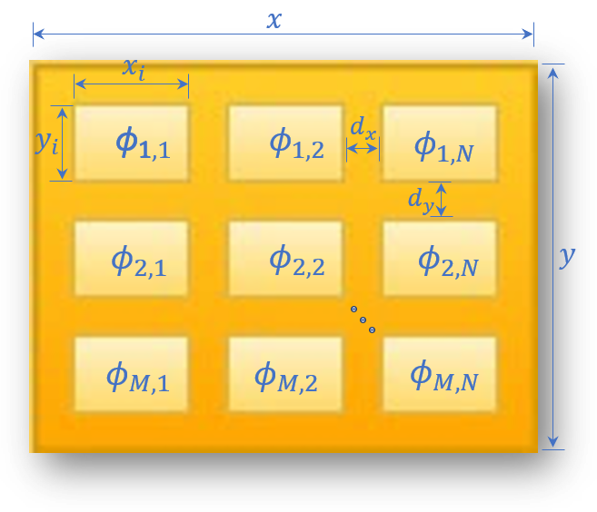
An Introduction to Reconfigurable Surfaces
Reconfigurable surfaces are part of the environment that are capable of manipulating the incident waves to alter the channel realization.
These surfaces contain many passive elements, each has determined size, location and complex weight.
The ability of controlling the channel is due the ability of controlling the phases of the elements on these surfaces, given by $φ$ matrix.
$$φ=\left[\begin{matrix}φ_{1,1} & ⋯ & φ_{1,N} \\ ⋮ & ⋱ & ⋮ \\ φ_{M,1} & ⋯ & φ_{M,N}\end{matrix}\right]$$

Slide 5
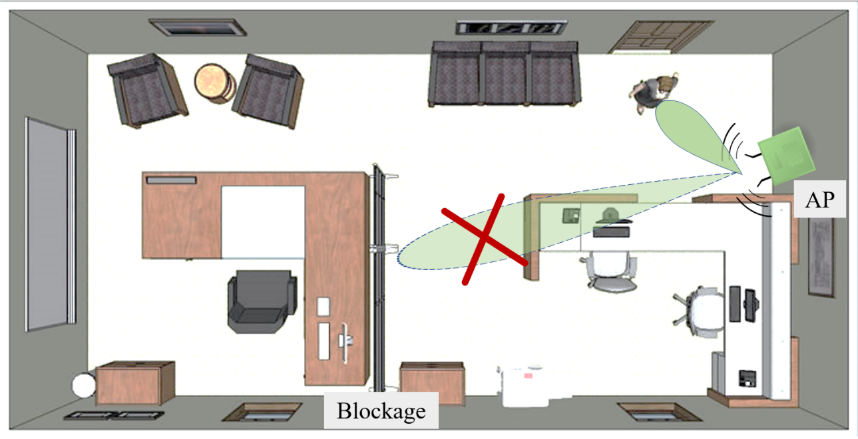
Conventional 802.11 BSS (dumb)
Consider one BSS consisting of one AP and one STA, operating at high frequencies.
The LoS between the AP and the STA is blocked.
The received signal by the STA is weak and the quality is bad due to the multipath.

Slide 6
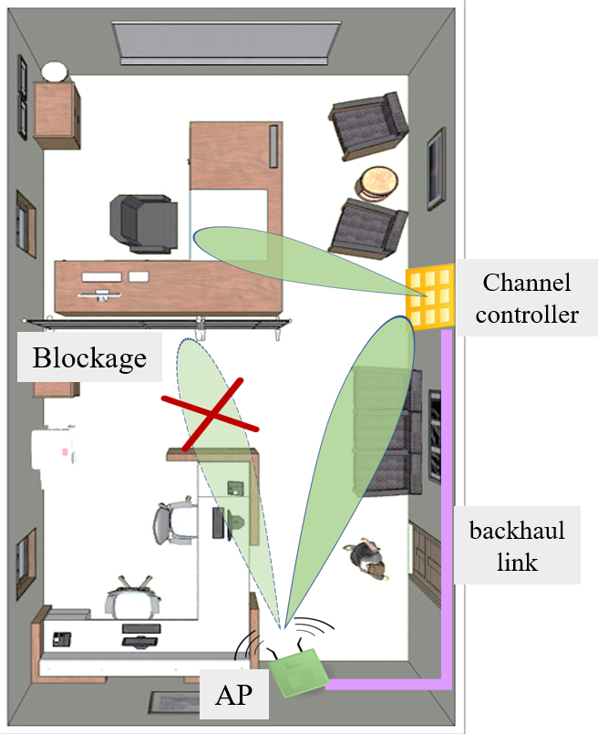
The Proposed 802.11 BSS (intelligent)
A surface with the capability of controlling the channel and changing the propagation environment is deployed.
The reconfigurable surface provides virtual LoS, expends the coverage area and enhance the quality of the signal received by the STA.
The reconfigurable surface is controlled by the AP through a backhaul link.

Slide 7
Why 802.11 and Reconfigurable Surfaces
Reconfigurable surface given optimum performance when deployed for indoor application, which is suitable for WiFi systems [1].
Reconfigurable surfaces deployment is a non-expensive effective solution for enlarging coverage area, rather than implementing multiple APs. Specifically for dense indoor environments.
Reconfigurable surfaces deployment can achieve the high requirements of the future WiFi systems such as EHT.

Slide 8
Feasibility of reconfigurable surfaces in 802.11
To provide EHT CSI must be very good.
To controlling the channel, all multipath can be aligned constructively to boost the performance at the receiver [2].
In fast varying channels, channel estimation overhead is high, and it increases exponentially as the number of antennas increases.
Controlling the propagation environment could alter time-varying channels into time-invariant channels.
Channel estimation is then reduced with minimum overhead.
Coverage area in rich scattering environment is small.
Controlling the channel increases the probability of LoS [2].

Slide 9
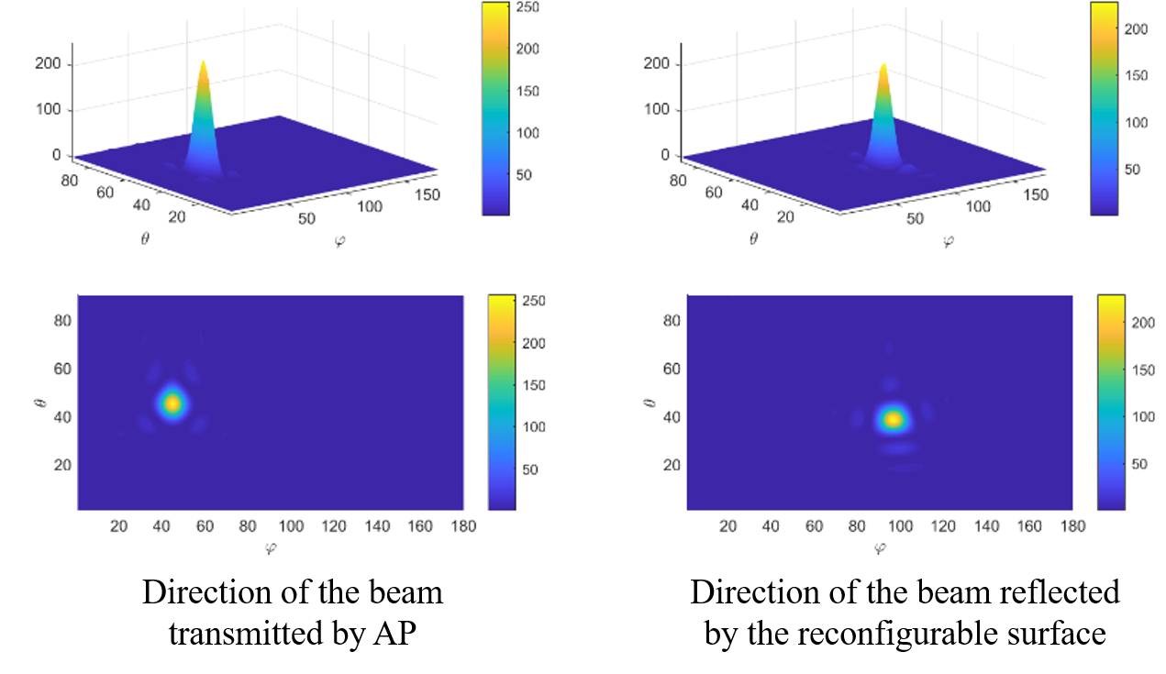
Feasibility of reconfigurable surfaces in 802.11

Slide 10
Conclusion
Controlling the channel via exploiting reconfigurable surfaces has been introduced.
The reconfigurable surface reshapes the reflected signal for maximum gain at the receiver.
The reconfigurable surface is controlled in real time by the AP, through a backhaul link.

Slide 11
References
[1] Björnson, E., Özdogan, Ö. and Larsson, E.G., 2019. Intelligent reflecting surface versus decode and-forward: How large surfaces are needed to beat relaying?. IEEE Wireless Communications Letters, 9(2), pp.244-248.
[2] Basar, E., Di Renzo, M., De Rosny, J., Debbah, M., Alouini, M.S. and Zhang, R., “Wireless communications through reconfigurable intelligent surfaces”. IEEE Access, 7, pp.116753-116773, 2019.

