Slide 1
Learning-based spectrum occupancy prediction exploiting multi-dimensional correlations
Date: 2020-11-03
Authors:

Slide 2
Outline
Abstract
Importance for long term sensing applications
Time and frequency correlations for SOP
Space correlation for SOP
Methods to using multi-dimensional correlations
The tensor-based method
Composite 2D-LSTMs-based method
Experiments and results
Summary
Mehmet Ali Aygul, IMU; Vestel

Slide 3
Abstract
Several sensing use cases have been discussed recently [1]. Accurate spectrum prediction and efficient utilization of the spectrum is critical to support them.
In this contrubiton, importance of spectrum occupancy prediction (SOP) for sensing transmission planning is discussed.
Some spectrum occupancy prediction methods are compared.

Slide 4
Importance for long term sensing applications (1/2)
Continuous applications (eg. home monitoring) requires continuous sensing. However, continously transmitting dedicated sensing transmissions is not efficient. Periodically transmitting is more logical.
Problem arises when spectrum is shared between different networks/devices
$y=\left\{\begin{matrix}\text{n} \text{H}\text{0}\text{: }\text{there} \text{is} \text{no} \text{signal} \\ \text{Hx}\text{+}\text{n} \text{H}\text{1}\text{: }\text{a} \text{signal} \text{is} \text{present}\end{matrix}\right.$

Slide 5
Importance for long term sensing applications (2/2)
Spectrum occupancy prediction can be used to differentiate between own network traffic and traffic from other networks (and spectrum users) to decide whether dedicated sensing transmissions are needed.
If network communication traffic is high (spectrum is occupied with own network transmissions), dedicated sensing transmissions are not needed. This prevents wasting spectral resources.
If spectrum is occupied by other networks/users, then dedicated transmissions are needed. In this case, free spectrum spaces need to be predicted.

Slide 6
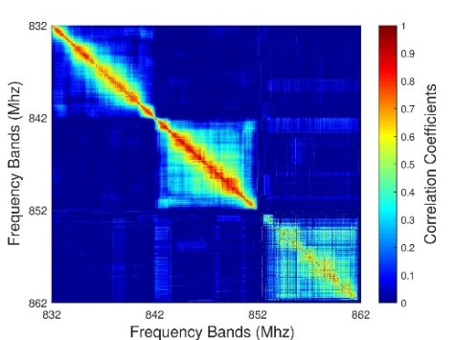
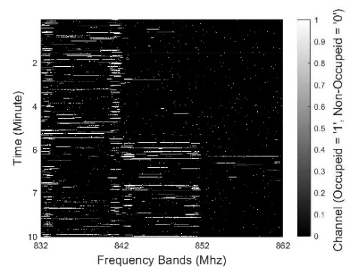
Time and frequency correlations for SOP
(a)
(b)
High correlation in the neighboring frequency bands
A strong correlation across both time and frequency

Slide 7
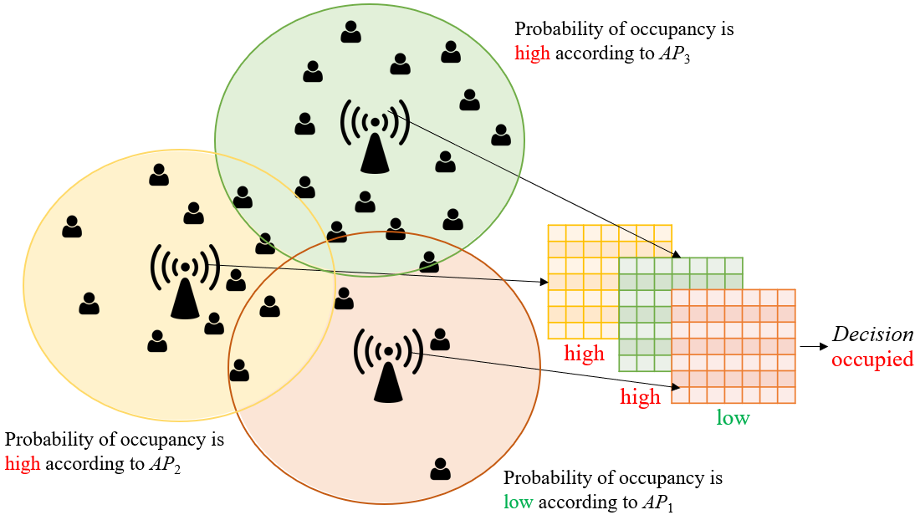
Space correlation for SOP

Slide 8
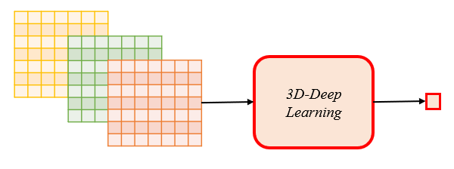
Methods to using multi-dimensional correlations (1/2)
The tensor-based method
Motivated by the existence of a multi-dimensional correlation, current literature uses tensor-based methods for spectrum occupancy prediction.
Such methods have high processing time, and they assume that 3D data can be provided at any time.

Slide 9
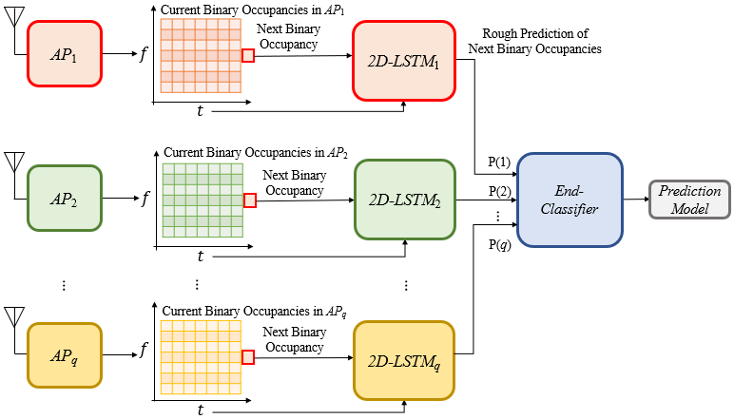
Methods to using multi-dimensional correlations (2/2)
Composite 2D-LSTMs-based method:

Slide 10
Experiments and results (1/3)
A real dataset is used for simulations.
Compared ARM, BIF, 1D-LSTM using only time correlation, 2D-LSTM using time and frequency correlations, ConvLSTM using multi-dimensions as a tensor, and the composite 2D-LSTMs-based method.
Validations in terms of precision (π), recall (Ψ), and F1-score performance metrics
The precision metric quantifies what percentage of positive results are actually positive.
The recall provides information on what percentage of true positives are identified correctly as positive.
The F1-score gives an overall measure with the harmonic average of precision and recall for the accuracy of a classifier model.
$$π=\frac{ε}{ε+v}, Ψ=\frac{ε}{ε+μ}$$
$$\frac{π x Ψ}{π+Ψ}$$
x
$$\text{, }\text{F}\text{1}\text{−}\text{score}\text{ = }\text{2}$$

Slide 11
Experiments and results (2/3)
Accuracy comparisons
Method | Measure
 | $$π$$ | $$Ψ$$ | $$\text{F}\text{1}\text{−}\text{score}$$
ARM | 0.9210 | 0.9681 | 0.9440
BIF | 0.9264 | 0.9738 | 0.9495
1D-LSTM | 0.9602 | 0.9780 | 0.9690
2D-LSTM | 0.9720 | 0.9732 | 0.9726
ConvLSTM | 0.9760 | 0.9763 | 0.9762
Composite 2D-LSTMs | 0.9727 | 0.9742 | 0.9735
Method | Measure
 | $$π$$ | $$Ψ$$ | $$\text{F}\text{1}\text{−}\text{score}$$
ARM | 0.8863 | 0.8704 | 0.8783
BIF | 0.9336 | 0.9130 | 0.9232
1D-LSTM | 0.9465 | 0.9165 | 0.9312
2D-LSTM | 0.9462 | 0.9216 | 0.9338
ConvLSTM | 0.9479 | 0.9298 | 0.9388
Composite 2D-LSTMs | 0.9476 | 0.9233 | 0.9353

Slide 12
Experiments and results (3/3)
Complexity comparisons
Method | Execution Time (s)
 | Training | Testing
The tensor-based method | 608.7 | 2.7
Composite 2D-LSTMs | 57.8 | 0.7
Method | Execution Time (s)
 | Training | Testing
The tensor-based method | 610.3 | 2.9
Composite 2D-LSTMs | 58.9 | 0.8

Slide 13
Summary
Importance of spectrum occupancy prediction for wireless sensing is highlighted.
Multi-dimensional spectrum occupancy prediction is discussed to use spectrum efficiently.
A composite 2D-LSTMs-based method is shown as a sub-optimal and more realistic method.
Relevant experimental measurement is shown to prove the feasibility of this method.

Slide 14
Reference
[1] 11-20-1712-00-00bf-wifi-sensing-use-cases.xlsx

