Slide 1
Learning-based spectrum occupancy prediction exploiting multi-dimensional correlations
Date: 2020-10-26
Authors:

Slide 2
Outline
Abstract
Spectrum occupancy prediction
A motivation to utilize multi-dimensional correlations
  Time and frequency
  Space
Methods to utilize multi-dimensional correlations
  Tensor-based method
  Composite 2D-LSTMs-based method
Experiments and Results
Summary
Mehmet Ali Aygul, IMU; Vestel

Slide 3
Abstract
  Several use cases have been discussed recently, and efficient utilization of the spectrum is critical to support them.
  In this contribution, the multi-dimensional spectrum occupancy prediction concept is proposed, and its methods are further discussed.
  The feasibility of the methods is validated through experimental measurements.

Slide 4
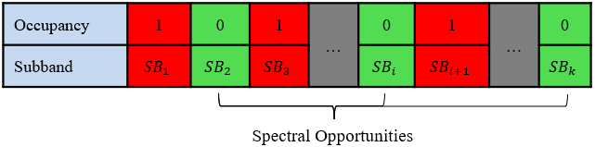
Spectrum Occupancy Prediction
Wireless networks and information traffic have grown exponentially over the last decade.
The radio spectrum is a limited resource, and it should be used efficiently.
n, H0: there is no PU
Hx+n, H1: a PU is present
Problem: finding the spectrum occupancy
y =
Mehmet Ali Aygul, IMU; Vestel

Slide 5
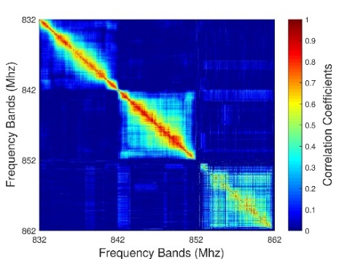
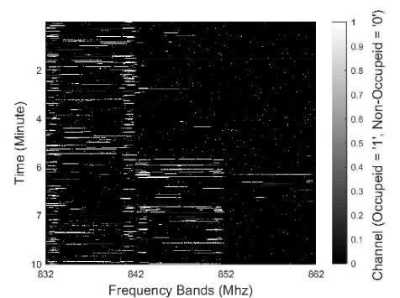
A motivation to utilize multi-dimensional correlations
  Time and Frequency Correlation
(a)
(b)
  Figures prove that the correlation is high in the neighboring frequency bands of each operator and there is a strong correlation across both time and frequency for each operator individually.

Slide 6
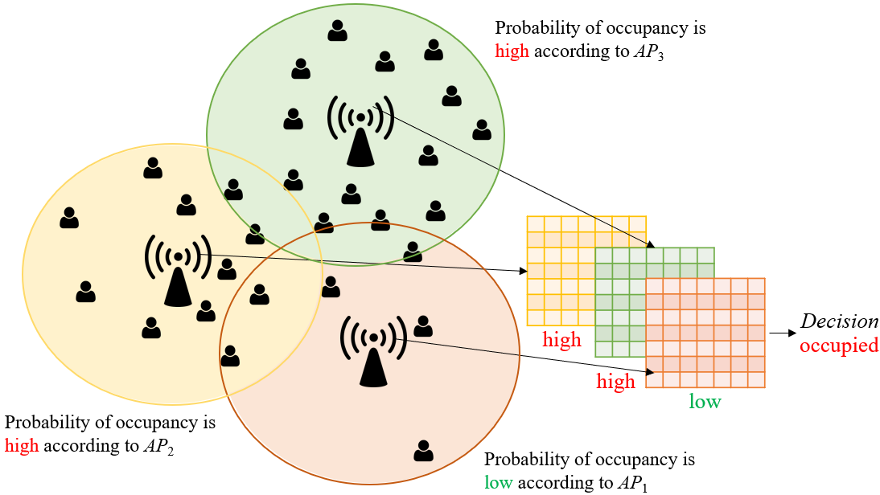
A motivation to utilize multi-dimensional correlations
  Space Correlation

Slide 7
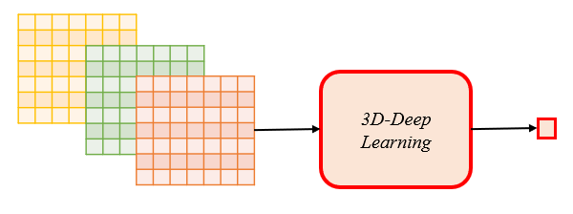
Methods to utilize multi-dimensional correlations
  Tensor-based method
  Motivated by the existence of a multi-dimensional correlation, current literature uses tensor-based methods for spectrum occupancy prediction. However, they have high processing time, and they assume that 3D data can be provided at any time.

Slide 8
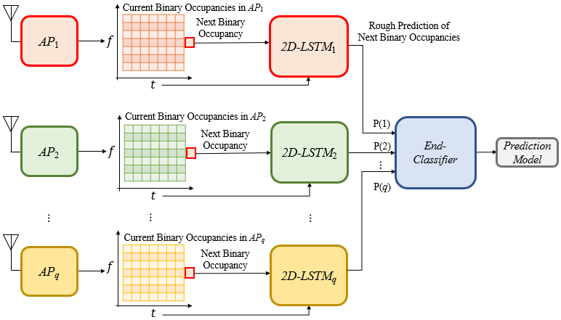
Methods to utilize multi-dimensional correlations
  Composite 2D-LSTMs-based method: Training Stage

Slide 9
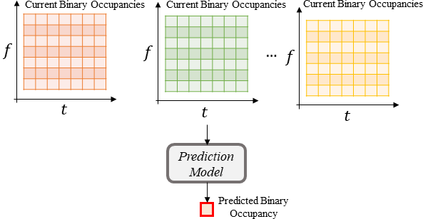
Methods to utilize multi-dimensional correlations
  Composite 2D-LSTMs-based method: Testing Stage

Slide 10

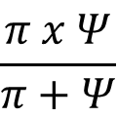
Experiments and Results
  Real dataset is used for simulations.
  Compared ARM, BIF, 1D-LSTM using only time correlation, 2D-LSTM using time and frequency correlations, ConvLSTM using multi-dimensions as a tensor, and the composite 2D-LSTMs-based method.
  Validations in terms of precision (π), recall (Ψ), and F1-score performance metrics.
  The precision metric quantifies what percentage of positive results are actually positive.
  The recall provides information on what percentage of true positives are identified correctly as positive.
  The F1-score gives an overall measure with the harmonic average of precision and recall for the accuracy of a classifier model.
$$π=\frac{ε}{ε+v}, Ψ=\frac{ε}{ε+μ}$$
$$\frac{π x Ψ}{π+Ψ}$$
x
$$\text{, }\text{F}\text{1}\text{−}\text{score}\text{ = }\text{2}$$

Slide 11
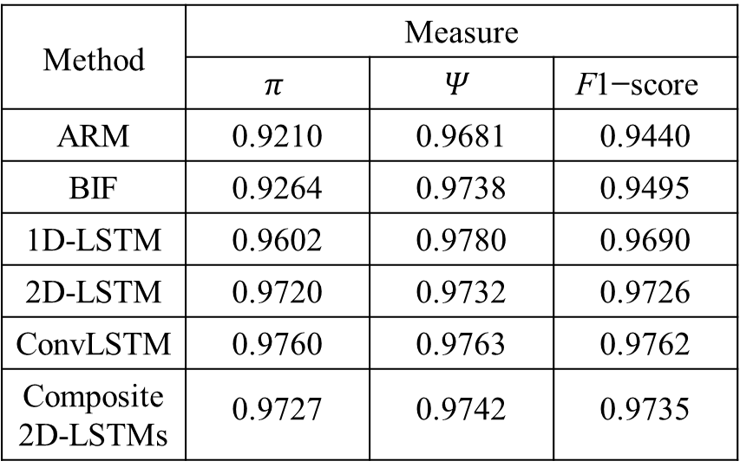
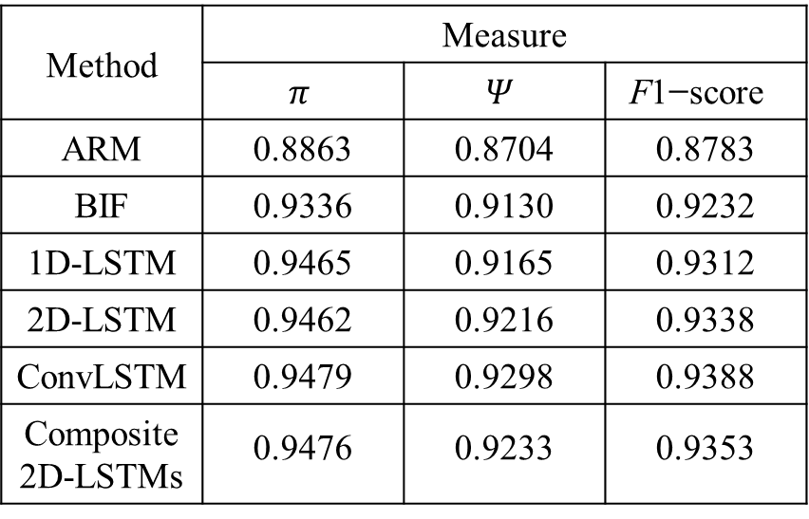
Experiments and Results
  Accuracy Comparisons
Method | Measure
 | $$π$$ | $$Ψ$$ | $$\text{F}\text{1}\text{−}\text{score}$$
ARM | 0.9210 | 0.9681 | 0.9440
BIF | 0.9264 | 0.9738 | 0.9495
1D-LSTM | 0.9602 | 0.9780 | 0.9690
2D-LSTM | 0.9720 | 0.9732 | 0.9726
ConvLSTM | 0.9760 | 0.9763 | 0.9762
Composite 2D-LSTMs | 0.9727 | 0.9742 | 0.9735
Method | Measure
 | $$π$$ | $$Ψ$$ | $$\text{F}\text{1}\text{−}\text{score}$$
ARM | 0.8863 | 0.8704 | 0.8783
BIF | 0.9336 | 0.9130 | 0.9232
1D-LSTM | 0.9465 | 0.9165 | 0.9312
2D-LSTM | 0.9462 | 0.9216 | 0.9338
ConvLSTM | 0.9479 | 0.9298 | 0.9388
Composite 2D-LSTMs | 0.9476 | 0.9233 | 0.9353

Slide 12
Experiments and Results
  Complexity Comparisons
Method | Execution Time (s)
 | Training | Testing
The tensor-based method | 608.7 | 2.7
Composite 2D-LSTMs | 57.8 | 0.7
Method | Execution Time (s)
 | Training | Testing
The tensor-based method | 610.3 | 2.9
Composite 2D-LSTMs | 58.9 | 0.8

Slide 13
Summary
In this presentation, multi-dimensional spectrum occupancy prediction is discussed to use spectrum efficiently.
Composite 2D-LSTMs-based method is shown as a sub-optimal and more realistic method.
Relevant experimental measurement is shown to prove the feasibility of this method.

