Slide 1
IEEE 802.11ax Backward Compatible Trigger Frame
RU Allocation Table
Date: 2020-12-13
Authors:
Name | Affiliations | Email
Steve Shellhammer | Qualcomm | shellhammer@ieee.org
Ron Porat | Broadcom | ron.porat@broadcom.com
DJ Moelker |  | dignus-jan.moelker@broadcom.com

Slide 2
Revision Edits
Added a Straw Poll on the use of Primary/Secondary indication for the RU/MRUs in the RU Allocation Table
Relabel the “LU” bit to the “PS160” bit
Description of the logic for the use of primary/secondary signaling is provided in,
  S. Shellhammer, et. al., ”Enhanced Trigger Frame for EHT Support,” IEEE 802.11-20/1429r3, December 2020

Slide 3
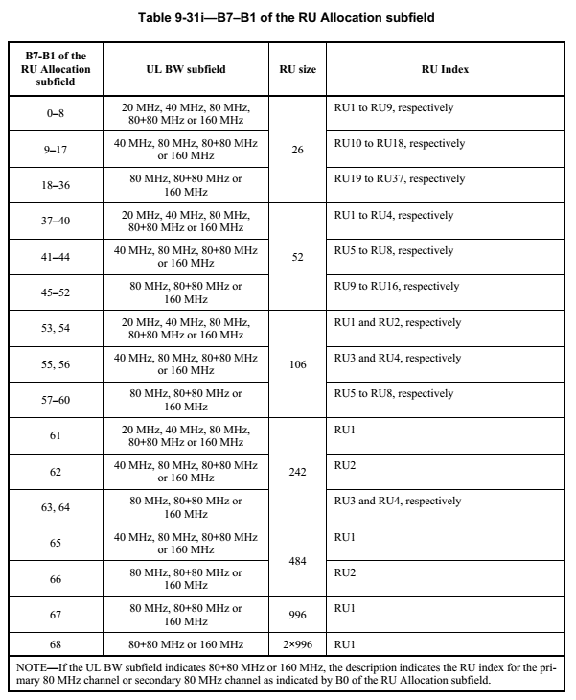
IEEE 802.11ax RU Allocation Table
Entries 0-68 already assigned
Entries 69-127 available for additional RUs/MRUs
  59 available entries

Slide 4
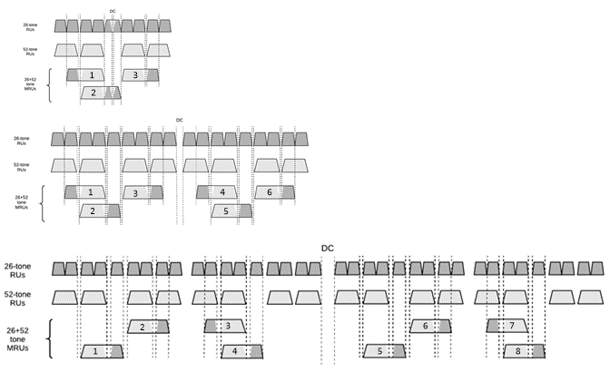
MRU26+52 – Indexing
The draft does not assign MRU indices to small MRUs
These indices are needed for the RU Allocation Table
If we were to assign indices in frequency order, we find that the indices of the MRUs within a 40 MHz PPDU do not match the indices of the MRUs within the lower half of the 80 MHz PPDU

Slide 5
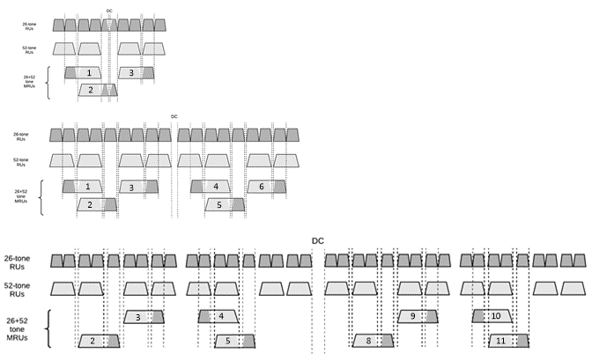
MRU26+52 – Recommended Indexing
With this recommended Indexing the indices in the 40 MHz PPDU match those of the lower part of the 80 MHz PPDU
With this approach the MRU Index uniquely identifies the MRU, within a 20 MHz, 40 MHz or 80 MHz PPDU

Slide 6
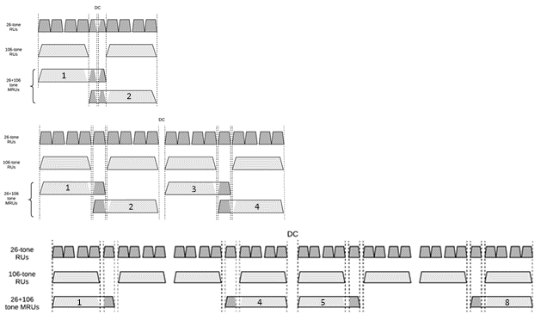
MRU26+106 – Recommended Indexing
With this recommended indexing the MRU index uniquely identifies the MRU within a 20 MHz, 40 MHz or 80 MHz PPDU

Slide 7
RU Allocation Table Entries
Add in RU996x4 and the MRUs < 80 MHz
B7-B1 of the RU Allocation Subfield | MRU | MRU Index
69 | RU996x4 | RU1
70-75 | MRU26+52 | MRU1 to MRU6, respectively
76 | Reserved
77-80 | MRU26+52 | MRU8 to MRU11, respectively
81 | Reserved
82-86 | MRU26+106 | MRU1 to MRU5, respectively
87-88 | Reserved
89 | MRU26+106 | MRU8
90-93 | MRU484+242 | MRU1 to MRU4, respectively
This leaves 34 table entries (94 to 127)

Slide 8
Remaining RUs/MRUs
MRU | Total Number in 320 MHz
MRU996+484 | 8
MRU996+484+242 | 16
MRU2x996+484 | 12
MRU3x996 | 4
MRU3x996+484 | 8
TOTAL | 48

Slide 9
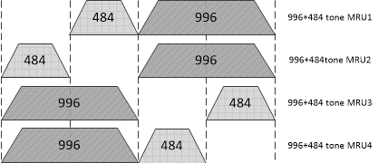
MRU996+484
B0
B7-B1
0
94
0
95
1
94
1
95
B0 and B7-B1 indicate MRU within 160 MHz
PS160 indicates which 160 MHz

Slide 10
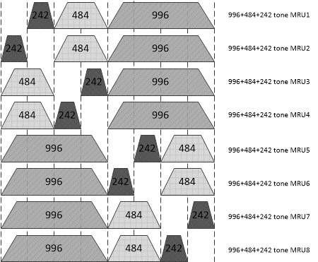
MRU996+484+242
B0
B7-B1
0
96
0
97
0
98
0
99
1
96
1
97
1
98
1
99
B0 and B7-B1 indicate MRU within 160 MHz
PS160 indicates which 160 MHz

Slide 11
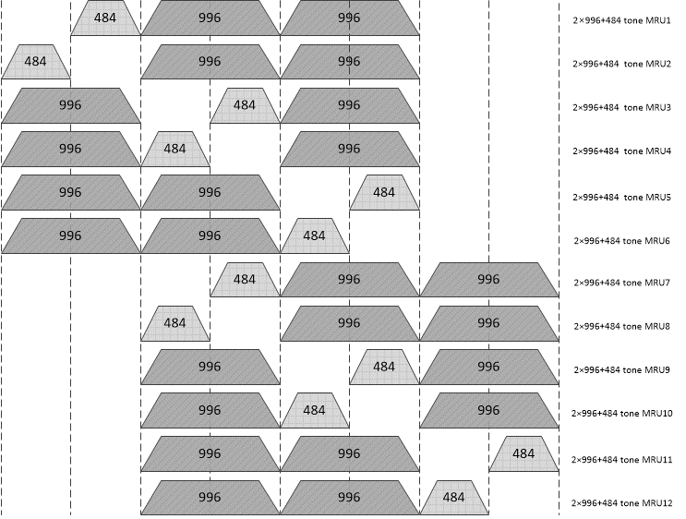
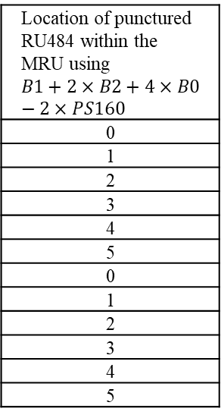
MRU2x996+484
PS160
B0
B7-B1
Encoding/Decoding Rules
PS160 provides location of the 240
B0, B1, B2, PS160 provide location of punctured RU484 within the MRU
0
0
100
0
0
101
0
0
102
0
0
103
0
1
100
Location of punctured RU484 within the MRU using $$B1+2×B2+4×B0−2×PS160$$
0
1
2
3
4
5
0
1
2
3
4
5
0
1
101
1
0
102
1
0
103
1
1
100
1
1
101
1
1
102
1
1
103

Slide 12
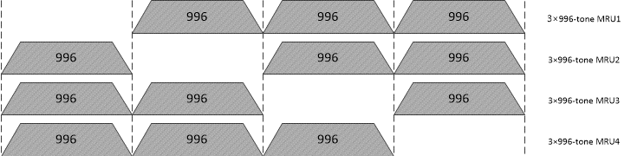
MRU3x996
PS160
B0
B7-B1
0
0
104
0
1
104
1
0
104
1
1
104

Slide 13
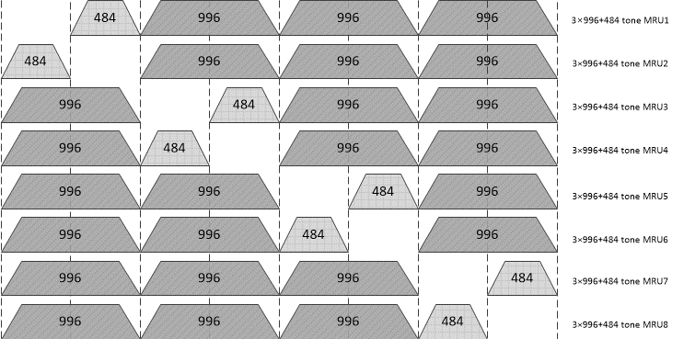
MRU3x996+484
PS160
B0
B7-B1
0
0
105
0
0
106
0
1
105
0
1
106
1
0
105
1
0
106
1
1
105
1
1
106

Slide 14
Reserved Entries
B7-B1 of the RU Allocation Subfield | MRU
107-127 | Reserved
A total of 21 reserved table entries

Slide 15
RU Allocation Table
Detailed RU Allocation Table Word document, embedded in the Presentation

Slide 16
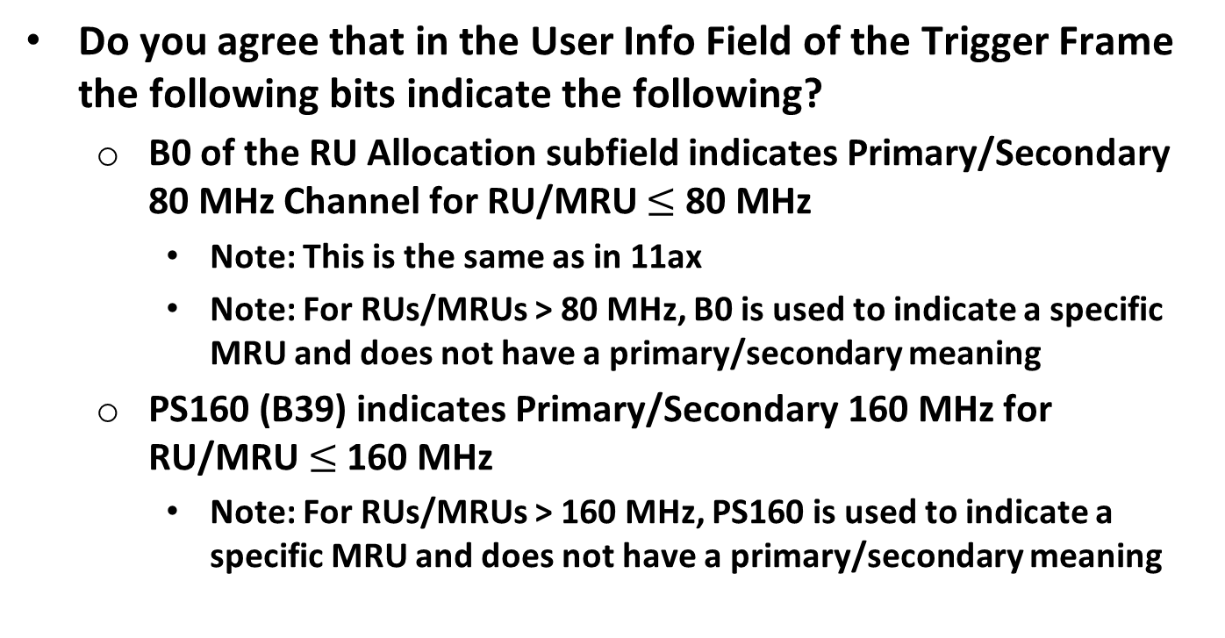
Straw Poll #1
Do you agree that in the User Info Field of the Trigger Frame the following bits indicate the following?
  B0 of the RU Allocation subfield indicates Primary/Secondary 80 MHz Channel for RU/MRU $≤$ 80 MHz
    Note: This is the same as in 11ax
    Note: For RUs/MRUs > 80 MHz, B0 is used to indicate a specific MRU and does not have a primary/secondary meaning
  PS160 (B39) indicates Primary/Secondary 160 MHz for RU/MRU $≤$ 160 MHz
    Note: For RUs/MRUs > 160 MHz, PS160 is used to indicate a specific MRU and does not have a primary/secondary meaning

Slide 17
Straw Poll #2
Do you agree to include the following entries in the Trigger Frame RU Allocation Table?
B7-B1 of the RU Allocation Subfield | MRU | MRU Index
69 | RU996x4 | RU1
70-75 | MRU26+52 | MRU1 to MRU6, respectively
76 | Reserved
77-80 | MRU26+52 | MRU8 to MRU11, respectively
81 | Reserved
82-86 | MRU26+106 | MRU1 to MRU5, respectively
87-88 | Reserved
89 | MRU26+106 | MRU8
90-93 | MRU484+242 | MRU1 to MRU4, respectively

Slide 18
Straw Poll #3
Do you agree to include the following entries in the Trigger Frame RU Allocation Table?
PS160
B7-B1
0
94
0
95
1
94
1
95
B0 and B7-B1 indicate MRU within 160 MHz
PS160 indicates which 160 MHz

Slide 19
Straw Poll #4
Do you agree to include the following entries in the Trigger Frame RU Allocation Table?
PS160
B7-B1
0
96
B0 and B7-B1 indicate MRU within 160 MHz
PS160 indicates which 160 MHz
0
97
0
98
0
99
1
96
1
97
1
98
1
99

Slide 20
Straw Poll #5
Do you agree to include the following entries in the Trigger Frame RU Allocation Table?
PS160
B0
B7-B1
0
0
100
0
0
101
0
0
102
0
0
103
0
1
100
0
1
101
1
0
102
1
0
103
1
1
100
1
1
101
1
1
102
1
1
103

Slide 21
Straw Poll #6
Do you agree to include the following entries in the Trigger Frame RU Allocation Table?
PS160
B0
B7-B1
0
0
104
0
1
104
1
0
104
1
1
104

Slide 22
Straw Poll #7
Do you agree to include the following entries in the Trigger Frame RU Allocation Table?
PS160
B0
B7-B1
0
0
105
0
0
106
0
1
105
0
1
106
1
0
105
1
0
106
1
1
105
1
1
106

Slide 23
Straw Poll #8
Do you support the Trigger Frame RU Allocation Table design embedded in Slide 15 of document IEEE 802.11-20/1703r2?

