Slide 1
IEEE 802.11ax Backward Compatible Trigger Frame RU Allocation Table
Date: 2020-11-18
Authors:
Name | Affiliations | Email
Steve Shellhammer | Qualcomm | shellhammer@ieee.org
Ron Porat | Broadcom | ron.porat@broadcom.com
DJ Moelker |  | dignus-jan.moelker@broadcom.com

Slide 2
Revision Edits
To avoid confusion with 80-MHz segment we have dropped the term “segment” when referring to 160 MHz
We have also changed “BS” to “LU” to indicate the Lower/Upper 160 MHz
We added some Straw Poll on portions of the RU Allocation Table

Slide 3
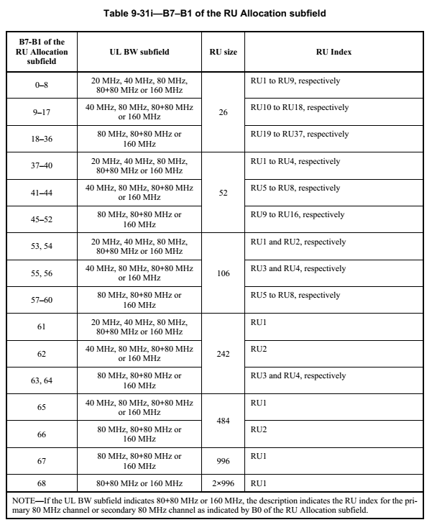
IEEE 802.11ax RU Allocation Table
Entries 0-68 already assigned
Entries 69-127 available for additional RUs/MRUs
59 available entries

Slide 4
80-MHz Segment Indicator
Propose the following bits to indicate the 80-MHz Segment
Bit Label | Bit Location | Interpretation
LU | B25 in User Info Field | Indicates Lower or Upper 160 MHz LU = 0 $→$ Lower 160 MHz LU = 1 $→$ Upper 160 MHz
B0 | B0 in RU Allocation Subfield | Indicates Lower or Upper 80 MHz Segment B0 = 0 $→$ Lower 80 MHz Segment B0 = 1 $→$ Upper 80 MHz Segment
With these two bits we can uniquely identify each of the four 80-MHz Segments

Slide 5
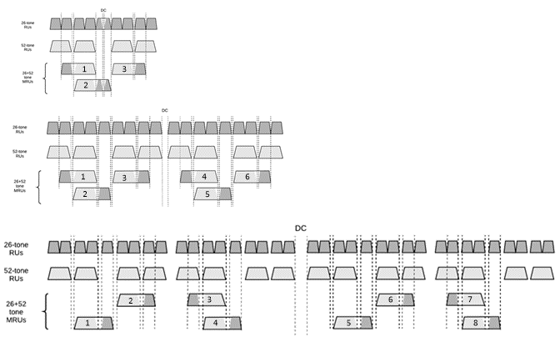
MRU26+52 – Indexing
The draft does not assign MRU indices to small MRUs
These indices are needed for the RU Allocation Table
If we were to assign indices in frequency order, we find that the indices of the MRUs within a 40 MHz PPDU do not match the indices of the MRUs within the lower half of the 80 MHz PPDU

Slide 6
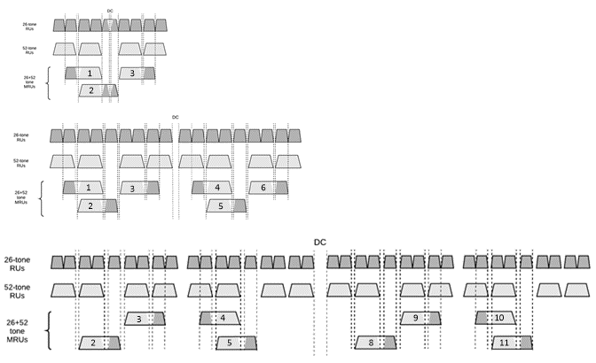
MRU26+52 – Recommended Indexing
With this recommended Indexing the indices in the 40 MHz PPDU match those of the lower part of the 80 MHz PPDU
With this approach the MRU Index uniquely identifies the MRU, within a 20 MHz, 40 MHz or 80 MHz PPDU

Slide 7
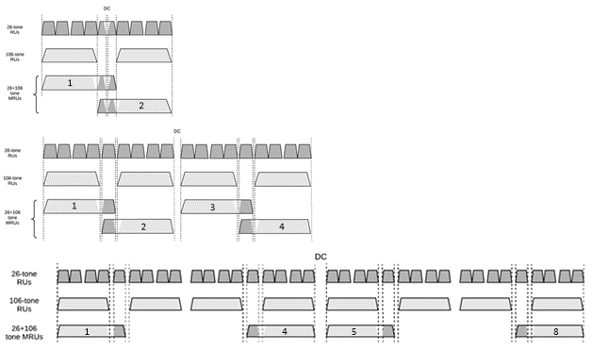
MRU26+106 – Recommended Indexing
With this recommended indexing the MRU index uniquely identifies the MRU within a 20 MHz, 40 MHz or 80 MHz PPDU

Slide 8
RU Allocation Table Entries
Add in RU996x4 and the MRUs < 80 MHz
B7-B1 of the RU Allocation Subfield | MRU | MRU Index
69 | RU996x4 | RU1
70-75 | MRU26+52 | MRU1 to MRU6, respectively
76 | Reserved
77-80 | MRU26+52 | MRU8 to MRU11, respectively
81 | Reserved
82-86 | MRU26+106 | MRU1 to MRU5, respectively
87-88 | Reserved
89 | MRU26+106 | MRU8
90-93 | MRU484+242 | MRU1 to MRU4, respectively
This leaves 34 table entries (94 to 127)

Slide 9
Remaining RUs/MRUs
MRU | Total Number in 320 MHz
MRU996+484 | 8
MRU996+484+242 | 16
MRU2x996+484 | 12
MRU3x996 | 4
MRU3x996+484 | 8
TOTAL | 48

Slide 10
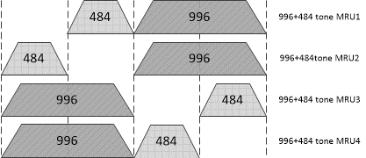
MRU996+484
B0
B7-B1
0
94
0
95
1
94
1
95
B0 and B7-B1 indicate MRU within 160 MHz
LU indicates which 160 MHz

Slide 11
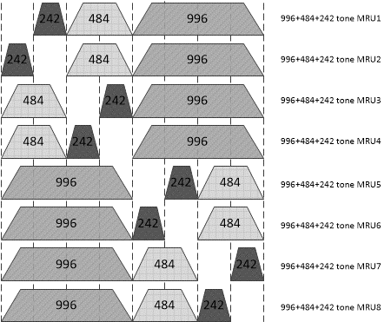
MRU996+484+242
B0
B7-B1
0
96
0
97
0
98
0
99
1
96
1
97
1
98
1
99
B0 and B7-B1 indicate MRU within 160 MHz
LU indicates which 160 MHz

Slide 12
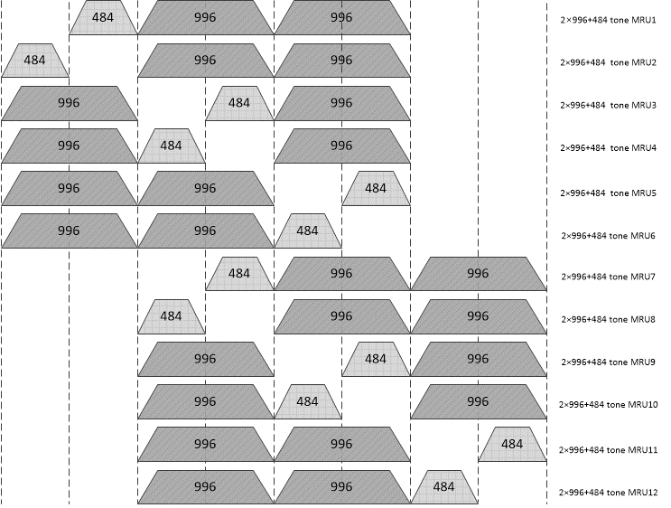
MRU2x996+484
LU
B0
B7-B1
0
0
100
Encoding/Decoding Rules
(LU,B0) provides 80-MHz segment location of hole (missing RU484)
B1 indicates if hole is in lower or upper part of 80-MHz segment
100-101 versus 102-103 indicates if Lower 240 MHz or Upper 240 MHz
0
0
101
0
1
100
0
1
101
1
0
100
1
0
101
0
1
102
0
1
103
1
0
102
1
0
103
1
1
102
1
1
103

Slide 13
MRU2x996+484 Option B
LU
B0
B7-B1
Encoding/Decoding Rules
LU provides location of 240
B0, B1, B2, LU provide location of punctured RU484 within MRU
0
0
100
0
0
101
0
0
102
0
0
103
0
1
100
Location of punctured RU484 within the MRU using B1+2*B2+4*B0-2*LU
0
1
2
3
4
5
0
1
2
3
4
5
0
1
101
1
0
102
1
0
103
1
1
100
1
1
101
1
1
102
1
1
103
Table for Option B provided in Appendix

Slide 14
MRU3x996
LU
B0
B7-B1
0
0
104
0
1
104
1
0
104
1
1
104

Slide 15
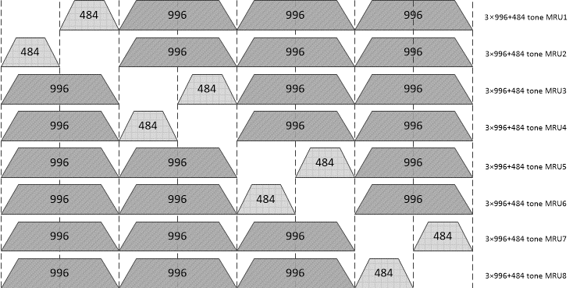
MRU3x996+484
LU
B0
B7-B1
0
0
105
0
0
106
0
1
105
0
1
106
1
0
105
1
0
106
1
1
105
1
1
106

Slide 16
Reserved Entries
B7-B1 of the RU Allocation Subfield | MRU
107-127 | Reserved
A total of 21 reserved table entries

Slide 17
RU Allocation Table
Detailed RU Allocation Table Word document, embedded in the Presentation

Slide 18
Straw Poll #1
Do you agree that B25 in the Trigger Frame User Info Field will be the Lower/Upper 160 MHz bit?
Note: Currently in 11ax that bit is the UL DCM bit, and is not needed for 11be since DCM has been absorbed into the MCS table

Slide 19
Straw Poll #2
Do you support the Trigger Frame RU Allocation Table design embedded in Slide 15 of document IEEE 802.11-20/1703r1?

Slide 20
Straw Poll 3
Do you agree to include the following entries in the Trigger Frame RU Allocation Table?
B7-B1 of the RU Allocation Subfield | MRU | MRU Index
69 | RU996x4 | RU1
70-75 | MRU26+52 | MRU1 to MRU6, respectively
76 | Reserved
77-80 | MRU26+52 | MRU8 to MRU11, respectively
81 | Reserved
82-86 | MRU26+106 | MRU1 to MRU5, respectively
87-88 | Reserved
89 | MRU26+106 | MRU8
90-93 | MRU484+242 | MRU1 to MRU4, respectively

Slide 21
Straw Poll #4
Do you agree to include the following entries in the Trigger Frame RU Allocation Table?
B0
B7-B1
0
94
0
95
1
94
1
95
B0 and B7-B1 indicate MRU within 160 MHz
LU indicates which 160 MHz

Slide 22
Straw Poll 5
Do you agree to include the following entries in the Trigger Frame RU Allocation Table?
B0
B7-B1
0
96
B0 and B7-B1 indicate MRU within 160 MHz
LU indicates which 160 MHz
0
97
0
98
0
99
1
96
1
97
1
98
1
99

Slide 23
Straw Poll 6a
Do you agree to include the following entries in the Trigger Frame RU Allocation Table?
LU
B0
B7-B1
0
0
100
0
0
101
0
1
100
0
1
101
1
0
100
1
0
101
0
1
102
0
1
103
1
0
102
1
0
103
1
1
102
1
1
103

Slide 24
Straw Poll 6b
Do you agree to include the following entries in the Trigger Frame RU Allocation Table?
LU
B0
B7-B1
0
0
100
0
0
101
0
0
102
0
0
103
0
1
100
0
1
101
1
0
102
1
0
103
1
1
100
1
1
101
1
1
102
1
1
103

Slide 25
Straw Poll 7
Do you agree to include the following entries in the Trigger Frame RU Allocation Table?
LU
B0
B7-B1
0
0
104
0
1
104
1
0
104
1
1
104

Slide 26
Straw Poll 8
Do you agree to include the following entries in the Trigger Frame RU Allocation Table?
LU
B0
B7-B1
0
0
105
0
0
106
0
1
105
0
1
106
1
0
105
1
0
106
1
1
105
1
1
106

Slide 27
Appendix

Slide 28
Table for MRU2x996+484 – Option B
9-bits RU Allocation subfield |  |  | RU size | Location of punctured RU484 within MRU with B1+2*B2+4*B0-2*LU | MRU Index with | RU Index
LU | B0 | B7-B1 of |  |  | B1+2*B2+4*B0+4*LU+1
 |  | RU Allocation subfield
0 | 0 | 100 | 2×RU996+RU484 | 0 | 1 | MRU1
0 | 0 | 101 |  | 1 | 2 | MRU2
0 | 0 | 102 |  | 2 | 3 | MRU3
0 | 0 | 103 |  | 3 | 4 | MRU4
0 | 1 | 100 |  | 4 | 5 | MRU5
0 | 1 | 101 |  | 5 | 6 | MRU6
1 | 0 | 102 |  | 0 | 7 | MRU7
1 | 0 | 103 |  | 1 | 8 | MRU8
1 | 1 | 100 |  | 2 | 9 | MRU9
1 | 1 | 101 |  | 3 | 10 | MRU10
1 | 1 | 102 |  | 4 | 11 | MRU11
1 | 1 | 103 |  | 5 | 12 | MRU12

