Slide 1
IEEE 802.11ax Backward Compatible Trigger Frame
RU Allocation Table
Date: 2020-10-26
Authors:
Name | Affiliations | Email
Steve Shellhammer | Qualcomm | shellhammer@ieee.org
Ron Porat | Broadcom | ron.porat@broadcom.com
DJ Moelker |  | dignus-jan.moelker@broadcom.com

Slide 2
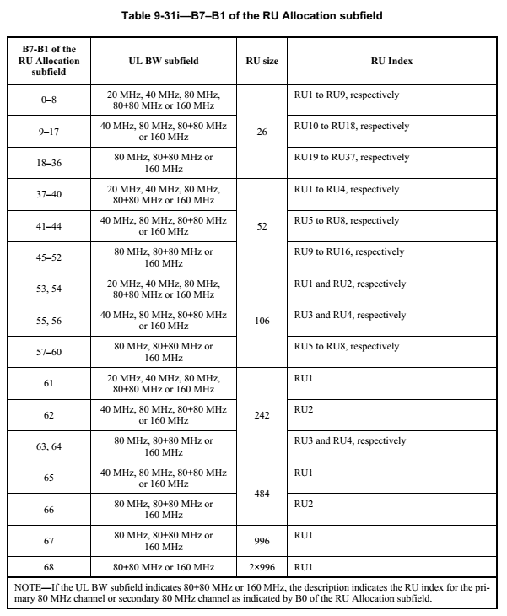
IEEE 802.11ax RU Allocation Table
Entries 0-68 already assigned
Entries 69-127 available for additional RUs/MRUs
  59 available entries

Slide 3
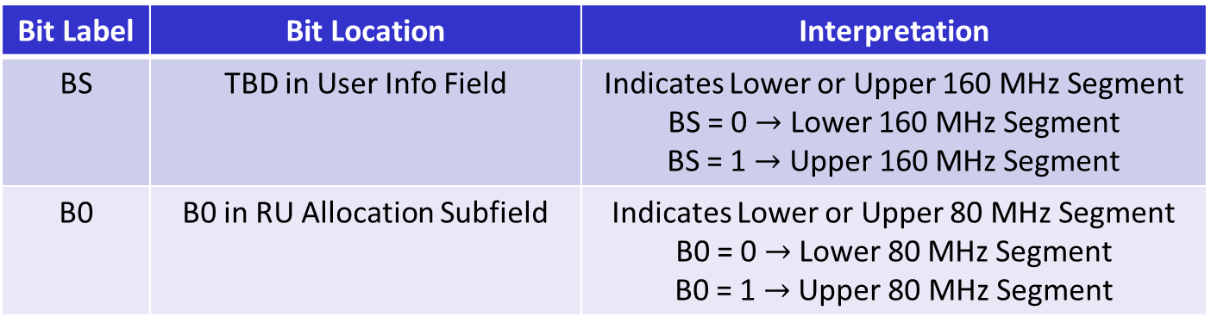
80-MHz Segment Indicator
Propose the following bits to indicate the 80-MHz Segment
Bit Label | Bit Location | Interpretation
BS | TBD in User Info Field | Indicates Lower or Upper 160 MHz Segment BS = 0 $→$ Lower 160 MHz Segment BS = 1 $→$ Upper 160 MHz Segment
B0 | B0 in RU Allocation Subfield | Indicates Lower or Upper 80 MHz Segment B0 = 0 $→$ Lower 80 MHz Segment B0 = 1 $→$ Upper 80 MHz Segment
With these two bits we can uniquely identify each of the four 80-MHz Segments

Slide 4
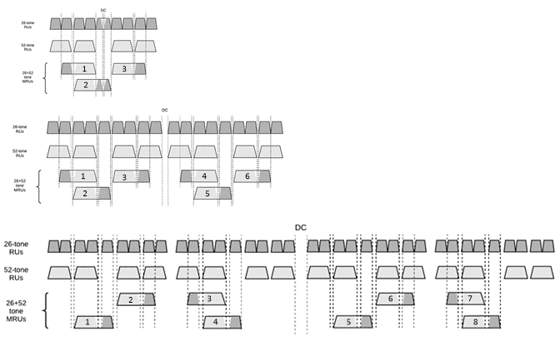
MRU26+52 – Indexing
The draft does not assign MRU indices to small MRUs
These indices are needed for the RU Allocation Table
If we were to assign indices in frequency order, we find that the indices of the MRUs within a 40 MHz PPDU do not match the indices of the MRUs within the lower half of the 80 MHz PPDU

Slide 5
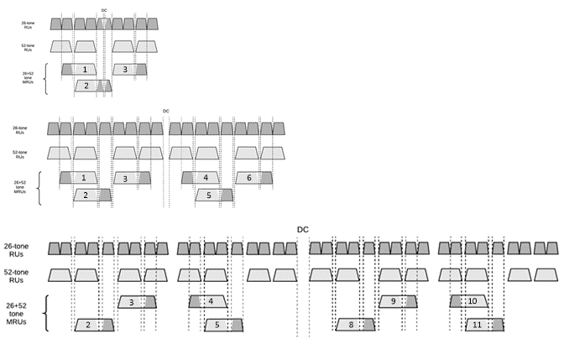
MRU26+52 – Recommended Indexing
With this recommended Indexing the indices in the 40 MHz PPDU match those of the lower part of the 80 MHz PPDU
With this approach the MRU Index uniquely identifies the MRU, within a 20 MHz, 40 MHz or 80 MHz PPDU

Slide 6
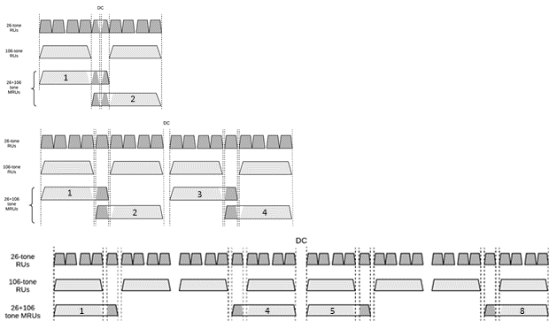
MRU26+106 – Recommended Indexing
With this recommended indexing the MRU index uniquely identifies the MRU within a 20 MHz, 40 MHz or 80 MHz PPDU

Slide 7
RU Allocation Table Entries
Add in RU996x4 and the MRUs < 80 MHz
B7-B1 of the RU Allocation Subfield | MRU | MRU Index
69 | RU996x4 | RU1
70-75 | MRU26+52 | MRU1 to MRU6, respectively
76 | Reserved
77-80 | MRU26+52 | MRU8 to MRU11, respectively
81 | Reserved
82-86 | MRU26+106 | MRU1 to MRU5, respectively
87-88 | Reserved
89 | MRU26+106 | MRU8
90-93 | MRU484+242 | MRU1 to MRU4, respectively
This leaves 34 table entries (94 to 127)

Slide 8
Remaining RUs/MRUs
MRU | Total Number in 320 MHz
MRU996+484 | 8
MRU996+484+242 | 16
MRU2x996+484 | 12
MRU3x996 | 4
MRU3x996+484 | 8
TOTAL | 48

Slide 9
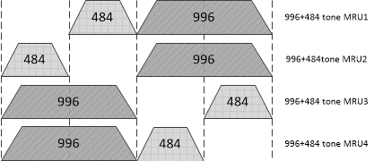
MRU996+484
B0
B7-B1
0
94
0
95
1
94
1
95
B0 and B7-B1 indicate MRU within 160 MHz Segment
BS indicates which 160 MHz Segment

Slide 10
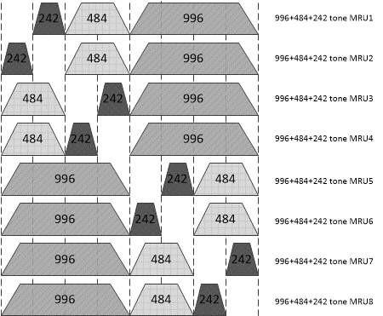
MRU996+484+242
B0
B7-B1
0
96
0
97
0
98
0
99
1
96
1
97
1
98
1
99
B0 and B7-B1 indicate MRU within 160 MHz Segment
BS indicates which 160 MHz Segment

Slide 11
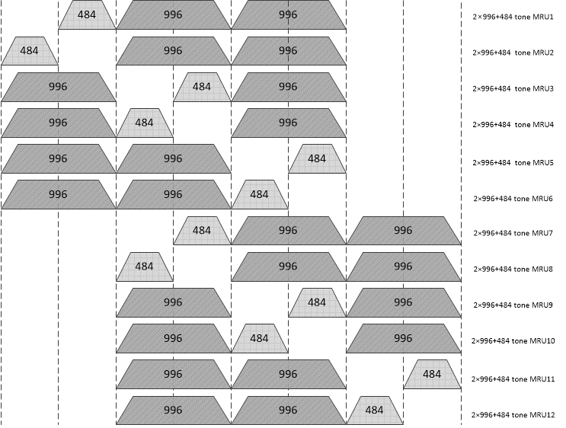
MRU2x996+484
BS
B0
B7-B1
0
0
100
Encoding/Decoding Rules
(BS,B0) provides 80-MHz segment location of hole (missing RU484)
B1 indicates if hole is in lower or upper part of 80-MHz segment
100-101 versus 102-103 indicates if Lower 240 MHz or Upper 240 MHz
0
0
101
0
1
100
0
1
101
1
0
100
1
0
101
0
1
102
0
1
103
1
0
102
1
0
103
1
1
102
1
1
103

Slide 12
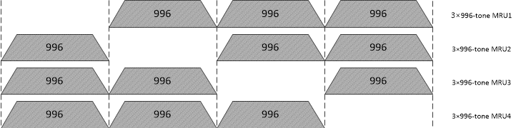
MRU3x996
BS
B0
B7-B1
0
0
104
0
1
104
1
0
104
1
1
104

Slide 13
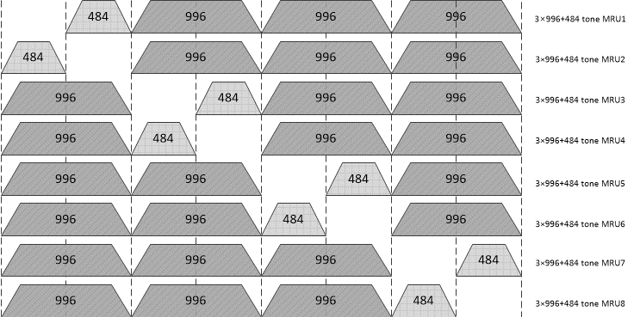
MRU3x996+484
BS
B0
B7-B1
0
0
105
0
0
106
0
1
105
0
1
106
1
0
105
1
0
106
1
1
105
1
1
106

Slide 14
Reserved Entries
B7-B1 of the RU Allocation Subfield | MRU
107-127 | Reserved
A total of 21 reserved table entries

Slide 15
RU Allocation Table
Detailed RU Allocation Table Word document, embedded in the Presentation

Slide 16
Straw Poll
Do you support the Trigger Frame RU Allocation Table design embedded in Slide 15 of document IEEE 802.11-20/1703r0?

