Slide 1
Dual-Carrier Index Modulation
Date: YYYY-MM-DD
Authors:

Slide 2
Introduction
MCS0 DCM has been proposed in [1] and it will be supported in 11be for 1ss.
Index modulation (IM) is a promising method to increase the data rate by exploiting the indices of building blocks such as transmit antennas and subcarriers.
In this presentation, we propose a method called dual-carrier index modulation (DC-IM) which combines DCM and IM techniques.
To further increase the error performance, we propose triple-carrier index modulation (TC-IM).

Slide 3
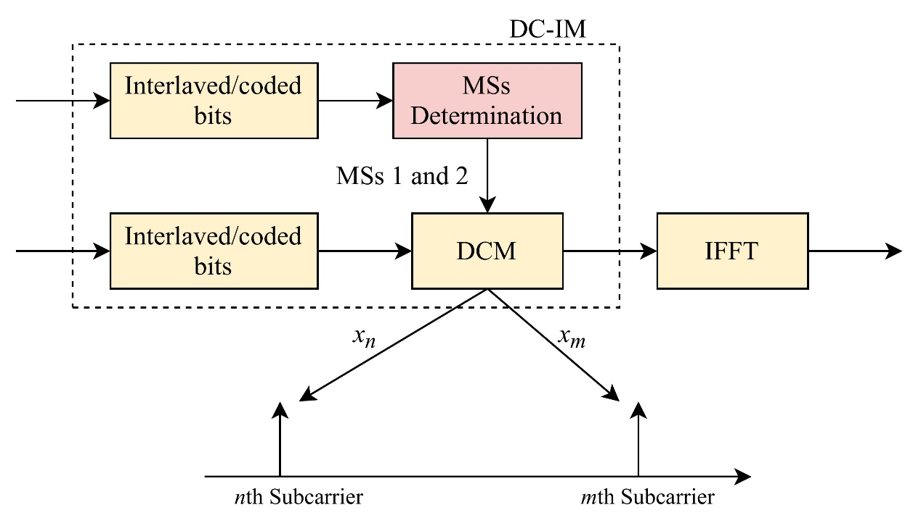
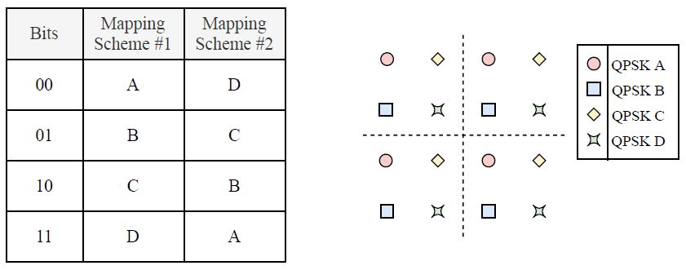
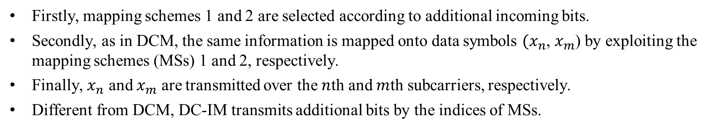
DC-IM modulation scheme
Firstly, mapping schemes 1 and 2 are selected according to additional incoming bits.
Secondly, as in DCM, the same information is mapped onto data symbols ${(x}_{n}$, $x_{m}$) by exploiting the mapping schemes (MSs) 1 and 2, respectively.
Finally, $x_{n}$ and $x_{m}$ are transmitted over the $n$th and $m$th subcarriers, respectively.
Different from DCM, DC-IM transmits additional bits by the indices of MSs.

Slide 4
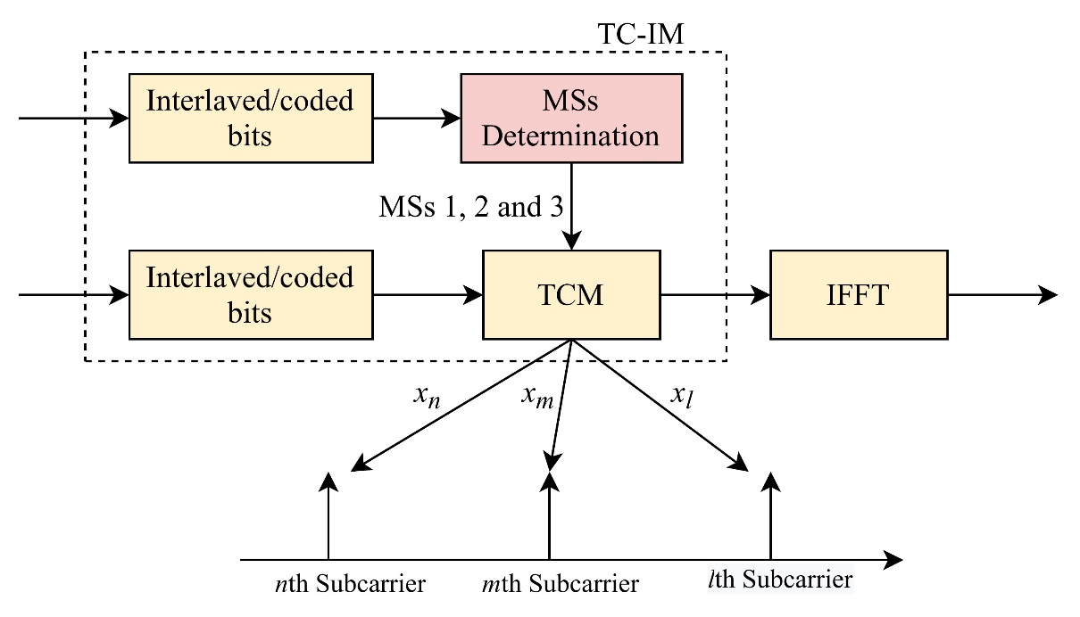
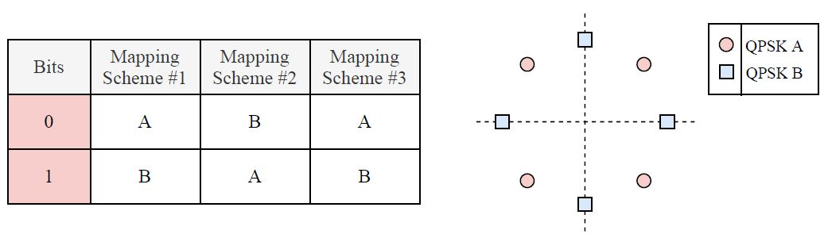
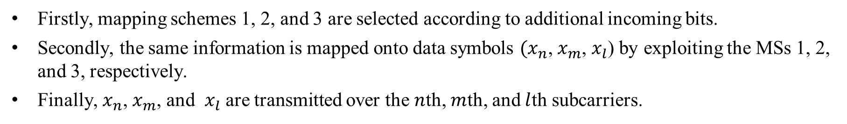
TC-IM modulation scheme
Firstly, mapping schemes 1, 2, and 3 are selected according to additional incoming bits.
Secondly, the same information is mapped onto data symbols ${(x}_{n}$, $x_{m}$, $x_{l}$) by exploiting the MSs 1, 2, and 3, respectively.
Finally, $x_{n}$, $x_{m}$, and $x_{l}$ are transmitted over the $n$th, $m$th, and $l$th subcarriers.

Slide 5
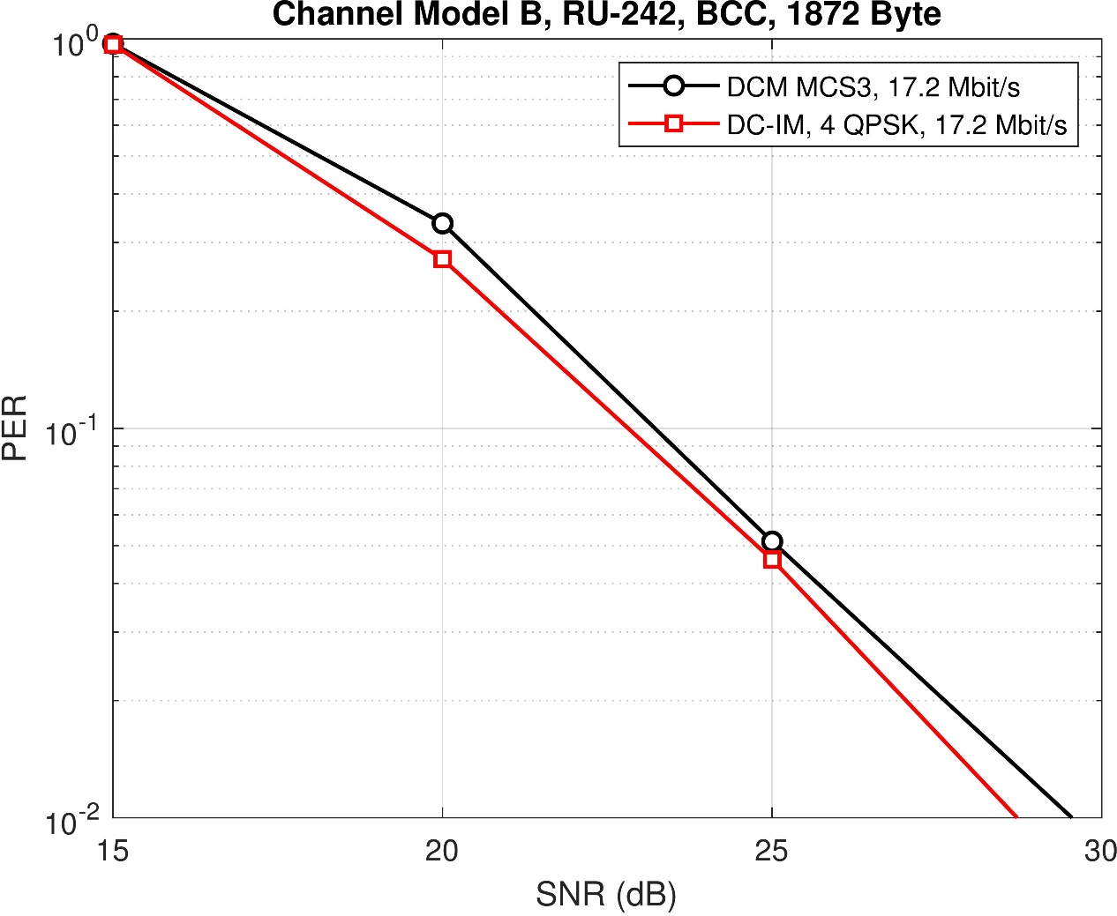
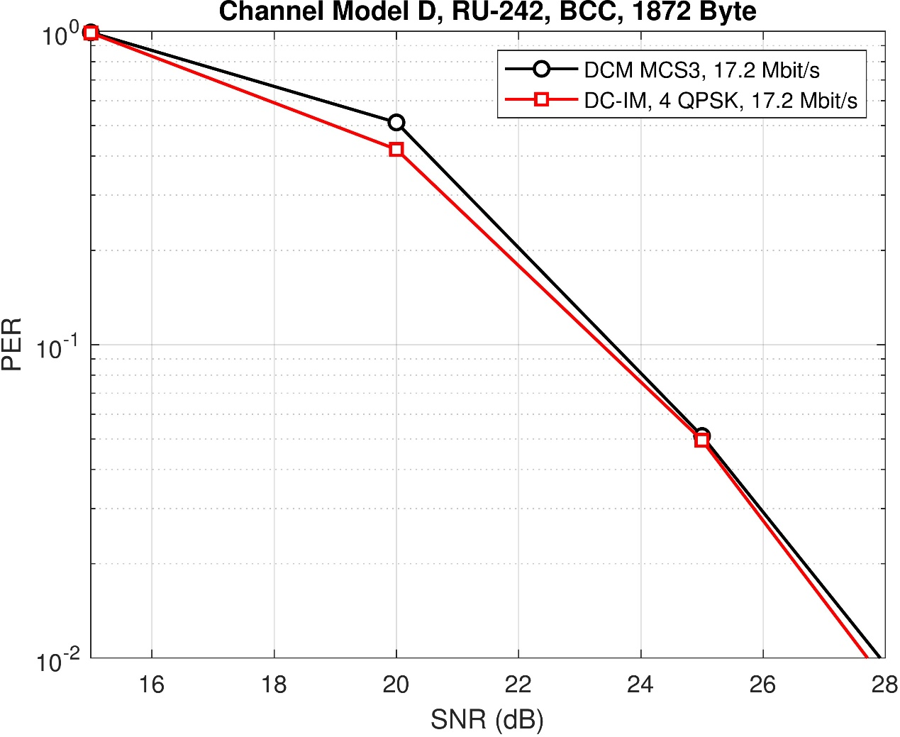
Simulation Results

Slide 6
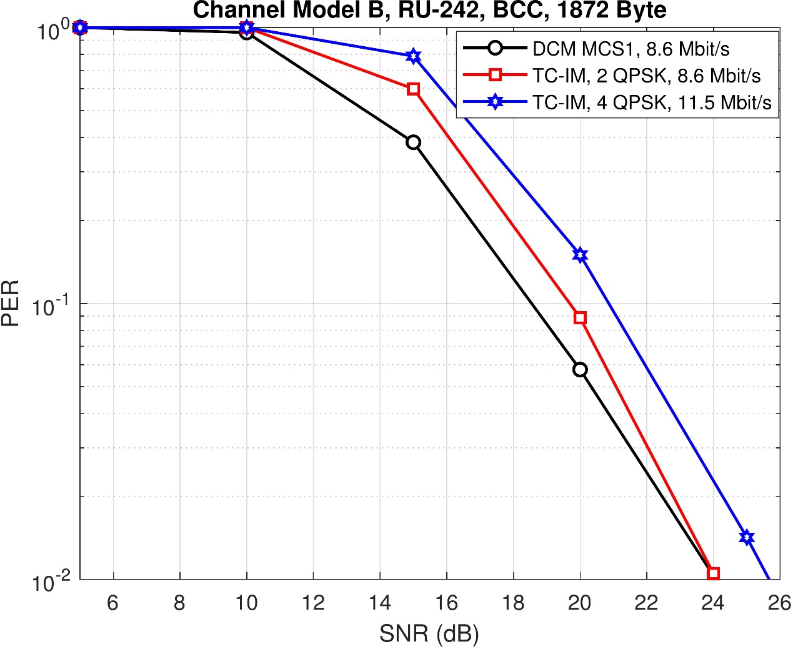
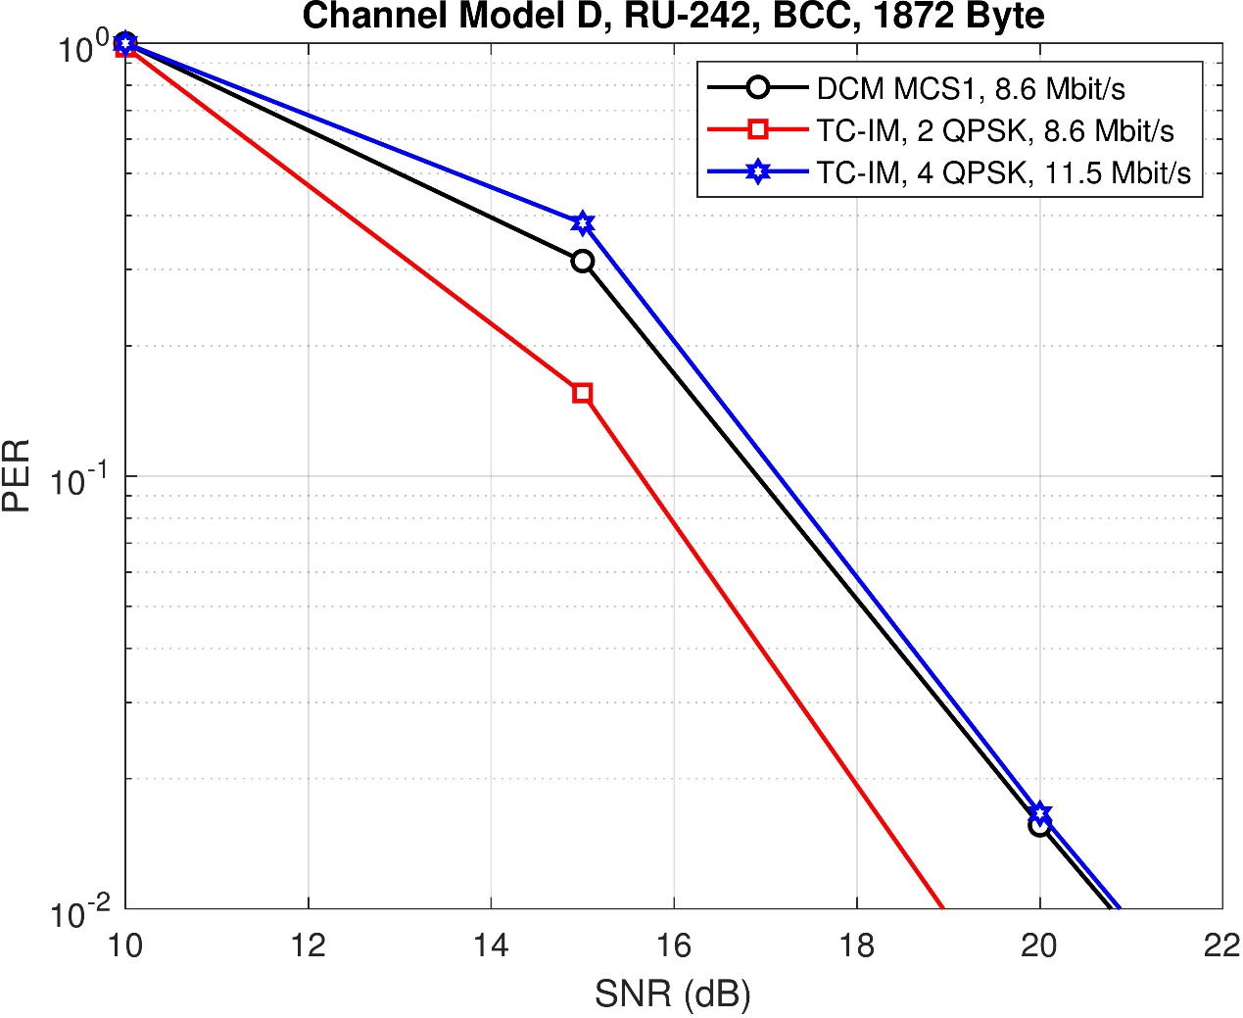
Simulation Results (Cont’d)

Slide 7
Conclusion
DC-IM modulation scheme is proposed.
TC-IM modulation scheme is proposed.

Slide 8
Straw Poll #1
Do you agree that DC-IM for Nss=1 is a MCS in 11be?

Slide 9
Straw Poll #2
Do you agree that TC-IM for Nss=1 is a MCS in 11be?

Slide 10
References
[1] 11-20-0986r0 Jianhan et al. “DCM for range extension in 6GHz LPI”

