Slide 1
Dual-Carrier Index Modulation
Date: YYYY-MM-DD
Authors:

Slide 2
Introduction
MCS0 DCM has been proposed in [1] and it will be supported in 11be for 1ss.
DCM reduces the data rate of any MCS by half.
Index modulation (IM) is a promising method to increase the data rate by exploiting the indices of building blocks such as transmit antennas and subcarriers.
In this presentation, we propose a method called dual-carrier index modulation (DC-IM) which combines DCM and IM techniques to increase the data rate .

Slide 3
DC-IM MCS0 modulation scheme
Firstly, mapping schemes 1 and 2 are selected according to additional 1 bit.
Secondly, as in DCM, the same information is mapped onto data symbols ${(x}_{n}$, $x_{m}$) by exploiting the mapping schemes 1 and 2, respectively.
Finally , $x_{n}$ and $x_{m}$ are transmitted over $n$th and $m$th subcarriers.
DCM-BPSK $→$ 0.5 bit per subcarrier, DCIM BPSK $→$ 1 bit per subcarrier

Slide 4
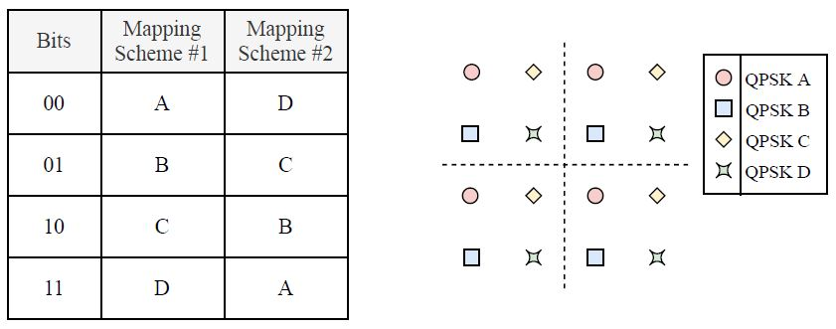
DC-IM MCS1 modulation scheme
To double the data rate of DCM MCS1, four non-overlapping QPSK constellations are required.

Slide 5
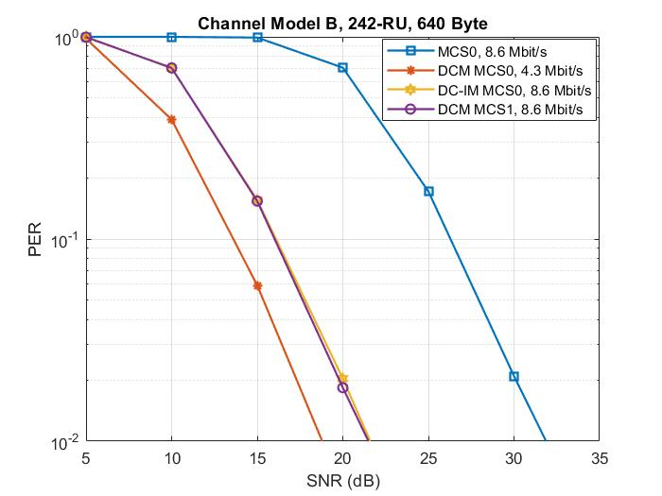
Simulation Results

Slide 6
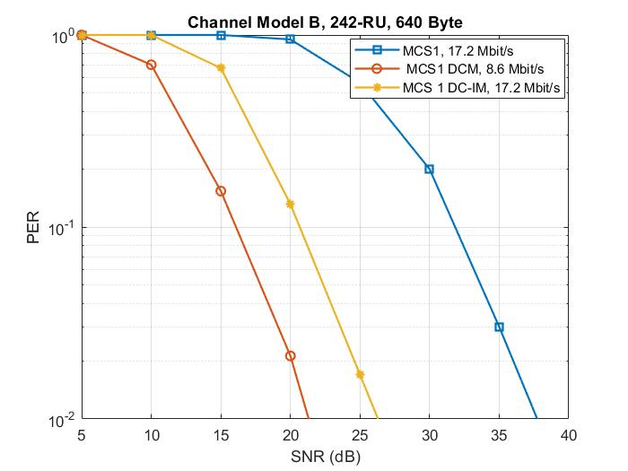
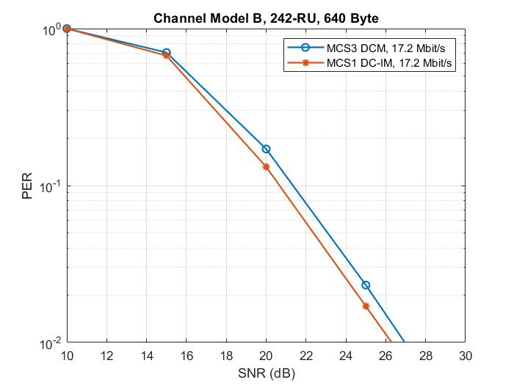
Simulation Results (Cont’d)

Slide 7
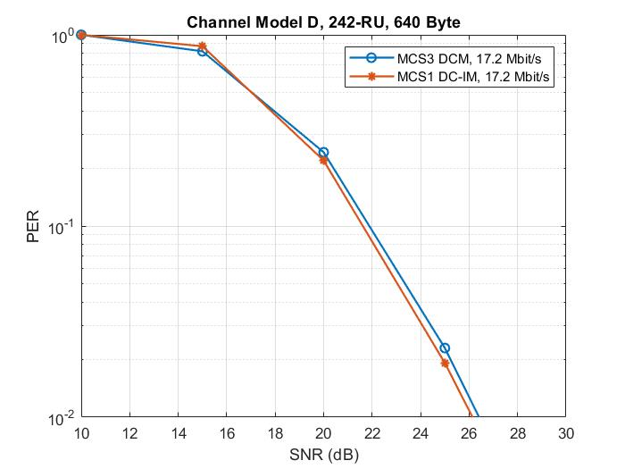
Simulation Results (Cont’d)

Slide 8
Conclusion
MCS1 DC-IM modulation scheme is proposed.

Slide 9
Straw Poll #1
Do you agree that MCS1 DC-IM for Nss=1 is a MCS in 11be?

Slide 10
References
[1] 11-20-0986r0 Jianhan et al. “DCM for range extension in 6GHz LPI”

