Slide 1
TDLS Handling in MLO
Date: 2020-10-12
Name | Affiliation | Address | Phone | Email
Abhishek Patil | Qualcomm Inc. |  |  | appatil@qti.qualcomm.com
Duncan Ho
George Cherian
Alfred Asterjadhi
Yanjun Sun

Slide 2
Problem 1
When an AP relays frames on behalf of one associated STA to another associated STA, it sets the A3 field to the SA (which is the MAC address of the initiating non-AP STA)
  In MLO, the SA would be the MLD MAC (see figure)
In TDLS, frames sent during discovery and setup are relayed thru the AP while frame exchanged after setup are directly sent between the STAs
  See appendix for details on TDLS frame type and traversal
  For frames sent directly between the STAs, the RA/TA fields would be set to the link address
    Motion 108
  For frames relayed by an MLO AP, the A3 is set to the SA which would be the MLD MAC addr of the non-AP MLD
    Therefore, there is an address mismatch during setup and direct link
    Not an issue when the STA of a non-AP MLD is associated with a legacy AP
      The STA of the non-AP MLD uses MLD MAC address (see example in appendix) - Motion 135, #SP221
A legacy STA would not make the association between MLD MAC and link MAC
  Further, it is not clear what should be the value carried in TA field when a STA of a non-AP MLD sends a TDLS Discovery Response frame (solicited or unsolicited)
MLO framework needs to provide a mechanism to preserve the legacy TDLS operation

Slide 3
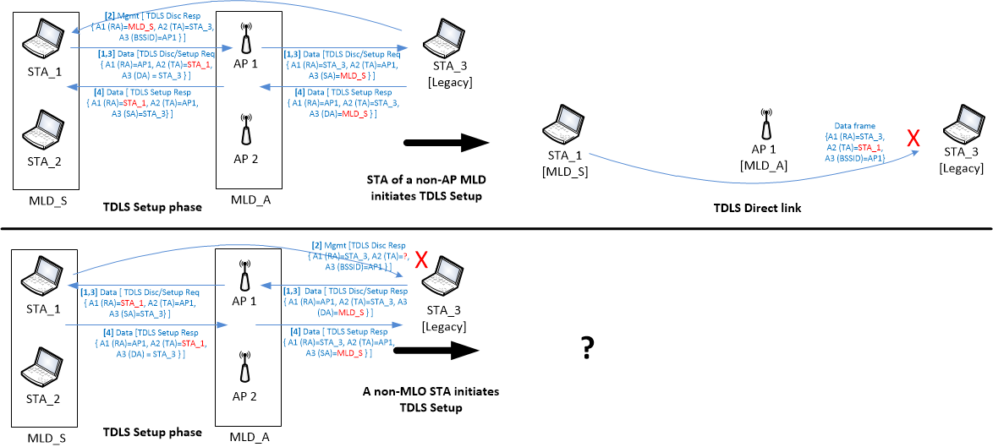
Address mismatch during TDLS setup and TDLS direct link

Slide 4
Solution
A STA of a non-AP MLD that is participating in a TDLS connection is required to do the following:
  Set the TA field to the non-AP MLD’s MAC address for frames sent directly to a TDLS peer STA
    Includes TDLS Discovery Response frame (9.6.7.16), ANQP Request/Response (GAS) frames (11.22.3.3.10) and Data frames sent on the TDLS link
  Set the TDLS initiator STA Address to the non-AP MLD MAC address in Link Identifier IE in TDLS (Discovery/Setup) Request frames
  Set the TDLS Responder STA Address to the non-AP MLD MAC address in Link Identifier IE in TDLS (Discovery/Setup) Response frames sent in response to a TDLS (Discovery/Setup) Request frame received from the TDLS peer STA
    Note: Discovery Response frame can be sent in an unsolicited
  Use the MLD MAC address during the TPK handshake
    Security key generation for TDLS session
All other STAs of the non-AP MLD shall not transmit a frame directed towards the legacy STA with which another STA of the non-AP MLD has performed TDLS setup.
  Rule is consistent with existing requirement in baseline spec (REVmd 11.20.4)
See appendix for details on Link Identifier element

Slide 5
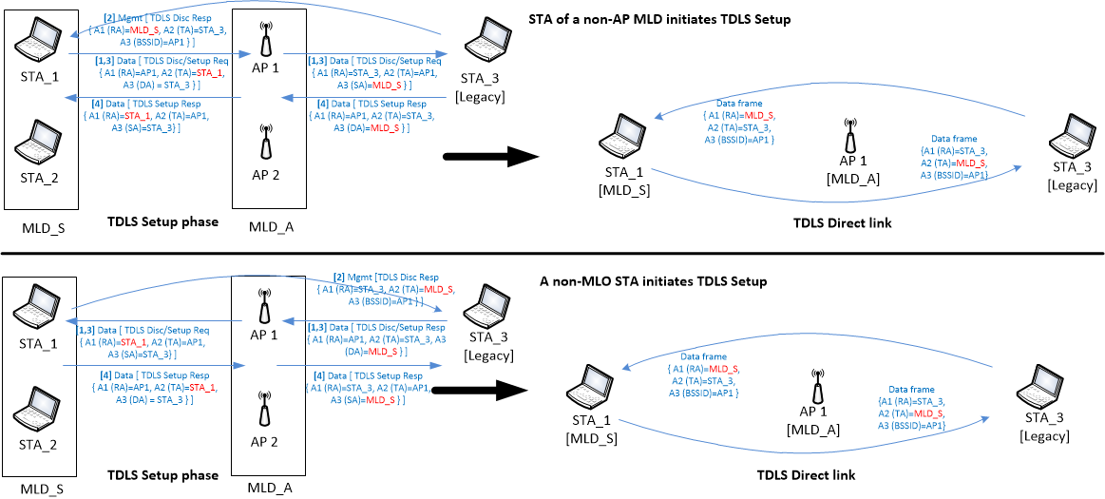
Solution

Slide 6
TDLS between MLO STAs
The rule for setting TA field would apply when TDLS is setup between two non-AP MLDs on a particular link
  BSSID field in the Link Identifier element identifies the link for which the discovery and setup is being performed
    Note: it is possible that the TDLS Discovery/Setup frames traversing the AP MLD are received on the wrong link (see appendix)
    See problem #3 and solution
To keep things simple in release 1 (R1):
  Limit scope of TDLS to single link
  Multi-link TDLS may be considered in R2 (TBD)

Slide 7
Problem 2
An n-STR non-AP MLD can’t simultaneously Tx and Rx on the two links
  E.g., non-AP MLD must be in Tx/Tx or Rx/Tx state on 5 + 6 GHz links
When a STA of an n-STR non-AP MLD has established TDLS on one of the n-STR link, the MLO framework needs to provide a mechanism to prevent Tx/Rx state between the n-STR links
  an AP of an AP MLD operating on the link which is n-STR to the TDLS link must not serve the STA of the non-AP MLD operating on that link when the TDLS link is busy

Slide 8
Solutions
Option 1 (preferred)
  Non-AP MLD requires AP to exchange (MU)RTS/CTS before any DL transmission on the link(s) that are n-STR with the TDLS link
    STA doesn’t respond to (MU)RTS if TDLS session is active
    Signaling can be via A-Control to indicate when RTS-Required is enabled or disabled
  Benefit: DL benefits from ML opportunities when TDLS session is not active
Option 2:
  Non-AP MLD enters PS mode on affected link(s) when TDLS session is active
  Limitation: Loose sync-ppdu benefit when TDLS session is active
Deafness consideration:
  In addition to managing AP’s transmissions, a Tx on the TDLS link should be considered as factor for causing deafness on the other link
    existing deaf recovery rules would apply (including receiving a frame with RA set to the link address or MLD address).

Slide 9
Problem 3
When intermediate AP is affiliated with an AP MLD, the Discovery Request frame (relayed via the AP MLD) can be received on the wrong link by the recipient MLD
  See examples in appendix
MLO framework needs to provide a mechanism to handle such cross-over of TDLS Discovery message
  Aid in the formation of TDLS on the correct link

Slide 10
Solution (to/from legacy case)
If the initiator of TDLS Discovery Request frame is a STA of an MLD and the recipient is a legacy STA, the cross-over issue won’t occur.
  AP of the AP MLD relays the request on the correct link and the legacy STA sends Discovery Response frame directly on the requested link.
  TDLS Setup Response frame sent by legacy STA (in response to TDLS Setup Request frame sent by a STA of the non-AP MLD) may be received on the wrong link
    However, BSSID field in Link Identifier element carried in the response frame would identify the correct link.
  ➔ no issue here
If the initiator of a TDLS Discovery Request frame is a legacy STA and the frame is directed towards a non-AP MLD, the cross-over issue can occur (see appendix)
  In such case, non-AP MLD can identify the requested link based on the BSSID field in the Link Identifier element and send Discovery Response frame directly to the initiator on the requested link.
  TDLS Setup Request frame sent by legacy STA may be received on the wrong link
    BSSID field in Link Identifier element carried in the request frame would identify the correct link
    TDLS Setup Response frame sent by a STA of the responding non-AP MLD would be delivered on the correct link by the AP MLD
  ➔ the desired link is identified based on BSSID field therefore no big deal

Slide 11
Solution (MLO-to-MLO case)
If both the initiator of a TDLS Discovery Request frame and the recipient are STAs affiliated with their respective MLDs, the cross-over issue can occur (see appendix)
  The recipient non-AP MLD can identify the requested link based on the BSSID field in the Link Identifier element and send the Discovery Response frame directly to the initiator on the requested link.
  The TDLS Setup Request frame sent by a STA of the initiating non-AP MLD may be received on the wrong link
    BSSID field in Link Identifier element carried in the request frame would identify the correct link
  The TDLS Setup Response frame sent by a STA of the responding non-AP MLD may be delivered on the wrong link
    BSSID field in Link Identifier element carried in the response frame would identify the correct link
  ➔ the desired link is identified based on BSSID field therefore no big deal

Slide 12
Summary
In this contribution we present a few challenges involved in setting up a TDLS link with legacy or an MLO peer.
  We provide an exception to the TA setting rule to address the address mismatch issue
  Extend baseline rules to MLO for by-passing AP MLD
  Provide guidance on managing AP MLD’s DL during an active TDLS session
  Provide rules on selecting the correct link for TDLS session

Slide 13
SP #1
Do you agree to the following for R1:
  A STA of a non-AP MLD that is participating in a TDLS connection shall do the following:
    Set the TA field to the non-AP MLD’s MAC address for frames sent directly to a TDLS peer STA
      These include TDLS Discovery Response frame (9.6.7.16), ANQP Request/Response (GAS) frames (11.22.3.3.10) and Data frames sent on TDLS link
    Set the TDLS initiator STA Address to the non-AP MLD MAC address in Link Identifier IE in TDLS (Discovery/Setup) Request frames
    Set the TDLS Responder STA Address to the non-AP MLD MAC address in Link Identifier IE in TDLS (Discovery/Setup) Response frames sent in response to a TDLS (Discovery/Setup) Request frame received from the TDLS peer STA
      Note: Discovery Response frame can be sent in an unsolicited
    Set the BSSID field in Link Identifier element to the BSSID of the AP on the desired link
    Use the MLD MAC address during the TPK handshake

Slide 14
SP #2
Do you agree to the following for R1:
  802.11be amendment shall provide a mechanism by which a non-AP MLD can request an AP MLD, to perform RTS/CTS exchange before sending DL frame(s) to a particular STA (STA1) of the non-AP MLD operating on an n-STR link
  Upon receiving such a request, an AP (AP1) of an AP MLD shall precede its DL with an RTS frame and proceed to DL frame(s) to the particular STA (STA1) of the non-AP MLD only if it receives an CTS response to its RTS
  NOTE: The signaling to require RTS/CTS exchange is TBD

Slide 15
SP #3
Do you agree to the following for R1:
  When a STA of a non-AP MLD receives a TDLS Discovery Request frame, the non-AP MLD shall identify the requested link based on the BSSID field in the Link Identifier element and shall send TDLS Discovery Response frame directly on the requested link.
  When a STA of a non-AP MLD receives a TDLS Setup Request frame, the non-AP MLD shall identify the requested link based on the BSSID field in the Link Identifier element
  When a STA of a non-AP MLD receives a TDLS Setup Response frame, the non-AP MLD shall identify the requested link based on the BSSID field in the Link Identifier element
  NOTE: the STA of the non-AP MLD that received a request or a response frame might not be operating on requested link

Slide 16
Appendix

Slide 17
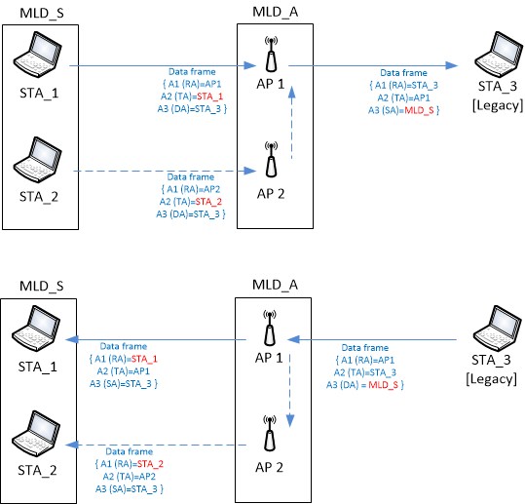
MLO AP relaying frames between MLO and non-MLO clients
BACK

Slide 18
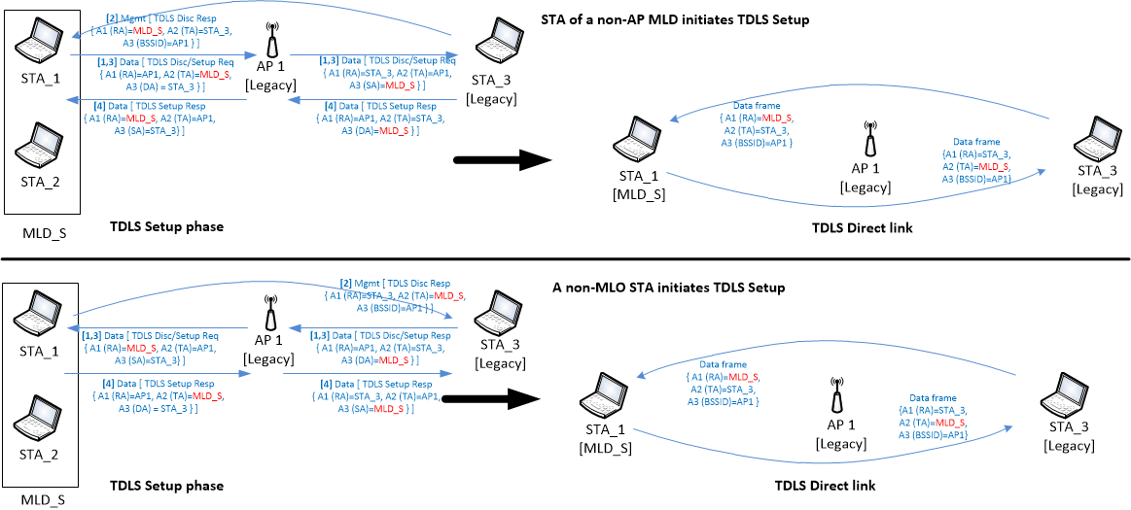
MLO client associated with legacy AP
BACK

Slide 19
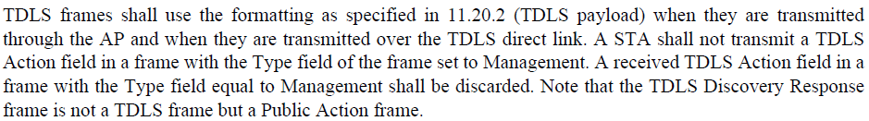
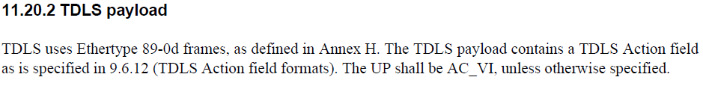
TDLS frame (types and pathway)
BACK
Frame | Via AP / Direct | Frame type | Remark
TDLS Discovery Request | Via AP | Data frame*
TDLS Discovery Response | Direct | Public Action (mgmt.) | Unsolicited allowed
TDLS Setup Request TDLS Setup Response frames TDLS Setup Confirm frames | Via AP | Data frame*
TDLS Teardown frame | Both allowed | Data frame* | Goes via AP if the peer is not in reachable
TDLS Channel Switch Request TDLS Channel Switch Response | Direct | Data frame*
TDLS Peer PSM Request TDLS Peer PSM Response | Direct | Data frame*
TDLS Peer Traffic Indication | Direct | Data frame*
* REVmd D5.0 9.6.12.1 (P1588L40)
* REVmd D5.0 11.20.1 (P2339L35)
* REVmd D5.0 11.20.2 (P2340L01)

Slide 20
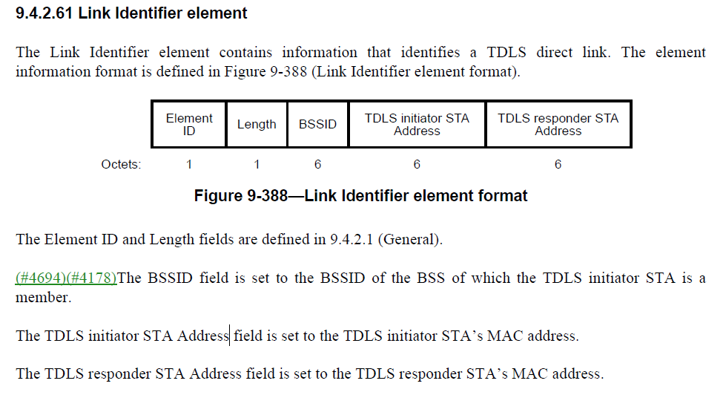
Link Identifier element
BACK

Slide 21
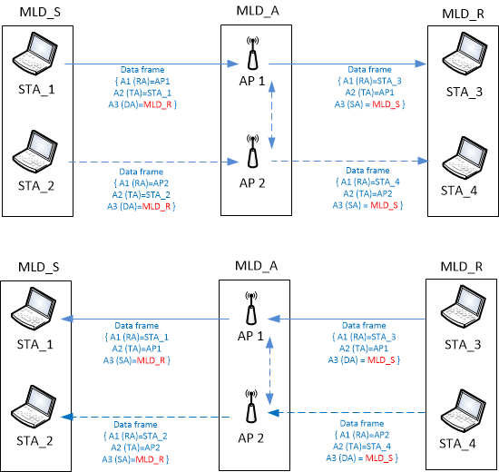
MLO AP relaying frames between two non-AP MLDs
BACK

Slide 22
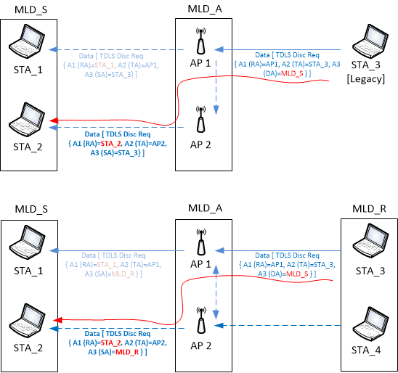
Cross over of Discovery Request when traversing an AP MLD
BACK

Slide 23
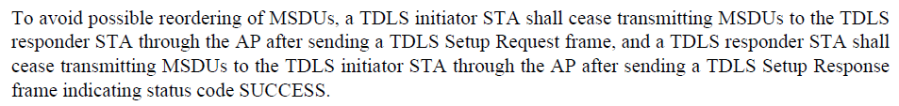
By-pass AP during active TDLS session
11.20.4:

Slide 24
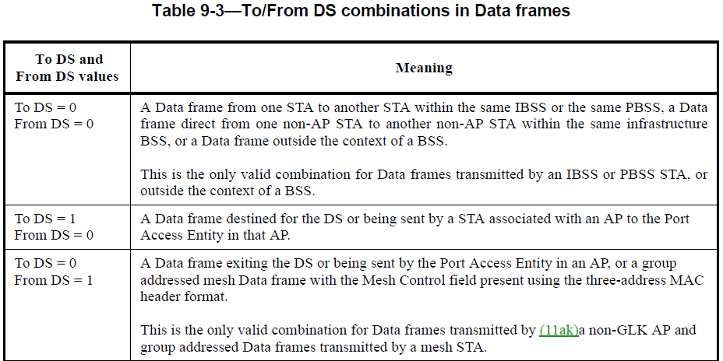
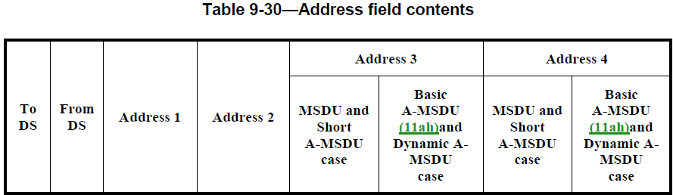
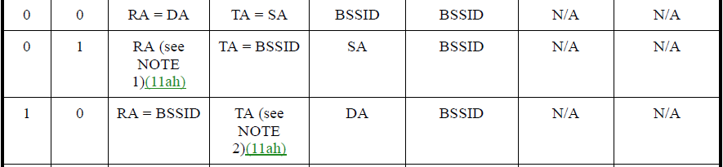

Slide 25
Related Motions
The value of the RA/TA fields sent over-the-air in the MAC header of a frame is the MAC address of the STA affiliated with the MLD corresponding to that link.
  [Motion 108, [33] and [169]]
The following applies for R1:
  For a ML transition from a legacy AP to an AP MLD, the MAC address of the non-AP STA that is associated with the legacy AP shall be used as the MLD MAC address of the non-AP MLD that is reassociated with the AP MLD.
  For a ML transition from an AP MLD to a legacy AP, the non-AP MLD MAC address of the non-AP MLD that is associated with the AP MLD shall be used as the MAC address of the non-AP STA that is reassociated with the legacy AP.
    NOTE – Tear down of previous association and have a new association is not an ML transition.
  [Motion 135, #SP221, [25] and [184]]

