Slide 1
A TXOP rule to reduce worst-case latency
Date: 2021-02-02
Authors:
Name | Affiliations | Address | Phone | email
Thomas Handte | Sony Corporation |  |  | Thomas.Handte (at) sony.com
Dana Ciochina |  |  |  | Dana.Ciochina (at) sony.com
Daniel Verenzuela |  |  |  | Daniel.Verenzuela (at) sony.com
Mohamed Abouelseoud |  |  |  | Mohamed.Abouelseoud (at) sony.com
Liangxiao Xin |  |  |  | Liangxiao.Xin (at) sony.com

Slide 2
Introduction (1/2)
Low latency service is an important application scenario for 11be
Various submissions addressed
Indication of low latency traffic [1-4]
Protected period for low latency traffic [3,5,6]
New EDCA queue [4,7]
Scheduling provision information [8,9]
QoS negotiation [1,3]
TXOP resource agreements [10]
The goal of these proposals is to reduce average and/or worst-case latency
Recent decision by TGbe to introduce R-TWT as protected period for low-latency traffic [6]
However, retransmissions may still occasionally happen, e.g., due to collisions or rate sounding
Retransmissions have large impact to worst-case latency
Goal of this submission is to provide improvements to existing technology in “missing response” case

Slide 3
Introduction (2/2)
Current behavior in missing response case depends on the position of the failed PPDU within a TXOP [11]
If the failed PPDU is the initial PPDU within a TXOP, a STA
Invokes backoff procedure with incremented CW[AC]
If the failed PPDU is a non-initial PPDU within a TXOP, a STA has the following options
Perform PIFS recovery,
Continue if CS mechanism indicates idle at TxPIFS boundary and remaining TXNAV is sufficient
Invoke backoff procedure within same TXOP with incremented CW[AC], or
Wait for TXNAV timer to expire and perform backoff with CW[AC] = CWmin[AC]
Suitability for low latency traffic
Any option that causes a STA to increment CW[AC] is harmful as it potentially provides various TXOPs to other ACs or STAs
This applies for option a), option c), or option b) if CS indicates non-idle
Option d) may be suitable if missing response occurs towards the end of a TXOP
Focus of this submission are options a), b), or c), i.e., cases when
A missing response occurs to an initial PPDU within a TXOP
A missing response occurs to a non-initial PPDU within a TXOP and the channel is detected as busy

Slide 4
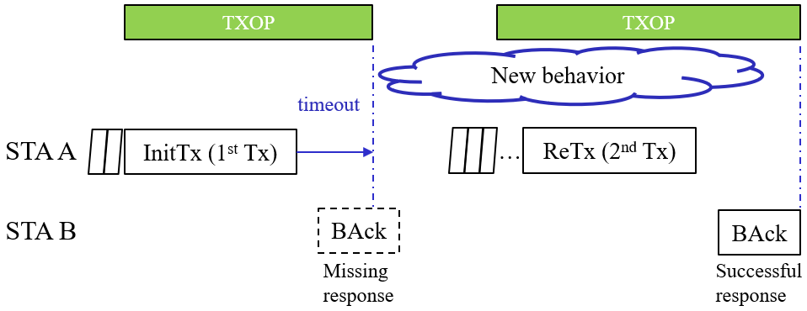
Goal of the submission
This submission provides a new rule for TXOP configuration to mitigate worst case latency
The rule is applicable for the “missing response” case under the conditions of previous slide
i.e., if a STA increments its CW[AC].
Example for a “missing response”
STA A transmits a PPDU to STA B that requires a response
A response frame is not received by STA A
STA A initiates backoff procedure and retransmits data
Definition of a new behavior of STA A in case of a “missing response”
Regular behavior applies once retransmission was successful or related MSDU lifetime is exceeded

Slide 5
Assumptions
We assume that
At least one STA has low-latency traffic and other traffic mapped to a different AC
The low-latency traffic is mapped to AC₀ which may be any high priority AC (e.g. AC_VO)
The other traffic is mapped to different AC than AC₀ (e.g. AC_VI) and has full queue
E.g., streaming data
R-TWT is in place and shrinks the number of STAs accessing the medium at same time
During TWT SP at least two STAs intend to access the channel
This may be intentionally or because STAs don’t consent with R-TWT agreement
EDCA is applied within R-TWT

Slide 6
TXOP limit shortening (1/3)
Scenario
After R-TWT SP starts STA A and STA B transmit at same time and PPDUs collide
After Ack timeout and CW increase, STAs content again to retransmit
However, AC ≠ AC₀ has smaller backoff counter and transmits first
Issue
The TXOP of the AC other than AC₀ impedes retransmission of AC₀
TXOP sharing is not applicable, because AC of other traffic has full buffer

Slide 7
TXOP limit shortening (2/3)
Solution
Shorten TXOP limit of ACs other than AC₀ after a missing response
Extent of TXOP limit shortening is TBD
Could be a function of retry counter, e.g., $TXOP_limit(AC)={TXOP_limit}_{0}\left(AC\right)⋅2^{−QSRC\left[LL_AC\right]}$ with $\text{AC}\text{≠}\text{AC}\text{0}$
Benefits
Time in between backoff count downs gets lower, hence time until retransmission lowers
AC₀ can access the channel sooner

Slide 8
TXOP limit shortening (3/3)
Applicability
TXOP limit shortening applies to all ACs except the AC in which the collision was caused (AC₀)
The extent of the TXOP limit shortening is defined in advance (e.g. by EDCA parameter element)
STAs that detect a missing response apply TXOP limit shortening
There is no signaling among STAs
A STA is supplied with different TXOP limits
One limit applies for initial transmission, whereas another limit applies for retransmission
Advantages
TXOP limit shortening is most useful if TXOP sharing can’t be applied
Traffic of low priority AC is of type full buffer, e.g. streaming data

Slide 9
Example
AP signals EDCA Parameter values to STAs
incl. new TXOP limits for retransmissions
A STA that observes a missing response in AC₀ (primary AC) applies the shortened TXOP limit for all ACs other than AC₀
Example: Collision in AC_VO
Shortened TXOP limits are: (AC_BK / AC_BE / AC_VI / AC_VO) = (1.264ms / 1.264ms / 2.048ms / 2.080ms)
AC | CWmin | CWmax | AIFSN | TXOP limit
 |  |  |  | if CW=CWmin | Otherwise
AC_BK | aCWmin | aCWmax | 7 | 2.528 ms | 1.264 ms
AC_BE | aCWmin | aCWmax | 3 | 2.528 ms | 1.264 ms
AC_VI | (aCWmin+1)/2-1 | aCWmax | 2 | 4.096 ms | 2.048 ms
AC_VO | (aCWmin+1)/4-1 | aCWmin+1/2-1 | 2 | 2.080 ms | 1.040 ms

Slide 10
Simulation (1/3)
Simulation Scenario
2 STAs transmitting uplink traffic to an AP
Both STAs have full buffer
EDCA
AIFSN=3, CWmin=15, CWmax=1023
Initial TXOP limit is 5.5ms
Minstrel rate adaption
Shortened TXOP limit is 2.8ms
STA-A follows the TXOP limit shortening, whereas STA-B does not
Analysis of the latency gain of STA-B induced by STA-A
Latency is measured without (w/o) Ack response or with (w/) Ack response
STA-A
AP
STA-B

Slide 11
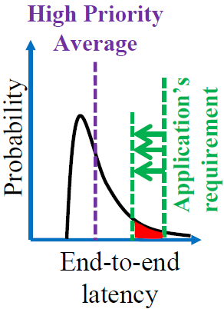
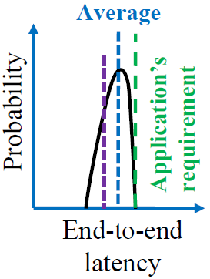
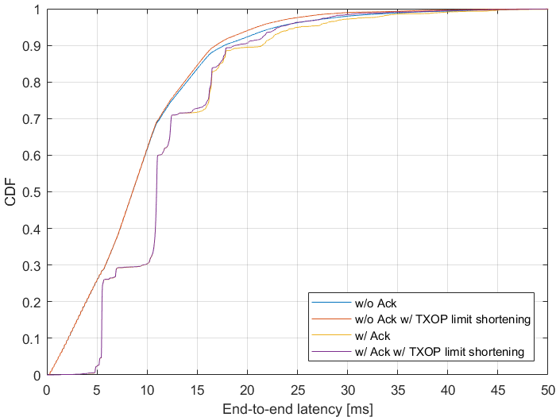
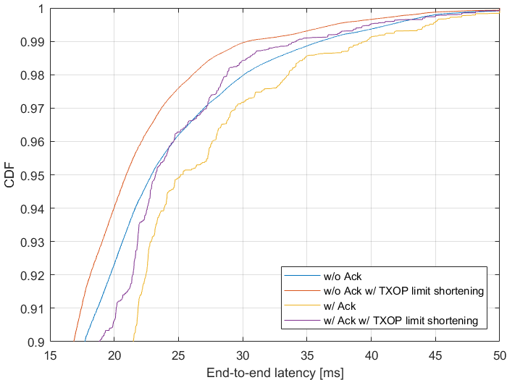
Simulation (2/3)
The proposed rule reduces worst-case latency
Difference plays out for CDF>0.9 as a missing response is a prerequisite for the TXOP rule to be applied
Reference [12]

Slide 12
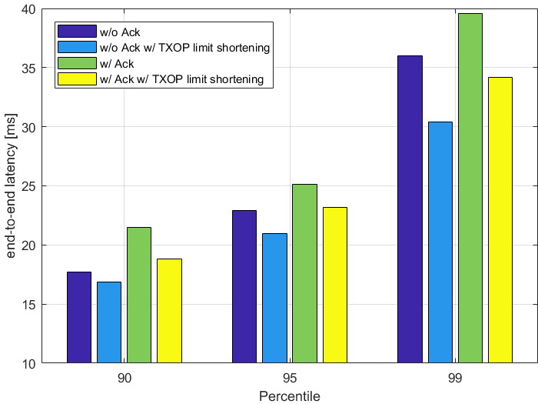
Simulation (3/3)
Gains are in the order of 0.5 to 6ms for the considered scenario
Corresponds to 2% to 16%
Actual gain depends on
How many STAs are part of the collision domain
For large collision domain triggered access or R-TWT is required
How many STAs are following the TXOP rule
TXOP limit shortening parameters
TXOP limit is divided by two in simulation
6ms
6ms
gain
2ms
2ms
1ms
3ms

Slide 13
Conclusion
TXOP rules as defined today may hinder low latency service
It is important to revisit how a TXOP is configured after a missing response
TXOP limit shortening is proposed to alleviate low latency service
After a missing response, the TXOP limit of ACs other than the one that suffered a missing response, shall be shortened
Benefits
Lower latency until successful response to retransmission
Earlier chance to retransmit
The proposed rule allows to balance throughput in favor of latency
Usage
AP signals TXOP limit shortening parameters according to traffic requirements and constraints
A STA that detects a missing response, applies the TXOP limit for shortened TXOP

Slide 14
Straw Poll #1
Do you agree to add the following to the TGbe SFD?
An AP may request STAs to shorten the TXOP limit of one or more AC₀, if
- no response frame was received for a transmitted PPDU that contained at least one MPDU soliciting an immediate response frame, and
the missing response frame caused the transmitting STA to increment CW[AC₀].
The shortened TXOP limit is applicable for all indicated ACs except AC₀.
The shortened TXOP limit is valid until no more MSDUs are pending for retransmission in AC₀ or related MSDU lifetimes expired.
Signaling is TBD
The extent of the TXOP limit shortening is TBD

Slide 15
References
[1] 11-20/418r4 Low latency service in 802.11be
[2] 11-20/463r3 Priority Access Support Options for NS/EP Serveices
[3] 11-20/163r1 Low Latency Enhancements for R1
[4] 11-19/1175r0 Channel Access Category
[5] 11-20/1350r0 Enhancements for QoS and low latency in 802.11be R1
[6] 11-20/1046r12 Protected TWT Enhancement for Latency Sensitive Traffic
[7] 11-20/1041r2 EDCA queue for RTA
[8] 11-20/1006r1 New Methods To Meet Low Latency Requirement
[9] 11-20/1076r0 Traffic indication of latency sensitive applications
[10] 11-20/1670r0 Low Latency resource agreements
[11] Draft P802.11REVmd_D5.0
[12] 11-19/1298r1 IEEE 802.1 TSN – An Introduction

