Slide 1
TXOP rules to reduce worst-case latency
Date: 2020-12-18
Authors:
Name | Affiliations | Address | Phone | email
Thomas Handte | Sony Corporation |  |  | Thomas.Handte (at) sony.com
Dana Ciochina |  |  |  | Dana.Ciochina (at) sony.com
Daniel Verenzuela |  |  |  | Daniel.Verenzuela (at) sony.com
Mohamed Abouelseoud |  |  |  | Mohamed.Abouelseoud (at) sony.com
Liangxiao Xin |  |  |  | Liangxiao.Xin (at) sony.com

Slide 2
Introduction (1/2)
Low latency service is an important application scenario for 11be
Various submissions addressed
Indication of low latency traffic [1-4]
Protected period for low latency traffic [3,5,6]
New EDCA queue [4,7]
Scheduling provision information [8,9]
QoS negotiation [1,3]
TXOP resource agreements [10]
The goal of these proposals is to reduce average and/or worst-case latency
Some target to limit retransmissions by e.g. protected period
However, retransmissions may still occasionally happen e.g. due to collisions
Retransmissions have large impact to worst-case latency
Goal of this submission is to provide improvements to existing technology in “missing response” case

Slide 3
Introduction (2/2)
Current behavior in missing response case depends on the position of the failed PPDU within a TXOP [11]
If the failed PPDU is the initial PPDU within a TXOP, a STA
Invokes backoff procedure with incremented CW[AC]
If the failed PPDU is a non-initial PPDU within a TXOP, a STA has the following options
Perform PIFS recovery,
Continue if CS mechanism indicates idle at TxPIFS boundary and remaining TXNAV is sufficient
Invoke backoff procedure within same TXOP with incremented CW[AC], or
Wait for TXNAV timer to expire and perform backoff with CW[AC] = CWmin[AC]
Suitability for low latency traffic
Any option that causes a STA to increment CW[AC] is harmful as it potentially provides various TXOPs to other ACs or STAs
This applies for option a), option c), or option b) if CS mechanism indicates non-idle
Option d) may be suitable if missing response occurs towards the end of a TXOP
Focus of this submission are options a), b), or c), i.e. the cases when
A missing response occurs to an initial PPDU within a TXOP
A missing response occurs to a non-initial PPDU within a TXOP and the channel is detected as busy

Slide 4
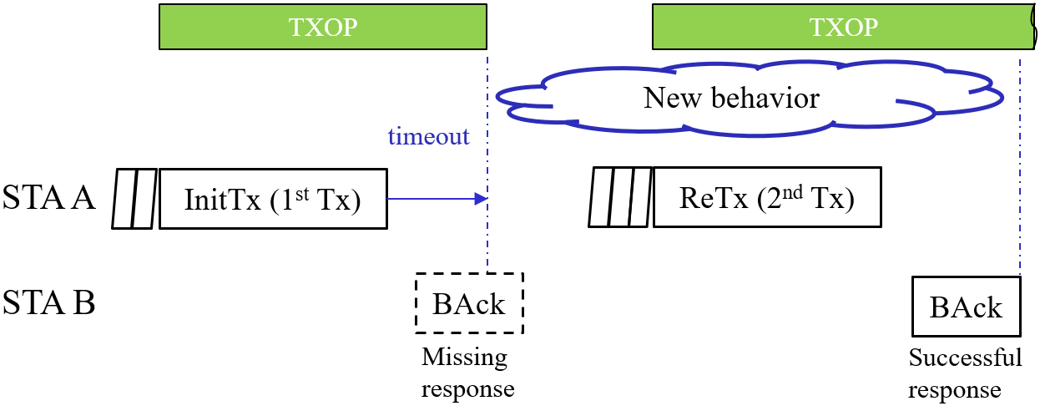
Goal of the submission
This submission provides new rules for TXOP configuration to mitigate worst case latency
The rules are applicable for the “missing response” case under the conditions of previous slide
i.e. if a STA increments its CW[AC].
Example for a “missing response”
STA A transmits a PPDU to STA B that requires a response
A response frame is not received by STA A
STA A initiates backoff procedure and retransmits data
Definition of a new behavior of STA A in case of a “missing response”
Regular behavior applies once retransmission was successful or related MSDU lifetime is exceeded

Slide 5
TXOP content restriction (1/3)
Scenario
PPDUs of two STAs collide
Issue
Once a new TXOP is obtained by a STA, it may hold not only retransmitted data but also other data e.g. from same or different TID to exploit TXOP
TXOP exploitation is favorable to maximize throughput, but causes latency to collision opponent
Duration of other data frame exchange adds to retry latency of collision opponent

Slide 6
TXOP content restriction (2/3)
Solution
Restrict content of a TXOP after a missing response
After a missing response, a TXOP shall contain no more than
retransmitted data and data of previously announced TIDs (e.g. same TID)
Benefits
Allows collision opponent (STA C) to access medium sooner

Slide 7
TXOP content restriction (3/3)
Applicability
TXOP content restriction applies to the AC in which the collided data units reside
Advantages
If colliding ACs are same
Content restriction prioritizes frames of an AC which are pending for retransmission across a BSS
Particularly important if multiple TIDs are mapped to same AC
If colliding ACs are different
Content restriction alleviates impact of a low priority AC transmitting before high priority AC
Example
AC_VI transmits before AC_VO with a probability of ~0.25 (assuming default EDCA parameter set [11])
Without TXOP content restriction, AC_VI may exploit its TXOP limit by adding further data
This causes latency to AC_VO traffic
Note that by default low priority ACs have typ. longer TXOP limit than high priority ACs [11]

Slide 8
TXOP shortening (1/3)
Scenario
Each STA has low-latency traffic and other traffic mapped to different ACs
Assume LL_AC to be any AC that contains low-latency traffic to be retransmitted
Assume that the AC that contains other traffic has full queue
Issue
The TXOP of the AC other than LL_AC impedes retransmission within LL_AC
TXOP sharing is not applicable, because AC of other traffic has non-empty queue

Slide 9
TXOP shortening (2/3)
Solution
Reduce TXOP limit of ACs other than LL_AC after a missing response
Extent of shortening is TBD
Could be a function of retry counter, e.g. $TXOP_limit(AC)={TXOP_limit}_{0}\left(AC\right)⋅2^{−QSRC\left[LL_AC\right]}$ with $\text{AC}\text{≠}\text{LL}\text{_}\text{AC}$
i.e. TXOP limits are halved with every retransmission
Benefits
Time in between CW count downs gets lower, hence time until retransmission lowers
Thus, the LL_AC gets channel access sooner

Slide 10
TXOP shortening (3/3)
Applicability
TXOP shortening applies to all ACs except the AC in which the collision was caused
The extent of the TXOP shortening is defined in advance (e.g. by signaling)
Only STAs that detect a missing response apply TXOP shortening
Advantages
TXOP shortening is most useful if TXOP sharing can’t be applied
Traffic of low priority AC is of type full buffer, e.g. streaming data

Slide 11
Usage of the proposed rules
The proposed rules allow to balance between throughput and latency
TXOP utilization reduces; hence throughput lowers due to more fragmented channel access
However, latency improves in the critical situation of a “missing response”
There are two sources of the latency gain
Self-induced, i.e. a STA that applies the proposed TXOP rules has a latency advantage
For example, a STA may transmit earlier because it applies TXOP shortening
Induced by other STAs, i.e. a STA has a latency advantage because another STA applies the proposed TXOP rules
For example, a STA may transmit earlier because another STA applied TXOP content restriction
Need for signaling
AP signals the appropriate TXOP rules to ensure that the latency gain induced by other STAs is present
Similar as TXOP limit of current spec [11]
Detailed signaling TBD
Could be part of EDCA parameter element, ADDTS request/response, or scheduling session [8,9]
Impact of legacy STAs
AP may control legacy STAs via different TXOP limit
Any throughput disadvantage compared to legacy STA may be balanced with lower TXOP limit

Slide 12
Simulation (1/3)
Simulation Scenario
2 STAs transmitting uplink traffic to an AP
Both STAs have full buffer
EDCA
AIFSN=3, CWmin=15, CWmax=1023
Initial max TXOP duration is 5.5ms
Minstrel rate adaption
Shortened max TXOP duration is 2.8ms
STA-A follows the TXOP rules, whereas STA-B does not
Analysis of the latency gain of STA-B induced by STA-A for a latency metric measured without (w/o) Ack response or with (w/) Ack response
STA-A
AP
STA-B

Slide 13
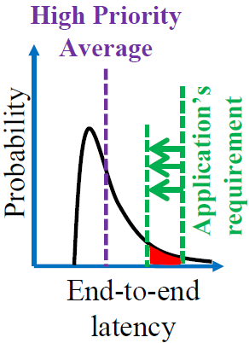
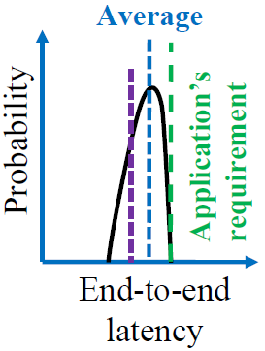
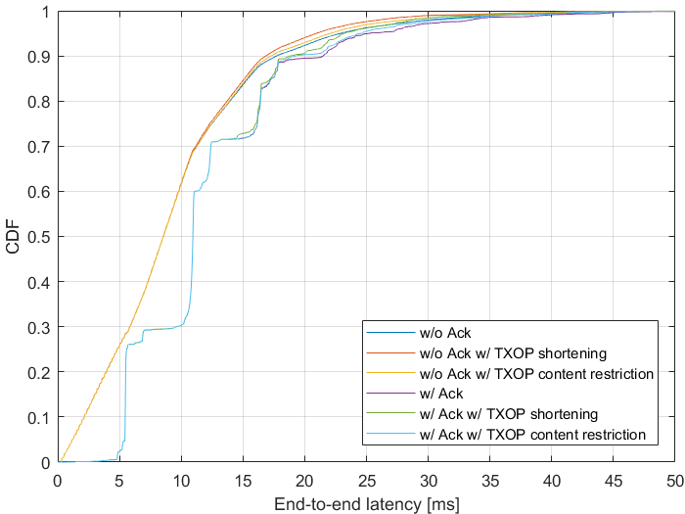
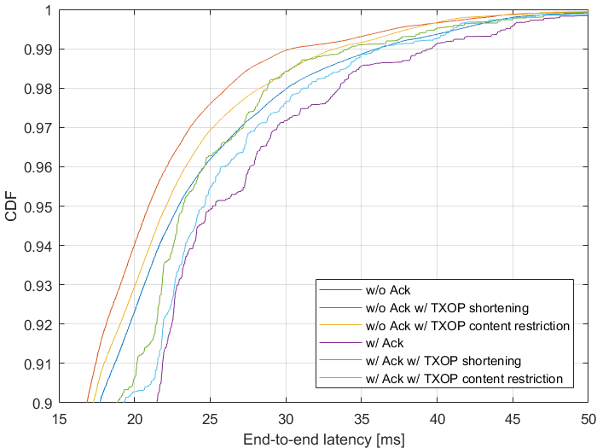
Simulation (2/3)
Proposed rules reduce worst-case latency
Difference plays out for CDF>0.9 as a missing response is a prerequisite for the TXOP rule to be applied
Reference [12]

Slide 14
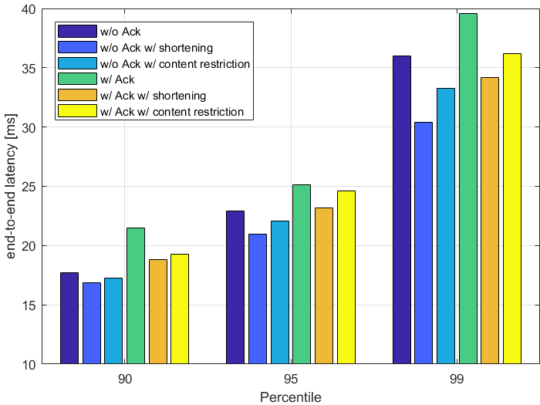
Simulation (3/3)
Gains are the order of 0.5 to 6ms for the considered scenario
Corresponds to 2% to 16%
Tendency is that TXOP content restriction achieves smaller gain than TXOP shortening
The retransmission goes into two TXOPs, because rate adaption lowers MCS
First TXOP has unchanged size but only the second is shortened. The likelihood that a TXOP of the considered STA with retrans- mitted data comes after the second TXOP is small.
With TXOP shortening, all TXOPs are shortened, increasing the likelihood that a TXOP of the considered STA comes after at least one shortened TXOP.
Actual gain depends on
How many STAs are part of the collision domain
For large collision domain triggered access or TWT is favorable
How many STAs are following the new TXOP rules
TXOP shortening parameters (here length is halved)
gain
3-6ms
3.5-6ms
1-2ms
1-2ms
2.5-3ms
0.5-1ms

Slide 15
Conclusion
TXOP rules as defined today may hinder low latency service
It is important to revisit how a TXOP is configured after a missing response
Two rules for TXOP are proposed that alleviate low latency service
TXOP content restriction
After a missing response, the TXOP that contains the retransmitted data shall contain no more than the data to be retransmitted, except data from announced TIDs
TXOP shortening
After a missing response, the maximum TXOP duration of ACs other than the one that suffered a missing response, shall be shortened
Benefits
Lower latency until successful response to retransmission
Earlier chance to retransmit in collision case
Both rules allow to balance throughput in favor of latency
Usage
AP signals appropriate settings according to traffic requirements and constraints

Slide 16
Straw Poll #1
Do you agree to add the following to the TGbe SFD?
An AP may request a STA to restrict the content of a TXOP of AC₀ to contain only MPDUs with retry subfield set to 1, MPDUs of indicated TIDs, and any required acknowledgements, if
no response frame was received for a transmitted PPDU that contained at least one MPDU soliciting an immediate response frame, and
the missing response frame caused the transmitting STA to increment CW[AC₀].
The restriction is valid until no more MPDUs in AC₀ are pending for retransmission or related MSDU lifetime is exceeded.

Slide 17
Straw Poll #2
Do you agree to add the following to the TGbe SFD?
An AP may request a STA to shorten the maximum TXOP duration of one or more AC₀, if
- no response frame was received for a transmitted PPDU that contained at least one MPDU soliciting an immediate response frame, and
the missing response frame caused the transmitting STA to increment CW[AC₀].
The shortened maximum TXOP duration is applicable for all indicated ACs except AC₀.
The shortened maximum TXOP duration is valid until no more MSDUs are pending for retransmission in AC₀ or related MSDU lifetimes are exceeded.
Extent of the TXOP shortening is TBD

Slide 18
References
[1] 11-20/418r4 Low latency service in 802.11be
[2] 11-20/463r3 Priority Access Support Options for NS/EP Serveices
[3] 11-20/163r1 Low Latency Enhancements for R1
[4] 11-19/1175r0 Channel Access Category
[5] 11-20/1350r0 Enhancements for QoS and low latency in 802.11be R1
[6] 11-20/1046r4 Protected TWT Enhancement for Latency Sensitive Traffic
[7] 11-20/1041r2 EDCA queue for RTA
[8] 11-20/1006r1 New Methods To Meet Low Latency Requirement
[9] 11-20/1076r0 Traffic indication of latency sensitive applications
[10] 11-20/1670r0 Low Latency resource agreements
[11] Draft P802.11REVmd_D4.0
[12] 11-19/1298r1 IEEE 802.1 TSN – An Introduction

