Slide 1
TXOP rules to reduce worst-case latency
Date: 2020-10-23
Authors:
Name | Affiliations | Address | Phone | email
Thomas Handte | Sony Corporation |  |  | Thomas.Handte (at) sony.com
Dana Ciochina |  |  |  | Dana.Ciochina (at) sony.com
Daniel Verenzuela |  |  |  | Daniel.Verenzuela (at) sony.com
Mohamed Abouelseoud |  |  |  | Mohamed.Abouelseoud (at) sony.com
Liangxiao Xin |  |  |  | Liangxiao.Xin (at) sony.com

Slide 2
Introduction (1/2)
Low latency service is an important application scenario for 11be
Various submissions addressed
Indication of low latency traffic [1-4]
Protected period for low latency traffic [3,5,6]
New EDCA queue [4,7]
Scheduling provision information [8,9]
QoS negotiation [1,3]
TXOP resource agreements [10]
The goal of these proposals is to reduce average and/or worst-case latency
Some target to limit retransmissions by e.g. protected period
However, retransmissions may still occasionally happen e.g. due to collisions or rate sounding
Retransmissions have large impact to worst-case latency
Goal of this submission is to provide improvements to existing technology in “missing response” case

Slide 3
Introduction (2/2)
Current behavior in missing response case depends on the position of the failed PPDU within a TXOP [11]
If the failed PPDU is the initial PPDU within a TXOP, a STA
Invokes backoff procedure with incremented CW[AC]
If the failed PPDU is a non-initial PPDU within a TXOP, a STA has the following options
Perform PIFS recovery,
Continue if CS mechanism indicates idle at TxPIFS boundary and remaining TXNAV is sufficient
Invoke backoff procedure within same TXOP with incremented CW[AC], or
Wait for TXNAV timer to expire and perform backoff with CW[AC] = CWmin[AC]
Suitability for low latency traffic
Anything that causes a STA to increment CW[AC] is harmful as it potentially provides various TXOPs to other ACs or STAs
This applies for option a), option c), or option b) if CS mechanism indicates non-idle
Option d) may be suitable if missing response occurs towards the end of a TXOP
Focus of this submission are options a), b), or c), i.e. the cases when
A missing response occurs to an initial PPDU within a TXOP
A missing response occurs to a non-initial PPDU within a TXOP and the channel is detected as busy

Slide 4
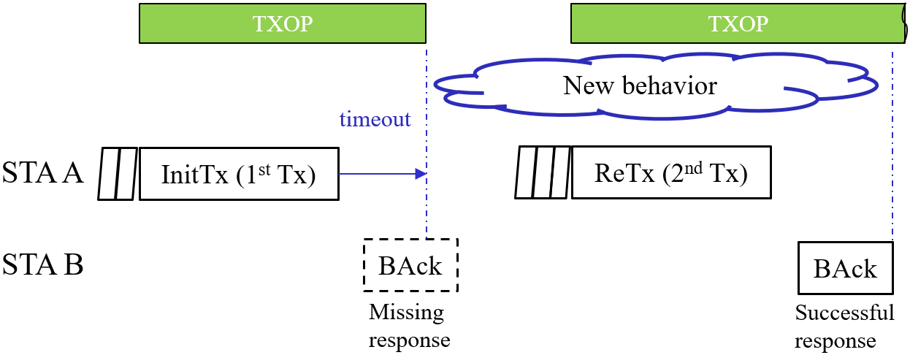
Goal of the submission
This submission provides new rules for TXOP configuration to mitigate worst case latency
The rules are applicable for the “missing response” case under the conditions of previous slide
i.e. if a STA increments its CW[AC].
Example for a “missing response”
STA A transmits a PPDU to STA B that requires a response
A response frame is not received by STA A
STA A initiates backoff procedure and retransmits data
Definition of a new behavior of STA A in case of a “missing response”
The new behavior is applicable for
the AC in which the collision was caused, or
all ACs except the AC in which the collision was caused
Regular behavior applies once retransmission was successful or related MSDU lifetime is exceeded

Slide 5
TXOP content restriction (1/2)
Issue
Once a new TXOP is obtained by STA A, it may hold not only retransmitted data but also other data e.g. from same or other TID
This behavior is favorable to maximize throughput, but causes latency
Latency is caused to
STA A’s own link, if latency is measured until BAck is received
Other links if a collision was the reason for the backoff
Example

Slide 6
TXOP content restriction (2/2)
Solution
Restrict content of a TXOP after a missing response
Two options for a TXOP to contain no more than
retransmitted data
retransmitted data and data of previously agreed TIDs (e.g. same TID) if available
Benefits
Avoids delay until a response is received
Allows other STA to access medium sooner in case of a collision
Example

Slide 7
TXOP shortening (1/2)
Scenario
A STA has low-latency traffic and best-effort traffic mapped to different ACs, e.g. AC_VO and AC_BE
Issue
The TXOP of other ACs impedes retransmission in a missing response case
Assume LL_AC to be any AC that contains data to be retransmitted, e.g. of a low latency TID
If an AC other than LL_AC is first to transmit and has a full queue, its TXOP impedes retransmission
Note that TXOP sharing is not applicable because primary AC has non-empty queue

Slide 8
TXOP shortening (2/2)
Solution
Reduce TXOP limit of ACs other than LL_AC in case LL_AC holds data to be retransmitted
Extent of shortening is TBD
Could be a function of retry counter, e.g. $TXOP_limit(AC)={TXOP_limit}_{0}\left(AC\right)⋅2^{−QSRC\left[LL_AC\right]}$ with $\text{AC}\text{≠}\text{LL}\text{_}\text{AC}$
i.e. TXOP limits is halved with every retransmission
Benefits
Time in between CW count downs gets lower, hence time until retransmission lowers
Allows the LL_AC to get channel access sooner

Slide 9
Effect of the proposed rules (1/2)
The proposed rules allow to balance between throughput and latency
TXOP utilization reduces; hence throughput lowers due to more fragmented channel access
However, latency improves in the critical situation of a “missing response”
There are two sources of the latency gain
Self-induced, i.e. a STA that applies the TXOP rules has a latency advantage
E.g. BAck arrives earlier or can retransmit earlier
Induced by other STAs, i.e. a particular STA can transmit earlier because another STA applies the TXOP rules
E.g. earlier chance to retransmit after a collision

Slide 10
Effect of the proposed rules (2/2)
Sometimes behavior of some STAs can not be influenced, e.g. legacy STA or OBSS STA
The self-induced latency gain is still present, but what is the impact of STAs not following the proposed TXOP rules?
Analysis of two scenarios
Scenario A
STA-A and STA-B apply the proposed TXOP rules
STA-A and STA-B are missing a response from their peer STAs due to a collision
Performance of each STA is given in comparison to both STAs using current TXOP rules
Scenario B
As Scenario A, but STA-A uses existing TXOP rules (e.g. legacy STA), STA-B applies the proposed TXOP rules
Scenario A
Scenario B
 | Latency | TXOP utilization
STA-A | Advantage | Reduced for traffic not related to retransmission
STA-B | Advantage | Reduced for traffic not related to retransmission
 | Latency | TXOP utilization
STA-A | Advantage | Unchanged
STA-B | Unchanged | Reduced for traffic not related to retransmission
In scenario B, the disadvantage of STA-B may be balanced by setting different TXOP limit for (legacy) STA-A

Slide 11
Simulation (1/3)
Simulation Scenario
2 STAs transmitting uplink traffic to an AP
Both STAs have full buffer
EDCA
AIFSN=3, CWmin=15, CWmax=1023
Initial max TXOP duration is 5.5ms
Minstrel rate adaption
Shortened max TXOP duration is 2.8ms
STA-A follows the TXOP rules, whereas STA-B does not
Analysis of the latency gain of STA-B induced by STA-A for a latency metric measured without (w/o) Ack response or with (w/) Ack response
STA-A
AP
STA-B

Slide 12
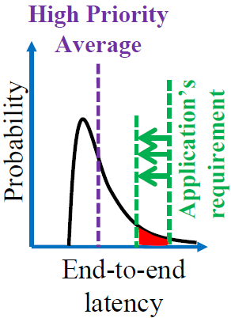
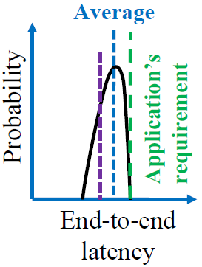
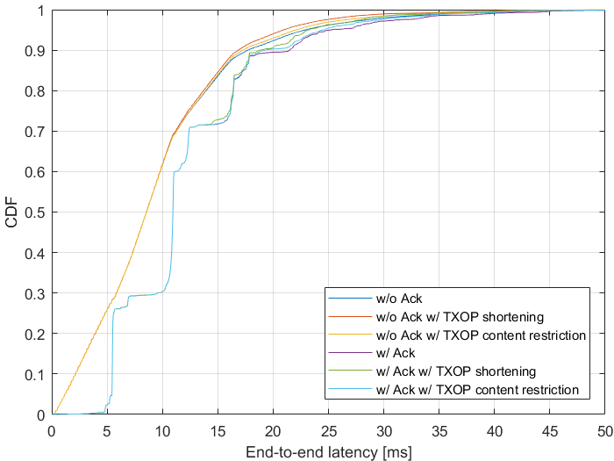
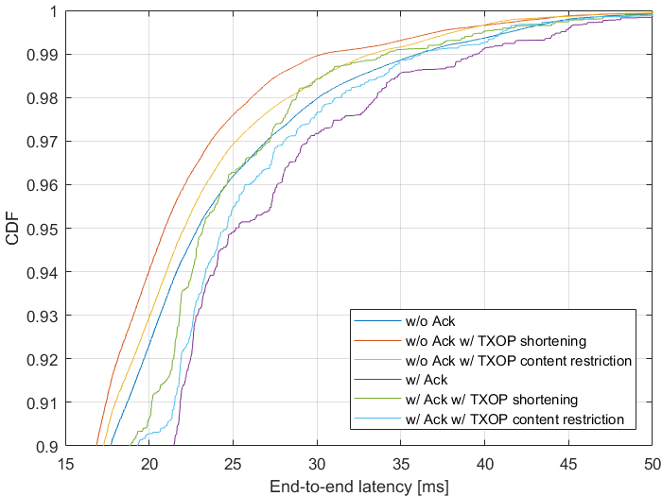
Simulation (2/3)
Proposed rules reduce worst-case latency
Difference plays out for CDF>0.9 as a missing response is a prerequisite for the TXOP rule to be applied
Reference [12]

Slide 13
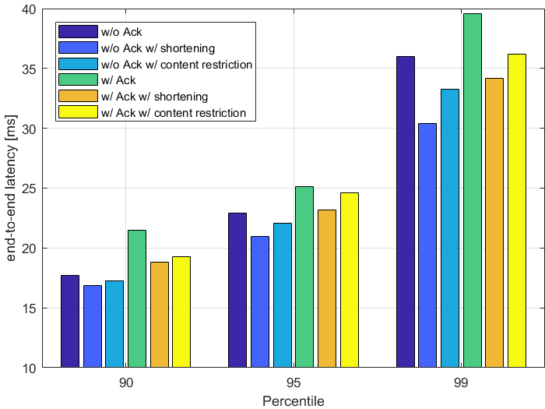
Simulation (3/3)
Gains are the order of 0.5 to 6ms for the considered scenario
Corresponds to 2% to 16%
Tendency is that TXOP content restriction achieves smaller gain than TXOP shortening
The retransmission goes into two TXOPs, because rate adaption lowers MCS
First TXOP has unchanged size but only the second is shortened. The likelihood that a TXOP of the considered STA with retrans- mitted data comes after the second TXOP is small.
With TXOP shortening, all TXOPs are shortened, increasing the likelihood that a TXOP of the considered STA comes after at least one shortened TXOP.
Gain certainly depends on
How many STAs are part of the collision domain
For large collision domain triggered access or TWT is favorable
How many STAs are following the new TXOP rules
TXOP shortening parameters (here length is halved)
gain
3-6ms
3.5-6ms
1-2ms
1-2ms
2.5-3ms
0.5-1ms

Slide 14
Applicability
The effectiveness of the proposed rules depends on traffic type, applied ACs, environment, and overall traffic load
Applicability of the proposed TXOP rules should be adjustable to requirements and constraints
Legacy STA can be controlled by setting a different (lower) TXOP limit
AP or STA may negotiate with its peer the applicability for its traffic streams among other parameters
The negotiation may be part of low-latency or RTA session initiation
Negotiation/ signaling is TBD
ADDTS request/response or scheduling session [8,9] could be reused
A bitmap could be envisioned to indicate applicability of each rule
Applicability should be made TID or AC specific (TBD)

Slide 15
Conclusion
TXOP rules as defined today may hinder low latency service
It is important to revisit how a TXOP is configured after a missing response
We propose two rules for TXOP that alleviate low latency service
TXOP content restriction
After a missing response, the TXOP that contains the retransmitted data shall contain no more than the data to be retransmitted, except data from agreed TIDs
TXOP shortening
After a missing response, the maximum TXOP duration of ACs other than the one that suffered a missing response, shall be shortened
Benefits
Lower latency until successful response to retransmission
Earlier chance to retransmit in collision case
Both rules allow to balance throughput in favor of latency
Applicability
AP and STA may negotiate appropriate settings according to requirements and constraints

Slide 16
Straw Poll #1
Do you agree to add the following to the TGbe SFD?
An AP may request a STA for a TID mapped to any AC₀ to restrict the content of a TXOP of AC₀ to contain only MPDUs with retry subfield set to 1 and any required acknowledgements, if
no response frame was received for a transmitted PPDU that contained at least one MPDU soliciting an immediate response frame, and
the missing response frame caused the transmitting STA to increment CW[AC₀].
The restriction is valid until no more MPDUs are pending for retransmission for the requested TID within AC₀ or related MSDU lifetime is exceeded.

Slide 17
Straw Poll #2
Do you agree to add the following to the TGbe SFD?
An AP may request a STA to shorten the maximum TXOP duration of one or more ACs, if
- no response frame was received for a transmitted PPDU that contained at least one MPDU soliciting an immediate response frame, and
the missing response frame caused the transmitting STA to increment CW[AC₀].
The shortened maximum TXOP duration is applicable for all agreed ACs except AC₀.
The shortened maximum TXOP duration is valid until no more MPDUs are pending for retransmission in AC₀ or related MSDU lifetime is exceeded.
Extent of the TXOP shortening is TBD
If this rule is applicable for all TIDs mapped to AC₀ is TBD

Slide 18
References
[1] 11-20/418r4 Low latency service in 802.11be
[2] 11-20/463r3 Priority Access Support Options for NS/EP Serveices
[3] 11-20/163r1 Low Latency Enhancements for R1
[4] 11-19/1175r0 Channel Access Category
[5] 11-20/1350r0 Enhancements for QoS and low latency in 802.11be R1
[6] 11-20/1046r4 Protected TWT Enhancement for Latency Sensitive Traffic
[7] 11-20/1041r2 EDCA queue for RTA
[8] 11-20/1006r1 New Methods To Meet Low Latency Requirement
[9] 11-20/1076r0 Traffic indication of latency sensitive applications
[10] 11-20/1670r0 Low Latency resource agreements
[11] Draft P802.11REVmd_D4.0
[12] 11-19/1298r1 IEEE 802.1 TSN – An Introduction

