Slide 1
BSR Fast Report in BA Frame
Date: 2020-10-21
Authors:
Name | Affiliation | Address | Phone | Email
Jerry Liu | Huawei |  |  | jianfei.liu@huawei.com
Jindou Chen
Tony Zeng

Slide 2
Introduction
Recap1: Two fields were defined in 11ax for reporting queue size by using Queue Size field in QoS Data and BSR A-Control. [1]
Recap2: STAs can implicitly report their buffer size in BSR frame or AP can explicitly solicit BSR information in BSRP frames. [2]
In this contribution, we introduce a efficiency method for STA to indicate its traffic status.

Slide 3
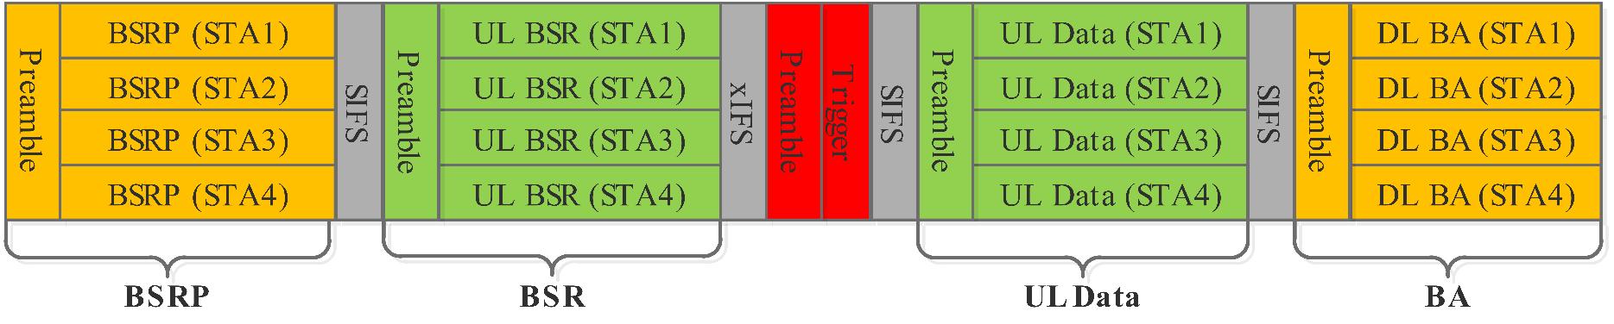
Background
In 802.11ax, AP can explicitly solicit particular BSR information in BSR frames and STAs can report their BSR in UL TB PPDU. This Request-Grant mechanism will increase the latency and overhead due to the frame exchange procedure.
STAs can implicitly report their BS information in BSR contained in A-Control field or QoS Control field, when STAs acquire the uplink transmission TXOP. This is determined by the STAs.

Slide 4
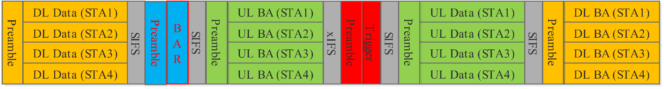
Block ACK
Wi-Fi supports ACK or Block ACK (BA) mechanism to acknowledge the received data. For immediate BA, the AP/STA will receive the BA after sending the data.
After SIFS time of data frame, BA is transmitted by STAs in uplink TB PPDU. The ACK increases the uplink transmission TXOP. We can make use of this uplink TXOP.

Slide 5
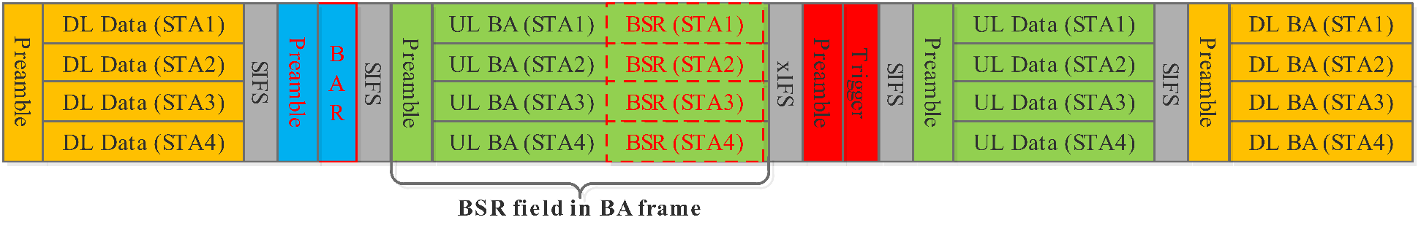
Fast BSR Report in BA frame 1/2
Fast BSR indication within immediate BA frames, this method can increase the chance of STAs’ BSR report. Additionally, the BSRP frame exchange procedure is not required.
Example:
  AP sends MU-PPDU to 4 STAs (STA1-STA4), after BAR transmission, 4 STAs response a BA with STA’s BSR in TB PPDU.
  After AP gets the BSR information from STA, it can start uplink scheduling based on the BSR information.

Slide 6
Fast BSR Report in BA frame 1/2
Two options can be considered:
Option 1: The BSR frame is transmitted in A-MPDU with BA.
Option 2: Define a new BAR and BA frame type, and add a BSR field in BA frame.
Overhead of Option 1 is bigger than Option 2. In this contribution, we recommend Option 2.

Slide 7
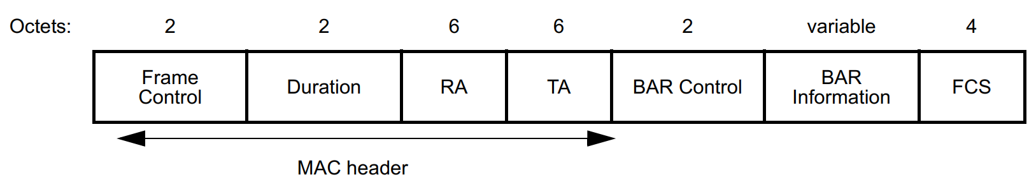
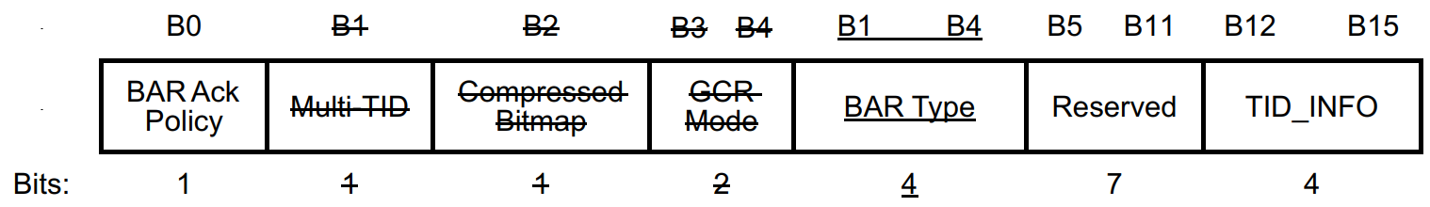
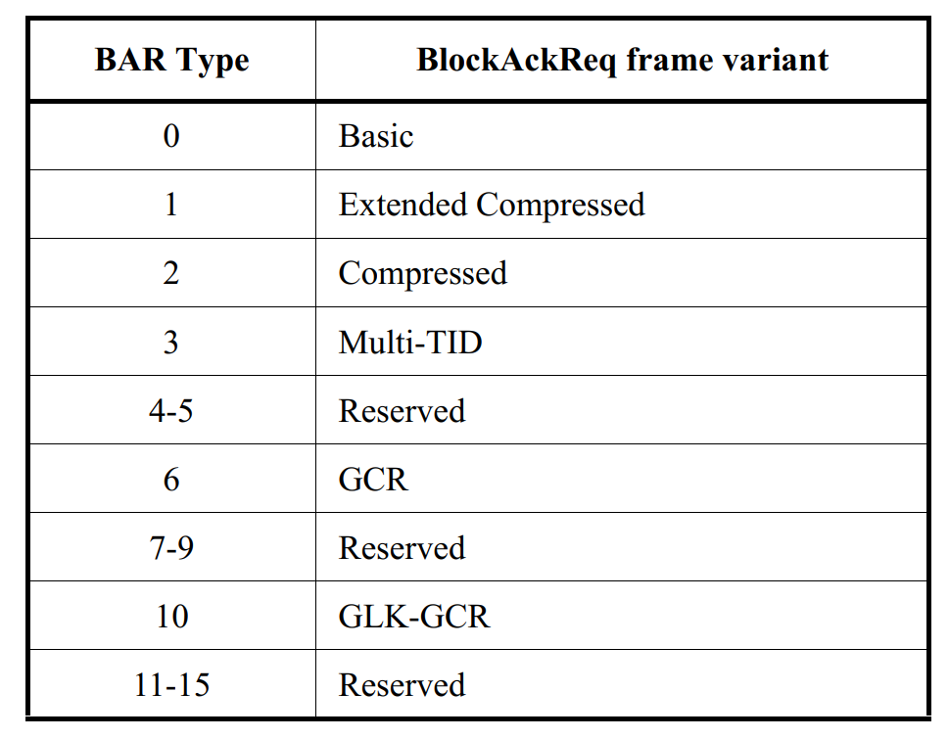
Fast BSR Report in BA frame 1/2
BSR-BAR frame format: introduce this frame to request the BSR-BA frame. BAR type 11 is defined as BSR-BAR variant.
BAR type | BlockAckReq frame variant
0 | Basic
… | …
10 | GLK-GCR
11 | BSR-BAR
12-15 | Reserved

Slide 8
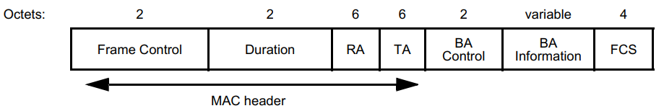
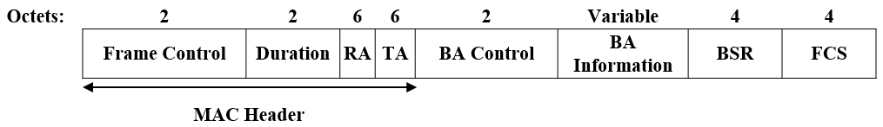
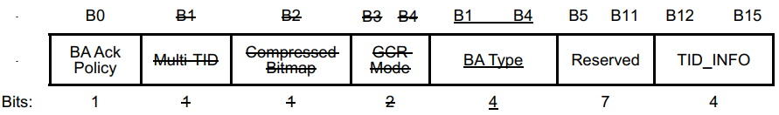
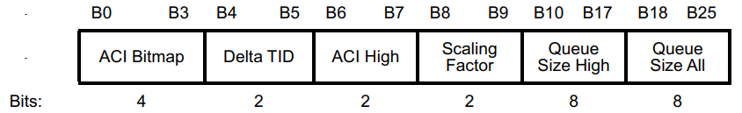
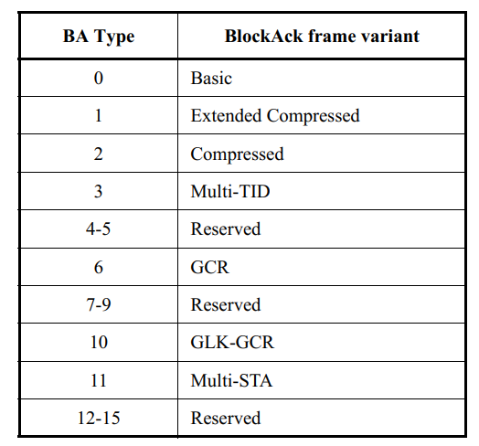
Fast BSR Report in BA frame 1/2
BSR-BA frame format: introduce this frame for STAs to report BSR information. BA type 12 is defined as the BSR-BA variant.
BA type | BlockAck frame variant
0 | Basic
… | …
11 | Multi-STA
12 | BSR-BA
13-15 | Reserved

Slide 9
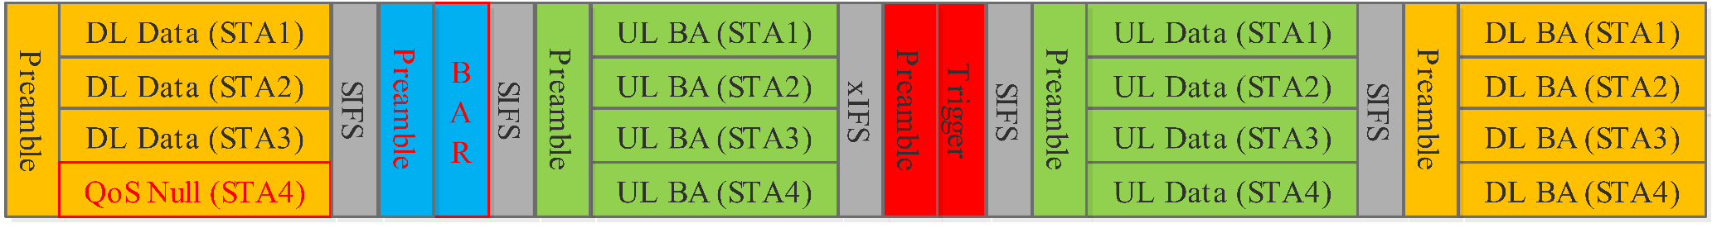
Fast BSR Report in BA frame 2/2
If there is no DL buffer data for one STA, it also can use BAR to request the BSR-BA frame.
Example,
  For DL transmission, STA4 has no data to transmit, it also can request the STA to response BSR-BA.
  The BAR request can be allocate to a 26-tone RU to increase the usage of small RUs and trigger BSR information from multi STAs

Slide 10
Summary
This contribution proposes a BSR report method. The STAs’ BSR can be transmitted within BA frames. This method makes user of the BAR-BA frame exchange procedure, which can increase the chance of STAs’ BSR and only increase few overhead. Additionally, the BSRP frame exchange procedure is not required.
In some situation, if there is no DL buffer data for one STA, the BSR-BAR also can be used to request the BSR-BA frame.

Slide 11
Straw Poll #1
Do you support to report BSR in BA frame?
-Note: Define a new BA frame format and add a BSR field in BA frame.

Slide 12
Straw Poll #2
Do you support to BSR-BAR and BSR-BA frame type and frame format defined in this contribution?

Slide 13
References
[1] “IEEE P802.11ax™/D6.0 ”
[2] Woojin Ahn, “11-15-1120-00-00ax-buffer-status-report”

Slide 14
Thank you！

