Slide 1
UL length indication in trigger frame
Date: 2020-10-19
Authors:
Name | Affiliations | Address | Phone | email
Ross Jian Yu | Huawei |  |  | ross.yujian@huawei.com
Ming Gan | Huawei |  |  | ming.gan@huawei.com
Mengshi Hu | Huawei |  |  | humengshi@Huawei.com

Slide 2
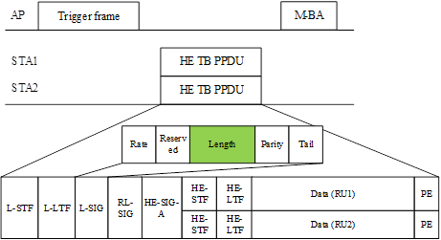
Background
In 11ax, in the trigger frame, the UL Length subfield of the Common Info field indicates the value of the L-SIG LENGTH field of the solicited HE TB PPDU.
For an HE TB PPDU, the LENGTH field is set to the TXVECTOR parameter L_LENGTH. This is to say that the solicited HE STA copies the UL length subfield of the Common Info field into the L-SIG Length field of the solicited HE TB PPDU directly.
…
NOTE: Please be noted that the discussion has nothing to do with the L-SIG length of the PPDU (non-HT/HE/EHT…) that carries the trigger frame.

Slide 3
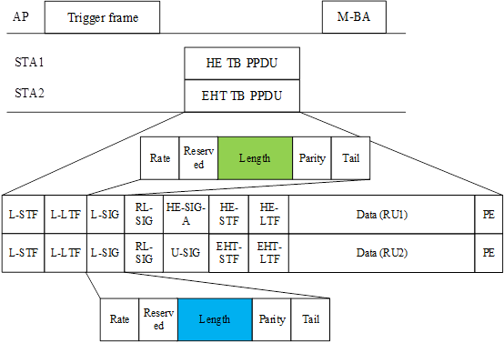
Background(cont’d)
The following SP has been passed [2]:
SP1 (764r2): Do you support to reuse the Trigger Type of 11ax in 11be
All the Per User Info fields in a Trigger frame other than MU-BAR Trigger shall have the same size.
Results: Yes/No/Abstain/No answer: 60/16/45/71
SP1 (840r2): Do you agree that the Trigger frame can be used to solicit the TB PPDU from both the HE STA(s) and EHT STA(s)?
Result: Yes/No/Abstain/No-answer: 94/5/21/71
The UL length subfield will be used to indicates the value of the L-SIG LENGTH field of both the solicited HE TB PPDU and EHT TB PPDU, and also EHT+ TB PPDU (if exist).
Note: the AP can only trigger one type of PPDU at a time

Slide 4
Background (cont’d)
For L-SIG length, in 11ax, m equal to 2 for HE TB PPDU
In 11be, m=0 for EHT PPDU, including EHT TB PPDU. This also applies to EHT+ PPDU.

Slide 5
UL length subfield in trigger frame and L_Length in HE/EHT TB PPDU
The UL length subfield will be used by both HE and EHT STA(s). Since we cannot modify the behavior of the existing HE STA, hence the EHT AP shall set the UL Length subfield of a trigger frame to the value given by Equation (27-11) with m = 2, no matter what PHY version (HE/EHT/EHT+) of the TB PPDU is triggered.
For an EHT STA, if the EHT STA is solicited to transmit HE TB PPDU, then the LENGTH field in L-SIG field is set to the TXVECTOR parameter L_LENGTH in an HE TB PPDU;
For an EHT STA, if the EHT STA is solicited to transmit EHT TB PPDU or EHT+ TB PPDU, then the Length field in L-SIG field is set to the TXVECTOR parameter L_LENGTH+2 in an EHT TB or EHT+ TB PPDU.
(UL)

Slide 6
UL length subfield in trigger frame and L_Length in HE/EHT TB PPDU
A summary through figure is shown as below:
(UL)
= UL Length
= UL Length+2

Slide 7
Straw Poll #1
Do you agree that an EHT AP shall set the UL Length subfield of a trigger frame to the value given by the following equation with m = 2 if the trigger frame is to solicit EHT TB PPDU?
This is for R1
Y
N
A

Slide 8
Straw Poll #2
Do you agree that for an EHT STA:
if the EHT STA is solicited to transmit HE TB PPDU, then the LENGTH field in L-SIG field shall be equal to UL length in the trigger frame for an HE TB PPDU;
if the EHT STA is solicited to transmit EHT TB PPDU, then the Length field in L-SIG field shall be equal to UL length in the trigger frame + 2 for an EHT TB PPDU?
This is for R1
Y
N
A

Slide 9
Straw Poll 3
Do you agree to add to the TGbe SFD the following:
An EHT AP shall set the UL Length subfield of a trigger frame to the value given by the following equation with m = 2 if the trigger frame is to solicit EHT TB PPDU?
For an EHT STA:
if the EHT STA is solicited to transmit HE TB PPDU, then the LENGTH field in L-SIG field shall be equal to UL length in the trigger frame for an HE TB PPDU;
if the EHT STA is solicited to transmit EHT TB PPDU, then the Length field in L-SIG field shall be equal to UL length in the trigger frame + 2 for an EHT TB PPDU?
This is for R1

Slide 10
Discussion on SP #1&2
SP#1 allows the AP side to set the same UL length (a multiple of 3 - 2) for all the cases below:
HE only case
EHT only case
A-PPDU case (HE and EHT)
For the behavior of an EHT STA, it is also very simple:
Set L_Length as UL length if the EHT STA is solicited to transmit HE TB PPDU, same behavior as 11ax
Set L_Length as UL length+2 if the EHT STA is solicited to transmit EHT TB PPDU, no matter if it is EHT only case or A-PPDU case.
Comment: easy implementation and logic for both AP and STA side.

Slide 11
Discussion on alternative solutions
Some alternative solution mentioned by commenters during the call:
Opt A1: at the AP side, the UL length is set to a multiple of 3 – 2 for HE only case; is set to a multiple of 3 for EHT only case; is set to a multiple of 3 – 2 for A-PPDU case
At the EHT STA side, set L_Length as UL length if the EHT STA is solicited to transmit HE TB PPDU, same behavior as 11ax; set L_Length as UL length if the EHT STA is solicited to transmit EHT TB PPDU for EHT only case; set the L_Length as UL length+2 if the EHT STA is solicited to transmit EHT TB PPDU for A-PPDU case.
Comment: different behavior at the AP side regarding different PPDU combinations; different behavior at the STA side even the STA is requested to transmit same EHT TB PPDU.

Slide 12
Discussion on alternative solutions
Some alternative solution mentioned by commenters during the call (cont’d):
Opt A2: at the AP side, the UL length is set to a multiple of 3 – 2 for HE only case; is set to a multiple of 3 or two UL length subfields for EHT only case; two UL length subfields for A-PPDU case.
At the EHT STA side, set L_Length as UL length if the EHT STA is solicited to transmit HE TB PPDU, same behavior as 11ax; set L_Length as UL length or UL length #2 if the EHT STA is solicited to transmit EHT TB PPDU for EHT only case; set the L_Length as UL length #2 if the EHT STA is solicited to transmit EHT TB PPDU for A-PPDU case.
Comment: different behavior at the AP side regarding different PPDU combinations, twice the overhead. At the STA side, may have different behavior (copy UL length or UL length #2) even the STA is requested to transmit same EHT TB PPDU.

Slide 13
References
[1] IEEE P802.11ax™/D7.0
[2] https://mentor.ieee.org/802.11/dcn/20/11-20-1496-04-00be-sep-nov-tgbe-teleconference-minutes.docx, Dennis Sundman (Ericsson)

