Slide 1
UL Beamforming for TB PPDUs in 11be
Date: 2020-10-18
Authors:
Name | Affiliation | Address | Phone | Email
Shimi Shilo | Huawei Technologies
Genadiy Tsodik
Arik Klein
Avner Epstein
Yaron Ben Arie

Slide 2
Background
  Beamforming has been supported since 802.11n
  It is widely used as a means to improve the performance and/or throughput
  Beamforming is supported for both DL and UL for a single STA in SU operation
    There are devices in the market today that support BF in the UL
  In 11ax, beamforming is not supported for a Trigger-Based PPDU (i.e. UL MU operation)
  In this contribution we focus on beamforming in the UL and in particular on supporting it for a Trigger-Based PPDU
  In 1672r1 we add:
    Simulation results for SU PPDU using a geometric channel model (e.g. using vertical/horizontal polarization)
    Beneficial use-cases for using UL MU Beamforming
  In 1672r2 we add information regarding the UL BF sequence

Slide 3
UL BF Limitations for a Trigger-Based PPDU in 11ax
  In 11ax UL, beamforming is limited to an HE SU/ER PPDU transmitted by a single STA
  It is not possible to support beamforming in an HE TB PPDU for several reasons:
    The AP cannot indicate to the STAs (in the preceding Trigger Frame) to apply beamforming in an UL TB PPDU
    There is no indication that beamforming is applied in HE-SIG-A of an HE TB PPDU
    If the sounding procedure is not triggered by the AP (beamformee), how and when do the STAs perform sounding? How do they ensure it is done before the UL BFed data transmission is invoked by the HE AP?
      Furthermore, if each STA needs to perform sounding independently, efficiency is compromised significantly
  We need to solve all of these issues for BF to be supported (efficiently) in 11be

Slide 4
UL BF in an SU operation
  Let us start by looking at the existing protocol for UL BF in an SU operation
  The baseline is an UL HE SU PPDU without BF
  UL BF is supported by the STA (beamformer) invoking the procedure, first by transmitting an NDP-A followed by an HE Sounding NDP, which is responded by the AP (beamformee) with a BFR

Slide 5
UL BF in an SU operation – cont.
  What gain can we get from the application of BF in the UL, considering that STAs typically are equipped with few antennas?
  We start with a link-level simulation, which we then use to compute the corresponding goodput, assuming the following:
    STA with 2 Tx antennas, AP with 8 Rx antennas
    20MHz BW (242-tone RU)
    Single spatial stream
    Durations:
      16usec symbol duration
      NDP-A: 28usec
      Sounding NDP: 60usec
      Block ACK: 50usec
      BFR: 92usec (assuming MCS 3, Ng=4, 2 angles per tone)
      Data PPDU: 60usec (preamble)+1000B data (duration depends on MCS)

Slide 6
UL BF in an SU operation – cont.
  The following figure shows the PER results for this scenario
  As expected, the gap is slightly larger than 3dB (for most cases)
  But considering the overhead required to support BF, what is the ‘real’ gain?

Slide 7
UL BF in an SU operation – cont.
  We compute the goodput for both schemes, for various payload sizes (aggregation) - alternatively, this could be replaced by multiple PPDUs
  transmitted within each
  sounding period
  At each SNR, we find
  the MCS which
  maximizes the throughput
  When the STAs
  transmit an aggregation
  of ~8 MPDUs, BF
  yields higher throughput
  for the majority of the
  SNR range
  For larger MPDU aggregation, BF
  always improves throughput

Slide 8
UL BF in an SU operation – cont.
  Simulations were repeated using a geometric channel model, where the STA’s transmitting antennas are spaced lambda (6cm at fc=5GHz) apart using the same polarization; the AP’s antennas are placed on a ULA with lambda/2
  separation (using
  same polarization)
  Link level simulations
  were carried out for
  MCS 2 to 7
  With sufficient data
  transmitted within a
  sounding period there
  is a ~2-4dB gain

Slide 9
UL BF in an SU operation – cont.
  Simulations were repeated using a geometric channel model, where the STA’s transmitting antennas are spaced lambda (6cm at fc=5GHz) apart using a different polarization (horizontal and vertical); the AP’s antennas are placed on a
  ULA with lambda/2
  separation (using the
  same polarization)
  Link level simulations
  were ran for MCS 2 to 7
  With sufficient data
  transmitted within a
  sounding period there
  is a ~2-3dB gain

Slide 10
UL BF in MU operation (TB PPDU)
  Having verified that UL BF is applicable in certain scenarios, we now turn to Trigger-Based PPDUs
  If there is no beamforming, the AP triggers the STA(s) to transmit UL data
  The AP cannot instruct the triggered STAs to apply BF, and the triggered STAs cannot indicate to the AP that they precoded their transmission
  Is there a way to support TB PPDUs with beamforming, and if so, what is the respective gain?

Slide 11
UL BF in MU operation (TB PPDU) – cont.
  Since there is no support for UL BF in a HE TB PPDU, we assume the following high-level protocol
  Unlike the existing protocol for SU operation (with BF), the AP (beamformee) triggers the sounding procedure for an efficient sounding procedure
  After receiving the Sounding NDPs (in HE TB PPDUs), the AP sends the Per-User precoding feedback values with the TF that initiates the UL MU Data transmission.

Slide 12
UL BF in MU operation (TB PPDU) – cont.
  The solicited STAs use the precoding values to respond with Beamformed Uplink data HE TB PPDUs
  The details of the protocol should be discussed at a later stage; here we make these assumptions in order to evaluate the achievable gain

Slide 13
UL BF in MU operation (TB PPDU) – cont.
  What gain can we get from the application of BF in an UL TB PPDU?
  Just like the SU PPDU case, we start with a link-level simulation, which we then use to compute the corresponding goodput, assuming the following:
    2 STA with 2 Tx antennas each, AP with 8 Rx antennas
    20MHz BW (242-tone RU)
    Single spatial stream transmitted by each STA
    Durations:
      16usec symbol duration
      Triggering NDP: 28usec
      Sounding NDP: 76usec (assuming 2x2=4 LTFs transmitted by each STA)
      Block ACK: 50usec
      BFR: 124usec (assuming MCS 3, Ng=4, 2 angles per tone)
      Data PPDU: 60usec (preamble)+1000B data (duration depends on MCS)

Slide 14
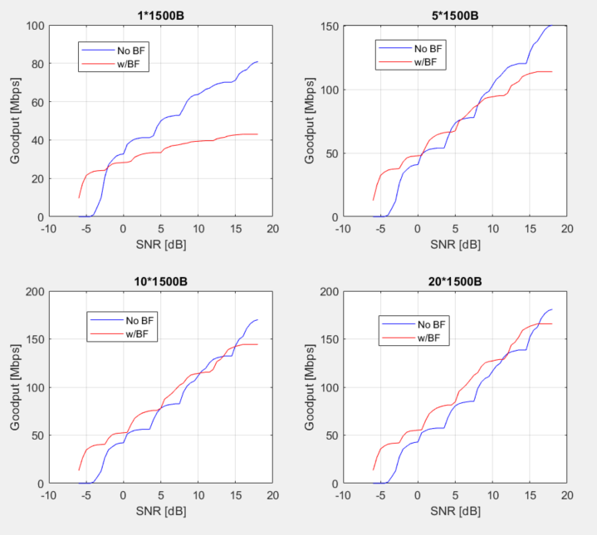
UL BF in MU operation (TB PPDU) – cont.
  We compute the goodput for various payload sizes (aggregation) and assuming the durations listed earlier
  At each SNR, we find the MCS which maximizes the throughput
  When the STAs
  transmit an aggregation
  of ~10 MPDUs, BF
  yields higher throughput
  for a majority of the
  SNR range
  For larger aggregation,
  BF is superior across
  the entire SNR range

Slide 15
UL BF in MU operation (TB PPDU) – cont.
  We also checked for a different scenario (UL MU-MIMO with 4 STAs):
    4 STA with 2 Tx antennas each, AP with 8 Rx antennas
    20MHz BW (242-tone RU)
    Single spatial stream transmitted by each STA
    Durations:
      16usec symbol duration
      Triggering NDP: 28usec
      Sounding NDP: 108usec (assuming 4x2=8 LTFs transmitted by each STA)
      Block ACK: 50usec
      BFR: 188usec (assuming MCS 3, Ng=4, 2 angles per tone)
      Data PPDU: 60usec (preamble)+1000B data (duration depends on MCS)

Slide 16
UL BF in MU operation (TB PPDU) – cont.
  We compute the goodput for both schemes, for various payload sizes (aggregation) and assuming the durations listed earlier
  Similar to the previous case, at each SNR, we find the MCS which maximizes
  the throughput
  Results are similar
  to the 2STAs case –
  as the number of
  aggregated MPDUs
  increases, so does
  the gain incurred by BF

Slide 17
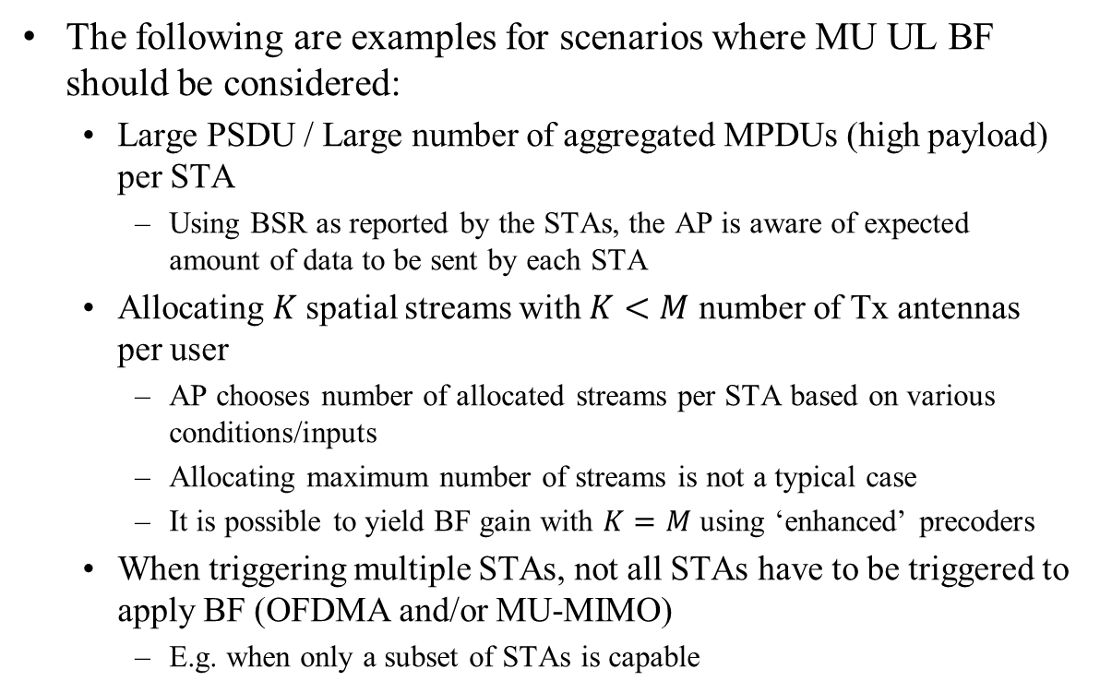
Where is it Beneficial to use MU UL BF?
  The following are examples for scenarios where MU UL BF should be considered:
    Large PSDU / Large number of aggregated MPDUs (high payload) per STA
      Using BSR as reported by the STAs, the AP is aware of expected amount of data to be sent by each STA
    Allocating $K$ spatial streams with $K<M$ number of Tx antennas per user
      AP chooses number of allocated streams per STA based on various conditions/inputs
      Allocating maximum number of streams is not a typical case
      It is possible to yield BF gain with $K=M$ using ‘enhanced’ precoders
    When triggering multiple STAs, not all STAs have to be triggered to apply BF (OFDMA and/or MU-MIMO)
      E.g. when only a subset of STAs is capable

Slide 18
PHY related Complexity Aspects
  The AP (beamformee) can feedback phase-aligned, continuous precoders to the STAs
    Therefore, the STAs need only perform interpolation in frequency – very low complexity
    This also ensures the AP can apply smoothing while demodulating the precoded data
  Alternative precoding methods (e.g. wider bandwidth precoders) can also be considered
    This means further reduction of complexity at STA side, requiring no interpolation and ensuring continuity in frequency
    Significant complexity reduction respective to precoder computation
    Can also reduce the overhead

Slide 19
Summary
  We discussed Uplink BF in 802.11, in particular the lack of support for TB PPDUs in 11ax
  We’ve shown via simulations that supporting BF in the UL, even when considering STAs with 2Tx antennas, is legitimate
    When we take the overhead associated with the protocol (Sounding NDP etc.) into consideration, there are scenarios where UL BF improves the performance
  There are devices today supporting UL BF, but this cannot be used in a TB PPDU
  We propose several use-cases where MU UL BF is beneficial
  We propose to support BF for TB PPDUs in 11be
    Note: no proposed changes to UL SU PPDU
    Note: Rel. 2 feature

Slide 20
Straw Poll #1
  Do you support to include a protocol which enables beamforming for triggered PPDUs in 11be?
    Note: this is a Rel. 2 feature

