Slide 1
UL Beamforming for TB PPDUs in 11be
Date: 2020-10-18
Authors:
Name | Affiliation | Address | Phone | Email
Shimi Shilo | Huawei Technologies
Genadiy Tsodik
Arik Klein
Avner Epstein
Yaron Ben Arie

Slide 2
Background
  Beamforming has been supported since 802.11n
  It is widely used as a means to improve the performance and/or throughput
  Beamforming is supported for both DL and UL for a single STA in SU mode
    There are devices in the market today that support BF in the UL
  In 11ax, beamforming is not supported for a Trigger-Based PPDU (i.e. UL MU mode)
  In this contribution we focus on beamforming in the UL and in particular on supporting it for a Trigger-Based PPDU

Slide 3
Limitations for a Trigger-Based PPDU in 11ax
  In 11ax UL, beamforming is limited to an HE SU/ER PPDU transmitted by a single STA
  It is not possible to support beamforming in an HE TB PPDU for several reasons:
    The AP cannot indicate to the STAs (in the preceding Trigger Frame) to apply beamforming in an UL TB PPDU
    There is no indication that beamforming is applied in HE-SIG-A of an HE TB PPDU
    If the sounding procedure is not triggered by the AP (beamformee), how and when do the STAs perform sounding? How do they ensure it is done before the UL BFed data transmission is invoked by the HE AP?
      Furthermore, if each STA needs to perform sounding independently, efficiency is compromised significantly
  We need to solve all of these issues for BF to be supported (efficiently) in 11be

Slide 4
UL BF in an SU mode
  Let us start by looking at the existing protocol for UL BF in an SU mode
  The baseline is an UL HE SU PPDU without BF
  UL BF is supported by the STA (beamformer) invoking the procedure, first by transmitting an NDP-A followed by an HE Sounding NDP, which is responded by the AP (beamformee) with a BFR

Slide 5
UL BF in an SU mode – cont.
  What gain can we get from the application of BF in the UL, considering that STAs typically are equipped with few antennas?
  We start with a link-level simulation, which we then use to compute the corresponding goodput, assuming the following:
    STA with 2 Tx antennas, AP with 8 Rx antennas
    20MHz BW (242-tone RU)
    Single spatial stream
    Durations:
      16usec symbol duration
      NDP-A: 28usec
      Sounding NDP: 60usec
      Block ACK: 50usec
      BFR: 92usec (assuming MCS 3, Ng=4, 2 angles per tone)
      Data PPDU: 60usec (preamble)+1000B data (duration depends on MCS)

Slide 6
UL BF in an SU mode – cont.
  The following figure shows the PER results for this scenario
  As expected, the gap is slightly larger than 3dB (for most cases)
  But considering the overhead required to support BF, what is the ‘real’ gain?

Slide 7
UL BF in an SU mode – cont.
  We compute the goodput for both schemes, for various payload sizes (aggregation) - alternatively, this could be replaced by multiple PPDUs
  transmitted within each
  sounding period
  At each SNR, we find
  the MCS which
  maximizes the throughput
  When the STAs
  transmit an aggregation
  of ~8 MPDUs, BF
  yields higher throughput
  for the majority of the
  SNR range
  For larger aggregation, BF
  always improves throughput

Slide 8
UL BF in MU mode (TB PPDU)
  Having verified that UL BF is applicable in certain scenarios, we now turn to Trigger-Based PPDUs
  Since there is no support for UL BF in a HE TB PPDU, we assume the following high-level protocol
  Here, unlike the existing protocol for SU mode, the AP (beamformee) triggers the sounding procedure for an efficient sounding procedure
  Since the AP does
  not (necessarily)
  decode the PHY
  preamble in MU mode,
  we assume the STAs must
  apply BF in the data
  transmission phase if
  indicated to do so

Slide 9
UL BF in MU mode (TB PPDU) – cont.
  What gain can we get from the application of BF in an UL TB PPDU?
  Just like the SU PPDU case, we start with a link-level simulation, which we then use to compute the corresponding goodput, assuming the following:
    2 STA with 2 Tx antennas each, AP with 8 Rx antennas
    20MHz BW (242-tone RU)
    Single spatial stream transmitted by each STA
    Durations:
      16usec symbol duration
      Triggering NDP: 28usec
      Sounding NDP: 76usec (assuming 2x2=4 LTFs transmitted by each STA)
      Block ACK: 50usec
      BFR: 124usec (assuming MCS 3, Ng=4, 2 angles per tone)
      Data PPDU: 60usec (preamble)+1000B data (duration depends on MCS)

Slide 10
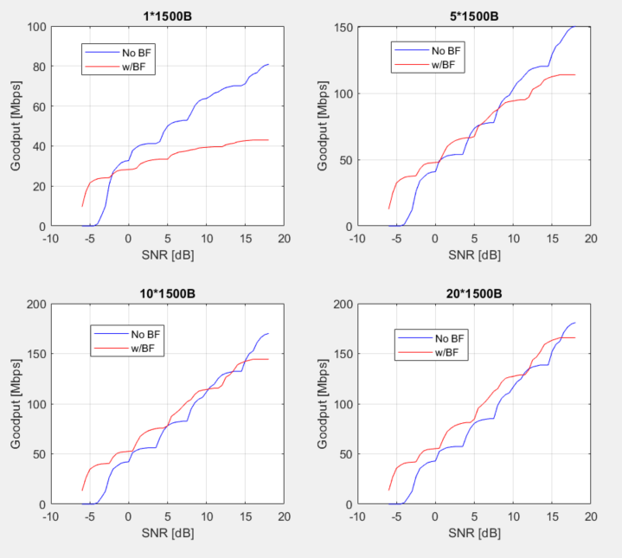
UL BF in MU mode (TB PPDU) – cont.
  We compute the goodput for various payload sizes (aggregation) and assuming the durations listed earlier
  At each SNR, we find the MCS which maximizes the throughput
  When the STAs
  transmit an aggregation
  of ~10 MPDUs, BF
  yields higher throughput
  for a majority of the
  SNR range
  For larger aggregation,
  BF is superior across
  the entire SNR range

Slide 11
UL BF in MU mode (TB PPDU) – cont.
  We also checked for a different scenario (UL MU-MIMO with 4 STAs):
    4 STA with 2 Tx antennas each, AP with 8 Rx antennas
    20MHz BW (242-tone RU)
    Single spatial stream transmitted by each STA
    Durations:
      16usec symbol duration
      Triggering NDP: 28usec
      Sounding NDP: 108usec (assuming 4x2=8 LTFs transmitted by each STA)
      Block ACK: 50usec
      BFR: 188usec (assuming MCS 3, Ng=4, 2 angles per tone)
      Data PPDU: 60usec (preamble)+1000B data (duration depends on MCS)

Slide 12
UL BF in MU mode (TB PPDU) – cont.
  We compute the goodput for both schemes, for various payload sizes (aggregation) and assuming the durations listed earlier
  Simliar to the previous case, at each SNR, we find the MCS which maximizes
  the throughput
  Results are similar
  to the 2STAs case –
  as the aggregation
  increases, so does
  the gain incurred by BF

Slide 13
Summary
  We discussed BF in 802.11, in particular the lack of support for TB PPDUs in 11ax
  We’ve shown via simulations that supporting BF in the UL, even when considering STAs with 2Tx antennas, is legitimate
    When we take the overhead associated with the protocol (NDP etc.) into consideration, there are scenarios where BF improves the performance
  There are devices today supporting UL BF, but this cannot be used in a TB PPDU
  We propose to support BF for TB PPDUs in 11be
    Note: no proposed changes to UL SU PPDU

Slide 14
Straw Poll #1
  Do you support to include a protocol which enables beamforming for triggered PPDUs in 11be?

