Slide 1
Low Latency resource agreements
Date: 2020-10-19
Authors:

Slide 2
Abstract
The TXOP mechanism and/or long transmit durations are well suited to non-critical transmissions, however critical transmissions suffer from the channel access delay induced by it
Methods are needed to provide more predictable channel access when STAs with different set of traffic requirements can coexist better
We propose to enable agreements between two nodes with different traffic requirements to allow sharing of resources during a reserved TXOP
Thus no need pre-configure any BSS-specific resources for low latency transmissions

Slide 3
Background
Low latency is an important feature that has been discussed within 11be:
[1] presents a set of proposals – one of them being RD protocol for STA to AP and between OBSS STAs
[2] presents an approach to enable periods of time during which low latency traffic can be protected from intra-BSS congestion
[3] proposes a general channel access method and associated signaling to provide a more predictable/latency throughput performance
[4] discusses possible ways for AP to constrain the use of protected channel access by using restricted TWT SPs
[5] reservation of resources for specific traffic announced by beacon or probe response
A lot of the proposals require changes at the MAC layer and may still not be able to guarantee bounded latency or channel access
We propose simple solutions to establish agreements between devices to guarantee more bounded channel access latency

Slide 4
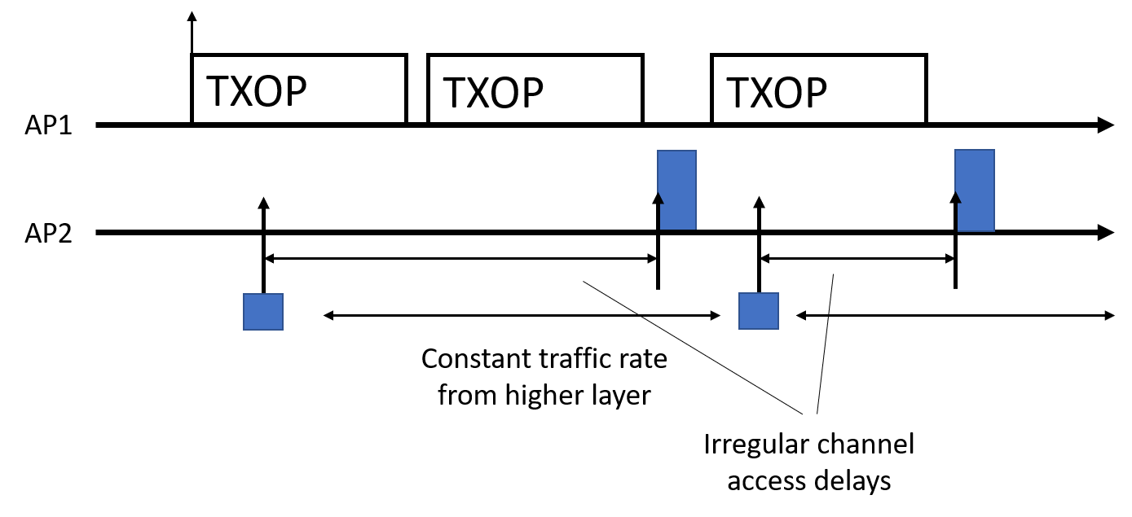
Problem: Critical transmissions and TXOP mechanism
Non-critical traffic: Any type of traffic without strict priority and reliability requirements
Critical traffic: May arrive at any time with high priority requirements.
In this example, AP2 will suffer severely from not being able to share resources from AP1 and AP1 will still have to contend with AP2

Slide 5
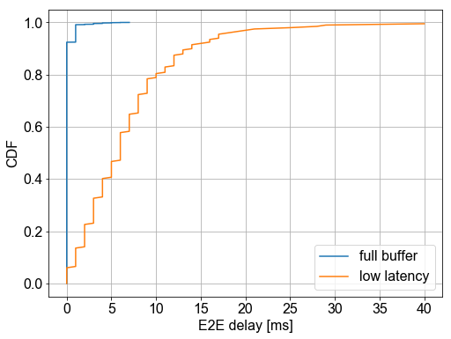
Problem: Critical transmissions and TXOP mechanism
As an example simulation:
A single AP
A STA with a non-critical full buffer traffic model, using 4ms TXOP limit
A STA with low latency small packet data arriving from higher layers roughly every 0.05s
It can be seen that the STA with low latency will not only suffer from large average latency, but also from a long tail
While the example is simple, it highlights a major issue
For critical traffic, improving the latency of the large tail is just as important as improving average latency

Slide 6
Example: Critical Transmissions Time Duration
If a STA wants to transmit 115 Bytes of critical data along with an ACK, it would take the following amount of time with 20MHz BW HE, 242 carriers
Preamble + header + MPDU(MCS3): 44us + 13.6us + 3*13.6us = 106.4us
SIFS: 16us
Ack: Preamble + header: 44us + 13.6us = 57.6us
This sums up to 180us, which compared to maximum TXOP duration of 4.096ms, equals to a 3% of its duration
Clearly letting a critical short transmission wait for the whole TXOP duration before contending for the channel is not a preferable solution

Slide 7
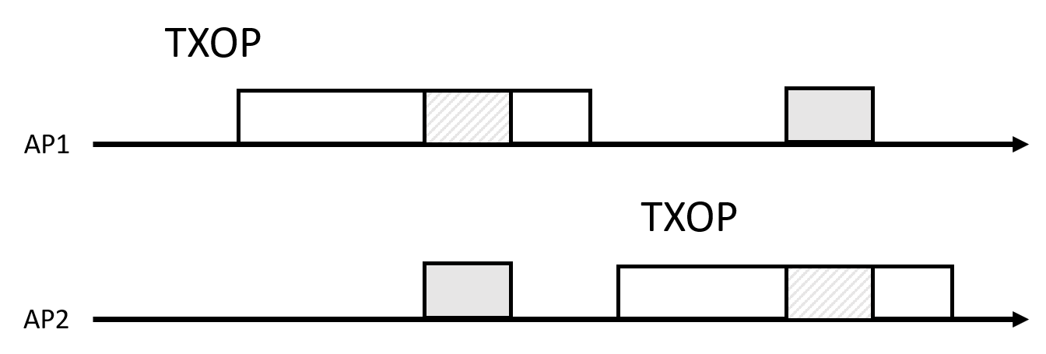
Proposal
The basic idea:
Enable the AP/non-AP STAs to share or partially share their TXOPs with other AP/non-AP STAs through pre-configured agreement between two AP/non-AP STAs
Agreement is only between two nodes and thus legacy devices will not be affected
The amount of reserved resources is set during the negotiation phase; however critical transmissions generally have small data packets and need small fractions of the TXOP length.

Slide 8
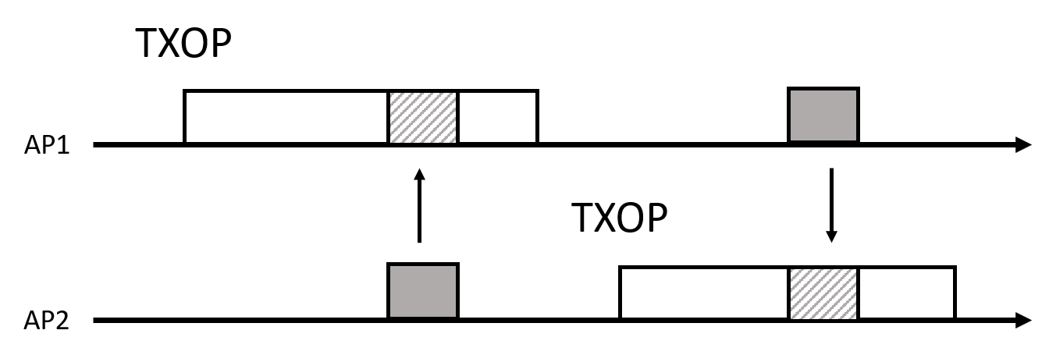
Proposal 1: Opportunistic spatial reuse agreements
One way to enable a STA to send critical data that may arrive during an ongoing TXOP transmission of another STA is to let the critical transmission overlap with the ongoing transmission(s)
The agreement between the two STAs may allow them to transmit on certain resources or for the whole TXOP duration whenever they reserve a TXOP.
A special case of the pre-emption is when both transmissions go through and/or if any of the nodes lower their transmission power – this moves it close to spatial reuse

Slide 9
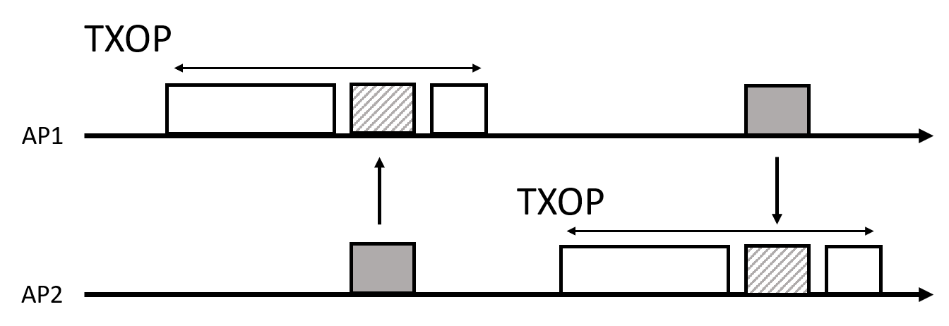
Proposal 2: Low latency resources in TXOP agreements
Another way to enable a STA to send critical data that may arrive during an ongoing TXOP transmission of another STA is to leave out empty resources within the TXOP
An agreement is thus made whereby the TXOP owner will not transmit on some resources and allow the other STA to transmit on those resources

Slide 10
Proposal 2 cont: Low latency resources in TXOP agreements
The resources reserved for critical transmissions may be reclaimed by the TXOP owner (e.g., if not used) or released by the STA with critical data (e.g., if not needed or used).
Reclaiming the resources may be required to deal with channel access rules
If the STA is required to send an indication whenever the resources are not needed, then it would be beneficial for the STA to end the agreement – which prevents the resources from being wasted

Slide 11
Advantages
By allowing sharing of resources, the latency for critical data is not only expected to be reduced but also bounded
In proposal 1 the channel access delay may be very low but cause interference, while in proposal 2 the channel access delay would be higher but with no interference
The loss in throughput is expected to be minimal for the device that shares
The proposed solution can co-exist with legacy devices as the nodes only use each other’s resources
This opposed is to other proposed methods where empty resources are reserved in time for latency critical access that legacy devices would not understand

Slide 12
Relation to previous work
COT sharing
In LAA/NR-U methods exists for a gNB to share its TXOP with its UE
11ax Spatial reuse
It is not suitable for low latency uses due the ad-hoc nature of 11ax SP, where any STA may transmit if a Spatial Reuse frame is sent
Reverse Direction protocol
Reverse Direction protocol allows an AP to reserve a TXOP and grant a non-AP STA to transmit – in our proposal the grant is not needed and the coordination may be intra-BSS

Slide 13
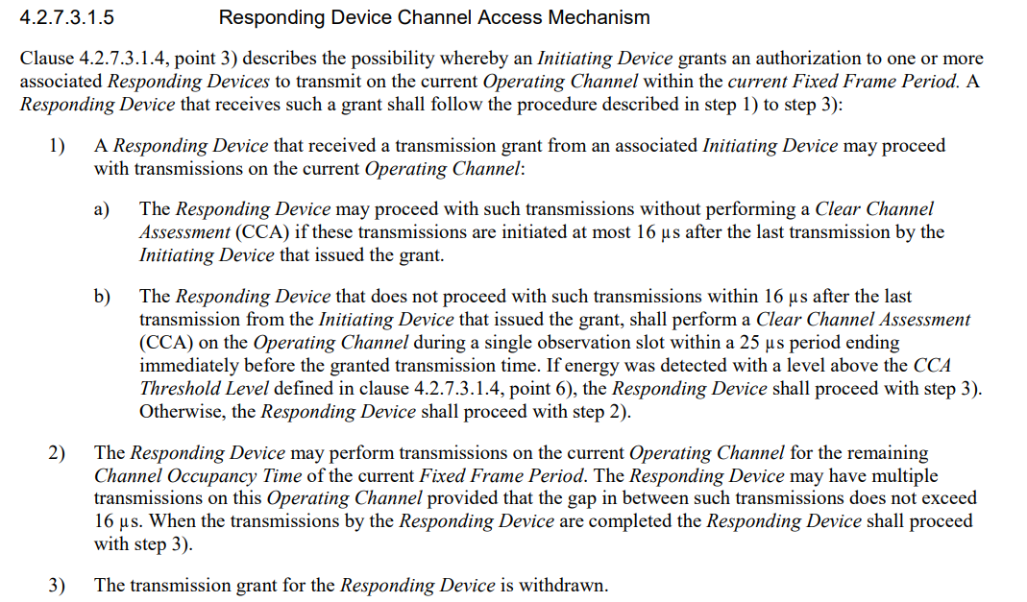
Regulatory aspects
EN 301.893 [6] allows for sharing of transmission resources between an initiating device and a responding device under certain conditions
Otherwise access to the channel will have similar issues as in the currently discussed 11be feature Multi-AP

Slide 14
Summary
We have proposed two mechanisms to allow critical transmissions during ongoing transmissions in a reserved TXOP.
The two mechanisms are based on
Opportunistic spatial reuse agreements
Low Latency resources in TXOP

Slide 15
SP
Do you agree that low latency could be achieved through pre-configured agreements between STAs?

Slide 16
References
[1] 11-20-0005r1 Proposals on Latency Reduction
[2] 11-20-1350r0 Enhancements for QoS and low latency in 802.11beR1
[3] 11-20-1045r3 Prioritized EDCA Access
[4] 11-20-1046r4 Proposed TWT Enhancement for Latency Sensitive Traffic
[5] 11-20-1355r2 Access mechanisms to meet the requirements of low latency traffics
[6] ETSI EN 301 893 5GHz RLAN Harmonised Standard covering the essential requirements of article 3.2 of Direction 2014/53/EU V2.0.7 (2016-11)

