Slide 1
Implicit Sounding Performance
Date: 2020-10
Authors:
Name | Affiliations | Address | Email
Oren Kedem | Huawei | Israel | oren.kedem@huawei.com
Dylan Fangchao Yuan |  | Nanjing, China | yuanfangchao@huawei.com
Lily Yunping Lyu |  | Nanjing, China | lvyunping@huawei.com
Jonathan Zheng Chen |  | Nanjing, China | chenzheng16@huawei.com

Slide 2
Abstract
There have been some discussions about implicit sounding in TGbe.
The latest straw poll in [1] shows interest to further investigate implicit sounding.
Do you support to investigate implicit sounding as an optional mode in TGbe (for R2)? Y/N/A: 47/8/10
Sounding performance (overhead, accuracy) actually is extremely important for MU-MIMO system. In order to further evaluate the feasibility and value of implicit sounding, we did several MU-MIMO tests in lab, comparing explicit sounding and implicit sounding performance, considering below conditions,
Channel aging
  Real environment is seldom static, therefore channel aging impact on performance must be considered
Calibration error
  Calibration accuracy has impact on implicit sounding performance
Notes:
Due to time variation of the propagation channel and delays in the sounding and computation, SINR limits on the signal-to- interference-plus-noise ratio (SINR) and hence the achievable rates

Slide 3
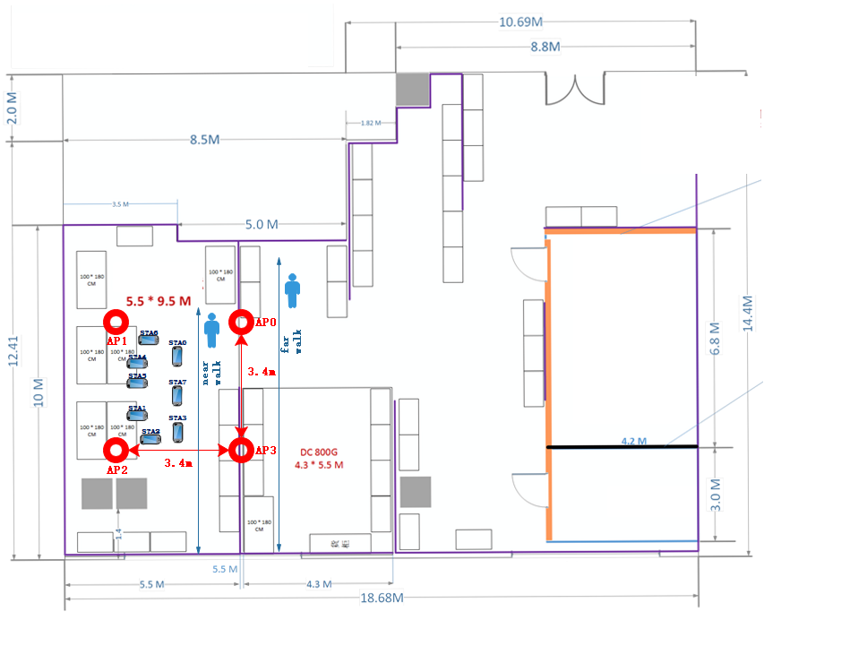
Test Setup
    20MHz
    AP N_{RX} : 4
    Max AP Num: 4
    STA N_{TX} : 1
    Max STA Num: 8
    HE-LTF mode: 4x, GI: 3.2us
    Sounding period: 5ms
    Scenario 1: A person walk near STAs
    Scenario 2: A person walk a little far from STAs
Scenario 1 Near Movement
Scenario 2 Far Movement
Notes:
Frequency Synchronization @AP: 300fs

Slide 4
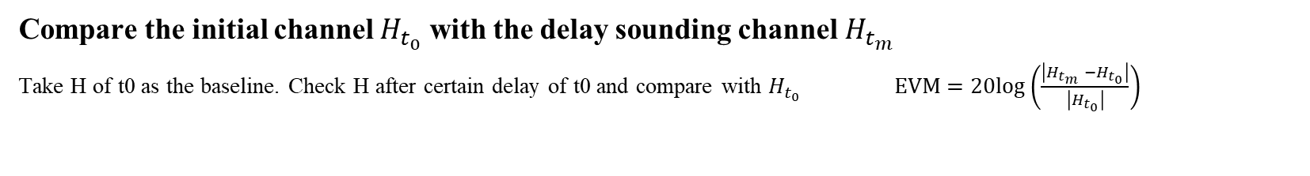
Test : Channel Variation EVM Result
Compare the initial channel $H_{t_{0}}$ with the delay sounding channel $H_{t_{m}}$
  Take H of t0 as the baseline. Check H after certain delay of t0 and compare with $H_{t_{0}}$ $EVM=20log\left(\frac{\left|H_{t_{m}} −H_{t_{0}}\right|}{\left|H_{t_{0}}\right|}\right)$
Observations:
Static case: Channel aging is not an issue
Far movement case: EVM is dropping as delay is increasing
Near movement case: Significant EVM degradation is observed, EVM goes down quickly at the start and it holds stable when delay is greater than 30ms
Note: CSI accuracy greater than -45dB is observed on 5ms Delay curve (Fig. 1), hence test result are not impacted by noise impairments

Slide 5
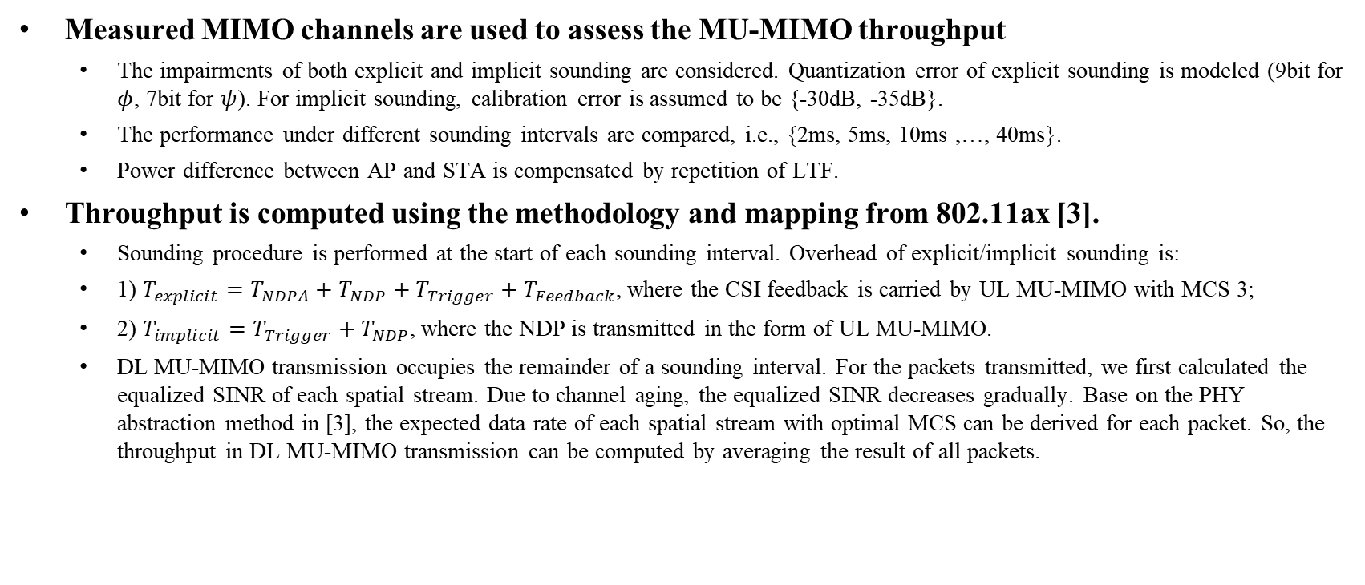
Simulation Methodology
Measured MIMO channels are used to assess the MU-MIMO throughput
  The impairments of both explicit and implicit sounding are considered. Quantization error of explicit sounding is modeled (9bit for $φ$, 7bit for $ψ$). For implicit sounding, calibration error is assumed to be {-30dB, -35dB}.
  The performance under different sounding intervals are compared, i.e., {2ms, 5ms, 10ms ,…, 40ms}.
  Power difference between AP and STA is compensated by repetition of LTF.
Throughput is computed using the methodology and mapping from 802.11ax [3].
  Sounding procedure is performed at the start of each sounding interval. Overhead of explicit/implicit sounding is:
  1) $T_{explicit}=T_{NDPA}+T_{NDP}+T_{Trigger}+T_{Feedback}$, where the CSI feedback is carried by UL MU-MIMO with MCS 3;
  2) $T_{implicit}=T_{Trigger}+T_{NDP}$, where the NDP is transmitted in the form of UL MU-MIMO.
  DL MU-MIMO transmission occupies the remainder of a sounding interval. For the packets transmitted, we first calculated the equalized SINR of each spatial stream. Due to channel aging, the equalized SINR decreases gradually. Base on the PHY abstraction method in [3], the expected data rate of each spatial stream with optimal MCS can be derived for each packet. So, the throughput in DL MU-MIMO transmission can be computed by averaging the result of all packets.
Sounding
DL MU-MIMO Transmission
Sounding
DL MU-MIMO Transmission
…
a sounding interval
    Explicit sounding procedure:
    Implicit sounding procedure:
NDPA
NDP
Trigger
Trigger
STA 1 Feedback
STA 1 NDP
STA 2 Feedback
MU-MIMO
STA 2 NDP
MU-MIMO
…
…
STA n Feedback
STA n NDP

Slide 6
Simulation 1-1: TX=16,Usr=8 Performance in Scenario 1
Observations:
When calibration error is equal or smaller than -30dB, implicit sounding has better performance compared to explicit sounding in all sounding interval cases
Explicit and implicit sounding performances are becoming similar when sounding interval is increasing.

Slide 7
Simulation 1-2: TX=16,Usr=8 Optimal Interval Performance in Scenario 1
  Optimal Sounding Intervals are those that achieve the best throughput performance per given Scheme, SNR and Calibration Error.
  For Example ➔ When SNR = 30dB and Calibration Error = -30dB, best performance configurations are:
    Implicit Sounding with 10ms Sounding Interval
    Explicit Sounding with 15ms Sounding Interval
Observation:
Implicit Sounding still show better performance compared with explicit sounding when Calibration Error ≤ -30dB
Explicit “Sounding Sweet Points” are always achieved in longer sounding interval compared to implicit.

Slide 8
Simulation 2: Tx=8,Usr =6 Case and Tx=4,Usr=3 Case
We did same tests for Tx=8, Usr=6 case and Tx=4, Usr=3 case.
Observation:
When calibration error is ≤ -35dB, implicit sounding has better performance.
When calibration error is -30dB, implicit sounding and explicit sounding have similar performance.
When decreasing MIMO dimension, the performance difference between explicit and implicit is getting smaller.

Slide 9
Analysis
Once SNR is high, channel aging becomes the dominating factor (instead of noise) to effect performance. Both implicit and explicit sounding need to decrease the sounding interval in order to get better performance.
Due to overhead issue, explicit sounding cannot use shorter sounding interval as implicit sounding.
As explicit sounding procedure consume long time period, it can’t fit into one TXOP.
Therefore, the decision of “When to start the explicit sounding?” and “which users should participate?” (especially when the number of users increase) has many constraints. Hence it is likely to leads a performance degradation.
Since implicit sounding supports short sounding intervals, it can be operated within TXOP hence AP decisions on number of users and TXOP utilization is relaxed.
Trigger
Data transmission
STA 1 NDP
STA 2 NDP
…
STA n NDP
TXOP

Slide 10
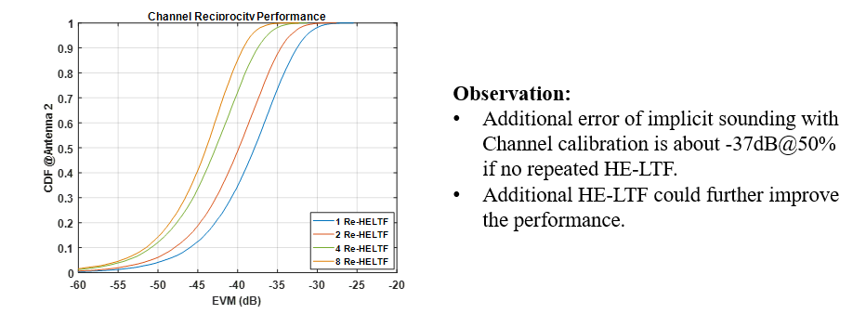
Conclusion
When calibration error can reach -30dB, performance of implicit sounding is good enough.
Implicit sounding is an instant sounding method hence is easy to be operated and implemented.
Implicit sounding does not add burden on STA side.
Note: [2] shows lab test result for calibration accuracy is about -37dB@50%. -30dB is not hard to get

Slide 11
SP
Do you support to add implicit sounding as an optional mode in TGbe?

Slide 12
References
[1] 11-20-0065-00-03be-implicit sounding scheme
[2] 11-19-1939-00-00be-Calibration of Implicit Sounding
[3] 11-14-0571-12-00ax-evaluation-methodology

Slide 13
Backup

Slide 14
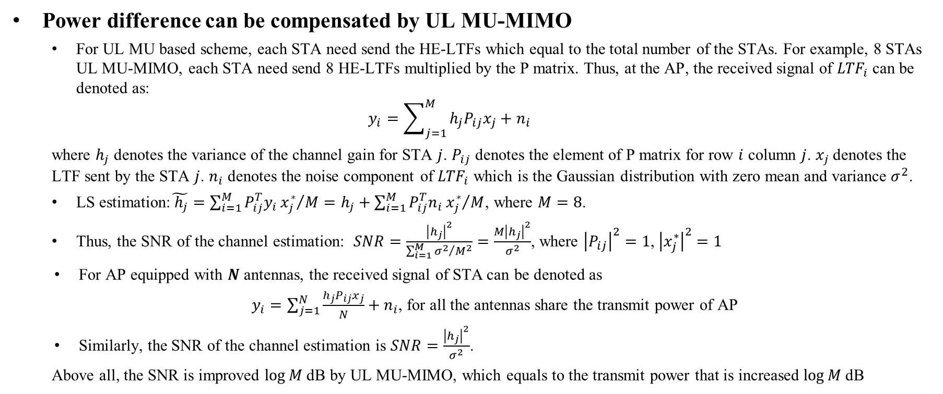
Power Difference Compensation
Power difference can be compensated by UL MU-MIMO
  For UL MU based scheme, each STA need send the HE-LTFs which equal to the total number of the STAs. For example, 8 STAs UL MU-MIMO, each STA need send 8 HE-LTFs multiplied by the P matrix. Thus, at the AP, the received signal of ${LTF}_{i}$can be denoted as:
  $$y_{i}=\sum_{j=1}^{M}{h_{j}P_{ij}x_{j}}+n_{i}$$
  where $h_{j}$ denotes the variance of the channel gain for STA $j$. $P_{ij}$ denotes the element of P matrix for row $i$ column $j$. $x_{j}$ denotes the LTF sent by the STA $j$. $n_{i}$ denotes the noise component of ${LTF}_{i}$ which is the Gaussian distribution with zero mean and variance $σ^{2}$.
  LS estimation:$\tilde{{ h}_{j}}={\sum_{i=1}^{M}{P_{ij}^{T}y_{i}}x_{j}^{∗}}/M=h_{j}+{\sum_{i=1}^{M}{P_{ij}^{T}n_{i}}x_{j}^{∗}}/M$, where $M=8$.
  Thus, the SNR of the channel estimation: $SNR=\frac{{\left|h_{j}\right|}^{2}}{{\sum_{i=1}^{M}{σ^{2}}}/{M^{2}}}=\frac{{M\left|h_{j}\right|}^{2}}{σ^{2}}$, where ${\left|P_{ij}\right|}^{2}=1$, ${\left|x_{j}^{∗}\right|}^{2}=1$
  For AP equipped with $N$ antennas, the received signal of STA can be denoted as
  $y_{i}=\sum_{j=1}^{N}{\frac{h_{j}P_{ij}x_{j}}{N}}+n_{i}$, for all the antennas share the transmit power of AP
  Similarly, the SNR of the channel estimation is $SNR=\frac{{\left|h_{j}\right|}^{2}}{σ^{2}}$.
  Above all, the SNR is improved $\log{M}$dB by UL MU-MIMO, which equals to the transmit power that is increased $\log{M}$dB

Slide 15
TX=8,Usr=6 Performance in scenario 1

Slide 16
TX=8,Usr=6 Optimal Interval Performance in Scenario 1

Slide 17
TX=4,Usr=3 Performance in scenario 1

Slide 18
TX=4,Usr=3 Optimal Interval Performance in Scenario 1

