Slide 1
WLAN sensing usage model: sneeze sensing
Date: 2020-10-13
Authors:
Name | Affiliation | Address | Phone | Email
Rui Du | Huawei Technologies Co. Ltd | F3, Huawei Base, Shenzhen, China |  | Ray.du@Huawei.com
Danny Kaipin Tan
Yingxiang Sun
Meihong Zhang
Chenchen Liu
Rui Du, et al (Huawei)

Slide 2
Outline
Abstract
  Usage model:
  Scenario
  Sneeze sensing
  Requirement and attribute
  Potential sensing architecture
  Experimental validation with monostatic sensing
  Realization of sneeze sensing
  Challenges and Solutions
Summary
References
Rui Du, et al (Huawei)

Slide 3
Abstract
Several usage models have been discussed in previous contributions[1-4].
In this contribution, sneeze sensing is proposed as a potential usage model for WLAN sensing and its relevant requirement are further discussed.
The feasibility of this usage model is validated through experimental measurement.
Rui Du, et al (Huawei)

Slide 4
Usage model: scenario
Sneezes play a key role in transferring respiratory diseases such as COVID-19 between infectious and susceptible individuals where the timely monitoring and alerting for sneezes can be important in preventing the spread of such diseases.
Sneeze sensing is important in public indoor scenarios, such as
hospital
train station
airport
…
Rui Du, et al (Huawei)

Slide 5
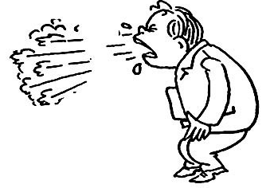
Usage model: sneeze sensing
Droplets
Target human
Transmitting signal
Receiving signal
Device 1
During the sneeze of an individual people, there are mainly two things could be used to detect if a sneeze happened.
Body movement
The inhale and exhale of the human body during the sneeze is quite special and this movement could be adopted for the detection of sneeze (similar to other movement detection).
Droplets volume
The fine mist of mucus and saliva can burst from a person’s nose and mouth at nearly 40 m/s and travel as far as 8 meters. This droplets volume also could be used for the detection of sneeze.
Rui Du, et al (Huawei)

Slide 6
Usage model: requirement and attribute
With the metrics proposed in [1,2], the requirement and attribute for sneeze sensing is shown in the table below.
Coverage |  | Resolution |  |  | Accuracy
Range (m) | Field of view (˚) | Range (m) | Angle (˚) | Velocity (m/s) | Range (m) | Angle (˚) | Velocity (m/s)
< 10 | ±60 | 0.1 | 2 | 0.05 | 0.02 | 0.5 | 0.01
Other performance
Probability of detection (%) | Latency (ms) | Refresh rate (Hz) | No. of simultaneous targets | Security | Robustness | Maximum network load | 60GHz only
>99 | <10 | >10 | <= 10 | High | High | 10 % | Yes
Rui Du, et al (Huawei)

Slide 7
Potential sensing architecture
Transmitting signal
Receiving signal in monostatic mode
Target human
Receiving signal in bistatic mode
Droplets
Device 1
Device 2
Sneeze could be sensed in monostatic and/or bistatic, multistatic mode.
Sensing result will be affected by the angle between transmitting signal, target movement and receiving signal.
Rui Du, et al (Huawei)

Slide 8
Experimental validation with monostatic sensing
Some experiments at 60 GHz with 13 dBm transmit power had been conducted to show the feasibility of sneeze sensing. In the experiment, a human is seated at a distance of 1 m away and facing the sensor.
To measure the sneeze droplet volume, additional target human’s body movement is kept to minimum during the measurement.
Usually, sneeze lasts between 0.3s to 0.7s[5], the following figure has been slowed down to display the sneeze droplet volume clearly.
Rui Du, et al (Huawei)

Slide 9
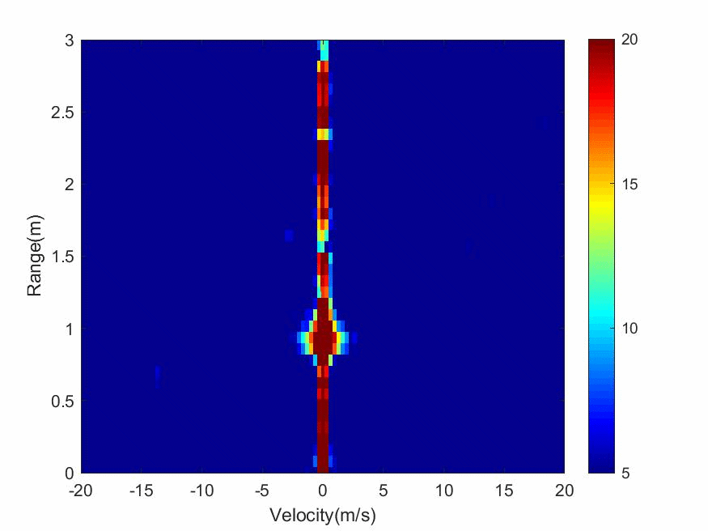
Experimental validation with monostatic sensing
As it is shown in the figure, high velocity Doppler component around 10m/s can be observed clearly in the measurement result.
After the sneeze happened, the high velocity Doppler component is slowing down to zero velocity, which is corresponding to the speed reduction of sneeze droplet volume in the test.
The high velocity Doppler component and the corresponding features of the sneeze droplet volume could be used for sneeze sensing recognition.
Range-Doppler-Time
Rui Du, et al (Huawei)

Slide 10
Realization of sneeze sensing
With sneeze sensing, we are able to estimate the useful information (location, velocity, etc.) of sneeze droplet volume.
Based on these information, we could analyze the fluid dynamics of this multiphase turbulent buoyant clouds and predict the range of droplet volume[6].
With further information (e.g. indoor air velocity and direction), it is even possible for us to predict the trajectory of the sneeze droplet volume.
Rui Du, et al (Huawei)

Slide 11
Challenges and Solutions
Affected by movements of human body
Human body movement will add Doppler component to the range-Doppler detection results.
The Doppler component velocity usually is smaller than the Doppler frequency of the sneeze droplet volume.
The effect of aspect angle
Sensing result is related to the aspect angle between sensor and target.
Multiple nodes, providing spatial diversity, could be adopted to enhance the robustness of the sensing.
Blockages of the sneeze sensing
The detection of sneeze droplet volume will be very challenging if it is occluded by the human body and/or other objects.
Multiple nodes, providing spatial diversity, could be helpful to alleviate this problem.
Direct and multipath interference
The direct signal and strong multipath may affect the sensing performance.
Reasonable isolation in antenna/RF and multipath cancellation algorithm in digital domain could be employed to mitigate this influence.
Rui Du, et al (Huawei)

Slide 12
Summary
In this presentation, sneeze sensing is discussed as a potential usage model for WLAN sensing.
Relevant experimental measurement is shown to prove the feasibility of this usage model.
Rui Du, et al (Huawei)

Slide 13
References
[1] 11-20-0905-02-SENS-usage-model-terminology-for-wlan-sensing.pptx
[2] 11-20-0937-00-SENS-introduction-to-usage-model-document.pptx
[3] 11-20-1239-00-SENS-use-cases-for-wireless-lan-sensing.pptx
[4] 11-20-1266-00-SENS-wlan-sensing-procedures-and-use-cases.pptx
[5] Z. Y. Han, W. G. Weng, Q. Y. Huang, “Characterizations of particle size distribution of the droplets exhaled by sneeze”, Journal of the Royal Society Interface, vol. 88, no.10, Nov. 2013.
[6] Bourouiba L, Dehandschoewercker E, Bush J W M. Violent expiratory events: on coughing and sneezing[J]. Journal of Fluid Mechanics, 2014, 745: 537-563.
Rui Du, et al (Huawei)

