Slide 1
TGba CRC Telco Agenda and Motions
Date: 2020-10-8
Authors:

Slide 2
Abstract
This document contains
  Agenda for TGba CRC call [October 12]
    Call information
      Join the Webex meeting here:
        https://ieeesa.webex.com/ieeesa/j.php?MTID=m81e91f557723fddd71af8dc47473b30a
        Meeting number: 173 229 1137
        Meeting password: wireless (94735377 from phones and video systems)
      Join by phone:
        Tap to call in from a mobile device (attendees only)
        +1-408-418-9388 USA Toll
        Global call-in numbers
        Access code: 173 229 1137
  Motions on comment resolutions (from motion# 8000)

Slide 3
Agenda [October 12]
  Call meeting to order
  Agenda setting
  Patent policy (links in the next slide)
  Attendance:
    Use IMAT to register your attendance
  SA ballot result review
  Presentations
    11-20/1596r0 - CR for CID 8001, Po-Kai Huang (Intel)
    11-20/1597r0 - CR for misc. CIDs, Minyoung Park (Intel)
  Timeline
  Adjourn

Slide 4
Teleconferences are subject to applicable policies and procedures
• IEEE Code of Ethics
– https://www.ieee.org/about/corporate/governance/p7-8.html
• IEEE Standards Association (IEEE-SA) Affiliation FAQ
– https://standards.ieee.org/faqs/affiliation.html
• Antitrust and Competition Policy
– https://standards.ieee.org/content/dam/ieee-standards/standards/web/documents/other/antitrust.pdf
• IEEE-SA Patent Policy
– http://standards.ieee.org/develop/policies/bylaws/sect6-7.html
– https://standards.ieee.org/about/sasb/patcom/
• IEEE 802 Working Group Policies &Procedures (29 Jul 2016)
– http://www.ieee802.org/PNP/approved/IEEE_802_WG_PandP_v19.pdf
• IEEE 802 LMSC Chair's Guidelines (Approved 13 Jul 2018)
– https://mentor.ieee.org/802-ec/dcn/17/ec-17-0120-27-0PNP-ieee-802-lmsc-chairs-guidelines.pdf
• Participation in IEEE 802 Meetings
– https://mentor.ieee.org/802-ec/dcn/16/ec-16-0180-05-00EC-ieee-802-participation-slide.pptx
• IEEE 802.11 WG OM: (Approved 10 Nov 2017)
– https://mentor.ieee.org/802.11/dcn/14/11-14-0629-22-0000-802-11-operations-manual.docx

Slide 5
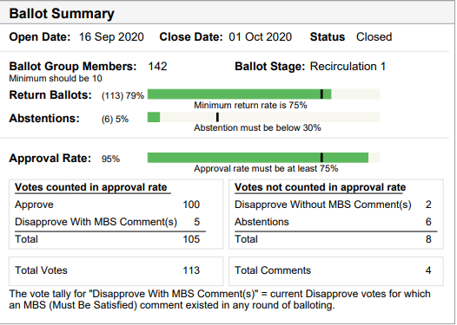
SA Ballot Summary
Approval rate: 95%
  100 approve, 5 disapprove
4 comments received

Slide 6
Timeline
2020
  October: comment resolution on D7.0
  October-November: D8.0 Recirc/Unchanged recirc
  November 13 – 802 EC Approval
  December 11 – Draft to RevCom
2021
  January: RevCom/SASB approval

Slide 7
Motion# 8000
Move to accept the comment resolution in [11-20/1596r0] for CIDs listed below:
  8001
  Move:
  Second:
  Result:

Slide 8
Motion# 8001
Move to accept the comment resolution in [11-20/1597r0] for CIDs listed below:
  8002, 8003, 8004
  Move:
  Second:
  Result:

