Slide 1
MU-RTS to SST-STAs
Date: 2020-10-07
Authors:

Slide 2
Abstract
This submission provides means for Sub-Channel Selective (SST) STAs to receive MU-RTS and transmit CTS as a response.

Slide 3
Recap, SST STA in 802.11ax
A STA and AP may setup an individual trigger-enabled TWT agreement to schedule the times when the STA operates in SST mode
20 MHz SST STA may operate in any secondary channel
  The PPDU reception rules are similar to the primary 20 channel
The 80 MHz SST STA may operate in the secondary 80 MHz channel
  The 80 MHz SST STA does not have a primary channel:
    STA receives HE MU and non-HT Duplicate PPDUs that are transmitted over the whole 80 MHz channel

Slide 4
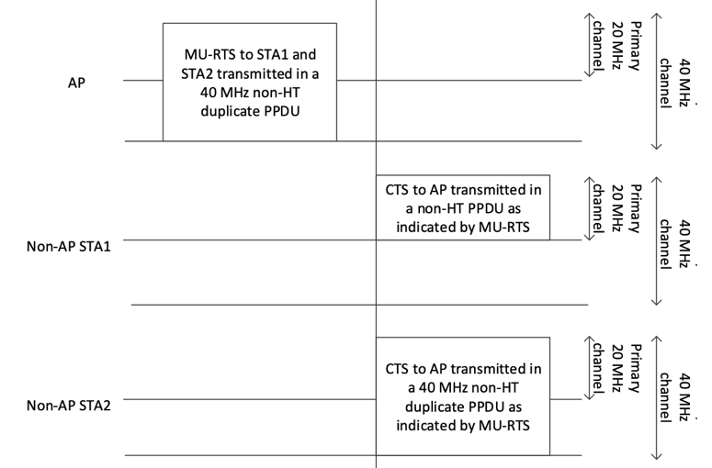
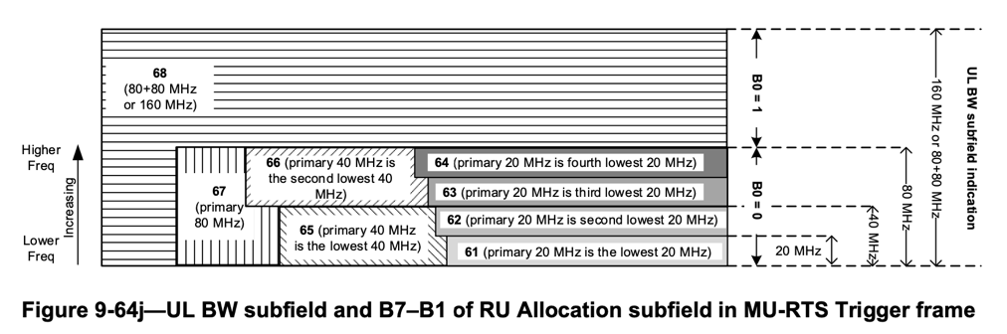
Recap, MU-RTS and CTS
MU-RTS may trigger CTS frame transmission from one or more STAs
The MU-RTS signals the channels in which the responding STAs transmit CTS if the channel(s) are IDLE
The CTS is always transmitted to the primary channel
The triggered STAs transmit CTS frames in the same format as specified in 802.11ax D7.0 clause 26.2.6.3(CTS Response to MU-RTS Trigger frame)
  This ensures that CTS frames have the same duration and content
  AP can receive CTS frames transmitted by multiple STAs on the same channel

Slide 5
Proposal1: MU-RTS and CTS exchange with EHT SST STA
1. CCA and NAV are obtained from the STA that receives DL transmission.
2. CTS protects the proximity of the STA that receives transmission
3. EHT SST STAs may operate outside the operating BW of the non-SST STAs.
4. Multiple responding STAs in primary channel make successful reservation likely
SIFS, CCA is done at the same time in all STAs

Slide 6
MU-RTS response alternatives
Case 1) AP does not receive CTS on any channel
  MU-RTS fails; AP obtains new TXOP through EDCA
Case 2) AP receives CTS on the primary channel
  AP follows the legacy rules and uses the reserved BW for TXOP
Case 3) AP receives CTS only from the SST-STA(s)
  The primary channel is not reserved by the MU-RTS frame
  Two alternatives to continue TXOP:
    AP may ignore the reservation on its secondary channels; TXOP fails
    AP may transmit only on the secondary channels
  It is up to AP implementation to select its operation
  The following slides explain the alternatives

Slide 7
Summary of proposal2, operation when CTS is received only on secondary channels
Alternative1: No data TX, AP may ignore the reservation
Alternative2: AP data transmission on secondary channels
SIFS, CCA is done at the same time in all STAs

Slide 8
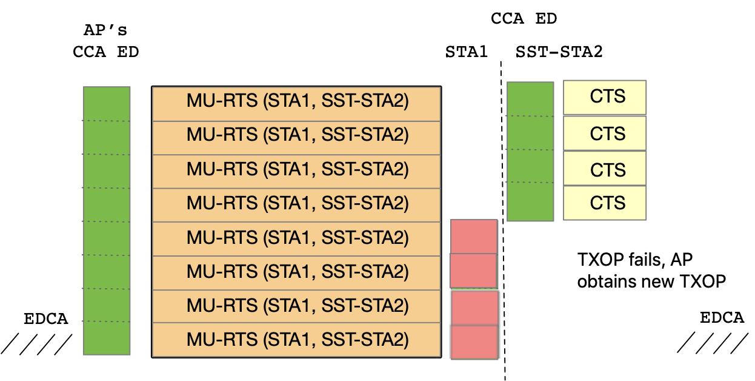
Alternative 1: Secondary channel reservation is ignored
Case: AP got CTS only on the secondary channels
  AP may ignore the reservation and obtain new TXOP through EDCA
  The AP is always present in the primary channel, but the secondary channel reservations may be wasted for OBSSs
  This scheme may be useful, if the AP has associated STAs that are not HE or EHT STAs
AP ignores reservation in secondary channels
CCA ED during the same SIFS

Slide 9
Alternative 2: AP transmits on reserved secondary channels
The AP may transmit on successfully reserved secondary channels
  This is like triggered UL transmission: A triggered STA may sense primary channel BUSY, but a triggered STA may sense secondary channel IDLE and transmit on the secondary channel
The MU-RTS frame can request multiple STAs to transmit CTS on the primary channel
  Multiple responding STAs may have higher likelihood to sense the primary channel IDLE and avoid hidden terminal problems

Slide 10
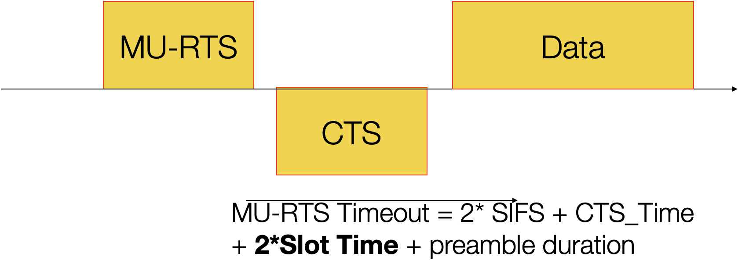
Recap, MU-RTS frame primary channel protection
All STAs set NAV when they receive MU-RTS frame
  An HE or EHT STA may reset NAV, if it does not receive a preamble within a MU-RTS timeout
  Legacy STAs cannot reset the NAV set by MU-RTS frame
AP should configure HE and EHT STAs to initiate UL EDCA transmissions with RTS CTS
  AP may set TXOP Duration Threshold subfield in HE Operation Parameters element to 1
  The RTS CTS protects the STAs from gaining to the media, if the AP is transmitting to SST-STAs

Slide 11
Motivation: Shorter MU-RTS frame
Short MU-RTS provides better protection against hidden STAs
  The triggered STAs may transmit CTS before transmissions from hidden STAs
The MU-RTS frame is transmitted in low TX Rate
  Packet size increases transmission duration
  @6 Mbit/s TX rate only 26 bits fit in one ~4µs symbol

Slide 12
Proposal 3: MU-RTS frame transmission per 80 MHz
MU-RTS frame is transmitted as a non-HT Duplicate PPDU
802.11be allows PPDUs to carry a different payload in each 80 MHz channel
  The MU-RTS frame on secondary, tertiary or quaternary 80 MHz channel may contain User Info fields only to the EHT SST STAs
  The MU-RTS frame transmission to SST-STAs may not increase the transmission duration of the MU-RTS frame

Slide 13
Recap, Packet Reception Channel
1. SST-STA Receives MU-RTS on Packet Detection channel [2]
2. The UL BW field of the MU-RTS frame signals the channels in which SST-STA transmits CTS. The SST-STA calculates the reserved channels from the Packet Detection Channel.
SIFS
[2] 20/736r2 EHT SST Operation, Mediatek

Slide 14
Proposal 4: Partial response to MU-RTS
The MU-RTS may allow an (SST-) STA to reserve a subset of the requested channels
  Successful reservation is more likely if a busy secondary channel does not prevent CTS transmission
  The SST-STA may send CTS on channels in which the AP is capable to transmit punctured PPDU
SIFS

Slide 15
Summary
The submission proposed MU-RTS CTS signalling for SST-STAs
  The DL transmissions to SST-STAs can have hidden terminal protection

Slide 16
SP 1
Do you support that 802.11be R2 allows AP to send an MU-RTS frame that requests CTS response from one or more EHT SST-STAs?
- The EHT SST-STAs respond with CTS if the requested channels are IDLE
- TDB whether SST-STA have additional capability to to send CTS on a subset of the requested channels

Slide 17
SP 2
Do you support that 802.11be R2 allows MU-RTS frame to have contains different payload at different 80 MHz channels?

Slide 18
SP 3
Do you support that 802.11be R2 STA has optional capability to send CTS as a response to the MU-RTS frame on a subset of the triggered channels?
- The MU-RTS frame signals whether a STA is allowed to transmit CTS on subset of the triggered channels

