Slide 1
MU-MIMO in 320MHz BW with Reduced Overhead
Date: 2020-9-29
Authors:
Name | Affiliation | Address | Phone | Email
Oded Redlich | Huawei Technologies
Shimi Shilo
Arik Klein
Avner Epstein
Yu Jian (Ross)

Slide 2
Introduction
  We propose a special mode of MU-MIMO transmission with reduced feedback for use in 320MHz BW
  This mode resembles the HE compressed mode with some adaptations due to the increase in BW
  While maintaining a reduced OH similar to HE compressed mode we gain:
  Support up to 16 STAs in a single PPDU (compared to up to 8 STAs in full-BW non-OFDMA compressed mode)
  Support flexible parking mechanism
    “Flexible” means that there aren’t any restrictions imposed on where a given STA may park

Slide 3
Recap – MU-MIMO in 11be
  The following definitions for MU-MIMO were accepted:
    The minimum RU size in which MU-MIMO is supported is 242 [1: 2.4.3, Motion 112].
    Maximum number of STAs in an MU-MIMO allocation is 8 [1: SP#47]
    Maximum number of SS per non-AP STA is 4 [1: 8.2, Motion 112].
  MU-MIMO assignment in 11ax is defined by the spatial configuration field within the user-field
    In 11ax where 8 SS is the limit, the spatial configuration field size is 4 bits
    In 11be, it is extended to 6 bits in order to support 16SS, hence increasing the user-field size.

Slide 4
Compressed Mode
  11ax compressed mode (HE-SIG-B compression=1) defines a single RU that spans the entire BW in which MU-MIMO transmission is used.
  In this case the RA sub-field is redundant, hence omitted so HE-SIG-B includes only the user-specific field.
  The number of STAs in the MU-MIMO allocation is defined in HE-SIG-A (instead of indicating the number of HE-SIG-B OFDM symbols in the non-compression mode)
  Using this compressed mode in EHT for BW=320MHz (including 240MHz=punctured 320MHz) to serve up to 8 STAs per PPDU may be less efficient in case more than 8 “demanding throughput” STAs are associated with the AP
  We think it is better to use two RUs that span the entire BW in order to serve more STAs operating on BW=320MHz and at the same time maintain similar OH reduction achieved in the compressed mode

Slide 5
MU-MIMO in 320MHz BW
  We consider the following assumptions/scenarios:
  Support up to 16 STA in a single PPDU with minimal EHT-SIG OH
    Use a default RU allocation of two RUs that span the entire BW
    This reduces signaling in EHT-SIG
    May be defined as a new mode or as a variant of compressed mode
  STAs support parking mechanism (e.g. SST) and may park anywhere, even in an RU outside their MU-MIMO RU
    Does not force additional restriction on the MU-MIMO grouping algorithm: any group may contain STAs that park in any segment
    This cannot be supported using A-PPDU
  Signaling issues
    Move spatial configuration field to EHT-SIG-Common
      Only for this mode
      There exist only 2 spatial configurations fields, hence it’s a waste to repeat them in all user-fields.
    Add some indications to each user-field
      To enable getting all necessary MU-MIMO parameters
      Essential when STAs that park in different segments belong to the same MU-MIMO group.
    Number of STAs in each MU-MIMO group is signaled in EHT-SIG-common

Slide 6
Low OH Mode in 320MHz
  Basic principle – maintain 11ax compressed mode main characteristics:
    DL transmission
    Omit RA sub-field - minimize EHT-SIG common field size
    No additional RUs besides the MU-MIMO RUs.
    STAs support full operating BW
      For example if the PPDU BW is 320MHz, then all STAs allocated in the PPDU support 320MHz
      There may be a scenario where an 80 MHz operating STA may still be part of this PPDU when the transmission BW is 240 MHz (punctured 320 MHz) - TBD
  Low OH modes
    Type 1: when a single MU-MIMO allocation is defined over the entire BW:
      Similar to 11ax full BW non-OFDMA compressed mode
      No implications when parking mechanism is applied
    Type 2: When two MU-MIMO allocations are used:
      First MU-MIMO allocation spans P160 or P80 (if S80 is punctured)
      Second MU-MIMO allocation spans S160/S80 (if any of S80 within S160 is punctured)
      Supporting parking may have some implications
    More types: TBD

Slide 7
Type-1 Compression Mode (Full BW )
  Up to 8 STAs over 240/320MHz where grouping may be unbalanced
    Non-OFDMA transmission –Exactly as in 802.11ax
    Any STA may park on any segment
  Signaling: similar to 11ax
  If parking mechanism is applied
    Use dummy user-field in each segment: each existing STA’s user-field is therefore placed in the correct location so the spatial configuration content is parsed correctly
    Alternatively, use the real user-fields instead of dummy user fields
      As a result, the user-specific field is the same in all segments

Slide 8
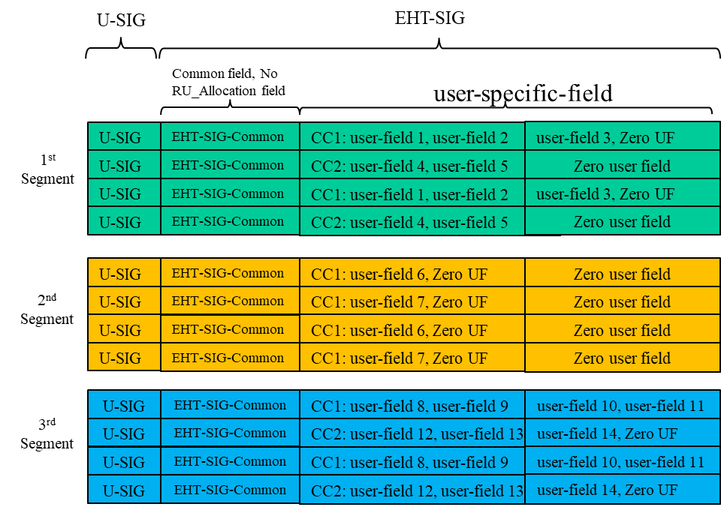
Type-2: Low OH MU-MIMO mode (2 RUs)
    Support up to 16 STAs in 2 default RUs
      For BW=320MHz
        1st RU = P160
        2nd RU = S160
      For BW=punctured 320MHz (160+80)
        1st RU = P160
        2nd RU = punctured S160
      For BW=punctured 320MHz (80+160)
        1st RU = punctured P160
        2nd RU = S160
    The following fields are replicated
    over all segments
      Signaling in U-SIG
        Reduced MU-MIMO OH mode
      Signaling in EHT-SIG-Common (may also be signaled in U-SIG)
        Spatial configuration of both RUs (12 bits) – moved out from the user fields
        Number of MU-MIMO users per MU-MIMO allocation (6 bits)
P160
S80

Slide 9
Type-2: Low OH MU-MIMO mode (2 RUs)
    The following signaling is suggested in
    the user-field
      STA_ID (11 bits)
      MCS (4 bits)
      Coding (1 bit)
      STA position in spatial configuration (*) (3 bits)
      User SC indication (**) (1 bit)
    (*) STA position in spatial configuration
    This field allows any STA to parse its location
    within the spatial configuration field without the need
    to decode other user-fields - especially those who
    park in other segments
    (**) User SC indication (MU-MIMO group index)
    Because there are 2 spatial configuration fields
    (rather than 1 as in the previous case) and both are
    transmitted in all segments, each STA needs to know which of the two is related to it. This bit indicates
    whether the STA takes groups 1’s spatial configuration field (‘0’) or group 2’s (‘1’). This field also indicates the MU-MIMO RU of the STA.
P160
S80

Slide 10
Type 2 - Low OH Mode Signaling
Reduced MU-MIMO OH Mode
STA position in spatial configuration
User SC Indication
Spatial Configuration
# STAs per MU-MIMO group
A detailed example is given in the appendix

Slide 11
MU-MIMO in 320 MHz – OH reduction
  As mentioned, we maintain OH reduction even though we increase the number of STAs in a single PPDU and allow them to park in any segment
    Omitting RA subfield saves up to 82 bits/C.C. (assuming RU Allocation table size is 9 bits: 9X8+10)
      Similar to what is saved for full-BW non-OFDMA compressed mode
    Removing spatial configuration (6 bits) and adding 4 indication bits to each user-field – potential saving of 2 bits per user-field = 16 bits/C.C.
      Although it is likely that these bits will be reserved in order to maintain fixed length of the user-fields
    Adding 18 bits (12 bits for 2 fields of spatial configuration & 6 bits for #MU-MIMO users per group) to EHT-SIG-common
  Total OH save:
    Potential of up to 80 bits,
    If user-field length stays unchanged: 64 bits.
    Equivalent to 3-4 OFDM symbols with MCS-0

Slide 12
Summary
  A reduced OH MU-MIMO mode for 320MHz BW is suggested
  This mode combines a minimal EHT-SIG duration signaling with two MU-MIMO RUs to support serving up to 16 STAs per PPDU assuming:
    All STAs may support Parking mechanism.
    All STAs support BW=320MHz
      in specific scenarios (TBD), some STAs may support BW=80 MHz
    Up to 8 STAs per each MU-MIMO RU
  Only in this mode - Spatial configuration field is moved from the user-fields to EHT-SIG common
  Two new fields are added to the user-field in order to signal MU-MIMO per-user parameters
    To enable supporting parking mechanism
  The overall OH in EHT-SIG is reduced by at least 64 bits for BW=320 MHz
  This expansion may be seen as a new transmission mode, hence requires an entry in U-SIG for signaling
    Alternatively it may be defined as the only MU-MIMO scheme in BW=320MHz, hence additional signaling is not needed

Slide 13
SP #1
Do you agree that EHT includes a mode in which MU-MIMO transmission with reduced over-head is done in two default RUs that span the entire BW?
  Only for BW=320MHz
  The default RUs are as defined in slide 8
  OH reduction is achieved by omitting RU allocation sub-field
  Whether if for R1/R2 is TBD
Y/N/A: xx/xx/xx

Slide 14
References
[1] 11-20/0566r32 Compendium of straw polls and potential changes to the Specification Framework Document

Slide 15
Appendix 1: Type-2 Compression Mode Signaling
    Example
    MU-MIMO groups
      Group 1 (data transmitted in P160) :
      users 1,3,5,7,9,11,13
      Group 2 (data transmitted S80) :
      users 2,4,6,8,10,12,14
    Parking – As shown in the figure
    Consider Group 1’s SS map
      Users 1, 5, 7: 2 spatial streams
      Users 3,9,11,13: 1 spatial stream
      Spatial configuration is therefore:
      [2 2 2 1 1 1 1]
    Consider Group 2’s SS map
      Users 8: 3 spatial streams
      Users 2,6,12: 2 spatial stream
      Users 4,10,14: 1 spatial stream
      Spatial configuration is therefore: [3 2 2 2 1 1 1]
    Both spatial configuration fields are signaled in all segments and their 12 bits content is
    [2 2 2 1 1 1 1], [3 2 2 2 1 1 1]

Slide 16
Appendix 1: Type-2 Compression Mode Signaling
group 1
group 2
    Example (cont.)
  In all segments: spatial configuration = [2 2 2 1 1 1 1], [3 2 2 2 1 1 1] (12 bits in EHT-common)
  “User SC indication” field in each UF is used
  as a pointer to the correct spatial configuration
  Consider segment #1
      Users 1,3 & 5 belong to group 1 therefore
      for these STAs “User SC indication ” = 0
      Users 2,4 & 6 belong to group 2 therefore
      for these STAs “User SC indication ” = 1
  Consider segment #2
      Users 7 belongs to group 1 therefore
      for this STAs “User SC indication ” = 0
      Users 8 belong to group 2 therefore
      for this STAs “User SC indication ” = 1
  Consider segment #3
      Users 9,11 & 13: “User SC indication ” = 0
      Users 10,12 & 14: “User SC indication ” = 1

Slide 17
Compression Mode Signaling – Opt 1 (10)
    Example (cont.)
    Example of how to set the “STA position in spatial configuration” field
      Spatial configuration is [2 2 2 1 1 1 1]
    So the content of user-field 7 in the 2nd segment (assuming MCS-1, LDPC):
      User 1: 000
      User 5: 001
      User 7: 010
      User 3: 011
      User 9: 100
      User 11: 101
      User 13: 110
STA_ID
MCS
STA position in SC
Coding
    User SC indication
11 bits
0001
010
1
0
STA 7 belongs to group 1

Slide 18
Appendix 2: Type-2 Compression Mode Parsing Example
    Based on the signaling described in Appendix 1, each STA can calculate its number of spatial streams and their indices (an example is given in the next slide)
      First, each STA extracts the spatial configuration/s structures from U-SIG/EHT-SIG-Common
      After decoding its user-field, each STA knows the complete set of parameters needed to correctly decode the MU-MIMO transmission
        “User SC indication”, if required, points to the relevant spatial configuration from which the total number of spatial stream is parsed
        “STA position in spatial configuration” enables parsing the indices of the spatial streams

Slide 19
Appendix 2: Type-2 Compression Mode Parsing Example
Examples of how a STA5 calculates its MU-MIMO User fields parameters:
  Spatial configuration =
  [2 2 2 1 1 1 1], [3 2 2 2 1 1 1]
STA | Num SS | position in SC
1 | 2 | 000
2 | 2 | 001
3 | 1 | 011
4 | 1 | 100
5 | 2 | 001
6 | 2 | 010
7 | 2 | 010
8 | 3 | 000
9 | 1 | 100
10 | 1 | 101
11 | 1 | 101
12 | 2 | 011
13 | 1 | 110
14 | 1 | 110
Group 1
Group 2
User SC indication = 0
User SC indication = 1
This implies that there are 2 SSs with indices 1&2 associated with a different user
  User 5 decodes its parameters in the corresponding user-fields and extract:
  STA_ID …
  STA position in spatial configuration = 001
  User SC indication = 0
“User SC indication” = 0 means it belongs to
group 1 so its spatial configuration is [2 2 2 1 1 1 1], hence there are total 10 spatial streams
Its position in spatial configuration is 2 (001), therefore its number of SS is 2 and their indices are 3,4 (because the user in position 1 has 2 SSs so their indices are 1,2)

Slide 20
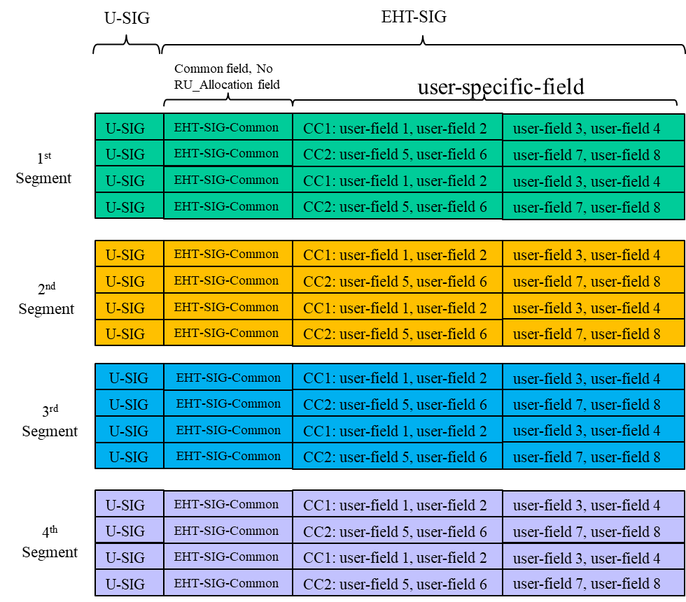
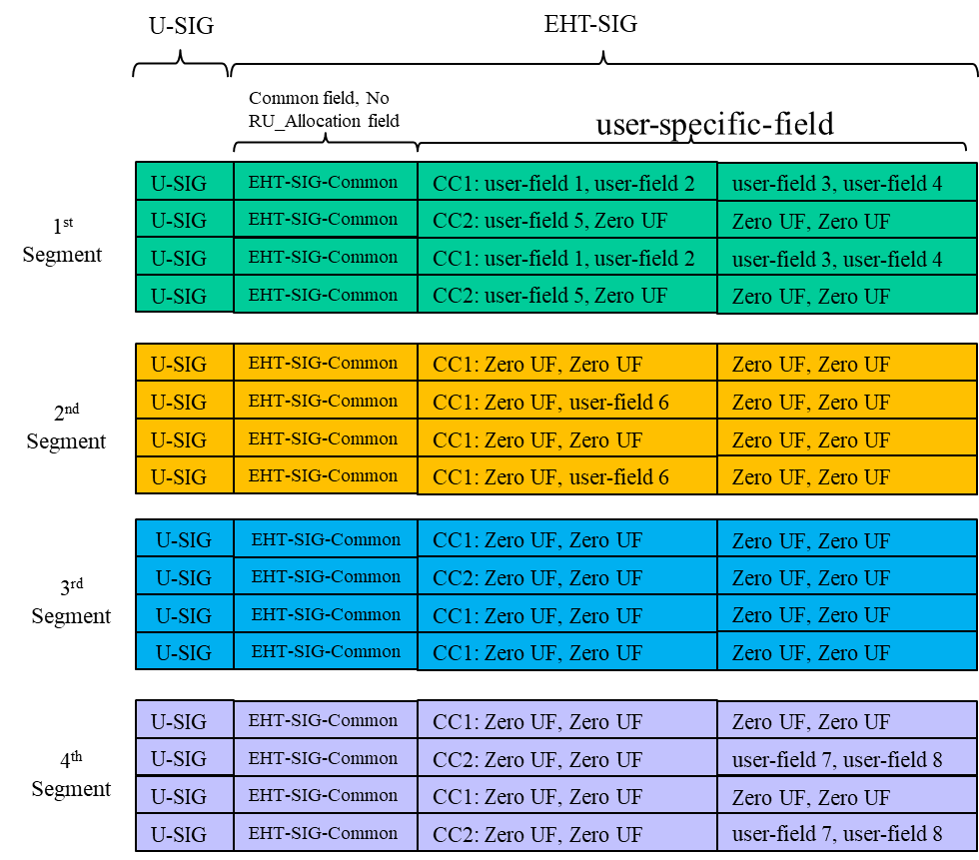
Appendix 3 - Type-1 Compression Mode (Full BW )
  In the example shown in the figure the parking location of each STA is:
    1st segment: 5 STAs
    2nd segment: 2 STAs
    3rd segment: 0 STA
    4th segment: 1 STAs
Using true user-field
Using dummy user-field

