Slide 1
5GS-WLAN Interworking Model and
QoS management
Date: 2020-10-02
Authors:

Slide 2
Abstract
It is expected that WLAN should enhance data throughput for increasing data traffic needs, and WLAN interworking to 3GPP 5G system for QoS specific ATSSS applications.
This tutorial introduces WLAN interworking model to 3GPP 5G system, QoS requirements and management for Non-GBR or GBR traffic which is referred from IEEE 802.11 AANI technical report “draft technical report on interworking between 3GPP 5G network and WLAN(IEEE 802.11-20/0013r5)”.
ATSSS: Access Traffic Steering, Switching & Splitting
GBR : Guaranteed Bit Rate.

Slide 3
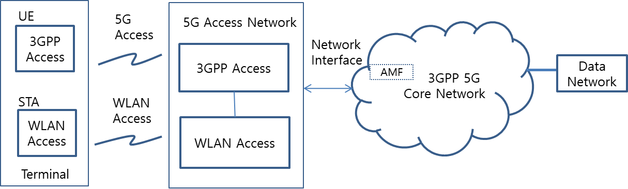
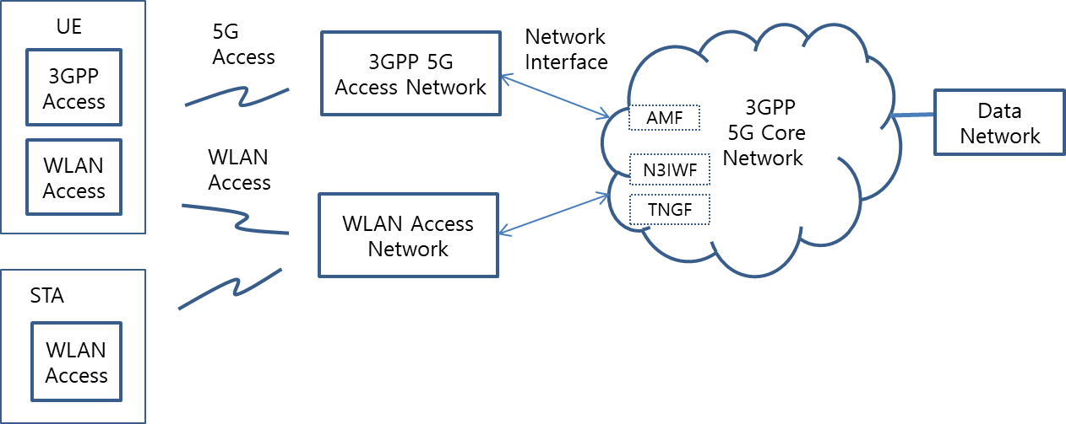
WLAN Interworking Types : Tightly coupled or Loosely coupled
The tightly coupled interworking type assumes that functional entities of the terminal and the two access networks are combined together and connect to 3GPP core network thus allowing a co-located 3GPP Access Network and a WLAN Access. This type is RAN level interworking.
The loosely coupled interworking type assumes that 3GPP and WLAN access networks operate independently and may be either co-located or be separate. This type is CN level Interworking and may have trusted or untrusted non-3GPP interworking.
There are two type of terminals: UE and STA, STA only.
Tightly coupled interworking reference model between 5G core network and WLAN(IEEE 802-11-20/0013r5)
Loosely coupled interworking reference model between 5G core network and WLAN(IEEE 802-11-20/0013r5)

Slide 4
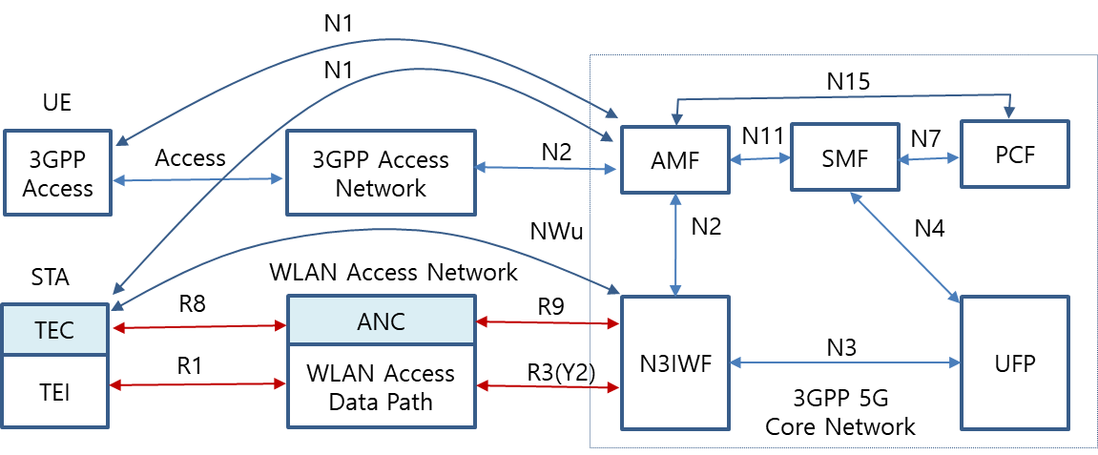
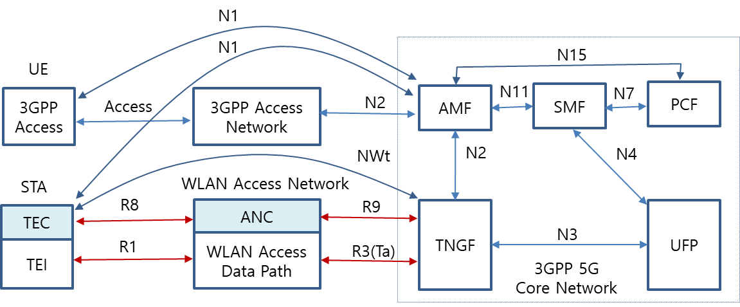
WLAN Interworking Functional Model in 5G System
WLAN interworking function model consists of UE/STA terminal, 3GPP/WLAN access network and 3GPP core network.
In the WLAN domain, R1 and R3 interfaces support the data flow via the PHY and MAC layers of STA and WLAN access network. In addition to the R1 and R3 interfaces, R8 and R9 control and management interfaces are considered to provide QoS mapping and MAC scheduling.
Untrusted WLAN interworking reference model with 5G core network (IEEE 802-11-20/0013r5)
Trusted WLAN interworking reference model with 5G core network
(IEEE 802-11-20/0013r5)

Slide 5
  Traffic Selection, Switching and Splitting(ATSSS) in 5G System
When the traffic is distributed between 5G access network and WLAN access network, the same QoS should be supported as long as the WLAN access network can support the same QoS treatment as the 5G access network. QoS flows on GBR traffic and Non-GBR traffic are specified in 3GPP TS 23.501.
GBR QoS Flow: A QoS Flow using the GBR resource type or the Delay-critical GBR resource type requiring guaranteed flow bit rate.
Non-GBR QoS Flow: A QoS Flow using the Non-GBR resource type and not requiring guaranteed flow bit rate.
Architectural reference model for ATSSS support(3GPP TS 23.501)

Slide 6
  QoS Characteristics in GBR and delay critical GBR
It is necessary that GBR flows are supported by the WLAN in both directions, e.g. non-AP STA to AP and AP to non-AP STA.
Resource Type | Default Priority Level | Packet Delay Budget | Packet Error Rate | Default Maximum Data Burst Volume | Default Averaging Window | Example Services
GBR | 20 | 100 ms | 10⁻² | N/A | 2000 ms | Conversational Voice
 | 40 | 150 ms | 10⁻³ | N/A | 2000 ms | Conversational Video (Live Streaming)
 | 30 | 50 ms | 10⁻³ | N/A | 2000 ms | Real Time Gaming, V2X messages Electricity distribution – medium voltage, Process automation - monitoring
 | 50 | 300 ms | 10⁻⁶ | N/A | 2000 ms | Non-Conversational Video (Buffered Streaming)
 | 7 | 75 ms | 10⁻² | N/A | 2000 ms | Mission Critical user plane Push To Talk voice (e.g., MCPTT)
 | 20 | 100 ms | 10⁻² | N/A | 2000 ms | Non-Mission-Critical user plane Push To Talk voice
 | 15 | 100 ms | 10⁻³ | N/A | 2000 ms | Mission Critical Video user plane
 | 56 | 150 ms | 10⁻⁶ | N/A | 2000 ms | "Live" Uplink Streaming (e.g. TS 26.238 [y])
 | 56 | 300 ms | 10⁻⁴ | N/A | 2000 ms | "Live" Uplink Streaming (e.g. TS 26.238 [y])
 | 56 | 300 ms | 10⁻⁸ | N/A | 2000 ms | "Live" Uplink Streaming (e.g. TS 26.238 [y])
 | 56 | 500 ms | 10⁻⁸ | N/A | 2000 ms | "Live" Uplink Streaming (e.g. TS 26.238 [y])
 | 56 | 500 ms | 10⁻⁴ | N/A | 2000 ms | "Live" Uplink Streaming (e.g. TS 26.238 [y])
Delay Critical GBR | 19 | 10 ms | 10-4 | 255 bytes | 2000 ms | Discrete Automation (see TS 22.261 [x])
 | 22 | 10 ms | 10-4 | 1354 bytes | 2000 ms | Discrete Automation (see TS 22.261 [x])
 | 24 | 30 ms | 10-5 | 1354 bytes | 2000 ms | Intelligent transport systems (see TS 22.261 [x])
 | 21 | 5 ms | 10-5 | 255 bytes | 2000 ms | Electricity Distribution- high voltage (see TS 22.261 [x])

Slide 7
  3GPP QoS Model
The SMF assigns QoS profile to AN in WLAN domain with QoS Flow Identification (QFI), which defines the QoS parameters for a QoS flow in the PDU session.
QoS flow is then mapped to AN resources for the assigned QFI.
QoS flow and mapping to AN resources in user plane for ATSSS support(3GPP TS 23.501)

Slide 8
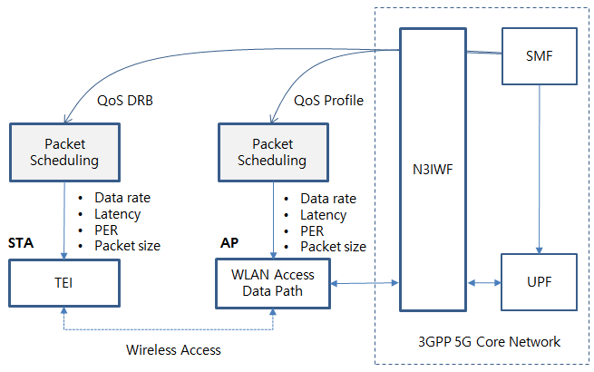
  WLAN QoS Mapping and Scheduling
  QoS mapping from 3GPP QoS to WLAN QoS is necessary
  Packet scheduling in STA and AP shall control MAC operation to meet required QoS
  AP QoS profile and STA DRB (Data Radio Bearers) contains service QoS identification and its parameters to define data rate, packet latency and PER value.
QoS mapping and scheduling example of WLAN(IEEE 802-11-20/0013r5)

Slide 9
  Gap analysis on GBR service
Resource Type | Services Examples | Packet Delay Budget | PER | Default Maximum Data Burst Volume | Gap Analysis of WLAN specification
GBR | Conversational Voice | 100 ms | 10⁻² | N/A | . 802.11ax MAC cannot support 3GPP GBR service requirements of deterministic packet latency, PER and data rate because the current EDCA is CSMA based MAC and supports only 4 service types of best effort, back ground, voice and video by controlling TXOP, AIFSN and contention window size. * HCCA relies on TSPECs, has a low level of implementation. . Enhanced MAC (802.11be) should consider QoS mapping, packet scheduling and related management procedures to support GBR. And PHY and MAC should be improved to control packet latency and reliability. . QoS flow identification and service priority shall be mapped to have fine granularity of service types and QoS parameters.
 | Conversational Video | 150 ms | 10⁻³ | N/A
 | Real Time Gaming, V2X messages | 50 ms | 10⁻³ | N/A
 | Non-Conversational Video | 300 ms | 10⁻⁶ | N/A
 | MCPTT | 75 ms | 10⁻² | N/A
 | Non-MCPTT | 100 ms | 10⁻² | N/A
 | MC-Video | 100 ms | 10⁻³ | N/A
 | "Live" Uplink Streaming | 150 ms | 10⁻⁶ | N/A
 | "Live" Uplink Streaming | 300 ms | 10⁻⁴ | N/A
 | "Live" Uplink Streaming | 300 ms | 10⁻⁸ | N/A
 | "Live" Uplink Streaming | 500 ms | 10⁻⁸ | N/A
 | "Live" Uplink Streaming | 500 ms | 10⁻⁴ | N/A

Slide 10
  Gap analysis on Delay Critical GBR service
Resource Type | Services Examples | Packet Delay Budget | PER | Default Maximum Data Burst Volume | Gap Analysis of WLAN specification
Delay Critical GBR | Discrete Automation | 10 ms | 10-4 | 255 bytes | . 802.11ax MAC cannot guarantee 3GPP delay critical GBR service requirements of latency, PER and guaranteed data rate. . Enhanced MAC (802.11be) should consider QoS mapping, packet scheduling and related management procedures to support GBR. And PHY and MAC should be improved to control packet latency and reliability. . 802.11bd NGV should consider ITS service requirement.
 | Discrete Automation | 10 ms | 10-4 | 1354 bytes
 | Intelligent transport systems | 30 ms | 10-5 | 1354 bytes
 | Electricity Distribution- high voltage | 5 ms | 10-5 | 255 bytes
WLAN shall support fine granularity of QoS and priority because 5G QoS ID has 6 bits and specifies QoS parameters involving GBR (Guaranteed Bit Rate), latency and PER.
Packet scheduling in STA and AP shall control MAC operation to meet required QoS. AP QoS profile and STA DRB (Data Radio Bearers) contains service QoS identification and its parameters

Slide 11
  5GS-WLAN Interworking Considerations
From 5GS and WLAN interworking reference model’s view, IEEE 802.11 should consider adding new functional entities and signaling procedures to support interworking with the 3GPP 5G network in terms of active scanning facility, association and authentication, QoS facility.
  QoS Management is essential !
QoS mapping to WLAN is necessary to support more granularity of QoS ID and parameters.
Packet scheduling in the STA and AP should meet data rate, latency and PER.
Timing scheduling and the adoption of a Hybrid ARQ scheme are very important.
802.11ax, as implemented, cannot support 3GPP GBR and delay critical GBR, and improved version (11be EHT, 11bd NGV) should consider MAC enhancement to support the service requirements.
Time Sensitive Network(TSN) application is highly related to QoS management in WLAN domain.

