Slide 1
MLD Security Considerations
Date: 2020-10-01
Authors:

Slide 2
Abstract
Single PTK is shared across links for MLO [1]
Extending the existing [2] security framework for sharing a single PTK across multiple links breaks widely used WLAN deployments.
We explain this use case along with a proposed fix.

Slide 3
Use Case: External keyholder encrypts/decrypts MPDUs
In this case, STA1 is a transmitter and STA 2 is a receiver.
The encryption keys are not shared outside of the key sharing boundary for both the key- holder entities.
Consider STA1 and STA2 as 802.11 capable entities within a larger system. Eg: Wireless subsystem in a smartphone or a laptop, wireless subsystem in an ‘hardware AP box’.

Slide 4
Use case examples
Example for DL traffic transmission:
MPDUs are encrypted at an entity external to the AP.
Entity can reside in the ‘AP hardware box’ as a separate hardware module, it can be a pure software solution like a private cloud server instance or it can be other hardware devices like wireless controller or a middlebox appliance, or any hybrid thereof, etc.
Encryption keys don’t leave the entity and are securely stored.
Encrypted MPDUs are sent to the AP.
Frames are transmitted by AP over the air (OTA) to the non-AP STA.
All BA session management (e.g. SN reordering) is still performed by the AP.
Eg: STA1 would be AP and STA2 would be non-AP STA on slide #3, etc.
Example for UL traffic transmission:
MPDUs are encrypted at an entity external to the non-AP STA.
Entity can be hardware entity, it can be a sub-system of an operating system, etc. It holds the keys and encrypts MPDUs in order to be security compliant. For example FIPS compliant wireless clients, etc.
Encrypted MPDUs are sent to the non-AP STA.
Frames are transmitted by the non-AP STA over the air to the AP.
All BA session management (e.g. SN reordering) is still performed by the non-AP STA.
Eg: STA1 would be non-AP STA and STA2 would be AP on slide #3.
Diagram on next slide for more explanation.

Slide 5
Contd. Use Case: non-AP STA WPA Pass Through Mode (Figure)
Host Device
Non-AP STA
AP
Tx Queue
2.4 GHz Radio
Address: S1
2.4 GHz Radio
Address: R1
Crypto Module
Rx FIFO
Host Interface
Cipher Keys
5 GHz Radio
Address: S2
5 GHz Radio
Address: R2
Rx FIFO
Tx Queue
All key data maintained only within the Crypto Module with no access by non-AP STA
Only encrypted frames exchanged over the host interface
Crypto Module typically implemented as a software module

Slide 6
Importance of this use case
Highly secure WLAN deployments use external key-holder mode.
Used in conjunction with security compliance certifications.
Eg: FIPS certified products and solutions, etc.
Eg: Federal/National and Local govt. administrative networks, Law enforcement networks, WLAN at public utilities infrastructure, Financial institutions, health industry, military usage, etc.
Many other network deployments also use this external key-holder mode of WLAN deployment.
Eg: Enterprises, stadiums, airports, universities, K-12 schools, shopping malls, etc. as it provides better security, firewalling ,etc.

Slide 7
External key-holder issues with MLO wrt Security framework
In MLO, A1/A2/A3 in a frame can change based on the link selected to transmit the frame and so will corresponding MIC generation.
So, either the link in MLO for traffic transmission is selected at a prior time in the external entity where encryption takes place:
In some use cases the benefits of real-time link selection are lost.
OR to preserve real-time MLO link selection, use of external key-holder is not possible.
Existing deployments are not directly upgrade-able to 802.11be compatible WLANs with the same performance level and security assurance. This is because security certifications require a good ‘key hygiene’ including a well-defined key sharing boundary which would be difficult in the case of MLO.
This problem applies to both, AP MLD and non-AP MLD.
Figure with the issue mentioned above is shown on the next slide

Slide 8
External key-holder issues with MLO wrt Security framework (Figure)
In this case: MLD1 is transmitter and MLD2 is receiver
The encryption keys are not shared outside of the key sharing boundary.
Consider MLD1 and MLD2 as 802.11 capable entities within a larger system. Eg: Wireless chipsets in a smartphone, wireless chipset in an ‘hardware AP box’.

Slide 9
Scope of solution
Proposed solution focuses on individually addressed Data frames.
Use cases do not compel a change for handling Management frames.

Slide 10
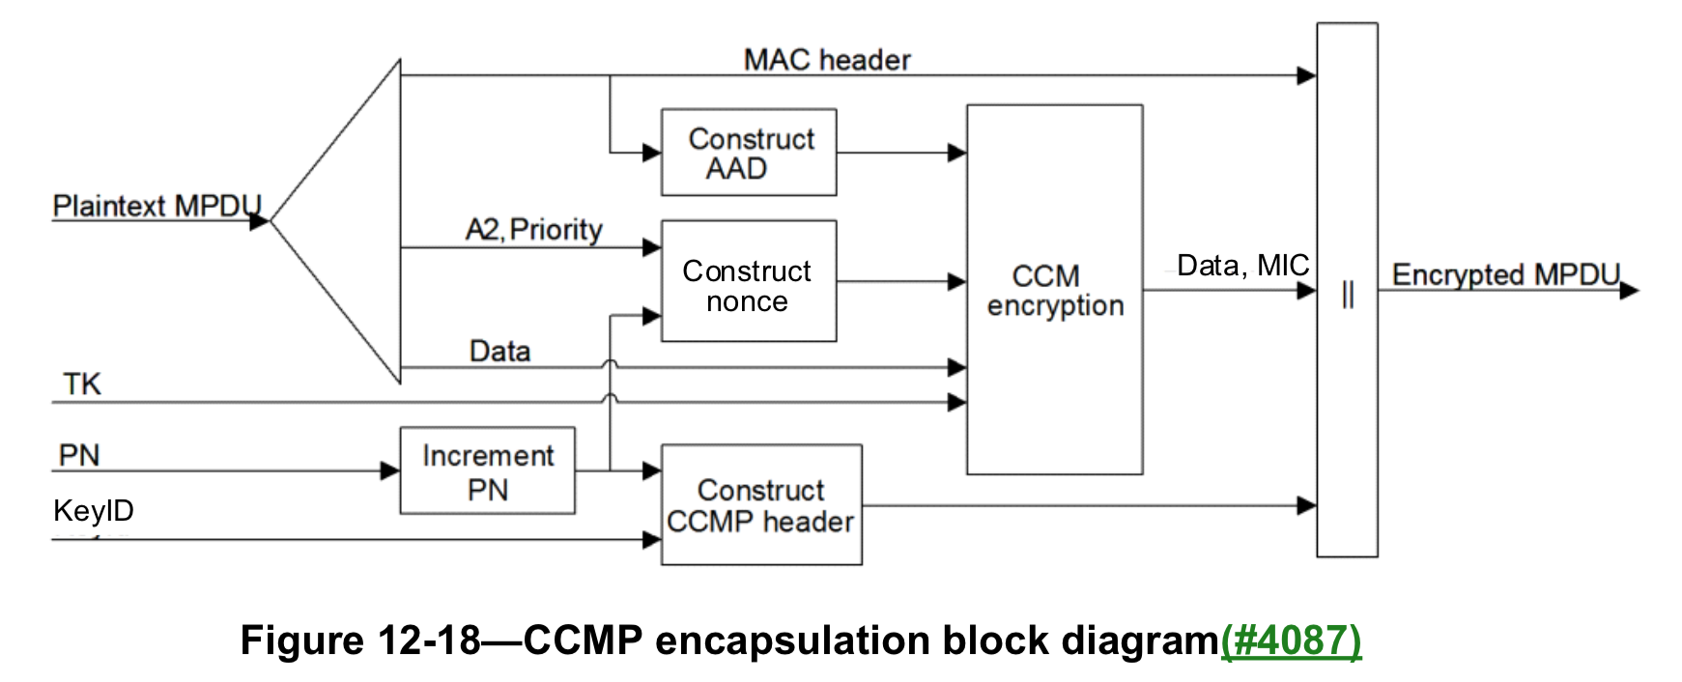
Proposed solution (general concept)
Changes from baseline spec:
Replacing of relevant and required Addresses (out of A1, A2,A3 and A4) to relevant MLD MAC during AAD Construction (which is used in MIC generation) for individually addressed Data frames. Relevant MLD MAC used in A2 which is used for Nonce construction for these frames.
Fig. 12-18 CCMP encapsulation block diagram
(P802.11REVmd_D5.0)
Details for specific conditions where only relevant addresses are replaced are given in proceeding slides.
Notes:
Update Fig 12-18

Slide 11
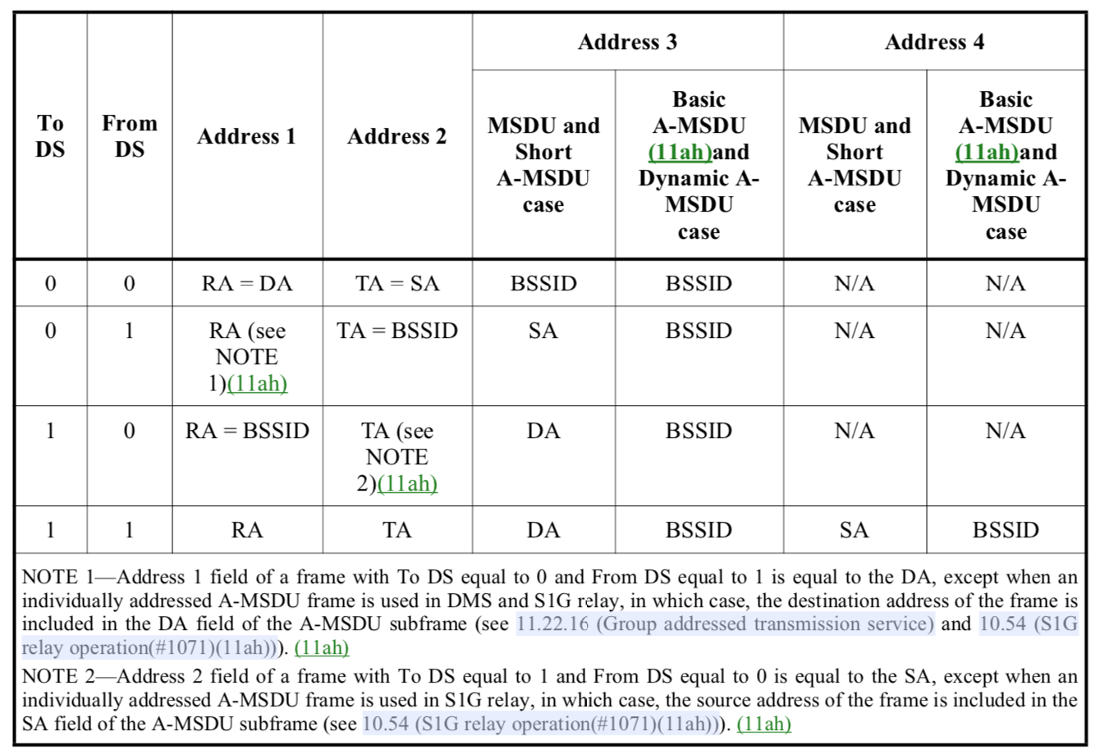
Proposed solution (details)
Table 9-30- Address field contents [2] [Shown just for reference. Address fields in the MAC header of the frame transmitted over the air will not be changed.]
Address 1 and Address 2 (blue box) are the local MAC addresses to Receive and Transmit on the WM. Hence they can be replaced with MLD MAC addresses for AAD computation. (i.e. A1 = non-AP MLD, A2 = AP MLD)
AP MLD MAC to be used in Address 2 for Nonce computation.
Non-AP MLD
MAC Address
AP MLD
MAC Address

Slide 12
Contd. Proposed solution (details)
Table 9-30- Address field contents [2] [Shown just for reference. Address fields in the MAC header of the frame transmitted over the air will not be changed.]
Address 3 will only be replaced by AP MLD MAC for AAD computation for the Basic A-MSDU case (blue box).
Caveat: When Address 3 is SA (green box) we cannot replace A3 with AP MLD MAC as MIC needs to be computed using SA.
Non-AP MLD
MAC Address
AP MLD
MAC Address
AP MLD MAC Address

Slide 13
Contd. Proposed solution (details)
Table 9-30- Address field contents [2] [Shown just for reference. Address fields in the MAC header of the frame transmitted over the air will not be changed.]
Address 1 and Address 2 (blue box) are the local MAC addresses to Receive and Transmit on the WM. Hence they can be replaced with MLD MAC addresses for AAD computation. (i.e. A1 = AP MLD, A2 = non-AP MLD)
Non-AP MLD MAC to be used in Address 2 for Nonce computation.
AP MLD
MAC Address
Non-AP MLD
MAC Address

Slide 14
Contd. Proposed solution (details)
Table 9-30- Address field contents [2] [Shown just for reference. Address fields in the MAC header of the frame transmitted over the air will not be changed.]
Address 3 will only be replaced by AP MLD MAC for AAD computation for the Basic A-MSDU case (blue box).
Caveat: When Address 3 is DA (green box) we cannot replace A3 with non-AP MLD MAC as MIC needs to be computed using DA.
AP MLD
MAC Address
Non-AP MLD
MAC Address
AP MLD MAC Address

Slide 15
Contd. Proposed solution (details)
Table 9-30- Address field contents [2] [Shown just for reference. Address fields in the MAC header of the frame transmitted over the air will not be changed.]
For mesh deployment use cases, consider the row in Table 9-30 with: To DS = 1, From DS = 1.
As before, Addresses (A1-A4) shown in blue boxes can be replaced with relevant MLD MAC addresses.

Slide 16
Advantages of the proposed solution
Minor changes to spec text to support a broadly used WLAN deployment use case.
Minimal changes to the AAD computation block.
Cleanly separates encryption from link transmission.
Allows possible single encryption engine for multiple links in MLO.
Can scale to more links in the future.
Allows faster retransmission (without MIC re-computation) on other enabled links.

Slide 17
No extra security implications
802.11i defined a security property of PTK i.e. a PTK is bound to the MAC address which derives it and it is that MAC address which sends the encrypted frame.
Benefit: Does not allow frame sent in one BSS to be replayed in another BSS.
In 802.11be, PTK is derived using MLD MAC and so it is bound to the MLD entity. Therefore, only the MLD is allowed to send the frame encrypted with that PTK.
But, A1/A2/A3 populated in MPDU are link specific.
That means we are intentionally are doing away with the property which 802.11i defined (above) and sharing the PTK between 2 different local link addresses (Eg: 2 APs within an AP MLD).
Additionally in D0.1 we have KDE exchanged during 4-way handshake between 2 MLDs which has Link IDs and other keys.
So, for example in case of DL traffic the non-AP MLD ‘knows’ which other entities (APs in an AP MLD) the PTK has been already shared with. Same is the case for UL traffic from non-AP MLD.
Therefore we are not losing any existing security guarantees with this proposal.

Slide 18
Summary
External key-holder is a well known and widely used entity for WLAN operation.
External encryption when using MLO in its current form is not suitable.
We propose a change to the existing spec text to support MLO fully using an external key-holder.

Slide 19
Straw Poll 1
In R1 do you support :
replacing Addresses A1 and A2 with MLD MAC Addresses for AAD computation,
replacing Address A3 (only in case when A3 is set to BSSID) with MLD MAC Address for AAD computation,
Using MLD MAC address in A2 for constructing Nonce
for the cases <To DS =0, From DS = 1> and <To DS = 1, From DS = 0> for individually addressed Data frames?
Y/N/A

Slide 20
Straw Poll 2
In R1 do you support:
replacing Addresses A1 and A2 with MLD MAC Addresses for AAD computation,
replacing Addresses A3 and A4 (only in case when A3 and A4 both are set to BSSID) with MLD MAC Addresses for AAD computation,
Using MLD MAC address in A2 for constructing Nonce
for the case <To DS =1, From DS = 1> for individually addressed Data frames?
Y/N/A

Slide 21
References
[1] https://mentor.ieee.org/802.11/dcn/19/11-19-1262-15-00be-specification-framework-for-tgbe.docx
[2] Draft P802.11REVmd_D5.0

