Slide 1
Discussion on WLAN sensing sequence design - follow up
Date: 2020-09-29
Authors:
Name | Affiliation | Address | Phone | Email
Rui Du | Huawei Technologies Co. Ltd | F3, Huawei Base, Shenzhen, China |  | Ray.du@Huawei.com
Danny Tan Kai Pin
Meihong Zhang
Chenchen Liu
Yingxiang Sun

Slide 2
Outline
Abstract
Ambiguity function
  Definition
  Analysis
Two types of receivers
  R-D with correlation receiver
  R-D with match filter receiver
  Analysis of R-D map
Analysis of R-D map with ambiguity function
Metrics for range-Doppler map
Comparison of ambiguity function and R-D map
Summary
References
Rui Du, et al. (Huawei)

Slide 3
Abstract
In previous presentations[1-2], the possibility of employing ambiguity function as a potential property for WLAN sensing sequence design is discussed.
In this contribution, further analysis of ambiguity function and range-Doppler map is done and discussed.
Rui Du, et al. (Huawei)

Slide 4
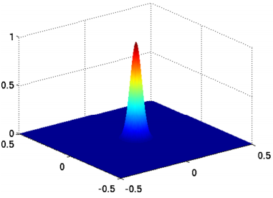
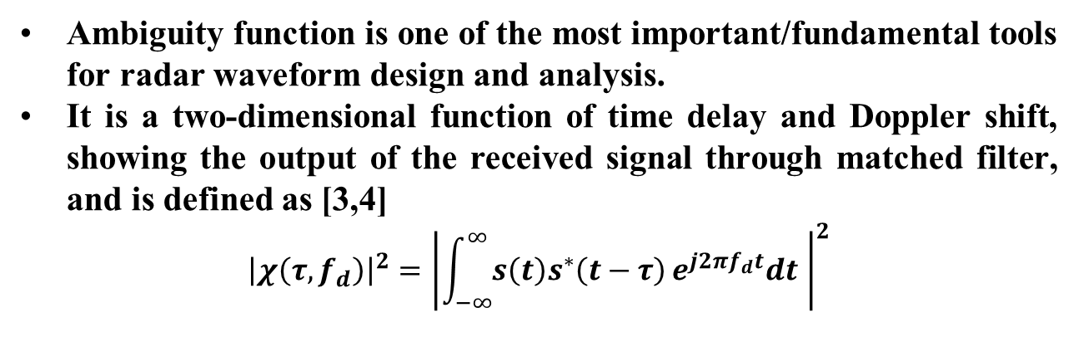
Definition of ambiguity function
Ambiguity function is one of the most important/fundamental tools for radar waveform design and analysis.
It is a two-dimensional function of time delay and Doppler shift, showing the output of the received signal through matched filter, and is defined as [3,4]
$${\left|χ\left(τ,f_{d}\right)\right|}^{2}={\left|\int_{−∞}^{∞}{s\left(t\right)s^{∗}\left(t−τ\right)}e^{j2πf_{d}t}dt \right|}^{2}$$
Doppler
Delay
Rui Du, et al. (Huawei)

Slide 5
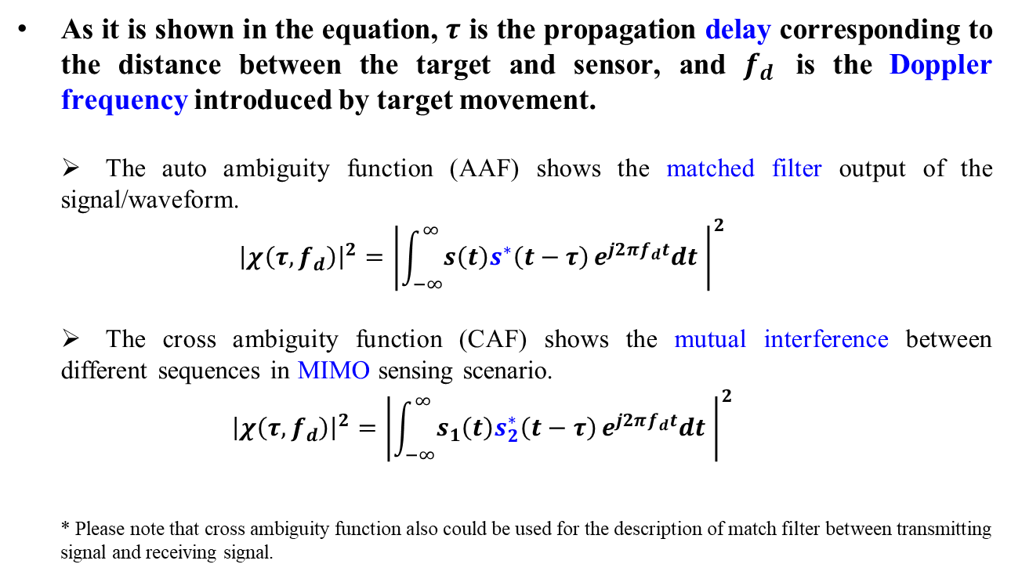
Analysis of ambiguity function
As it is shown in the equation, $τ$ is the propagation delay corresponding to the distance between the target and sensor, and $f_{d}$ is the Doppler frequency introduced by target movement.
The auto ambiguity function (AAF) shows the matched filter output of the signal/waveform.
$${\left|χ\left(τ,f_{d}\right)\right|}^{2}={\left|\int_{−∞}^{∞}{s\left(t\right)s^{∗}\left(t−τ\right)}e^{j2πf_{d}t}dt \right|}^{2}$$
The cross ambiguity function (CAF) shows the mutual interference between different sequences in MIMO sensing scenario.
$${\left|χ\left(τ,f_{d}\right)\right|}^{2}={\left|\int_{−∞}^{∞}{s_{1}\left(t\right)s_{2}^{∗}\left(t−τ\right)}e^{j2πf_{d}t}dt \right|}^{2}$$
* Please note that cross ambiguity function also could be used for the description of match filter between transmitting signal and receiving signal.
Parameter estimation
Rui Du, et al. (Huawei)

Slide 6
Two types of receivers
Correlation receiver
Cross correlation is done between the receiving signal (target echo) and transmitting signal (reference signal). Correlation peak appears at the time delay corresponding to the target distance.
But, if the target is moving, a Doppler shift will be modulated into the echo signal. This induced Doppler shift will distort the output of the correlator where the correlation peak will no longer be optimal. It can be concluded that the Doppler information of the target cannot be detected with a single transmission using the correlation receiver (correlation only provide delay information).
Matched filter receiver
To compensate the Doppler shift introduced by the target movement, matched filter receiver could be employed.
Matched filter will compensate the delay and Doppler to maximize the output energy (just as the ambiguity function’s definition indicates) and the peak will appear at target’s delay and Doppler shift. If the signal is long enough (having good Doppler resolution), it is able to detect the target distance and Doppler information simultaneously with a single transmission.
Rui Du, et al. (Huawei)

Slide 7
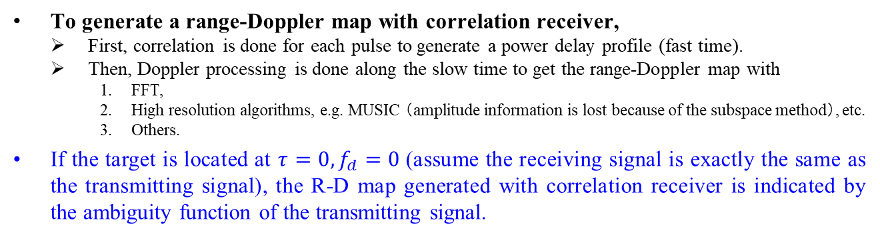
R-D with correlation receiver
Doppler
Doppler processing along slow time
Range
To generate a range-Doppler map with correlation receiver,
First, correlation is done for each pulse to generate a power delay profile (fast time).
Then, Doppler processing is done along the slow time to get the range-Doppler map with
  FFT,
  High resolution algorithms, e.g. MUSIC （amplitude information is lost because of the subspace method）, etc.
  Others.
If the target is located at $τ=0,f_{d}=0$ (assume the receiving signal is exactly the same as the transmitting signal), the R-D map generated with correlation receiver is indicated by the ambiguity function of the transmitting signal.
Rui Du, et al. (Huawei)

Slide 8
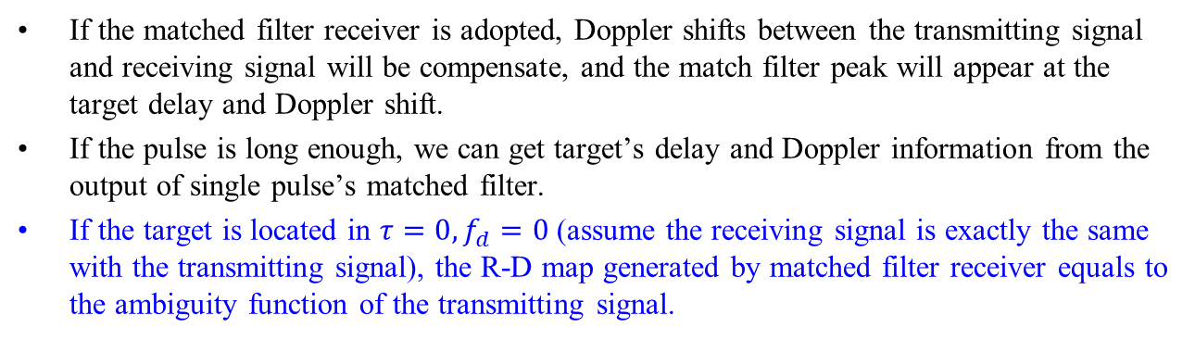
R-D with matched filter receiver
If the matched filter receiver is adopted, Doppler shifts between the transmitting signal and receiving signal will be compensate, and the match filter peak will appear at the target delay and Doppler shift.
If the pulse is long enough, we can get target’s delay and Doppler information from the output of single pulse’s matched filter.
If the target is located in $τ=0,f_{d}=0$ (assume the receiving signal is exactly the same with the transmitting signal), the R-D map generated by matched filter receiver equals to the ambiguity function of the transmitting signal.
Rui Du, et al. (Huawei)

Slide 9
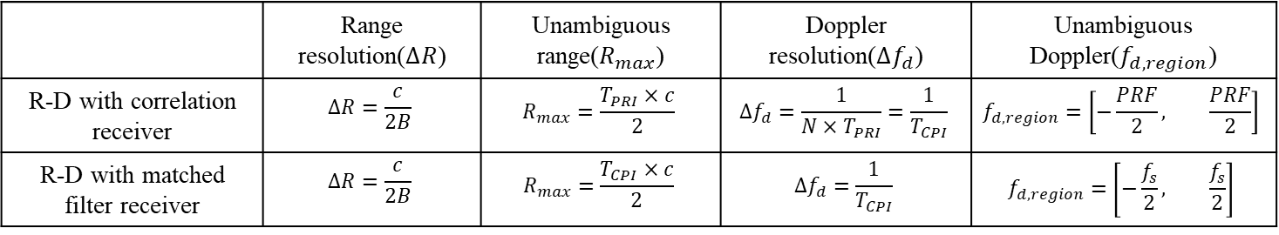
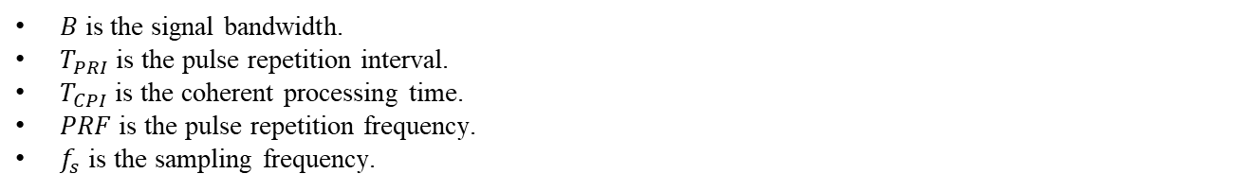
Analysis of R-D map
The 3dB mainlobe width along range is defined as the range resolution.
The maximum detection range is defined as the unambiguous range.
The 3dB mainlobe width along the Doppler dimension is defined as the Doppler resolution.
The maximum Doppler that could be detected is defined as the unambiguous Doppler frequency.
Doppler resolution
Doppler region
Doppler
Range resolution
Range
 | Range resolution($∆R$) | Unambiguous range($R_{max}$) | Doppler resolution($∆f_{d}$) | Unambiguous Doppler($f_{d, region}$)
R-D with correlation receiver | $$∆R=\frac{c}{2B}$$ | $$R_{max}=\frac{T_{PRI}×c}{2}$$ | $$∆f_{d}=\frac{1}{{N×T}_{PRI}}=\frac{1}{T_{CPI}}$$ | $$f_{d, region}=\left[−\frac{PRF}{2}, \frac{PRF}{2}\right]$$
R-D with matched filter receiver | $$∆R=\frac{c}{2B}$$ | $$R_{max}=\frac{T_{CPI}×c}{2}$$ | $$∆f_{d}=\frac{1}{T_{CPI}}$$ | $$f_{d, region}=\left[−\frac{f_{s}}{2}, \frac{f_{s}}{2}\right]$$
$B$ is the signal bandwidth.
$T_{PRI}$ is the pulse repetition interval.
$T_{CPI}$ is the coherent processing time.
$PRF$ is the pulse repetition frequency.
$f_{s}$ is the sampling frequency.
Rui Du, et al. (Huawei)
Notes:
统一格式。

Slide 10
Analysis R-D map with ambiguity function
Top view
Doppler resolution
Doppler
Delay resolution
Doppler
Delay
Delay
For the R-D map generated with correlation receiver, each row of the R-D map is a cross correlation between transmitting signal and receiving signal. The correlation result with different Doppler shift (after Doppler processing) is indicated in ambiguity function.
For the R-D map generated with the matched filter receiver, ambiguity function is the output of matched filter (this is clearly shown by the equation in slide 4) !
Both of the receivers’ outputs are indicated by the ambiguity function !
Correlation receiver is often adopted in pulse radar. It has equivalent performance but lower computation complexity.
Rui Du, et al. (Huawei)

Slide 11
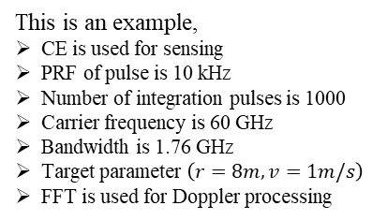
Metrics for range Doppler map
Range estimation.
Doppler/speed estimation.
Amplitude estimation.
This is an example,
CE is used for sensing
PRF of pulse is 10 kHz
Number of integration pulses is 1000
Carrier frequency is 60 GHz
Bandwidth is 1.76 GHz
Target parameter $\left(r=8m,v=1m/s\right)$
FFT is used for Doppler processing
Due to the potential transmission approach of sequence in WLAN sensing, correlation receiver could be adopted and a simple simulation is shown above on.
What metrics could be used for the evaluation of range Doppler map ?
Peak to sidelobe ratio, et al. (already included in the ambiguity function)
Estimation accuracies (range, speed accuracy)
To estimate the range and Doppler/speed of the target, a detector should be adopted (CA-CFAR is adopted in this example).
To evaluate the performance, end to end simulation is needed !
Rui Du, et al. (Huawei)

Slide 12
Comparison of ambiguity function and R-D map
Ambiguity function
It is a fundamental analysis of waveform which indicates the limitation and utility of the waveforms and provide a guideline for the selection of suitable waveforms for variable applications.
It has been adopted for radar waveform design and analysis in the last few decades[3,4].
Range-Doppler map
It gives the signal processing/sensing results within the coherent processing time and could be used for the evaluation of sensing performance in certain scenarios.
Rui Du, et al. (Huawei)
Notes:
表格总结？

Slide 13
Summary
In this presentation, further analysis of ambiguity function is introduced and discussed.
Based on the discussion above on, ambiguity function and R-D map both could be used for the evaluation of sensing, and ambiguity function is a more fundamental choice for the waveform design and analysis.
Rui Du, et al. (Huawei)

Slide 14
References
[1] 11-20-1328-00-SENS-discussion-on-wlan-sensing-sequence-design.pptx
[2] 11-20-1444-00-SENS-Golay Sequences and Ambiguity Function.pptx
[3] Skolnik M I. Introduction to radar systems[M]. New York: McGraw-hill, 1980.
[4] Mahafza B R. Radar systems analysis and design using MATLAB[M]. CRC press, 2002.
Rui Du, et al. (Huawei)

Slide 15
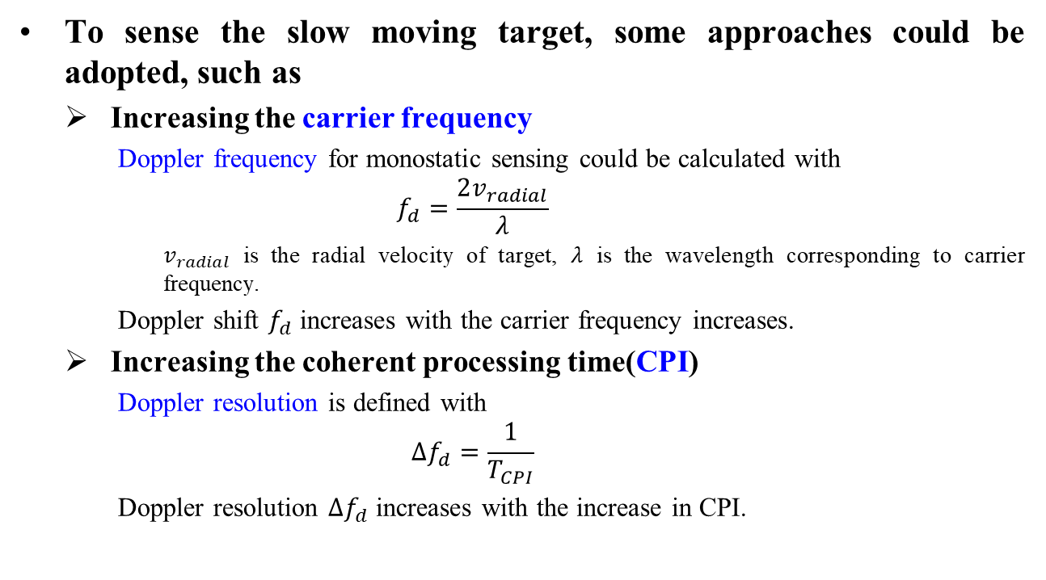
Annex: sensing the slow moving target
To sense the slow moving target, some approaches could be adopted, such as
Increasing the carrier frequency
  Doppler frequency for monostatic sensing could be calculated with
  $$f_{d}=\frac{2v_{radial}}{λ}$$
    $v_{radial}$ is the radial velocity of target, $λ$ is the wavelength corresponding to carrier frequency.
  Doppler shift $f_{d}$ increases with the carrier frequency increases.
Increasing the coherent processing time(CPI)
  Doppler resolution is defined with
  $$∆f_{d}=\frac{1}{T_{CPI}}$$
  Doppler resolution $∆f_{d}$ increases with the increase in CPI.
Rui Du, et al. (Huawei)

