Slide 1
NDP Design for EHT
Date: 2020-09-15
Authors:

Slide 2
Introduction
In this contribution
  We propose an NDP with no EHT-SIG
  The proposed NDP is aligned with HE NDP, which enables the A-PPDU based sounding [3][4].

Slide 3
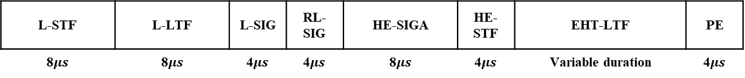
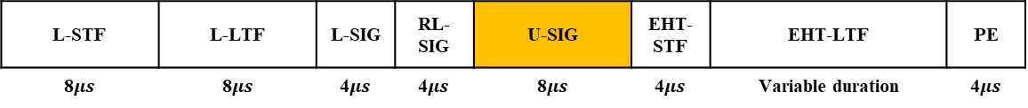
Overview of the Proposed NDP
Propose an EHT-NDP with no EHT-SIG, which is aligned with HE NDP
Proposed in [1]
L-STF | L-LTF | L-SIG | RL-SIG | U-SIG | EHT-SIG | EHT-STF | EHT-LTF | PE
8$μs$ | 8$μs$ | 4$μs$ | 4$μs$ | 8$μs$ | 8$μs$ | 4$μs$ | Variable duration | 4$μs$
Proposed in [2]
L-STF | L-LTF | L-SIG | RL-SIG | U-SIG | EHT-SIG | EHT-STF | EHT-LTF | PE
8$μs$ | 8$μs$ | 4$μs$ | 4$μs$ | 8$μs$ | 4$μs$ | 4$μs$ | Variable duration | 4$μs$
Proposed
L-STF | L-LTF | L-SIG | RL-SIG | U-SIG | EHT-STF | EHT-LTF | PE
8$μs$ | 8$μs$ | 4$μs$ | 4$μs$ | 8$μs$ | 4$μs$ | Variable duration | 4$μs$
HE-NDP
L-STF | L-LTF | L-SIG | RL-SIG | HE-SIGA | HE-STF | EHT-LTF | PE
8$μs$ | 8$μs$ | 4$μs$ | 4$μs$ | 8$μs$ | 4$μs$ | Variable duration | 4$μs$

Slide 4
U-SIG and EHT-SIG Subfields
EHT-SIG contains lots of unnecessary subfields for NDP
  The yellow-marked subfields are redundancy for NDP
    Can result in one or more symbol overhead compared with HE NDP
  Merged to U-SIG
Field | Category | Subfield
EHT-SIG | Common Field | Spatial reuse
 |  | GI+LTF size
 |  | Number of EHT-LTF symbols and midamble periodicity
 |  | Doppler
 |  | Pre-FEC padding
 |  | LDPC extra symbol segment
 |  | Reserved
 |  | PE disambiguity
 |  | Number of non-OFDMA users
 | User Filed | STA-ID
 |  | NSTS
 |  | Beamformed
 |  | MCS
 |  | Reserved
 |  | Coding
 | CRC & Tail | CRC in EHT-SIG
 |  | CRC in EHT-SIG
Field | Category | Subfield
U-SIG | Version Independent | Version identifier
 |  | UL/DL
 |  | BSS color
 |  | TXOP
 |  | PPDU BW
 | Version Dependent | Punctured channel indication
 |  | Reserved
 |  | PPDU Type
 |  | Reserved
 |  | EHT-SIG MCS
 |  | Number of EHT-SIG symbols
 |  | Compression Mode
 | CRC & Tail | CRC in U-SIG
 |  | Tail in U-SIG

Slide 5
EHT-NDP Indication
Two options can be used to indicate the EHT-NDP
  (Option 1) Use PPDU Type (1bit) and Compression Mode (2 bits)
  (Option 2) Use PPDU Type (2 bits) only
 | DL/UL (1 bit) | PPDU Type (1 bits) | Compression Mode (2 bits) | Note
TB PPDU | UL | 0 | 0 | No EHT-SIG
UL SU/SU DUP | UL | 1 | 1 | EHT-SIG, No RU Allocation, CC=[1 1 1 1]
DL SU/SU DUP | DL | 1 | 1 | EHT-SIG, No RU Allocation, CC=[1 1 1 1]
OFDMA | DL | 1 | 0 | EHT-SIG, RU Allocation, CC=[1 2 1 2]
Non-OFDMA MU-MIMO | DL | 1 | 2 | EHT-SIG, No RU Allocation, CC=[1 2 1 2]
NDP | DL/UL | 0 | 1 | No EHT-SIG
 | DL/UL (1 bit) | PPDU Type (2 bits) | Note
TB PPDU | UL | 0 | No EHT-SIG
UL/SU DUP | UL | 1 | EHT-SIG, No RU Allocation, CC=[1 1 1 1]
DL/SU DUP | DL | 1 | EHT-SIG, No RU Allocation, CC=[1 1 1 1]
OFDMA | DL | 0 | EHT-SIG, RU Allocation, CC=[1 2 1 2]
Non-OFDMA MU-MIMO | DL | 2 | EHT-SIG, No RU Allocation, CC=[1 2 1 2]
NDP | DL/UL | 3 | No EHT-SIG

Slide 6
Proposed U-SIG Subfields for EHT-NDP
We believe that unnecessary subfields in U-SIG have sufficient bit size along with the reserved subfield to replaced with the necessary subfields in EHT-SIG
If the Option 1 is used, U-SIG subfields for NDP will be as below.
  The bit size is based on [1] and [2]
Field | Category | Subfield |  | Bits
 |  | Non-NDP | NDP
U-SIG | Version Independent | Version identifier |  | 3
 |  | UL/DL |  | 1
 |  | BSS color |  | 6
 |  | TXOP |  | 7
 |  | PPDU BW |  | 3
 | Version Dependent | Punctured channel indication |  | 5
 |  | Reserved |  | 1
 |  | PPDU Type |  | 1
 |  | Reserved | Beamformed (1) GI+LTF size (3) Nsts (4) Reserved (5) | 6
 |  | EHT-SIG MCS |  | 2
 |  | Number of EHT-SIG symbols |  | 5
 |  | Compression Mode |  | 2
 | CRC & Tail | CRC in U-SIG |  | 4
 |  | Tail in U-SIG |  | 6
 | Total # of Bits in U-SIG |  |  | 52

Slide 7
Proposed U-SIG Subfields for EHT-NDP
If the Option 2 is used, U-SIG subfields for NDP will be as below.
  The bit size is based on [1] and [2]
Field | Category | Subfield |  | Bits
 |  | Non-NDP | NDP
U-SIG | Version Independent | Version identifier |  | 3
 |  | UL/DL |  | 1
 |  | BSS color |  | 6
 |  | TXOP |  | 7
 |  | PPDU BW |  | 3
 | Version Dependent | Punctured channel indication |  | 5
 |  | Reserved |  | 1
 |  | PPDU Type |  | 2
 |  | Reserved | Reserved (5) Beamformed (1) GI+LTF size (3) Nsts (4) | 6
 |  | EHT-SIG MCS |  | 2
 |  | Number of EHT-SIG symbols |  | 5
 |  | Reserved |  | 1
 | CRC & Tail | CRC in U-SIG |  | 4
 |  | Tail in U-SIG |  | 6
 | Total # of Bits in U-SIG |  |  | 52

Slide 8
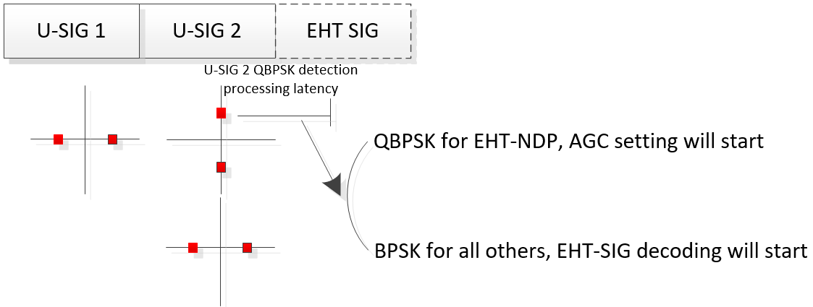
Constellation based EHT-NDP Indication - (Updated)
Group’s concerns on our previous contribution (1474r1)
  Viterbi decoding of U-SIG for parsing PPDU Type and/or Compression Mode can delay the AGC setting time, which uses the following EHT-STF
  Implicit indication using the NDPA is not a safe method
Constellation based NDP indication method - Proposal
  In order to have enough time for the AGC setting in EHT-STF, we propose following constellation for U-SIG, similar to VHT-SIG-A
    U-SIG1 (4us): BPSK
    U-SIG2 (4us): QBPSK for NDP, and BPSK for others

Slide 9


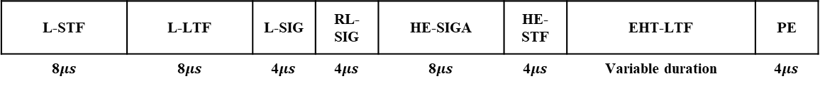

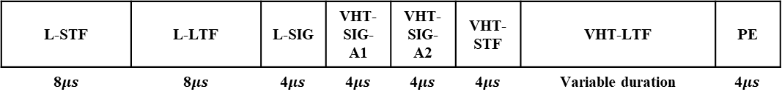
Constellation based EHT-NDP Indication - (Updated)
Comparison of NDP structure
VHT-NDP
L-STF | L-LTF | L-SIG | VHT-SIG-A1 | VHT-SIG-A2 | VHT-STF | VHT-LTF | PE
8$μs$ | 8$μs$ | 4$μs$ | 4$μs$ | 4$μs$ | 4$μs$ | Variable duration | 4$μs$
HE-NDP
mod (LENGTH, 3) = 1
L-STF | L-LTF | L-SIG | RL-SIG | HE-SIGA | HE-STF | EHT-LTF | PE
8$μs$ | 8$μs$ | 4$μs$ | 4$μs$ | 8$μs$ | 4$μs$ | Variable duration | 4$μs$
Proposed EHT-NDP
mod (LENGTH, 3) = 0
L-STF | L-LTF | L-SIG | RL-SIG | U-SIG | EHT-STF | EHT-LTF | PE
8$μs$ | 8$μs$ | 4$μs$ | 4$μs$ | 8$μs$ | 4$μs$ | Variable duration | 4$μs$

Slide 10
Summary
We proposed to design EHT-NDP with no EHT-SIG symbol, which is the only method to enable the A-PPDU based sounding
Two options were proposed to have a separate entity to indicate EHT-NDP
  Option 1) PPDU Type (1bit) and Compression Mode (2bits)
  Option 2) PPDU Type (2bits) only
In addition, in order to have enough time for AGC setting in EHT-NDP, we also proposed the following U-SIG constellation
  U-SIG1: BPSK
  U-SIG2: QBPSK for EHT-NDP and BPSK for others

Slide 11
SP #1
Do you agree that zero EHT-SIG symbol for EHT-NDP?
  Y
  N
  A

Slide 12
SP #2
Do you agree that following subfields are included in U-SIG for EHT-NDP?
  Beamformed (1 bit)
  GI+LTF size (TBD)
  Nsts (4 bit)
  Y
  N
  A

Slide 13
SP #3
Do you support to have a separate entity to indicate EHT-NDP by using PPDU Type and/or Compression Mode subfields?
  Y
  N
  A

Slide 14
SP #4
Do you agree that following constellation in U-SIG?
  U-SIG1: BPSK
  U-SIG2: QBPSK for NDP, and BPSK for others
  Y
  N
  A

Slide 15
Reference
[1] 802.11-19/1238r0, Open Issues on Preamble Design
[2] 802.11-20/1317r0, SIG contents discussion for EHT sounding NDP
[3] 802.11-20/0693r1, Aggregated PPDU for Large BW.
[4] 802.11-20/1015r1, EHT NDPA Frame Design Discussion

