Slide 1
Proposals and related work on Center Frequency for the Common Mode Mandatory PHY
Date: 2020-09
Authors:

Slide 2
Abstract
This presentation reviews the proposals and related work on the optimal center frequency for the common mode mandatory PHY of TGbb.
Documents IEEE 802.11-20/0572r1 and IEEE 802.11-20/1037r0 are reviewed.

Slide 3
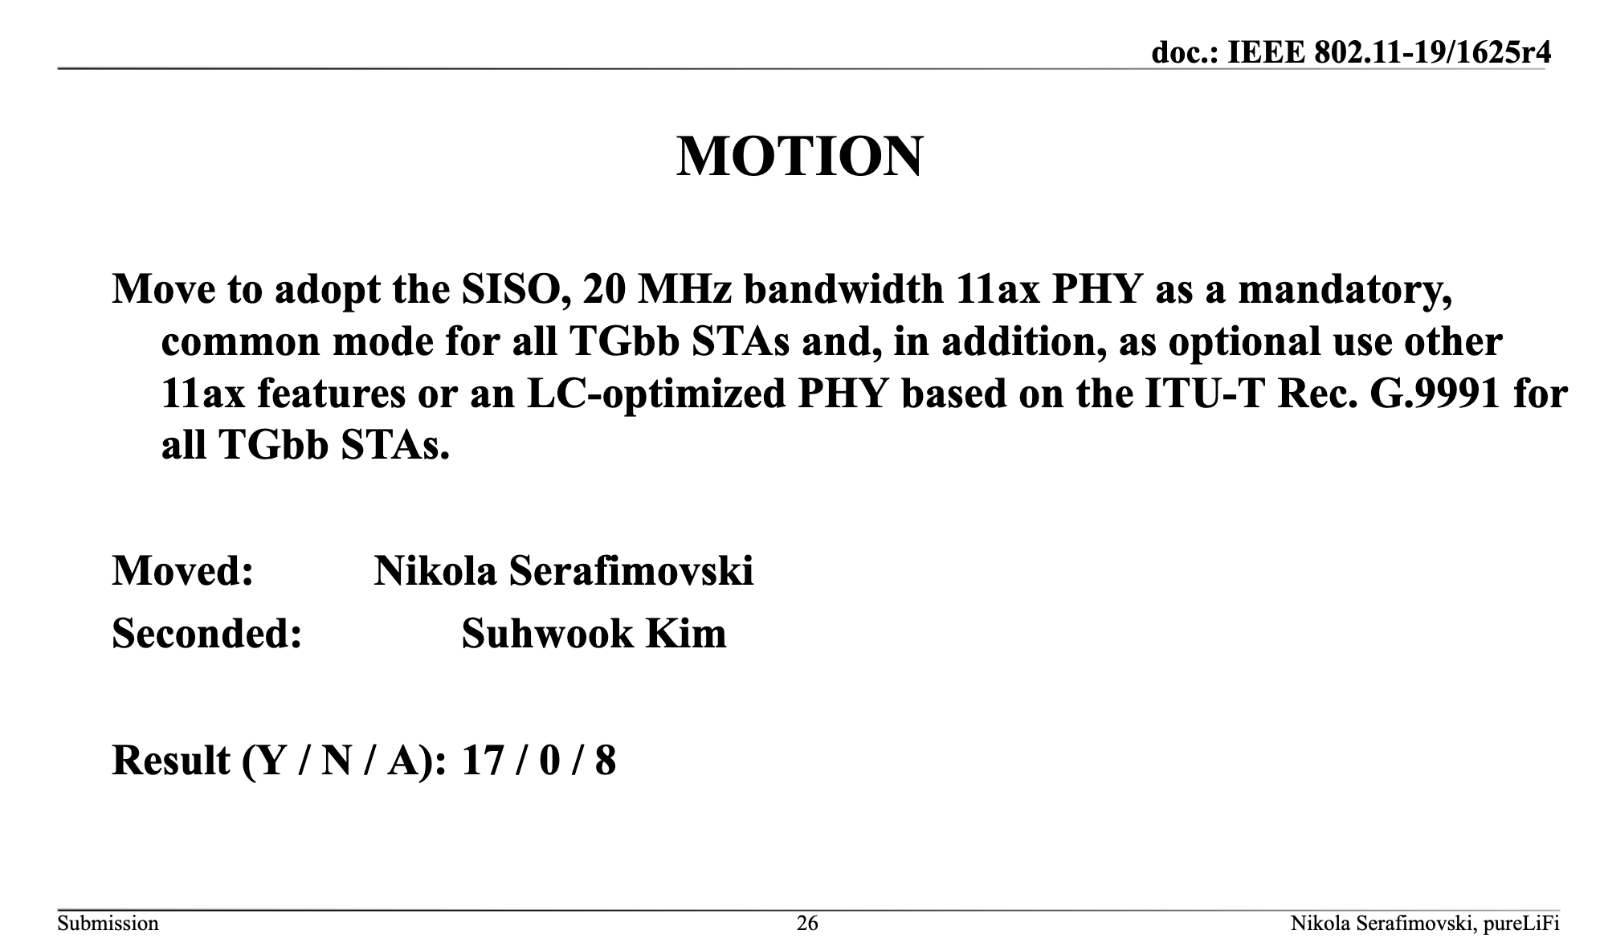
April 2020
Ardimas Purwita (University of Edinburgh)

Slide 4
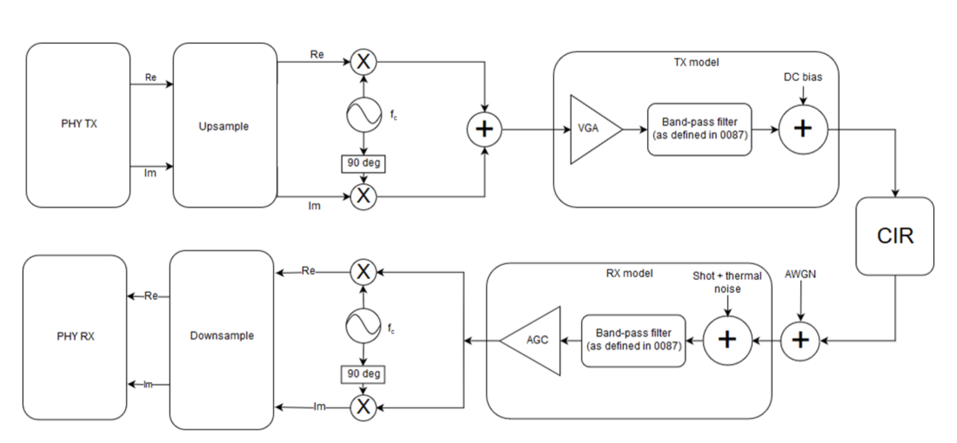
EVM Test
IEEE 802.11-19/0187r4
Constellation
reference
Estimated symbols
from equalizer
Calculate EVM
(Eq. 28-127
in IEEE P802.11ax™/D3)
High SNR assumption: limited by freq. selective channels and shot noise

Slide 5
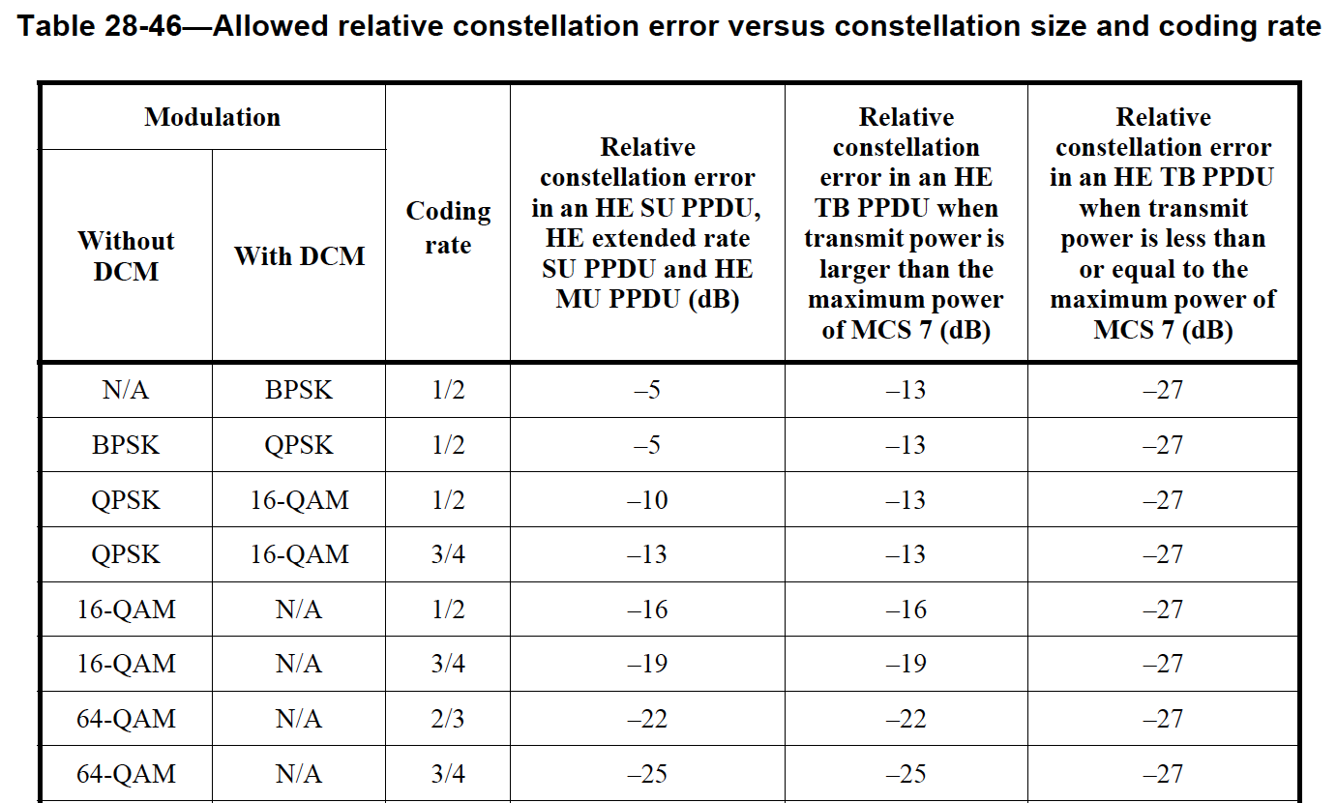
Further Discussions
For example, with respect to the previous AWGN simulations, we have the EVM in dB for MCS6 as:
BETTER
fc | 10.5 MHz | 11.5 MHz | 15 MHz | 40 MHz
EVM (dB) | -23.45 | -29.01 | -34.95 | -37.29

Slide 6
Problem Formulation
Given that we are confident with the EVM values, then we can find the optimal frequency as follows:
  i.e., it is an exhaustive search over CIRs and MCS index values, but the EVM value must be lower than the allowed EVM values that are defined in the 802.11ax document
fc* = arg min (EVM) for each CIR and MCS index values s.t. the EVM does not exceed the allowed EVM values

Slide 7
Our Approach
Samples, BW = 20 MHz
- - EVM limit
Insignificant improvement
Find the knee point

Slide 8
Snapshot (1)
BW = 20 MHz
Most channels exhibit the optimal center frequency at 12.45 MHz
12.45 MHz
heavy tail

Slide 9
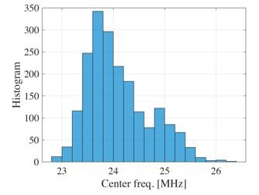
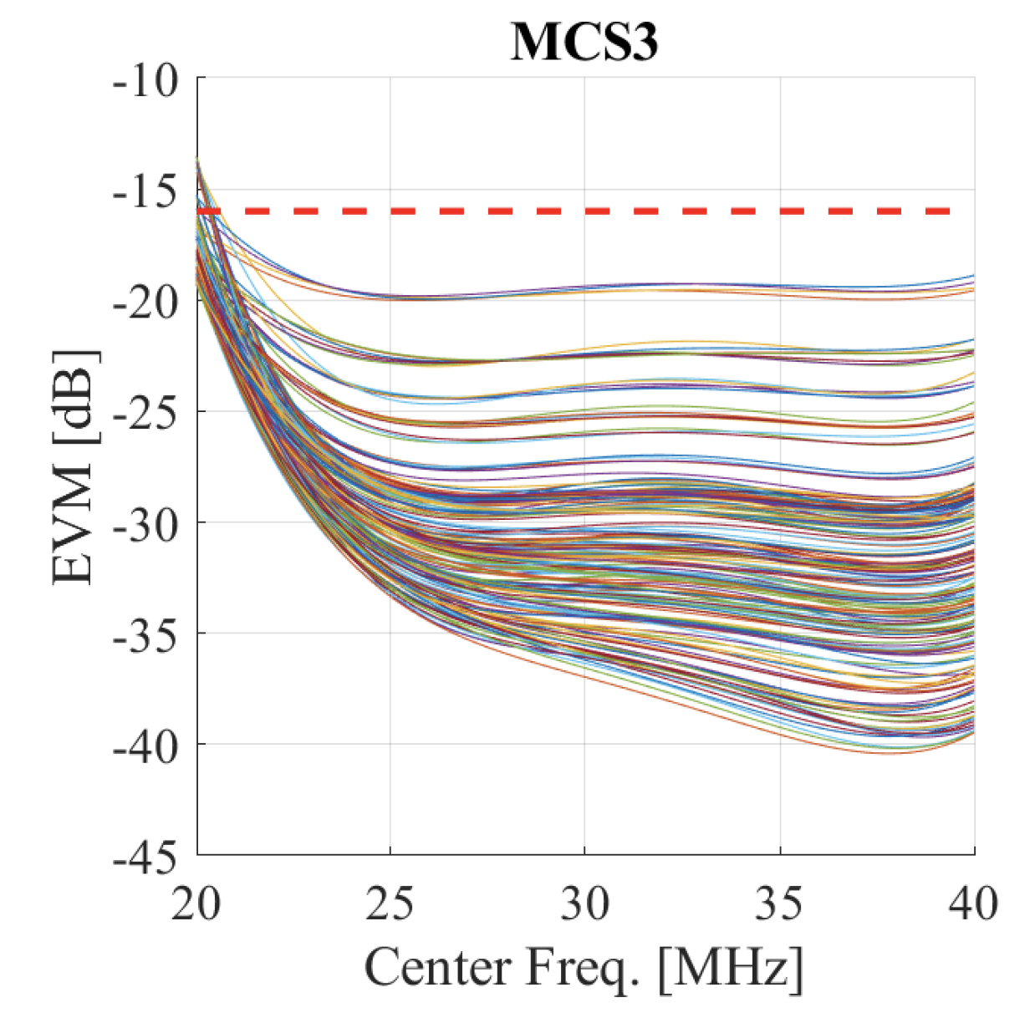
Snapshot (2)
BW = 40 MHz
Most channels exhibit the optimal center frequency at 24 MHz
24 MHz
heavy tail

Slide 10
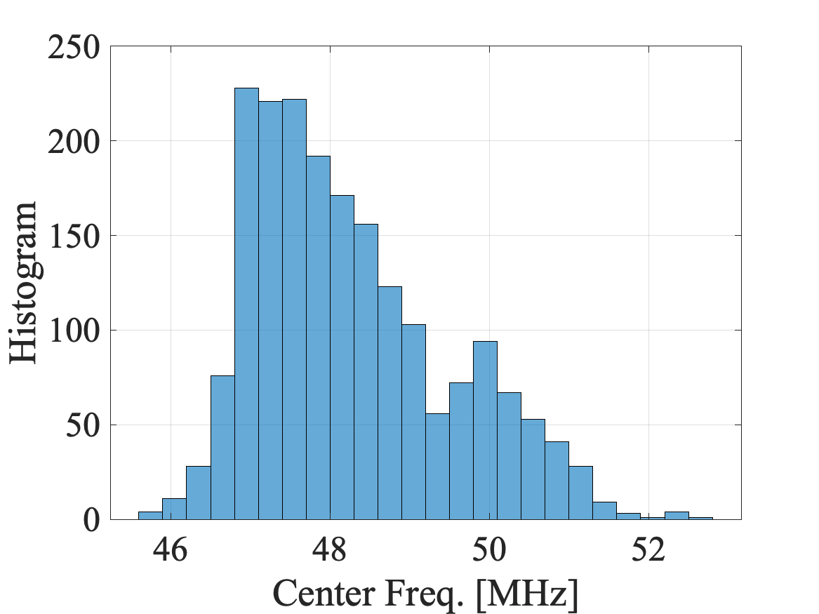
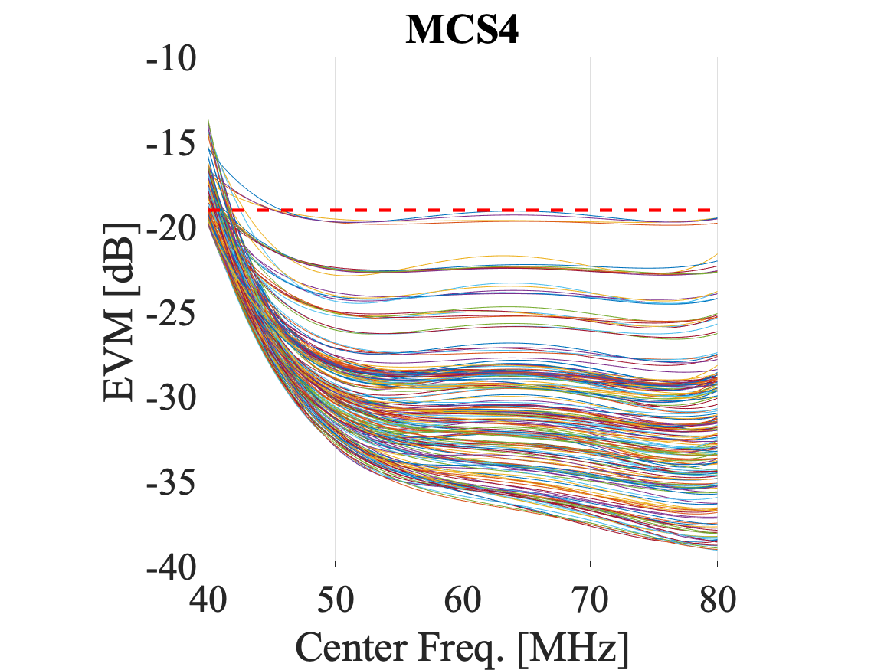
Snapshot (3)
BW = 80 MHz
Most channels exhibit the optimal center frequency at 47 MHz
47 MHz
heavy tail

Slide 11
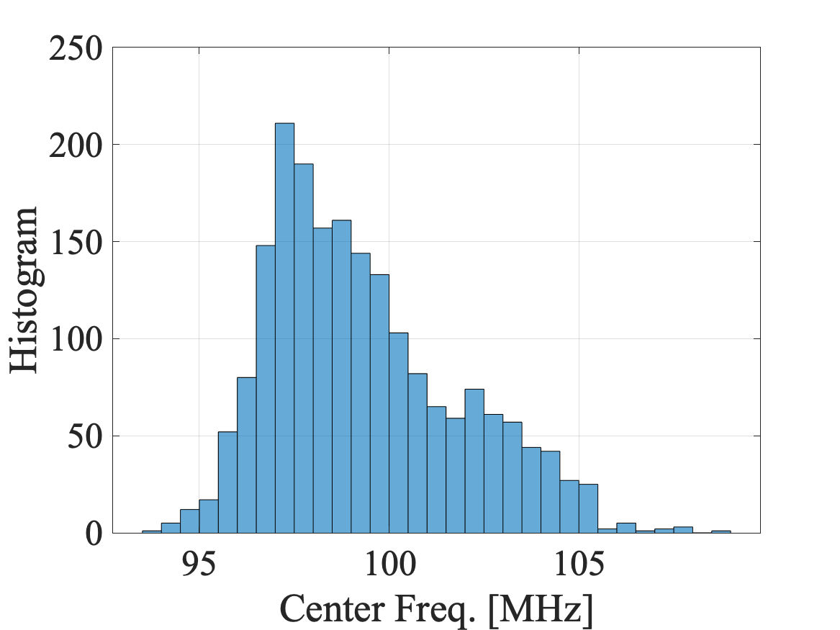
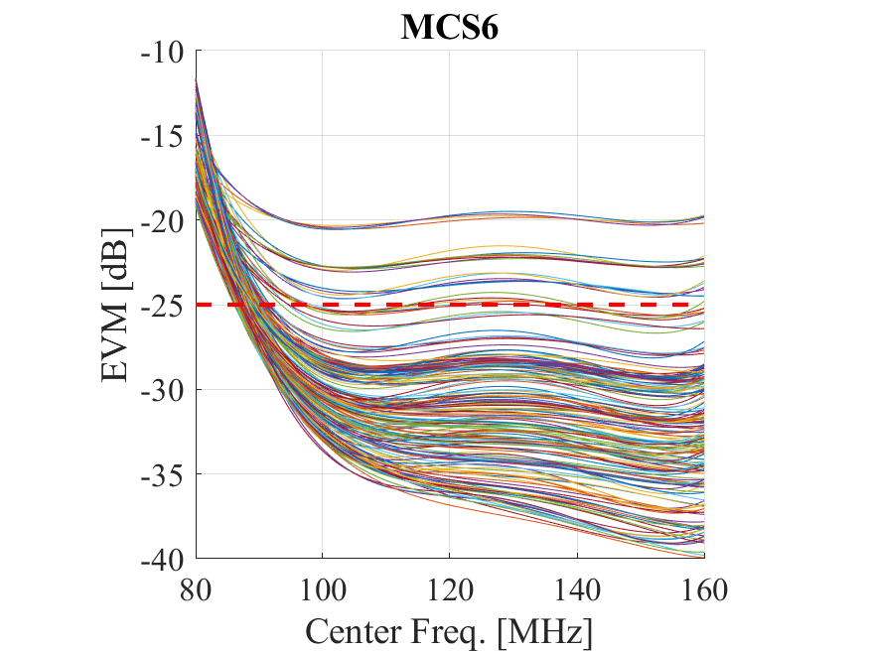
Snapshot (4)
BW = 160 MHz
Most channels exhibit the optimal center frequency at 96 MHz
97 MHz
heavy tail

Slide 12
Observation Results
BW [MHz] | fc* [MHz] | Δ [MHz]
20 | 16 (-24.63 dBr) | 6
40 | 26 (-22.26 dBr) | 6
80 | 46 (-21.11 dBr) | 6
160 | 86 (-20.55 dBr) | 6
BW [MHz] | fc* [MHz] | Δ [MHz]
20 | 20 (-28 dBr) | 10
40 | 30 (-23.89 dBr) | 10
80 | 50 (-21.92 dBr) | 10
160 | 90 (-20.96 dBr) | 10
BW [MHz] | fc* [MHz] | Δ [MHz]
20 | 24 (-31.37 dBr) | 14
40 | 34 (-25.53 dBr) | 14
80 | 54 (-22.73 dBr) | 14
160 | 94 (-21.36 dBr) | 14
BW [MHz] | fc* [MHz] | Δ [MHz]
20 | 26 (-33.05 dBr) | 16
40 | 36 (-26.35 dBr) | 16
80 | 56 (-23.14 dBr) | 16
160 | 96 (-21.56 dBr) | 16
Notes: Red means the corresponding Δ results in an nonoptimal performance. The criterion is based on the following limits, which are based on the intermediate results (see the previous page).
{BW,Limit in dBr} = {20 MHz, -21.68 dBr}, {40 MHz, -21.43 dBr}, {80 MHz, -21.32 dBr}, {160 MHz, -21.56 dBr}

Slide 13
Experimental validation
Experimental validation is done on the center frequency for the common mode mandatory PHY for 20 MHz and 40 MHz channels.

Slide 14
Experimental Setup
5 GHz band
5 GHz band
Laptop
Laptop
70 cm
eth0
Down-
conversion
fc
fc
eth0
802.11ac
OWC
Front-end
OWC
Front-end
Up-
conversion
CPU/host
802.11ac
CPU/host
SBC + RF down-conversion
PD
SBC + RF up-conversion
Oscilloscope

Slide 15
Experimental Setup video
https://photos.google.com/share/AF1QipNTcH1Fe5Yqsj92M-nTI-5Ks7mOoES7_cAVPSmrp2qGaZV5O4sW2eqUEnda-EbKwQ/photo/AF1QipNv5hXvyyJYri_C17R3GPwhMryHYtJgPiYyFurH?key=SXFPdkwwZldoNFFoQWlCNHRQWDNrRHNsTzFqckJn

Slide 16
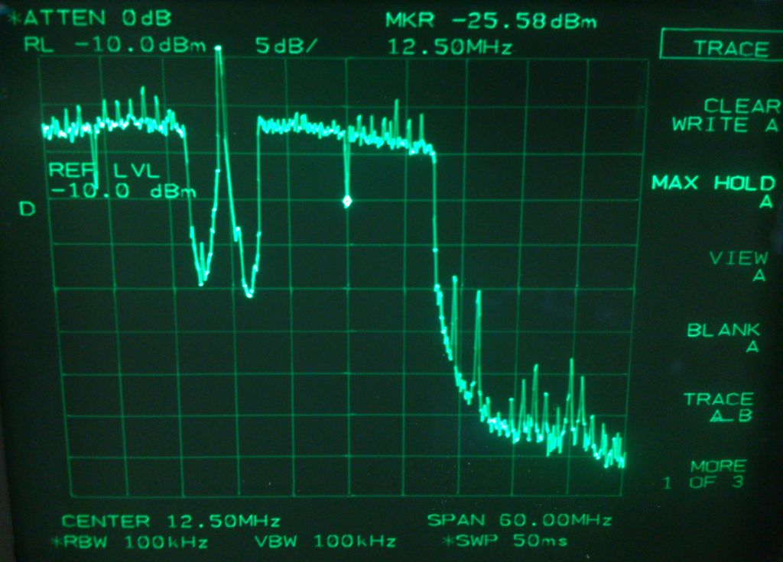
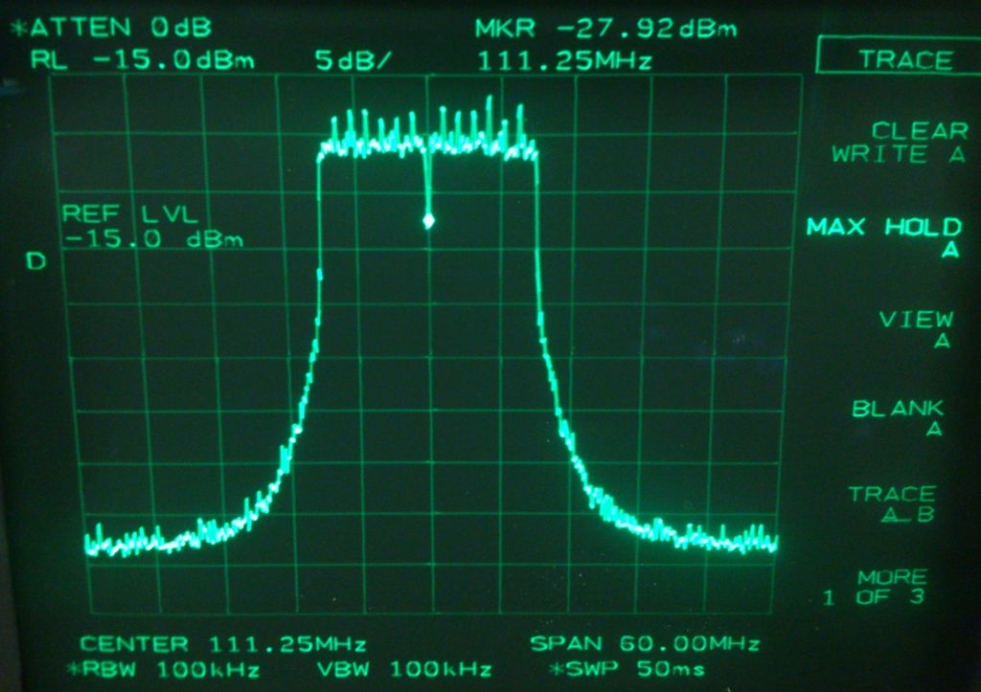
Initial Measurement
Using an 802.11ac chipset and a down-conversion, we obtain the following optical spectrum, for example, with fc =12.5 MHz and fc = 111.25 MHz, respectively

Slide 17
Experimental video for 21 MHz centre freq.
https://photos.google.com/share/AF1QipNTcH1Fe5Yqsj92M-nTI-5Ks7mOoES7_cAVPSmrp2qGaZV5O4sW2eqUEnda-EbKwQ/photo/AF1QipPX0cHX0Fjegiyonlfp2iP1PIEUOE8Pl01ld_g8?key=SXFPdkwwZldoNFFoQWlCNHRQWDNrRHNsTzFqckJn

Slide 18
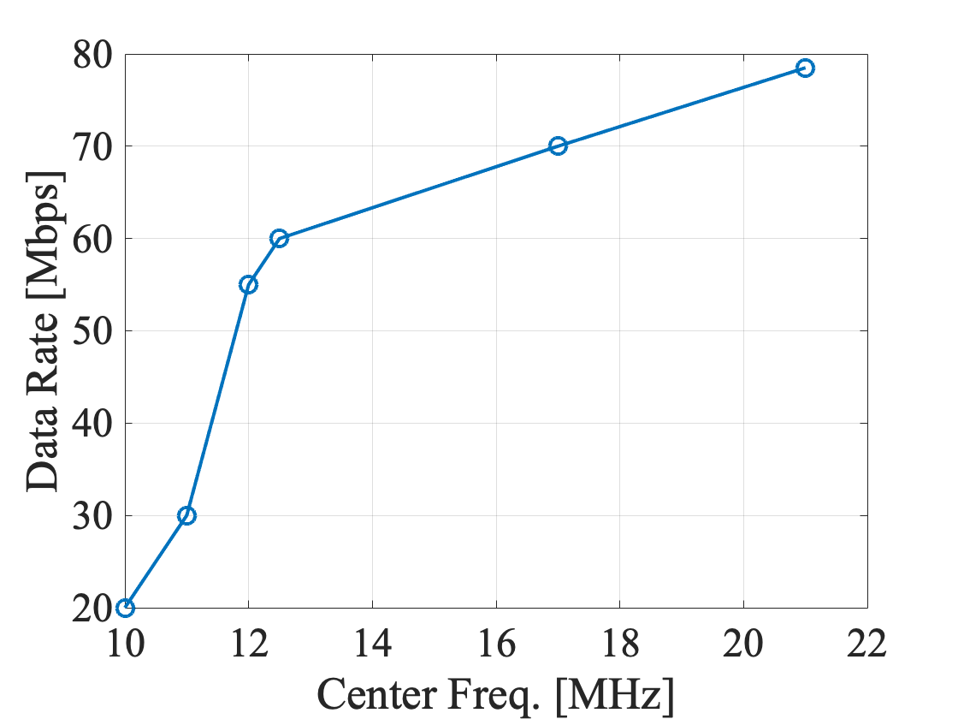
Measurements with BW = 20 MHz
fc [MHz] | Data rate [Mbps] (1 min measurement)
10 | 20-25
11 | 30
12 | 55
12.5* | 60-65
17 | 70
21 | 78.5
5.06 GHz (default) | 79.5
Note: Our simulation shows the optimum center frequency of 12.5 MHz based on the knee-point criterion.

Slide 19
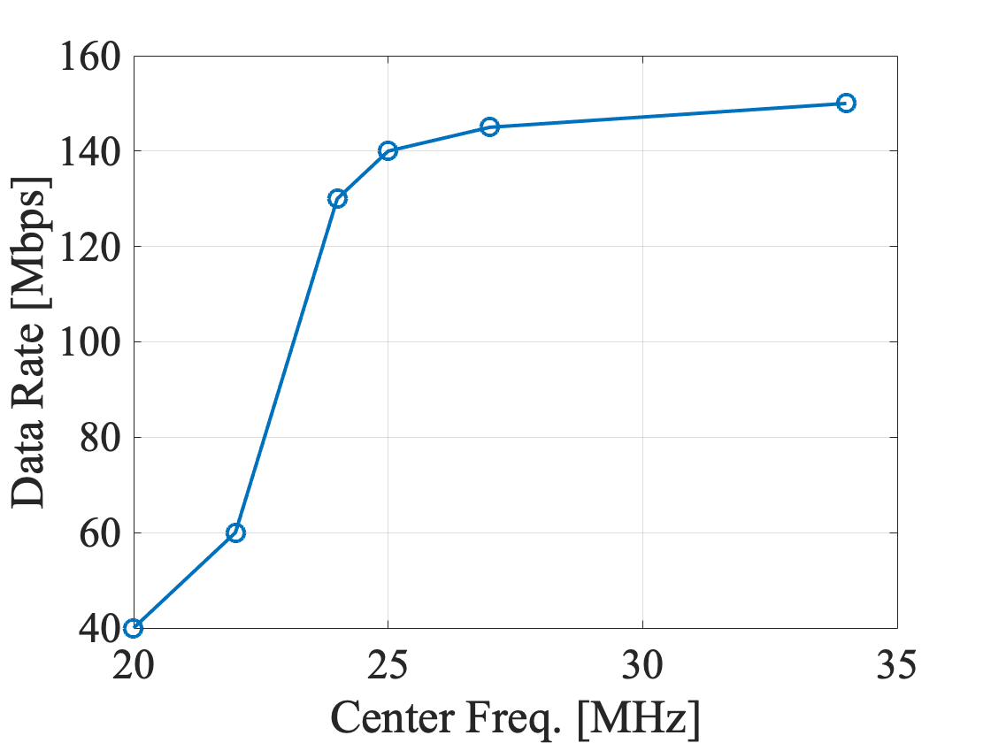
Measurements with BW = 40 MHz
fc [MHz] | Data rate [Mbps] (1 min measurement)
20 | 40
22 | 60
24* | 130-140
25 | 140-145
27 | 145-150
34 | 150-155
5.06 GHz (default) | 165
Note: Our simulation shows the optimum center frequency of 24 MHz based on the knee-point criterion.

Slide 20
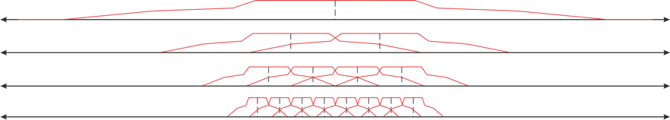
Results
BW [MHz] | fc* [MHz] | Δ [MHz]
20 | 26 (-33.05 dBr) | 16
40 | 36 (-26.35 dBr) | 16
80 | 56 (-23.14 dBr) | 16
160 | 96 (-21.56 dBr) | 16
BW = 160 MHz
fc=96 MHz
BW = 80 MHz
fc=56 MHz
BW = 40 MHz
fc=36 MHz
BW = 20 MHz
fc=26 MHz

Slide 21
Channelization
BW [MHz] | fc [MHz]
20 | 26, 46, 66, 146, 166, 186, 206, 226, 246, 266, 286, 306, 326, 466, 486, 506, 526, 546, 566, 586, 606, 626
40 | 36, 56, 96, 136, 176, 376, 416, 456, 496
80 | 56, 136, 376, 456
160 | 96, 416
320 | 176

Slide 22
Straw Poll
Should TGbb adopt 26 MHz as the center frequencies for the 20 MHz mandatory, common mode PHY of TGbb.
Result (Y / N / A): / /

Slide 23
Motion
Instruct the Technical Editor to replace the existing content of clause 32.3.2.3.9.4 in draft D0.2 with the following text:
“The LC common mode shall operate at a centre frequency of 26 MHz. The common bandwidth shall be 20 MHz. This centre frequency shall correspond to LC channel 0.”
Moved: Nikola Serafimovski
Seconded:
Result (Y / N / A): / /

Slide 24
32.3.3.3.24 Centre frequencies
The centre frequencies and channel numbering depending on the CBW are shown in Table 1.
Table 1 — Channelization
Channel number | fc (MHz) | Frequency range (MHz) | 20 MHz | 40 MHz | 80 MHz | 160 MHz | 320 MHz
LC0 | 26 | 16-36 | 20 | 40 | 80 | 160 | 320
LC1 | 36 | 16-56
LC2 | 46 | 36-56 | 20
LC3 | 56 | 16-96
LC4 | 66 | 56-76 | 20 | 40
LC5 | 76 | 56-96
LC6 | 86 | 76-96 | 20
LC7 | 96 | 16-176
LC8 | 106 | 96-116 | 20 | 40 | 80
LC9 | 116 | 96-136
LC10 | 126 | 116-136 | 20
LC11 | 136 | 96-176
LC12 | 146 | 136-156 | 20 | 40
LC13 | 156 | 136-176
LC14 | 166 | 156-176 | 20
LC15 | 176 | 16-336
LC16 | 186 | 176-196 | 20 | 40 | 80 | 160
LC17 | 196 | 176-216
LC18 | 206 | 196-216 | 20
LC19 | 216 | 176-256
LC20 | 226 | 216-236 | 20 | 40
LC21 | 236 | 216-256
LC22 | 246 | 236-256 | 20
LC23 | 256 | 176-336
LC24 | 266 | 256-276 | 20 | 40 | 80
LC25 | 276 | 256-296
LC26 | 286 | 276-296 | 20
LC27 | 296 | 256-336
LC28 | 306 | 296-316 | 20 | 40
LC29 | 316 | 296-336
LC30 | 326 | 316-336 | 20

Slide 25
Motion
Instruct the Technical Editor to replace the existing content of clause 32.3.3.3.24 in draft D0.2 with the content from slide 24.
Moved: Nikola Serafimovski
Seconded:
Result (Y / N / A): / /

