Slide 1
Golay Sequences and Ambiguity Function
Date: 2020-09-07
Authors:

Slide 2
Abstract
This presentation discusses How Golay Sequences may be used for radar and sensing application and what their ambiguity function look like.

Slide 3
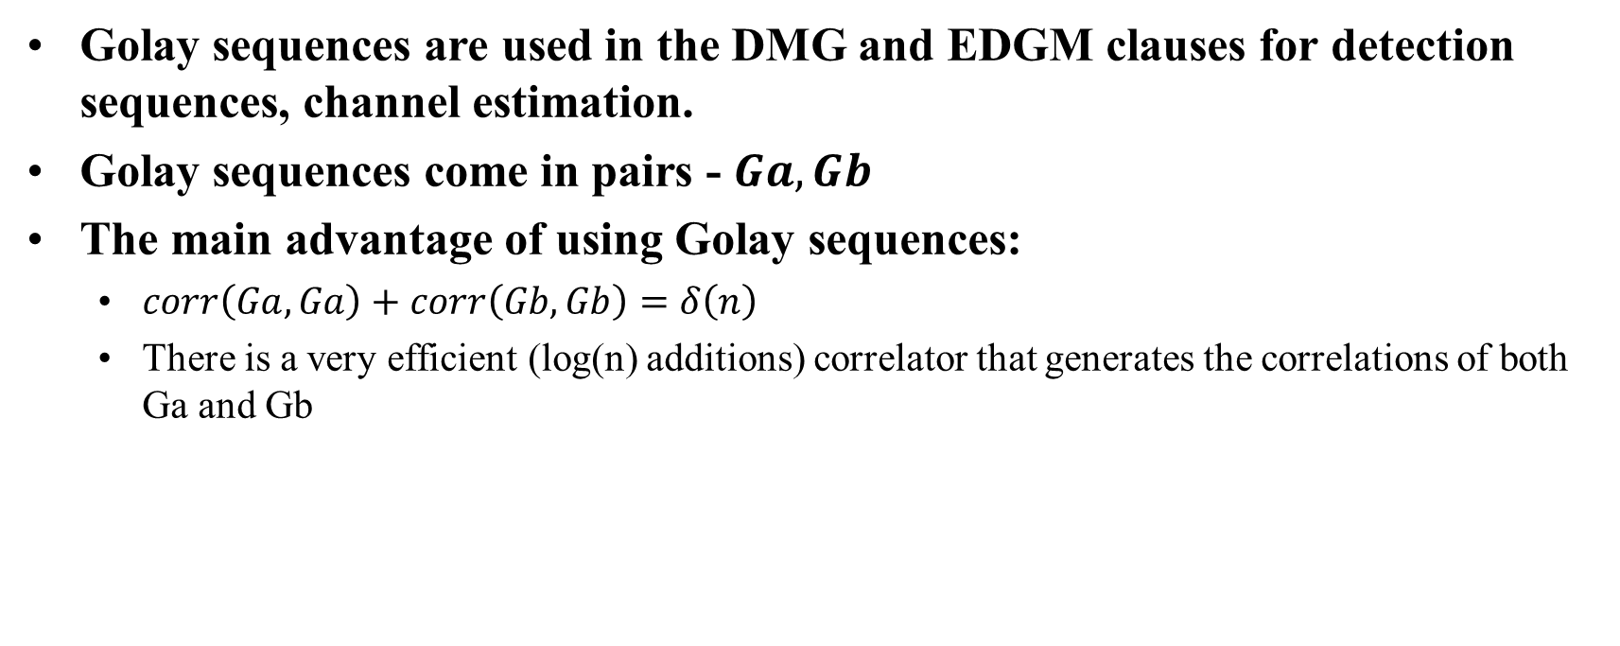
Very Short Introduction to Golay Complementary Sequences
Golay sequences are used in the DMG and EDGM clauses for detection sequences, channel estimation.
Golay sequences come in pairs - $Ga, Gb$
The main advantage of using Golay sequences:
  $corr\left(Ga,Ga\right)+corr\left(Gb,Gb\right)=δ\left(n\right)$
  There is a very efficient (log(n) additions) correlator that generates the correlations of both Ga and Gb

Slide 4
How Can Golay sequences be used for Radar/Sensing
Use the CE sequences as it is in the DMG/EDMG subclause
Maximum Propagation delay limited to 128 samples (~10m)
Allows usage of existing HW
Possible Implementation: output of correlator (of both Ga and Gb) are summed with appropriate delay and sign change
Transmit Sequences separately
Allows for longer propagation delay without overlap
Some use of existing HW
Possible Implementation: Correlator outputs are summed with the appropriate delay

Slide 5
How does this fit in an EDMG PPDU
The sequences mentioned in the previous slide can be considered as modified TRN Units in an EDMG PPDU.
Each sequence is a TRN-Unit, that may be transmitted in a different antenna setting (direction)
Several PPDUs may be transmitted in different times to facilitate accurate doppler estimation.

Slide 6
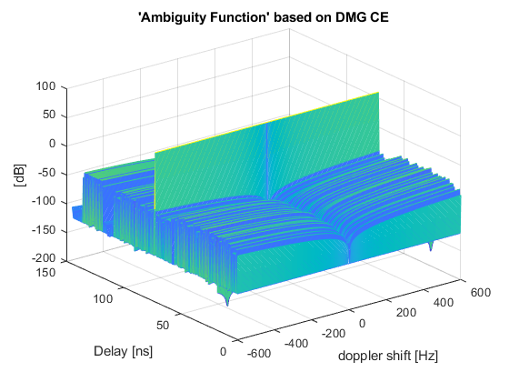
Performance of channel estimation version
The upper figure shows the sum of 8 correlation with appropriate delays. We can see that there is a zero side lobes correlation zone of ±128 samples (±72ns)
The lower figure shows an ‘ambiguity function’ with doppler shifts of ±600Hz
We can see that there is a 90dB difference between the peak and the sidelobes
It is not possible to measure doppler shift in a single pulse using this sequence
This a single Pulse Analysis, to find the speed of an object we need more than one pulse

Slide 7
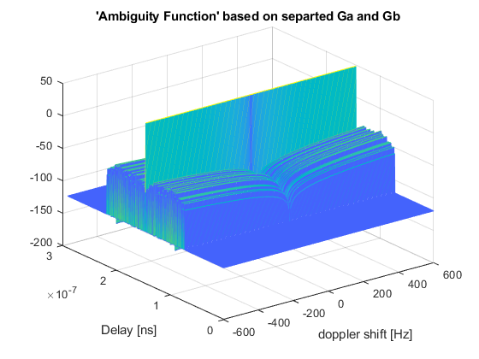
Separated Ga and Gb
The figure shows a pseudo ambiguity function based on the sum of correlation with Ga and Gb
Maximum Doppler sidelobe ~80dB.
Cannot detect doppler using a single pulse.

Slide 8
Fractional Delay
What happens when the delay is not a multiple of samples
The figure shows the results for the worst case of 0.5 sample delay (implemented by DFT).
We that the peak is spread over two samples and is 2 dB lower.
Sync interpolation can recover the peak

Slide 9
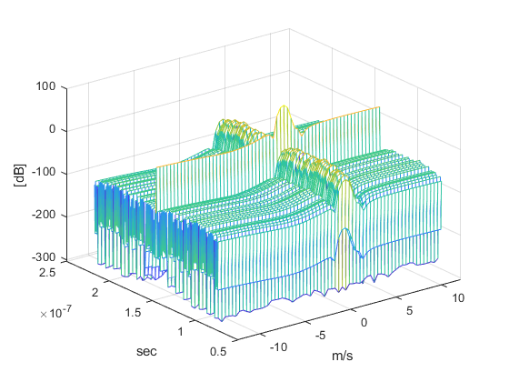
How can we estimate doppler using these sequences
The figure shows a range-doppler map based on 64 pulse pairs
Pulse pairs were separated by 100usec
To get accurate doppler results, super resolution methods are needed (MUSIC/ESPRIT).

Slide 10
Conclusions
Golay sequences are a good candidate for sensing applications, especially if they are already present within the design.
The ambiguity function is probably not a good measure for sequence quality – it is measuring the ability of the sequence to enable both doppler and delay estimation in a single pulse. This is nearly impossible at the low speeds we are interested in due to phases noise between transmitter and receiver.

Slide 11
References

