Slide 1
RU Restriction for 20MHz Operation
Date: 2020-09-14
Authors:
Name | Affiliation | Address | Phone | Email
Eunsung Park | LG Electronics | 19, Yangjae-daero 11gil, Seocho-gu, Seoul 137-130, Korea |  | esung.park@lge.com
Dongguk Lim |  |  |  | dongguk.lim@lge.com
Jinyoung Chun |  |  |  | jiny.chun@lge.com
Jinsoo Choi |  |  |  | js.choi@lge.com

Slide 2
Introduction
TGbe agreed to support the followings
  20MHz operating channel width in 2.4GHz band mandatorily
  20MHz only client in 2.4/5GHz band only
  Various small RU aggregation in each bandwidth
  New tone plan for 80MHz OFDMA transmission
Similar to 11ax, we propose 11be supports that 20MHz operating / only STAs are assigned to certain RUs / MRUs in a wider bandwidth EHT OFDMA transmission
  Some RUs / MRUs in a wider bandwidth have some data tones which are located in tones corresponding to DC / guard of 20MHz operation due to the discrepancy in tone plan
In each bandwidth, we also propose RU restriction for 20MHz operation considering the agreed RUs / MRUs and tone plans

Slide 3
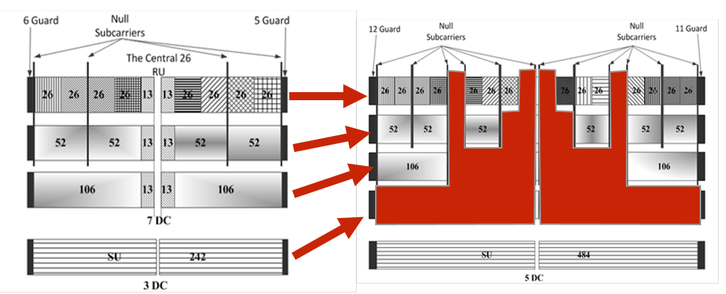
Recap on RU restriction in 11ax [1] (1/2)
20MHz operating STAs (with corresponding Rx filtering) cannot receive some RUs without penalty in a wider bandwidth transmission
  The performance is badly hit, when the number of affected data tones* is more than 10% of data
  If those affected tones are not many, the performance is reliable
  → Middle 26-tone RUs are not allocated to 20MHz operating STAs for wider bandwidth OFDMA PPDU
*affected data tones: data tones modulated on DC/guard tone location of 20MHz operation

Slide 4
Recap on RU restriction in 11ax [1] (2/2)
All 242-tone RUs in wider bandwidth have data modulated on the DC tone location of 20 MHz operating STAs
  This may cause RX DC (DL OFDMA) or TX LO leakage (UL OFDMA) to interfere w/ the data tones, further degrading performance
  The performance may depend on implementation
  UL OFDMA may be much more vulnerable to this factor because it needs more accurate synchronization
  → It is optional whether all 242-tone RUs of 20 MHz operating STAs to be supported in wider bandwidth DL OFDMA
  → 242-tone RUs shall not be allocated to 20MHz operating STAs in wider bandwidth for UL OFDMA
Based on the rules used for 11ax, we propose RU restriction for 11be

Slide 5
RU Restriction for 40MHz (1/2)
There are some MRUs as well as RUs which have tones affected by 20MHz operation
  RUs in red
    They have more than 10% data loss* (12.5%), and thus, need to be not allocated to 20MHz operating STAs
  RUs in green
    They have less than 10% data loss (8.3%, 4.2%, 2%)
    The performance may be depending on MCS and Nss, and, severely degraded with 4K QAM and 16SS that 11be supports
    20MHz operating STAs may use low MCS and small Nss basically, and thus, we can consider allocating these RUs to 20MHz operating STAs
*data loss: ratio of # of affected data tones to # of data tones

Slide 6
RU Restriction for 40MHz (2/2)
Cont.
  RUs / MRUs in blue
    They have less than 10% data loss (4.2%, 2.4%, 4%, 2.6%) but there are some data tones located in DC tones of 20MHz operation
    They can be optionally allocated to 20MHz operating STAs for DL OFDMA
    They need to be not allocated to 20MHz operating STAs for UL OFDMA
    From the scheduling perspective, middle 26+52/106 MRUs may not be useful for 20MHz operating STAs, and thus, these MRUs can be disallowed for both DL and UL OFDMA
  RUs / MRUs in white
    They can be allocated to 20MHz operating STAs

Slide 7
RU Restriction for BW ≥ 80MHz
40MHz tone plan is duplicated in 80MHz but some MRUs are not supported
  RUs in red: more than 10% data loss, disallowed
  RUs in green: less than 10% data loss, allowed
  RUs / MRUs in blue: less than 10% data loss, data tones located in DC
    Optionally allowed for DL OFDMA
    Disallowed for UL OFDMA
    From the scheduling perspective, middle 26+52/106 MRUs can be disallowed for both DL and UL OFDMA
  RUs / MRUs in white: allowed
  All the above can apply to each 80MHz for BW ≥ 80MHz

Slide 8
Summary
Middle 26-tone RUs shall not be allocated to 20MHz operating STAs for 40 / 80 / 160 / 320 MHz DL / UL OFDMA transmission
242-tone RUs may be allocated to 20MHz operating STAs for 40 / 80 / 160 / 320 MHz DL OFDMA transmission but shall not be allocated to 20MHz operating STAs for 40 / 80 / 160 / 320 MHz UL OFDMA transmission
As to middle 26 + 52/106 MRUs, it may be better to disallow them from being allocated to 20MHz operating STAs for 40 / 80 / 160 / 320 MHz DL / UL OFDMA transmission
20MHz operating STAs shall support the tone mapping of the other RUs / MRUs with less than 242 tones for 40 / 80 / 160 / 320 MHz DL / UL OFDMA transmission

Slide 9
Straw Poll #1
Do you agree to add the following text to TGbe SFD?
  11be supports that RUs / MRUs with less than or equal to 242 tones are allocated to 20MHz operating STAs for 40 / 80 / 160 / 320 MHz DL / UL OFDMA transmission
    RU restriction is TBD
    80+80 / 160+160 MHz is TBD
  This is for rel. 1
Y/N/A: //

Slide 10
Straw Poll #2
Do you agree to add the following text to TGbe SFD?
  Middle 26-tone RUs shall not be allocated to 20MHz operating STAs for 40 / 80 / 160 / 320 MHz DL / UL OFDMA transmission
    80+80 / 160+160 MHz is TBD
  This is for rel. 1
Y/N/A: //

Slide 11
Straw Poll #3
Do you agree to add the following text to TGbe SFD?
  242-tone RUs may be allocated to 20MHz operating STAs for 40 / 80 / 160 / 320 MHz DL OFDMA transmission but shall not be allocated to 20MHz operating STAs for 40 / 80 / 160 / 320 MHz UL OFDMA transmission
    80+80 / 160+160 MHz is TBD
    Note: For downlink OFDMA, receiving 242-tone RUs is optional for 20MHz operating STAs
  This is for rel. 1
Y/N/A: //

Slide 12
Straw Poll #3a
Do you agree to add the following text to TGbe SFD?
  242-tone RUs may be allocated to 20MHz operating STAs for 40 / 80 / 160 / 320 MHz DL OFDMA
    80+80 / 160+160 MHz is TBD
    Note: For downlink OFDMA, receiving 242-tone RUs is optional for 20MHz operating STAs
    Note: UL OFDMA case is TBD
  This is for rel. 1
Y/N/A: //

Slide 13
Straw Poll #4
Do you agree to add the following text to TGbe SFD?
  Middle 26 + 52/106 MRUs shall not be allocated to 20MHz operating STAs for 40 / 80 / 160 / 320 MHz DL / UL OFDMA transmission
    80+80 / 160+160 MHz is TBD
  This is for rel. 1
Y/N/A: //

Slide 14
References
[1] 802-11-16/0906r0 RU Restriction on 20MHz Operating STAs

