Slide 1
EHT NDPA frame design
Date: 2020-09-09
Authors:
Name | Affiliations | Address | Phone | Email
Cheng Chen | Intel |  |  | cheng.chen@intel.com
Po-kai Huang
Laurent Cariou
Xiaogang Chen
Qinghua Li
Danny Alexander
Notes:
September 2012

Slide 2
Motivation
This contribution provides analysis on design of NDPA frame for EHT.

Slide 3
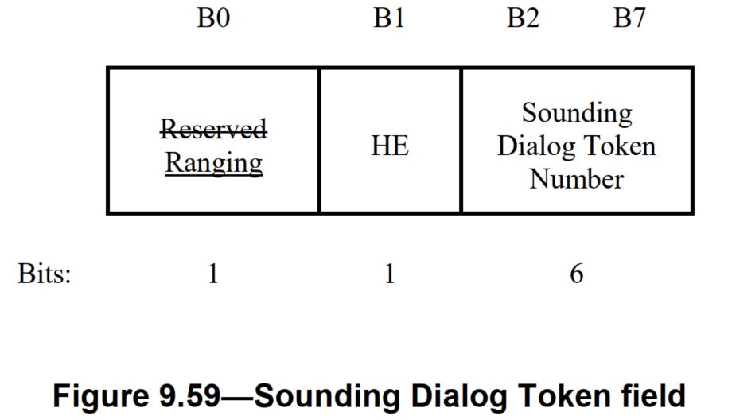
NDPA frame---Sounding Dialog Token
Ranging | HE | Encoding
N/A | N/A | VHT NDPA
N/A | 1 | HE NDPA
1 | 0 | Ranging NDPA
1 | 1 | Reserved
Currently B0-B1 are encoded to represent different variants of NDPA frame.
Option 1: Create a new variant for EHT NDPA, i.e., use the reserved encoding 11.
  VHT STAs and HE STAs will parse the new EHT NDPA as VHT NDPA and HE NDPA respectively. EHT STAs know this is EHT NDPA.
  Disambiguation between VHT/HE STAs with EHT STAs need to be addressed.
Option 2: Reuse existing HE NDPA variant for EHT NDPA, i.e., does not create a new variant with the reserved encoding value.
  VHT STAs and HE STAs will parse the NDPA as VHT NDPA and HE NDPA respectively.
  Need to add an HE/EHT indication in STA Info field to help EHT STAs identify the signaling for new EHT features.

Slide 4
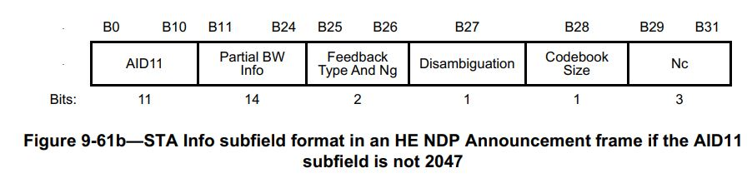
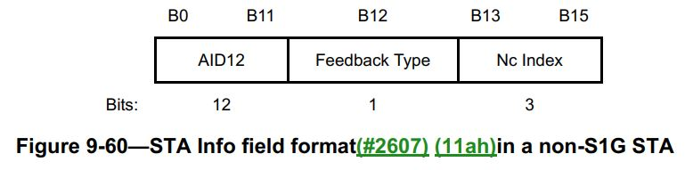
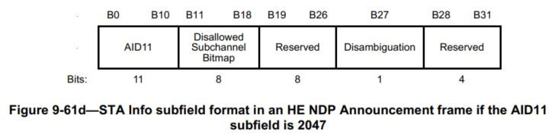
NDPA frame---STA Info
The STA Info field is 2 bytes for a VHT STA, and 4 bytes for an HE STA.
  In order to prevent a non-HE VHT STA wrongly determining its AID in HE NDPA, there is a disambiguation bit in the HE STA Info field.
If we further extend the length of the STA Info field for an EHT STA, we need to take care of disambiguation scenarios where either a VHT STA or an HE STA may wrongly determine its AID in an EHT STA Info field.
Considering the complexity of designing such disambiguation, we propose to keep the size of STA Info field for EHT STA.

Slide 5
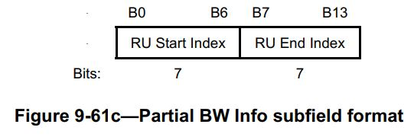
Option 1: Create a new EHT NDPA variant
As long as we keep the size of STA Info field unchanged, we do not need to worry about the disambiguation between EHT and HE STAs.
We can then safely redesign and compress Partial BW Info subfield to release a few bits for subfields that need expansion, for example, Nc subfield.
  Currently Partial BW Info is based on RU 26 granularity. There were 74 26-tone RUs, so need 7 bits for RU Start Index and RU End Index. There are 148 26-tone RUs, so need 8 bits for RU Start Index and RU End Index.
  PHY is considering using RU242 granularity for partial BW CSI feedback.
  Option 1: Use RU242 granularity to compress this field
    4 bits each for RU Start Index and RU End Index. 8 bits in total
  Option 2: Keep RU 26 granularity, but change the signaling of this field
    One possible solution is to keep the first 7 or 8 bits to indicate the RU Start Index, or to indicate the center subcarrier and half of the span and use the subsequent 4 to 5 bits to indicate the total span of feedback bandwidth.

Slide 6
Option 2: Reuse HE NDPA variant
In this case, since we need to change the format of STA Info field for EHT STAs, we will need an HE/EHT indication bit in STA Info field to identify whether this STA Info field is for HE STA or EHT STA.
Seems that the only option is to use B23-B24, which are the two MSB bits for RU End Index [1].
  HE STAs will never set B23-B24 to 11, as the valid range for HE STAs is 0-73.
  We can set this two bits to 11 to indicate the corresponding STA Info field is a EHT STA Info field.
  We again need to compress Partial BW Info subfield, so that we at least release B23-B24.

Slide 7
Option 1 vs. Option 2
Both options work, but Option 2 needs more complicated signaling for HE/EHT identification in STA Info subfield.
  However, we do not see a clear use case for mixing HE and EHT STAs in one NDPA frame, and moreover:
    Tone plan for 11ax and 11be are different.
    EHT LTF can potentially be different from HE LTF.
    We probably need to sound HE and EHT STAs separately.
  Option 1 is preferred.

Slide 8
Channel puncturing
Currently we use a specific STA Info field with AID 2047 to indicate the puncturing status of each 20 MHz channel.
We needs to extend the Disallowed Subchannel Bitmap by 8 bits to cover 320 MHz.
Propose to use the 8 reserved bits B19-B26.

Slide 9
Conclusions
In this contribution, we discussed the design options for NDPA frame in EHT.

Slide 10
SP1
Do you agree to create a new EHT NDPA variant using the reserved encoding value 11 for B0-B1 in Sounding Dialog Token field?

Slide 11
SP2
Do you agree to keep the size of STA Info field of EHT NDPA frame unchanged as 4 bytes?

Slide 12
SP3
Do you agree to compress the Partial BW Info subfield to at least 8 bits?

Slide 13
SP4
Do you agree to use the 8 reserved bits B19-B26 to expand the Disallowed Subchannel Bitmap when the AID11 subfield is 2047?

Slide 14
References
[1] 11-20-1015-01-00be-eht-ndpa-frame-design-discussion

