Slide 1
Enhanced Trigger Frame for EHT Support
Date: 2021-01-06
Authors:
Name | Affiliations | Address | email
Steve Shellhammer | Qualcomm |  | shellhammer@ieee.org
Bin Tian |  |  | btian@qti.qualcomm.com
Yanjun Sun |  |  | yanjuns@qti.qualcomm.com
Alfred Asterjadhi |  |  | aasterja@qti.qualcomm.com

Slide 2
Introduction
Here we propose an Enhanced Trigger Frame that is backward compatible with HE STAs with additional support for EHT STAs
Benefits of this Design
  Leverage 802.11ax Trigger Frame Design
Updates in this revision
  Given we are developing a better understanding of the U-SIG in the TB PPDU, we show how the information needed for the U-SIG in the TB PPDU can be carried in the Trigger Frame
  For the User Info Field RU Allocation Table, we consider using Primary/Secondary Channels versus Lower/Upper Channels

Slide 3
Requirements
Item | Requirement
Backward Compatibility | An HE STA decoding the Enhanced Trigger Frame will not have any modified behavior
EHT Support | An EHT STA can decode the Enhanced Trigger Frame and support new EHT Features
320 MHz Support | The Enhanced Trigger Frame signals 320 MHz for EHT STAs
16 Spatial Stream Support | The Enhanced Trigger Frame signals up to 16 Total Spatial Streams for EHT STAs
RU Allocation | The Enhanced Trigger Frame supports EHT RU Allocations including MRU allocations

Slide 4
Trigger Frame – Reserved Bits
Available Reserved Bits
Common Info Field, the UL HE SIG-A2 Reserved subfield (B54-B62)
  These bits are currently set to all ones
  These bits are copied into the SIG-A2 Reserved subfield in the HE UL TB PPDU
Common Info Field, the Reserved Bit (B63)
  This bit is currently set to zero
User Info Field, the Reserved bit (B39)
  This bit is currently set to zero
User Info Field, the MSB of AID12 is unused except for a few special cases, and can be reused
  See Table 9-31h
Summary
We have 10 available reserved bits in the Common Info Field
We have 2 available reserved bits in the User Info Field

Slide 5
UL HE SIG-A2 Reserved Subfield (B54-B62)
Text from 802.11ax Draft 7
  The UL HE-SIG-A2 Reserved subfield of the Common Info field carries the value to be included in the Reserved field in the HE-SIG-A2 subfield of the solicited HE TB PPDUs. An HE AP sets the UL HE-SIG-A2 Reserved subfield to all 1s.
This ensures that all HE STAs transmit the same bits in the SIG-A2 Reserved subfield
These bits are must cut from the Trigger Frame and pasted into the HE-SIG-A2 field
These bits are not used for any other purpose in HE
These bits can be modified for EHT without causing an impact on HE STAs

Slide 6
Common Information

Slide 7
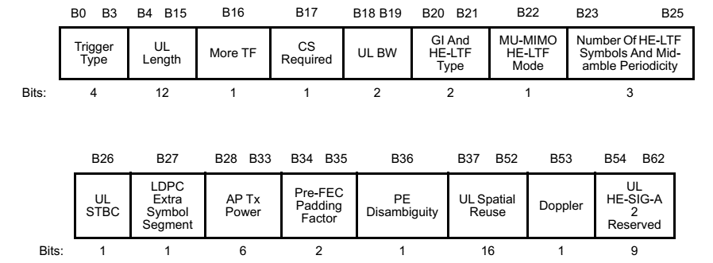
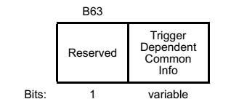
Reference – 802.11ax Common Info Field
For reference, here is the 802.11ax Common Info Field

Slide 8
Latest TB PPDU U-SIG
In [1] we have the latest U-SIG contents for the TB PPDU
Field | Category | Subfield | Bits
U-SIG | Version Independent | Version identifier | 3
 |  | PPDU BW | 3
 |  | UL/DL | 1
 |  | BSS color | 6
 |  | TXOP | 7
 |  | Reserved | 2
 |  | TBD1 | 4
 | Version Dependent | PPDU format & EHT-SIG Compression | 2
 |  | Reserved | 1
 |  | Spatial Reuse 1 | 4
 |  | Spatial Reuse 2 | 4
 |  | TBD2 | 5
 | CRC & Tail | CRC in U-SIG | 4
 |  | Tail in U-SIG | 6
 | Total # of Bits in U-SIG |  | 52
Like in 11ax, STAs transmitting in the same 20 MHz need to transmit the same U-SIG, so Third-Party STAs can decode the U-SIG
The necessary information is better to be carried in the Trigger Frame, versus having assigning fixed values
Fields for some of these entries are already available in the Common Info Field
We need to account for the new fields
Alice Chen, Sameer Vermani, Bin Tian and Youhan Kim, “U-SIG Design for TB PPDU,” IEEE 802-11/20-1546r0, September 2020

Slide 9
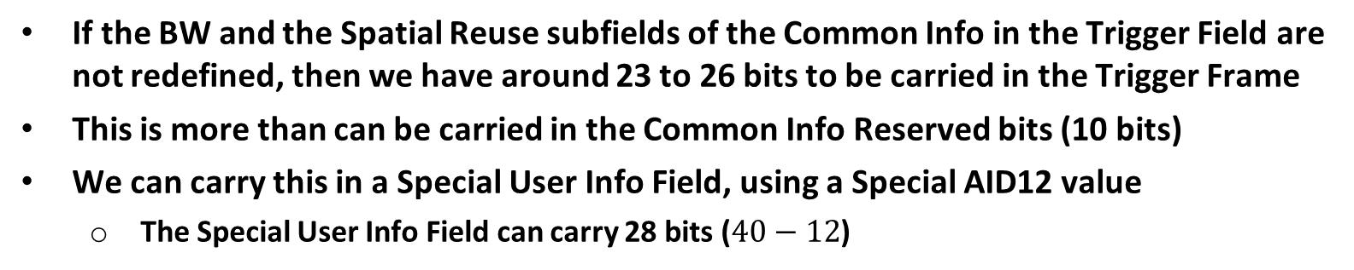
U-SIG in TB PPDU
Field | Category | Subfield | Bits | From Trigger Frame
U-SIG | Version Independent | Version identifier | 3 | 0 to 3
 |  | PPDU BW | 3 | 3
 |  | UL/DL | 1 | Derived as in 11ax
 |  | BSS color | 6 | Derived as in 11ax
 |  | TXOP | 7 | Derived as in 11ax
 |  | Reserved | 2 | 2
 |  | TBD1 | 4 | 4
 | Version Dependent | PPDU format & EHT-SIG Compression | 2 | Derived as in 11ax
 |  | Reserved | 1 | 1
 |  | Spatial Reuse 1 | 4 | 4
 |  | Spatial Reuse 2 | 4 | 4
 |  | TBD2 | 5 | 5
 | CRC & Tail | CRC in U-SIG | 4 | Derived as in 11ax
 |  | Tail in U-SIG | 6 | Derived as in 11ax
 | Total # of Bits in U-SIG |  | 52
If the BW and the Spatial Reuse subfields of the Common Info in the Trigger Field are not redefined, then we have around 23 to 26 bits to be carried in the Trigger Frame
This is more than can be carried in the Common Info Reserved bits (10 bits)
We can carry this in a Special User Info Field, using a Special AID12 value
  The Special User Info Field can carry 28 bits ($40−12$)

Slide 10
Proposal for Carrying Necessary U-SIG Subfields in Special User Info Field
Define a special AID12 value in Table 9-31h “AID12 Subfield Encoding” to indicate that the User Info Field with this special AID12 value is a Special User Info Field carrying the non-derived content for the U-SIG of the TB PPDU
The first 12 bits (B0-B11) of the User Info Field is AID12
The remaining 28 bits (B12-B39) are allocated to the following U-SIG Subfields
Subfield | Length (Bits)
PHY Version Identifier | 3
PPDU Bandwidth | 3
Spatial Reuse 1 | 4
Spatial Reuse 2 | 4
U-SIG Reserved | 12
Reserved | 2
The exact bit assignments can be done once the U-SIG format is finalized for the TB PPDU
This Special User Info Field is sent right after the Common Info Field

Slide 11
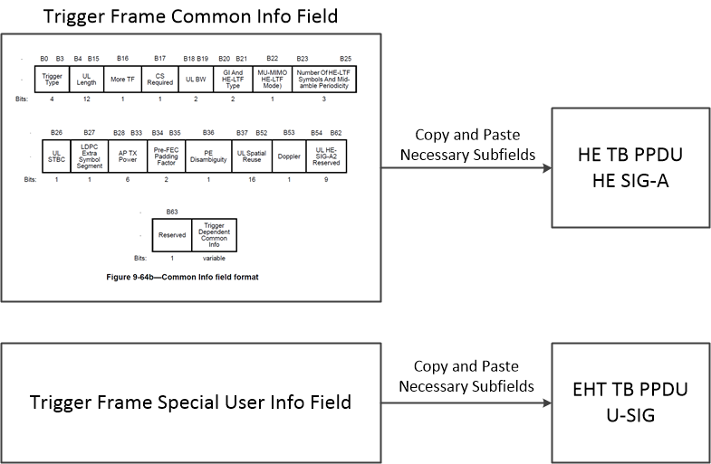
Mapping Content from Trigger Frame to TB PPDU Preambles

Slide 12
802.11ax Draft Statement
The following statement is in the 802.11ax Draft, Clause 26.5.2.2.4
  “The AP shall place User Info fields with the AID12 subfield set to 0 or a value greater than 2007 after User Info fields with the AID12 subfield set to a value in the range 1 to 2007 (if any present).”
Here we propose a way of keeping the Special User Info Field right after the Common Info Field while still addressing this statement in the 802.11ax Draft

Slide 13
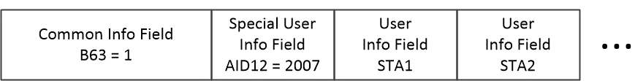
Proposal for AID12 Value
Instead of using one of the currently reserved AID12 values we propose to use a currently unreserved value, AID12 = 2007
Make that a special value in EHT, indicating the Special User Info Field
Place the Special User Info Field right after the Common Info Field
  This is consistent with the statement in the 11ax draft, since the AID12 value is not greater than 2007
Set the Common Info Field Reserved bit (B63) to the Enhanced Trigger Frame Flag
  The current value of B63 in 11ax is zero
  If set to one the STA knows this is an Enhanced Trigger Frame
  This indicates the presence of the Special User Info Field with AID12=2007 to convey additional Common Information, as shown below

Slide 14
Number of HE LTFs and Midamble Periodicity
It is possible to expand the “Number of HE LTFs and Midamble Periodicity” subfield to support up to 16 LTFs
Number of HE LTFs and Midamble Periodicity Value | Number of HE LTFs (Doppler = 0) | Number of HE LTFs Midamble Periodicity (Doppler = 1) | Number of EHT LTFs (Doppler = 0) (FOR EHT) | Number of EHT LTFs Midamble Periodicity (Doppler = 1) (FOR EHT)
0 | 1 | 1 (10 symbols) | 1 | 1 (10 symbols)
1 | 2 | 2 (10 symbols) | 2 | 2 (10 symbols)
2 | 4 | 4 (10 symbols) | 4 | 4 (10 symbols)
3 | 6 | Reserved | 6 | Reserved
4 | 8 | 1 (20 symbols) | 8 | 1 (20 symbols)
5 | Reserved | 2 (20 symbols) | 12 | 2 (20 symbols)
6 | Reserved | 4 (20 symbols) | 16 | 4 (20 symbols)
7 | Reserved | Reserved | Reserved | Reserved

Slide 15
Common Info Summary
B63 is the Enhanced Trigger Frame Flag
  In 802.11ax B63 is a reserved bit and is set to zero
  In 802.11be B63 is the Enhanced Trigger Frame Flag and is set to one
    This indicates it is an Enhanced Trigger Frame and supports EHT
    It also indicates that AID12=2007 is a Special AID12 value
A Special User Info field is placed right after the Common Info Field
  It uses Special AID12=2007
  It carries the non-derived information for the U-SIG in the TB PPDU
    PHY Version Identifier, PPDU Bandwidth, Spatial Reuse 1, Spatial Reuse 2, U-SIG Reserved bits
The Number of HE LTFs and Midamble Periodicity subfield has been extended to support 12 and 16 LTFs

Slide 16
User Information

Slide 17
Update
The update proposal for the User Info Field includes the following changes
  Change RU Allocation table bits (LU, B0) from Lower/Upper meaning to Primary/Secondary meaning
  Remove the HE/EHT bit from the User Info Field
This approach provides backward compatibility with 11ax and provides an EHT Reserved bit
Material from the earlier proposal is in the Backup

Slide 18
Clarification of HE/EHT User Info Field Format
HE STAs
  User Info Field is always the HE format
R1 EHT STAs
  If Enhanced Trigger Frame Flag is zero, User Info Field is HE format
    EHT STA transmits HE TB PPDU
  If Enhanced Trigger Frame Flag is one, User Info Field is EHT Format
    EHT STA transmits EHT TB PPDU
R2 EHT STAs
  It is possible to support both HE or EHT User Info Field formats in one Trigger Frame to support A-PPDU in R2

Slide 19
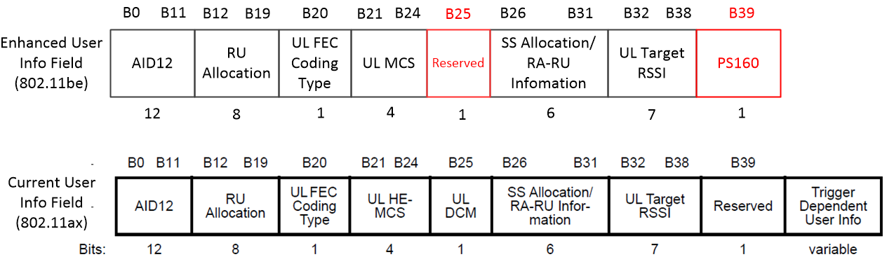
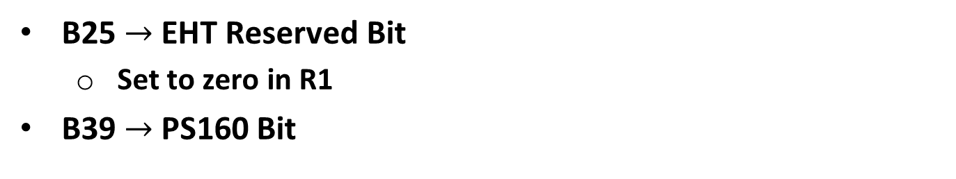
User Info Field Subfields
B25 $→$ EHT Reserved Bit
  Set to zero in R1
B39 $→$ PS160 Bit

Slide 20
Primary/Secondary Definition for B0 and Additional bit
B0 is the Primary/Secondary 80 MHz bit for RUs/MRUs less than or equal to 80 MHz
  For larger MRUs, B0 is a bit used in the indication of the specific MRU, and no longer has a primary/secondary meaning
PS160 is the Primary/Secondary 160 MHz bit for RUs/MRUs less than or equal to 160 MHz
  For larger MRUs PS160, is a bit used in the indication of the specific MRU, and no longer has a primary/secondary meaning

Slide 21
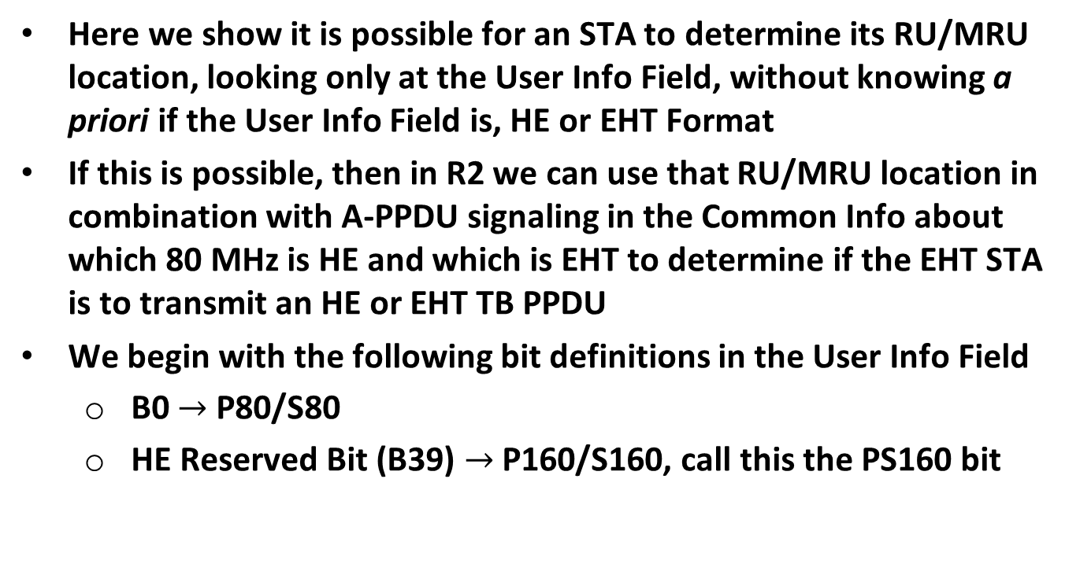
Backward Compatibility with 802.11ax
Here we show it is possible for an STA to determine its RU/MRU location, looking only at the User Info Field, without knowing a priori if the User Info Field is, HE or EHT Format
If this is possible, then in R2 we can use that RU/MRU location in combination with A-PPDU signaling in the Common Info about which 80 MHz is HE and which is EHT to determine if the EHT STA is to transmit an HE or EHT TB PPDU
We begin with the following bit definitions in the User Info Field
  B0 $→$ P80/S80
  HE Reserved Bit (B39) $→$ P160/S160, call this the PS160 bit

Slide 22
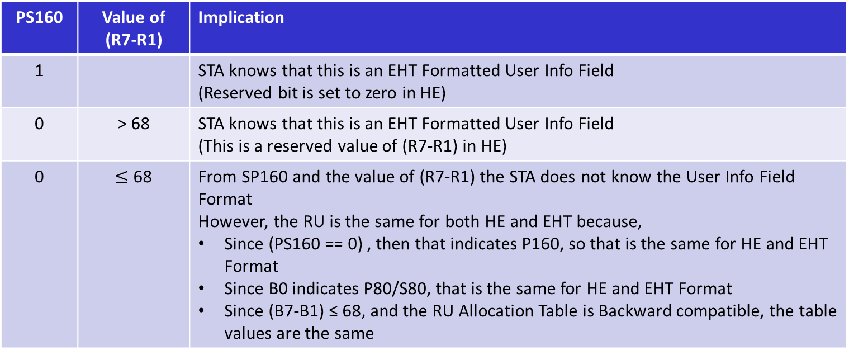
Logic – Primary/Secondary Approach
PS160 | Value of (R7-R1) | Implication
1 |  | STA knows that this is an EHT Formatted User Info Field (Reserved bit is set to zero in HE)
0 | > 68 | STA knows that this is an EHT Formatted User Info Field (This is a reserved value of (R7-R1) in HE)
0 | $≤$ 68 | From SP160 and the value of (R7-R1) the STA does not know the User Info Field Format However, the RU is the same for both HE and EHT because, Since (PS160 == 0) , then that indicates P160, so that is the same for HE and EHT Format Since B0 indicates P80/S80, that is the same for HE and EHT Format Since (B7-B1) ≤ 68, and the RU Allocation Table is Backward compatible, the table values are the same
Hence the STA can determine the exact RU/MRU location looking only at {PS160, B0, B7-B1}
This means in R2 we can signal which 80 MHz is HE and which is EHT to support A-PPDU
  Exact signaling for A-PPDU TB PPDU to be deferred to R2
In R1 the User Info Field is always formatted for EHT

Slide 23

Clarification – RU Allocation Table
(RUs/MRUs $≤$ 80 MHz)
B0 indicates P80/S80
PS160 indicates P160/S160
For all RUs/MRUs that fit in 80 MHz, these two bits uniquely identify the 80 MHz segment

Slide 24
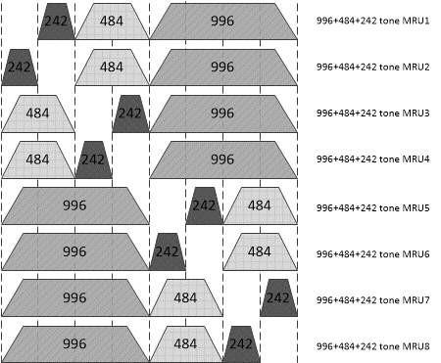

Clarification – RU Allocation Table
(80 MHz < RUs/MRUs $≤$ 160 MHz)
B0
B7-B1
0
96
0
97
0
98
0
99
1
96
1
97
1
98
1
99
B0 and B7-B1 indicate MRU within 160 MHz
PS160 indicates whether this is in P160 or S160

Slide 25
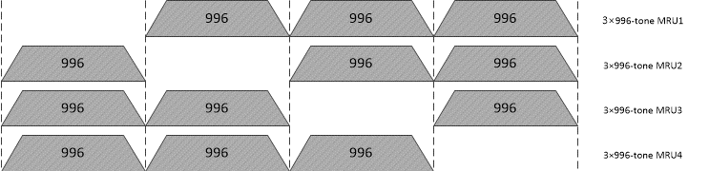

Clarification – RU Allocation Table
(160 MHz < RUs/MRUs $≤$ 320 MHz)
PS160
B0
B7-B1
0
0
104
0
1
104
1
0
104
1
1
104
For MRUs larger than 160 MHz, the bits B0 and PS160 are just bits identifying the specific MRU and have no meaning of Primary/Secondary

Slide 26
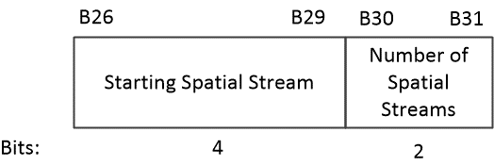
SS Allocation Subfield
Four bits allow indexing the starting spatial stream over the full 16-bit range, supporting up to a total of 16 spatial streams in UL MU-MIMO
Two bits for the Number of Spatial Streams supports up to 4 spatial streams per-user

Slide 27
User Info Field Summary
B25 is an EHT Reserved bit. In R1 it is set to zero.
B39 is the PS160 Bit
  Used in the RU Allocation Table
B26-29 is a 4-bit subfield indicating the Starting Spatial Stream Number
B30-B31 is a 2-bit subfield indicating the number of per-User Spatial Streams
As described earlier
  In R2 TB A-PPDU signaling can be included in the Common Info
  Since the STA can determine its RU/MRU location processing only the User Info Field, without knowing a priori if the User Info Field is, HE or EHT format

Slide 28
Straw Poll #1
Do you agree that in a Trigger Frame that solicits an EHT TB PPDU, a Special User Info Field is placed immediately after the Common Info Field and the Special User Info Field carries the following non-derived subfields of the U-SIG in the TB PPDU,
  PHY Version ID (3 bits)
  PPDU Bandwidth Extension Field (2 bits) [1]
  Spatial Reuse 1 (4 bits)
  Spatial Reuse 2 (4 bits)
  U-SIG Reserved Bits (12 bits)
The length of the Special User Info Field is the same length as the length of the other User Info Fields in the Trigger Frame

Slide 29
Straw Poll #2
Do you agree that,
  If the Special User Info Field is not present in the Trigger Frame, then the User Info Field is the HE format and the EHT STA transmits an HE TB PPDU
  In R1, if the Special User Info Field is present in the Trigger Frame, the User Info Field is the EHT Format and the EHT STA transmits an EHT TB PPDU

Slide 30
Straw Poll #3
Do you agree to identify the Special User Info Field (that carries the non-derived subfields of the U-SIG) by using the value 2007 in the AID12 subfield?
  An EHT AP shall not use the value 2007 as an association identifier (AID) for any STA

Slide 31
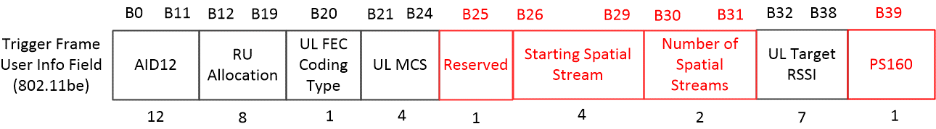
Reference: Trigger Frame User Info Field Subfields
This figure is provided for reference for Straw Polls 4-6

Slide 32
Straw Poll #4
Do you agree that B39 in a User Info Field addressed to an EHT STA within a Trigger Frame is the Primary/Secondary 160 (PS160) subfield
  Note: The PS160 subfield, along with B7-B0 of the RU Allocation subfield, specify the RU/MRU

Slide 33
Straw Poll #5
Do you agree that B25 in a User Info Field addressed to an EHT STA within a Trigger Frame is reserved and is set to zero in R1?
  Note: In 802.11ax B25 is the DCM bit, which is not needed in 802.11be

Slide 34
Straw Poll #6
Do you agree to use four bits of a User Info Field addressed to an EHT STA within a Trigger Frame for the Spatial Stream Allocation subfield and to indicate the starting spatial stream, and two bits to indicate the number of per-user spatial streams?
  Note: This supports up to a total of 16 spatial streams with up to four spatial streams per-user

Slide 35
References
Ming Gan, et. al., “Backward compatible EHT trigger frame follow up,” IEEE 802.11-20/1808r4, January 2021

