Slide 1
Enhanced Trigger Frame for EHT Support
Date: 2020-12-07
Authors:
Name | Affiliations | Address | email
Steve Shellhammer | Qualcomm |  | shellhammer@ieee.org
Bin Tian |  |  | btian@qti.qualcomm.com
Yanjun Sun |  |  | yanjuns@qti.qualcomm.com
Alfred Asterjadhi |  |  | aasterja@qti.qualcomm.com

Slide 2
Introduction
Here we propose an Enhanced Trigger Frame that is backward compatible with HE STAs with additional support for EHT STAs
Benefits of this Design
Leverage 802.11ax Trigger Frame Design
Updates in this revision
Given we are developing a better understanding of the U-SIG in the TB PPDU, we show how the information needed for the U-SIG in the TB PPDU can be carried in the Trigger Frame
For the User Info Field RU Allocation Table, we consider using Primary/Secondary Channels versus Lower/Upper Channels

Slide 3
Requirements
Item | Requirement
Backward Compatibility | An HE STA decoding the Enhanced Trigger Frame will not have any modified behavior
EHT Support | An EHT STA can decode the Enhanced Trigger Frame and support new EHT Features
320 MHz Support | The Enhanced Trigger Frame signals 320 MHz for EHT STAs
16 Spatial Stream Support | The Enhanced Trigger Frame signals up to 16 Total Spatial Streams for EHT STAs
RU Allocation | The Enhanced Trigger Frame supports EHT RU Allocations including MRU allocations

Slide 4
Trigger Frame – Reserved Bits
Available Reserved Bits
Common Info Field, the UL HE SIG-A2 Reserved subfield (B54-B62)
These bits are currently set to all ones
These bits are copied into the SIG-A2 Reserved subfield in the HE UL TB PPDU
Common Info Field, the Reserved Bit (B63)
This bit is currently set to zero
User Info Field, the Reserved bit (B39)
This bit is currently set to zero
User Info Field, the MSB of AID12 is unused except for a few special cases, and can be reused
See Table 9-31h
Summary
We have 10 available reserved bits in the Common Info Field
We have 2 available reserved bits in the User Info Field

Slide 5
UL HE SIG-A2 Reserved Subfield (B54-B62)
Text from 802.11ax Draft 7
The UL HE-SIG-A2 Reserved subfield of the Common Info field carries the value to be included in the Reserved field in the HE-SIG-A2 subfield of the solicited HE TB PPDUs. An HE AP sets the UL HE-SIG-A2 Reserved subfield to all 1s.
This ensures that all HE STAs transmit the same bits in the SIG-A2 Reserved subfield
These bits are must cut from the Trigger Frame and pasted into the HE-SIG-A2 field
These bits are not used for any other purpose in HE
These bits can be modified for EHT without causing an impact on HE STAs

Slide 6
Common Information

Slide 7
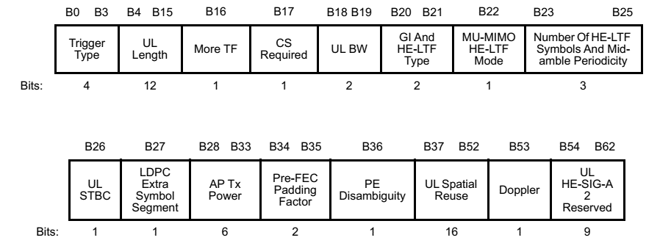
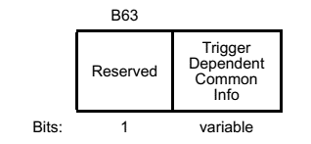
Reference – 802.11ax Common Info Field
For reference, here is the 802.11ax Common Info Field

Slide 8
Latest TB PPDU U-SIG
In [1] we have the latest U-SIG contents for the TB PPDU
Field | Category | Subfield | Bits
U-SIG | Version Independent | Version identifier | 3
 |  | PPDU BW | 3
 |  | UL/DL | 1
 |  | BSS color | 6
 |  | TXOP | 7
 |  | Reserved | 2
 |  | TBD1 | 4
 | Version Dependent | PPDU format & EHT-SIG Compression | 2
 |  | Reserved | 1
 |  | Spatial Reuse 1 | 4
 |  | Spatial Reuse 2 | 4
 |  | TBD2 | 5
 | CRC & Tail | CRC in U-SIG | 4
 |  | Tail in U-SIG | 6
 | Total # of Bits in U-SIG |  | 52
Like in 11ax, STAs transmitting in the same 20 MHz need to transmit the same U-SIG, so Third-Party STAs can decode the U-SIG
The necessary information is better to be carried in the Trigger Frame, versus having assigning fixed values
Fields for some of these entries are already available in the Common Info Field
We need to account for the new fields
Alice Chen, Sameer Vermani, Bin Tian and Youhan Kim, “U-SIG Design for TB PPDU,” IEEE 802-11/20-1546r0, September 2020

Slide 9
U-SIG in TB PPDU
Field | Category | Subfield | Bits | From Trigger Frame
U-SIG | Version Independent | Version identifier | 3 | 0 to 3
 |  | PPDU BW | 3 | 3
 |  | UL/DL | 1 | Derived as in 11ax
 |  | BSS color | 6 | Derived as in 11ax
 |  | TXOP | 7 | Derived as in 11ax
 |  | Reserved | 2 | 2
 |  | TBD1 | 4 | 4
 | Version Dependent | PPDU format & EHT-SIG Compression | 2 | Derived as in 11ax
 |  | Reserved | 1 | 1
 |  | Spatial Reuse 1 | 4 | 4
 |  | Spatial Reuse 2 | 4 | 4
 |  | TBD2 | 5 | 5
 | CRC & Tail | CRC in U-SIG | 4 | Derived as in 11ax
 |  | Tail in U-SIG | 6 | Derived as in 11ax
 | Total # of Bits in U-SIG |  | 52
If the BW and the Spatial Reuse subfields of the Common Info in the Trigger Field are not redefined, then we have around 23 to 26 bits to be carried in the Trigger Frame
This is more than can be carried in the Common Info Reserved bits (10 bits)
We can carry this in a Special User Info Field, using a Special AID12 value
The Special User Info Field can carry 28 bits ($40−12$)

Slide 10
Proposal for Carrying Necessary U-SIG Subfields in Special User Info Field
Define a special AID12 value in Table 9-31h “AID12 Subfield Encoding” to indicate that the User Info Field with this special AID12 value is a Special User Info Field carrying the non-derived content for the U-SIG of the TB PPDU
The first 12 bits (B0-B11) of the User Info Field is AID12
The remaining 28 bits (B12-B39) are allocated to the following U-SIG Subfields
Subfield | Length (Bits)
PHY Version Identifier | 3
PPDU Bandwidth | 3
Spatial Reuse 1 | 4
Spatial Reuse 2 | 4
U-SIG Reserved | 12
Reserved | 2
The exact bit assignments can be done once the U-SIG format is finalized for the TB PPDU
This Special User Info Field is sent right after the Common Info Field

Slide 11
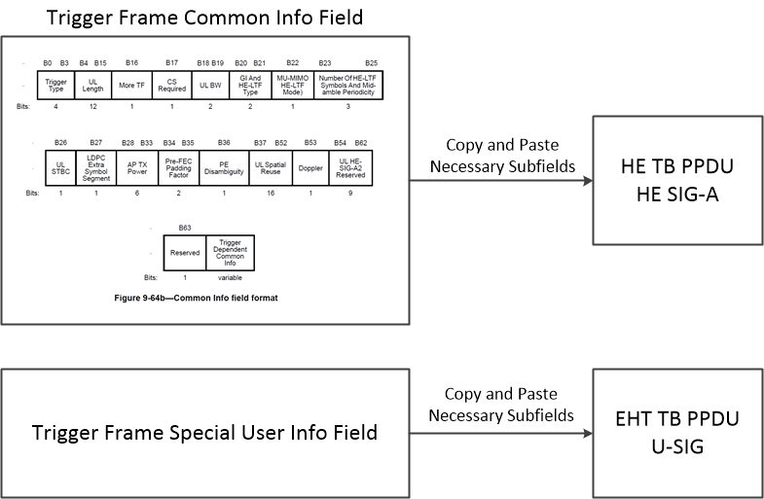
Mapping Content from Trigger Frame to TB PPDU Preambles

Slide 12
802.11ax Draft Statement
The following statement is in the 802.11ax Draft, Clause 26.5.2.2.4
“The AP shall place User Info fields with the AID12 subfield set to 0 or a value greater than 2007 after User Info fields with the AID12 subfield set to a value in the range 1 to 2007 (if any present).”
Here we propose a way of keeping the Special User Info Field right after the Common Info Field while still addressing this statement in the 802.11ax Draft

Slide 13
Proposal for AID12 Value
Instead of using one of the currently reserved AID12 values we propose to use a currently unreserved value, AID12 = 2007
Make that a special value in EHT, indicating the Special User Info Field
Place the Special User Info Field right after the Common Info Field
This is consistent with the statement in the 11ax draft, since the AID12 value is not greater than 2007
Set the Common Info Field Reserved bit (B63) to the Enhanced Trigger Frame Flag
The current value of B63 in 11ax is zero
If set to one the STA knows this is an Enhanced Trigger Frame
This indicates the presence of the Special User Info Field with AID12=2007 to convey additional Common Information, as shown below

Slide 14
Number of HE LTFs and Midamble Periodicity
It is possible to expand the “Number of HE LTFs and Midamble Periodicity” subfield to support up to 16 LTFs
Number of HE LTFs and Midamble Periodicity Value | Number of HE LTFs (Doppler = 0) | Number of HE LTFs Midamble Periodicity (Doppler = 1) | Number of EHT LTFs (Doppler = 0) (FOR EHT) | Number of EHT LTFs Midamble Periodicity (Doppler = 1) (FOR EHT)
0 | 1 | 1 (10 symbols) | 1 | 1 (10 symbols)
1 | 2 | 2 (10 symbols) | 2 | 2 (10 symbols)
2 | 4 | 4 (10 symbols) | 4 | 4 (10 symbols)
3 | 6 | Reserved | 6 | Reserved
4 | 8 | 1 (20 symbols) | 8 | 1 (20 symbols)
5 | Reserved | 2 (20 symbols) | 12 | 2 (20 symbols)
6 | Reserved | 4 (20 symbols) | 16 | 4 (20 symbols)
7 | Reserved | Reserved | Reserved | Reserved

Slide 15
Common Info Summary
B63 is the Enhanced Trigger Frame Flag
In 802.11ax B63 is a reserved bit and is set to zero
In 802.11be B63 is the Enhanced Trigger Frame Flag and is set to one
This indicates it is an Enhanced Trigger Frame and supports EHT
It also indicates that AID12=2007 is a Special AID12 value
A Special User Info field is placed right after the Common Info Field
It uses Special AID12=2007
It carries the non-derived information for the U-SIG in the TB PPDU
PHY Version Identifier, PPDU Bandwidth, Spatial Reuse 1, Spatial Reuse 2, U-SIG Reserved bits
The Number of HE LTFs and Midamble Periodicity subfield has been extended to support 12 and 16 LTFs

Slide 16
User Information

Slide 17
Update
The update proposal for the User Info Field includes the following changes
Change RU Allocation table bits (LU, B0) from Lower/Upper meaning to Primary/Secondary meaning
Remove the HE/EHT bit from the User Info Field
This approach provides backward compatibility with 11ax and provides an EHT Reserved bit
Material from the earlier proposal is in the Backup

Slide 18
Clarification of HE/EHT User Info Field Format
HE STAs
User Info Field is always the HE format
R1 EHT STAs
If Enhanced Trigger Frame Flag is zero, User Info Field is HE format
EHT STA transmits HE TB PPDU
If Enhanced Trigger Frame Flag is one, User Info Field is EHT Format
EHT STA transmits EHT TB PPDU
R2 EHT STAs
It is possible to support both HE or EHT User Info Field formats in one Trigger Frame to support A-PPDU in R2

Slide 19
User Info Field Subfields
B25 $→$ EHT Reserved Bit
Set to zero in R1
B39 $→$ PS160 Bit

Slide 20
Primary/Secondary Definition for B0 and Additional bit
B0 is the Primary/Secondary 80 MHz bit for RUs/MRUs less than or equal to 80 MHz
For larger MRUs, B0 is a bit used in the indication of the specific MRU, and no longer has a primary/secondary meaning
PS160 is the Primary/Secondary 160 MHz bit for RUs/MRUs less than or equal to 160 MHz
For larger MRUs PS160, is a bit used in the indication of the specific MRU, and no longer has a primary/secondary meaning

Slide 21
Backward Compatibility with 802.11ax
Here we show it is possible for an STA to determine its RU/MRU location, looking only at the User Info Field, without knowing a priori if the User Info Field is, HE or EHT Format
If this is possible, then in R2 we can use that RU/MRU location in combination with A-PPDU signaling in the Common Info about which 80 MHz is HE and which is EHT to determine if the EHT STA is to transmit an HE or EHT TB PPDU
We begin with the following bit definitions in the User Info Field
B0 $→$ P80/S80
HE Reserved Bit (B39) $→$ P160/S160, call this the PS160 bit

Slide 22
Logic – Primary/Secondary Approach
PS160 | Value of (R7-R1) | Implication
1 |  | STA knows that this is an EHT Formatted User Info Field (Reserved bit is set to zero in HE)
0 | > 68 | STA knows that this is an EHT Formatted User Info Field (This is a reserved value of (R7-R1) in HE)
0 | $≤$ 68 | From SP160 and the value of (R7-R1) the STA does not know the User Info Field Format However, the RU is the same for both HE and EHT because, Since (PS160 == 0) , then that indicates P160, so that is the same for HE and EHT Format Since B0 indicates P80/S80, that is the same for HE and EHT Format Since (B7-B1) ≤ 68, and the RU Allocation Table is Backward compatible, the table values are the same
Hence the STA can determine the exact RU/MRU location looking only at {PS160, B0, B7-B1}
This means in R2 we can signal which 80 MHz is HE and which is EHT to support A-PPDU
Exact signaling for A-PPDU TB PPDU to be deferred to R2
In R1 the User Info Field is always formatted for EHT

Slide 23
Clarification – RU Allocation Table (RUs/MRUs $≤$ 80 MHz)
B0 indicates P80/S80
PS160 indicates P160/S160
For all RUs/MRUs that fit in 80 MHz, these two bits uniquely identify the 80 MHz segment

Slide 24
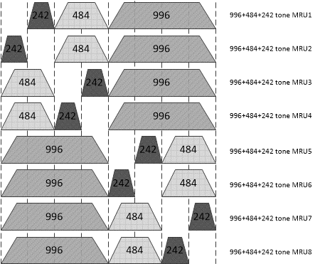
Clarification – RU Allocation Table (80 MHz < RUs/MRUs $≤$ 160 MHz)
B0
B7-B1
0
96
0
97
0
98
0
99
1
96
1
97
1
98
1
99
B0 and B7-B1 indicate MRU within 160 MHz
PS160 indicates whether this is in P160 or S160

Slide 25
Clarification – RU Allocation Table (160 MHz < RUs/MRUs $≤$ 320 MHz)
PS160
B0
B7-B1
0
0
104
0
1
104
1
0
104
1
1
104
For MRUs larger than 160 MHz, the bits B0 and PS160 are just bits identifying the specific MRU and have no meaning of Primary/Secondary

Slide 26
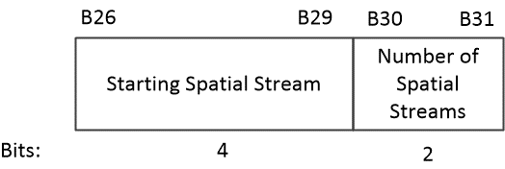
SS Allocation Subfield
Four bits allow indexing the starting spatial stream over the full 16-bit range, supporting up to a total of 16 spatial streams in UL MU-MIMO
Two bits for the Number of Spatial Streams supports up to 4 spatial streams per-user

Slide 27
User Info Field Summary
B25 is an EHT Reserved bit. In R1 it is set to zero.
B39 is the PS160 Bit
Used in the RU Allocation Table
B26-29 is a 4-bit subfield indicating the Starting Spatial Stream Number
B30-B31 is a 2-bit subfield indicating the number of per-User Spatial Streams
As described earlier
In R2 TB A-PPDU signaling can be included in the Common Info
Since the STA can determine its RU/MRU location processing only the User Info Field, without knowing a priori if the User Info Field is, HE or EHT format

Slide 28
Straw Poll #1
Do you agree to set the Trigger Frame Common Info Field Reserved Bit (B63), Enhanced Trigger Frame Flag, to one to indicate this is an Enhanced Trigger Frame?
Note: This indicates the presence of the Special User Info Field, immediately after the Common Info Field, which carries the non-derived subfields of the U-SIG in the TB PPDU
Note: This indicates that the User Info Field addressed to an R1 EHT STA is in the EHT Format

Slide 29
Straw Poll #2
Do you agree that,
If Enhanced Trigger Frame Flag is zero, the User Info Field is HE format
EHT STA transmits HE TB PPDU
In R1, if Enhanced Trigger Frame Flag is one, the User Info Field is EHT Format
EHT STA transmits EHT TB PPDU

Slide 30
Straw Poll #3
Do you agree that in the Trigger Frame, immediately after the Common Info Field, there is a Special User Info Field which carries the following non-derived subfields of the U-SIG in the TB PPDU,
PHY Version ID (3 bits)
PPDU Bandwidth (3 bits)
Spatial Reuse 1 (4 bits)
Spatial Reuse 2 (4 bits)
U-SIG Reserved Bits (12 bits)

Slide 31
Straw Poll #4
Do you agree to assign a Special AID12 value of 2007 in the Trigger Frame for the Special User Info Field which carries the non-derived subfields of the U-SIG in the TB PPDU?

Slide 32
Straw Poll #5
Do you agree to change the following reserved values in the Trigger Frame Common Info Field Number of HE LTFs and Midamble Periodicity table, for the case Doppler = 0, as follows?
Number of HE LTFs and Midamble Periodicity subfield value = 5 indicates the Number of LTFs = 12
Number of HE LTFs and Midamble Periodicity subfield value = 6 indicates the Number of LTFs = 16

Slide 33
Straw Poll #6
Do you agree that in the User Info Field of the Trigger Frame the following bits indicate the following?
B0 of the RU Allocation subfield indicates Primary/Secondary 80 MHz Channel for RU/MRU $≤$ 80 MHz
Note: This is the same as in 11ax
Note: For RUs/MRUs > 80 MHz, B0 is used to indicate a specific MRU and does not have a primary/secondary meaning
PS160 (B39) indicates Primary/Secondary 160 MHz for RU/MRU $≤$ 160 MHz
Note: For RUs/MRUs > 160 MHz, PS160 is used to indicate a specific MRU and does not have a primary/secondary meaning

Slide 34
Straw Poll #7
Do you agree that in the EHT User Info Field of the Trigger Frame B25 is an EHT Reserved and set to zero in R1?

Slide 35
Straw Poll #8
Do you agree to use four bits of the Trigger Frame User Info Field Spatial Stream Allocation subfield to indicate the starting spatial stream, and two bits to indicate the number of per-user spatial streams?
Note: This supports up to a total of 16 spatial streams with up to four spatial streams per-user

Slide 36
Straw Poll 9
Do you agree with the following EHT User Info Field format in the EHT Enhanced Trigger Frame?

Slide 37
Backup

Slide 38
EHT R1 AP Behavior
To trigger an HE TB PPDU the AP sends an HE Tigger Frame
Note that B63 of the Common Info Field is set to zero
User Info Field formatted as HE format
To trigger an EHT TB PPDU the AP sets the following in the Trigger Frame:
Sets the Enhanced Trigger Frame Flag (B63) to one
Sets subfields in Common Info Field
Sends a Special User Info Field immediately after the Common Info Field
The AID12 value of the Special User Info Field is set to 2007
The Special User Info Field carries the non-derived subfields of the U-SIG in the TB PPDU
PHY Version Identifier, PPDU Bandwidth, Spatial Reuse 1, Spatial Reuse 2, U-SIG Reserved bits
For each User Info Field
Sets B25 (EHT reserved) to zero
Sets {PS160, B0, B1-B7} to signal the appropriate RU/MRU
Sets B26-B29 to indicate the Starting Spatial Stream
Sets B30-B31 to indicate the Number of per-User Spatial Streams
Sets the other subfields in the User Info Field

Slide 39
EHT R1 STA Behavior
If Enhanced Trigger Frame Flag (B63) of the Common Info Field is set to zero, the STA processes the HE Tigger frame and sends a HE TB PPDU
If Enhanced Trigger Frame Flag (B63) of the Common Info field is set to one it:
Decodes the necessary fields of the Common Info Field
Decodes the Special User Info Field, with AID12=2007, which is immediately after the Common Info Field, and uses that info to populate the U-SIG of the EHT TB PPDU
Uses {PS160, B0, B1-B7} to identify the RU/MRU
Decodes B26-B29 to identify the Starting Spatial Stream number
Decodes B30-B31 to identify the Number of per-User Spatial Streams
Decodes the rest of the User Info Field
Transmits an EHT TB PPDU

Slide 40
Material from Earlier Version

Slide 41
Enhanced User Info Field
For Reference here is the 802.11ax User Info
The main issue is to expand the functionality of the User Info Field to support EHT features while maintaining forward compatibility for R2
In the following we provide an example which achieves these goals

Slide 42
Example – Enhanced User Info Field
Here we provide an example of the Enhanced User Info Field
Provides support for
Full set of RUs/MRUs
Support up to 16 Spatial Streams
HE/EHT bit to indicate to each EHT STA if it is to transmit an HE or EHT TB PPDU

Slide 43
Lower/Upper 160 MHz Segment Bit
Combining this bit with the 8-bit RU Allocation subfield, provides an effective 9-bit subfield
This is sufficient for supporting all RUs and MRUs

Slide 44
SS Allocation Subfield
Four bits allow indexing the starting spatial stream over the full 16-bit range, supporting up to a total of 16 spatial streams in UL MU-MIMO
Two bits for the Number of Spatial Streams supports up to 4 spatial streams per-user

Slide 45
HE/EHT Format (Reserved Bit B39)
We use the Reserved Bit (B39) to indicate to the EHT STA whether the User Info Field is the original format or the enhanced format
If the HE/EHT Format bit is set to HE, then the EHT STA will transmit an HE TB PPDU
If the HE/EHT Format bit is set to EHT, then the EHT STA will transmit an EHT TB PPDU
HE/EHT Format (B39) | Meaning | Comment
HE (value = 0) | The User Info Field is unchanged | STA to transmit an HE TB PPDU
EHT (value = 1) | Enhanced User Info Field | STA to transmit an EHT TB PPDU

Slide 46
Enhanced User Info Field
Subfield | HE Bits | EHT Bits | Comments for EHT
AID12 | 12 | 12 | No Change
RU Allocation | 8 | 8 | Combining Lower/Upper 160 MHz bit with 8-bit RU Allocation subfield provides 9-bits, which is sufficient for all RUs and MRUs.
UL FEC Coding Type | 1 | 1 | No Change
MCS | 4 | 4 | DCM is Merged into MCS Subfield
DCM | 1 | 0 | Merges DCM with MCS
SS Allocation | 6 | 6 | Four bits for starting spatial stream and two bits for the number of spatial streams. Supports up to four spatial streams per-user
UL Target RSSI | 7 | 7 | No Change
HE/EHT Format |  | 1 | Indicated to EHT STA whether to behave as HE or EHT STA
Lower/Upper 160 MHz Segment |  | 1 | Used to indicate if RU Allocation is for Lower or Upper 160 MHz Segment
Reserved | 1 | 0 | The MSB of AID12 is available for Future Use There is also a Reserved bit in the Trigger Dependent User Info Field of the Basic Trigger Frame Variant

