Slide 1
Enhanced Trigger Frame for EHT Support
Date: 2020-10-13
Authors:
Name | Affiliations | Address | email
Steve Shellhammer | Qualcomm |  | shellhammer@ieee.org
Bin Tian |  |  | btian@qti.qualcomm.com
Yanjun Sun |  |  | yanjuns@qti.qualcomm.com
Alfred Asterjadhi |  |  | aasterja@qti.qualcomm.com

Slide 2
Introduction
Here we propose an Enhanced Trigger Frame that is backward compatible with HE STAs with additional support for EHT STAs
Benefits of this Design
  Leverage 802.11ax Trigger Frame Design
  Can trigger either HE or EHT STAs
  Can trigger both HE and EHT STAs with one Trigger Frame to support TB A-PPDUs

Slide 3
Requirements
Item | Requirement
Backward Compatibility | An HE STA decoding the Enhanced Trigger Frame will not have any modified behavior
EHT Support | An EHT STA can decode the Enhanced Trigger Frame and support new EHT Features
320 MHz Support | The Enhanced Trigger Frame signals 320 MHz for EHT STAs
16 Spatial Stream Support | The Enhanced Trigger Frame signals up to 16 Total Spatial Streams for EHT STAs
RU Allocation | The Enhanced Trigger Frame supports EHT RU Allocations including MRU allocations

Slide 4
Trigger Frame – Reserved Bits
Available Reserved Bits
Common Info Field, the UL HE SIG-A2 Reserved subfield (B54-B62)
  These bits are currently set to all ones
  These bits are copied into the SIG-A2 Reserved subfield in the HE UL TB PPDU
Common Info Field, the Reserved Bit (B63)
  This bit is currently set to zero
User Info Field, the Reserved bit (B39)
  This bit is currently set to zero
User Info Field, the MSB of AID12 is unused except for a few special cases, and can be reused
  See Table 9-31g
Summary
We have 10 available reserved bits in the Common Info Field
We have 2 available reserved bits in the User Info Field

Slide 5
UL HE SIG-A2 Reserved Subfield (B54-B62)
Text from 802.11ax Draft 7
  The UL HE-SIG-A2 Reserved subfield of the Common Info field carries the value to be included in the Reserved field in the HE-SIG-A2 subfield of the solicited HE TB PPDUs. An HE AP sets the UL HE-SIG-A2 Reserved subfield to all 1s.
This ensures that all HE STAs transmit the same bits in the SIG-A2 Reserved subfield
These bits are must cut from the Trigger Frame and pasted into the HE-SIG-A2 field
These bits are not used for any other purpose in HE
These bits can be modified for EHT without causing an impact on HE STAs

Slide 6
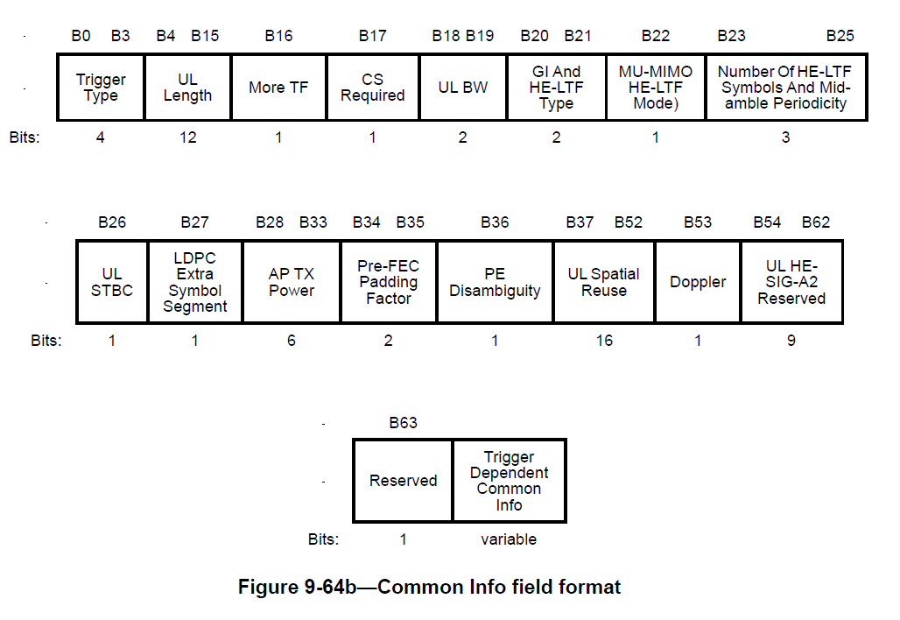
For Reference – Common Info Field

Slide 7
Enhanced Common Info Field
Add support for
  320 MHz
  16 spatial streams
  Content of U-SIG for TB PPDU
    PHY Version Number
    Puncturing Info (TBD)

Slide 8
New Common Info Subfields
Subfield Name | Bits | Description
Enhanced Trigger Frame Flag | 1 | Indicates this is an Enhanced Trigger Frame
PHY Version Field | 3 | Default value (all ones) indicates HE Another value indicates EHT Other values are TBD
UL BW Extension Field | 1 | This expands the UL BW field from 2 bits (four cases) to 3 bits (eight cases) when the PHY Version Field indicates EHT One of the new bandwidths is 320 MHz while the others are reserved
Puncture for each 80-MHz segment | TBD | The U-SIG for TB PPDUs is not yet fully defined. If puncturing is included in the U-SIG for TB PPDU, then this info needs to be included in the Trigger Frame

Slide 9
Interpretation of New Subfields
Enhanced Trigger Frame Flag
  Set to zero in 802.11ax Trigger Frame
  When set to one it indicates this is an Enhanced Trigger Frame
PHY Version
  Copied into U-SIG of TB PPDU
BW Expansion
  This bit can be combined with the two-bit BW Field
  Possible bit mapping (on right)
BW Expansion (B59) | BW | Bandwidth
0 | 0 | 20 MHz
0 | 1 | 40 MHz
0 | 2 | 80 MHz
0 | 3 | 80+80 MHz or 160 MHz
1 | 0 | 320 MHz
1 | 1 | Reserved
1 | 2 | Reserved
1 | 3 | Reserved

Slide 10
New Common Info Bits – Spoof a “Special User AID”
More bits may be needed, for example, for the puncturing subfield in the U-SIG
  The number of bits needed for puncturing is TBD
One method to provide additional Common Info Bits is to transmit a spoofed User Info Field
This would be the first User Info Field in the User Info List
The AID would use a “Special” AID value never used by a STA in the BSS
After the AID there are 28 bits which could used for EHT TB PPDUs
  These bits may also be useful for R2 features

Slide 11
Number of HE LTFs and Midamble Periodicity
It is possible to expand the “Number of HE LTFs and Midamble Periodicity” subfield to support up to 16 LTFs
Number of HE LTFs and Midamble Periodicity Value | Number of HE LTFs (Doppler = 0) | Number of HE LTFs Midamble Periodicity (Doppler = 1) | Number of EHT LTFs (Doppler = 0) (FOR EHT) | Number of EHT LTFs Midamble Periodicity (Doppler = 1) (FOR EHT)
0 | 1 | 1 (10 symbols) | 1 | 1 (10 symbols)
1 | 2 | 2 (10 symbols) | 2 | 2 (10 symbols)
2 | 4 | 4 (10 symbols) | 4 | 4 (10 symbols)
3 | 6 | Reserved | 6 | Reserved
4 | 8 | 1 (20 symbols) | 8 | 1 (20 symbols)
5 | Reserved | 2 (20 symbols) | 12 | 2 (20 symbols)
6 | Reserved | 4 (20 symbols) | 16 | 4 (20 symbols)
7 | Reserved | Reserved | Reserved | Reserved

Slide 12
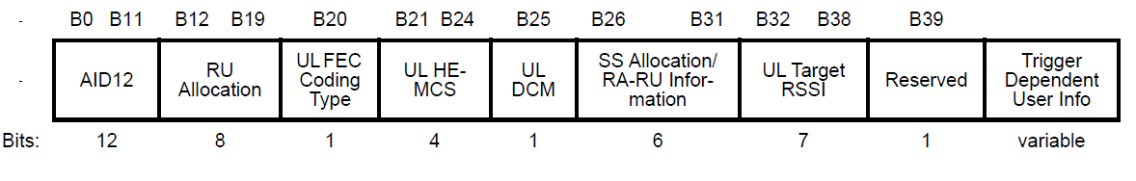
Enhanced User Info Field
For Reference here is the 802.11ax User Info
The main issue is to expand the functionality of the User Info Field to support EHT features while maintaining forward compatibility for R2
In the following we provide an example which achieves these goals

Slide 13
Example – Enhanced User Info Field
Here we provide an example of the Enhanced User Info Field
Provides support for
  Full set of RUs/MRUs
  Support up to 16 Spatial Streams
  HE/EHT bit to indicate to each EHT STA if it is to transmit an HE or EHT TB PPDU

Slide 14
Lower/Upper 160 MHz Segment Bit
Combining this bit with the 8-bit RU Allocation subfield, provides an effective 9-bit subfield
This is sufficient for supporting all RUs and MRUs (See Backup)

Slide 15
SS Allocation Subfield
SS Allocation Field
Four bits allow indexing the starting spatial stream over the full 16-bit range, supporting up to a total of 16 spatial streams in UL MU-MIMO
Two bits for the Number of Spatial Streams supports up to 4 spatial streams per-user

Slide 16
HE/EHT Format (Reserved Bit B39)
We use the Reserved Bit (B39) to indicate to the EHT STA whether the User Info Field is the original format or the enhanced format
  If the HE/EHT Format bit is set to HE, then the EHT STA will transmit an HE TB PPDU
  If the HE/EHT Format bit is set to EHT, then the EHT STA will transmit an EHT TB PPDU
HE/EHT Format (B39) | Meaning | Comment
HE (value = 0) | The User Info Field is unchanged | STA to transmit an HE TB PPDU
EHT (value = 1) | Enhanced User Info Field | STA to transmit an EHT TB PPDU

Slide 17
Enhanced User Info Field
Subfield | HE Bits | EHT Bits | Comments for EHT
AID12 | 12 | 12 | No Change
RU Allocation | 8 | 8 | Combining Lower/Upper 160 MHz bit with 8-bit RU Allocation subfield provides 9-bits, which is sufficient for all RUs and MRUs.
UL FEC Coding Type | 1 | 1 | No Change
MCS | 4 | 4 | DCM is Merged into MCS Subfield
DCM | 1 | 0 | Merges DCM with MCS
SS Allocation | 6 | 6 | Four bits for starting spatial stream and two bits for the number of spatial streams. Supports up to four spatial streams per-user
UL Target RSSI | 7 | 7 | No Change
HE/EHT Format |  | 1 | Indicated to EHT STA whether to behave as HE or EHT STA
Lower/Upper 160 MHz Segment |  | 1 | Used to indicate if RU Allocation is for Lower or Upper 160 MHz Segment
Reserved | 1 | 0 | The MSB of AID12 is available for Future Use There is also a Reserved bit in the Trigger Dependent User Info Field of the Basic Trigger Frame Variant

Slide 18
Conclusions
Enhanced Trigger Frame
  Fully Backward compatible with HE
  Enhanced to support EHT features
    320 MHz bandwidth
    Up to 16 Spatial Streams
    RUs and MRUs
  Provided an example of Enhanced User Info Field
  Can be expanded to support Uplink TB A-PPDU

Slide 19
Straw Poll #1
Do you support reusing the 802.11ax Trigger Type value for EHT?

Slide 20
Straw Poll #2
Do you support reassigning reserved bits in the Tigger Frame Common Info Field for the following new subfields?
Subfield Name | Bits
Enhanced Trigger Frame Flag | 1
PHY Version Field | 3
UL BW Extension Field | 1

Slide 21
Straw Poll #3
Do you agree to reassign one of the reserved bits in the Trigger Frame Common Info Field to indicate that this Trigger Frame is an Enhanced Trigger Frame, supporting EHT Features?

Slide 22
Straw Poll #4
Do you agree to reassign one of the reserved bits in the Trigger Frame Common Info Field as a bandwidth expansion bit?
  Note: This expands the number of bandwidth bits from two bits to three bits. One of the eight values can be used to indicate 320 MHz bandwidth. The other three values could be reserved.

Slide 23
Straw Poll #5
Do you agree to reassign three reserved bits in the Trigger Frame Common Info Field to indicate the PHY Version number?
  Note: The PHY Version Number is copied and pasted into the U-SIG field of the TB PPDU

Slide 24
Straw Poll #6
Do you agree to change the following reserved values in the Trigger Frame Common Info Field Number of HE LTFs and Midamble Periodicity table, for the case Doppler = 0, as follows?
  Number of HE LTFs and Midamble Periodicity subfield value = 5 indicates the Number of LTFs = 12
  Number of HE LTFs and Midamble Periodicity subfield value = 6 indicates the Number of LTFs = 16

Slide 25
Straw Poll #7
Do you agree to use four bits of the Trigger Frame User Info Field Spatial Stream Allocation subfield to indicate the starting spatial stream, and two bits to indicate the number of per-user spatial streams?
  Note: This supports up to a total of 16 spatial streams with up to four spatial streams per-user

Slide 26
Straw Poll #8
Do you agree to the following subfields in the Trigger Frame User Info Field?
Subfield | Bits
AID12 | 12
RU Allocation | 8
UL FEC Coding Type | 1
MCS | 4
SS Allocation | 6
UL Target RSSI | 7
HE/EHT Format | 1
Lower/Upper 160 MHz Segment | 1

Slide 27
Straw Poll #9
Do you agree to include a Lower/Upper 160 MHz Segment bit in the Trigger Frame User Info Field?
  Note: Combining this bit with the 8-bit RU Allocation subfield provides an effective 9-bit field, which is sufficient for supporting all RUs and MRUs. (See Backup)

Slide 28
Straw Poll #9
Do you agree to include an HE/EHT bit in the Trigger Frame User Info Field, indicating to the EHT STA whether to transmit an HE or EHT TB PPDU?

Slide 29
Backup

Slide 30
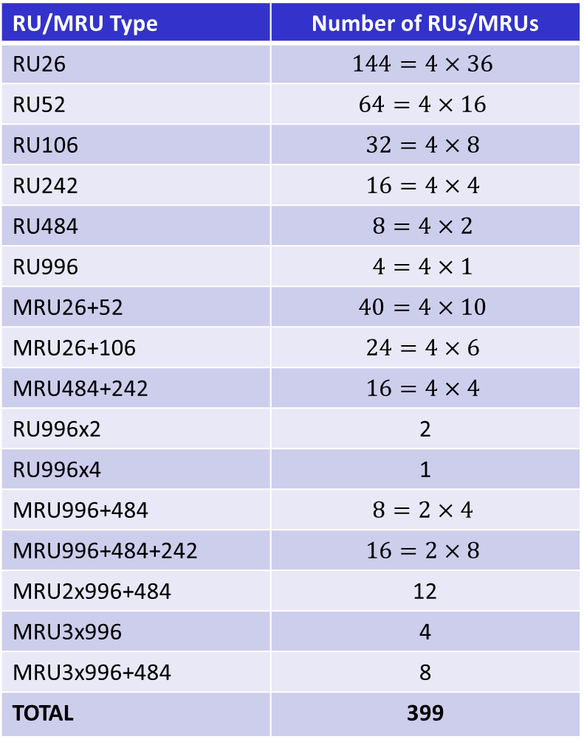
RU/MRU Count
RU/MRU Type | Number of RUs/MRUs
RU26 | $$144=4×36$$
RU52 | $$64=4×16$$
RU106 | $$32=4×8$$
RU242 | $$16=4×4$$
RU484 | $$8=4×2$$
RU996 | $$4=4×1$$
MRU26+52 | $$40=4×10$$
MRU26+106 | $$24=4×6$$
MRU484+242 | $$16=4×4$$
RU996x2 | 2
RU996x4 | 1
MRU996+484 | $$8=2×4$$
MRU996+484+242 | $$16=2×8$$
MRU2x996+484 | 12
MRU3x996 | 4
MRU3x996+484 | 8
TOTAL | 399
A 9-bit table provides 512 entries, which is sufficient to cover all RUs and MRUs

