Slide 1
Enhanced Trigger Frame for EHT Support
Date: 2020-09-14
Authors:
Name | Affiliations | Address | email
Steve Shellhammer | Qualcomm |  | shellhammer@ieee.org
Bin Tian |  |  | btian@qti.qualcomm.com
Yanjun Sun |  |  | yanjuns@qti.qualcomm.com
Alfred Asterjadhi |  |  | aasterja@qti.qualcomm.com

Slide 2
Introduction
Here we propose an Enhanced Trigger Frame that is backward compatible with HE STAs with additional support for EHT STAs
Benefits of this Design
Leverage 802.11ax Trigger Frame Design
Can trigger either HE or EHT STAs
Can trigger both HE and EHT STAs with one Trigger Frame to support TB A-PPDUs

Slide 3
Requirements
Item | Requirement
Backward Compatibility | An HE STA decoding the Enhanced Trigger Frame will not have any modified behavior
EHT Support | An EHT STA can decode the Enhanced Trigger Frame and support new EHT Features
320 MHz Support | The Enhanced Trigger Frame signals 320 MHz for EHT STAs
16 Spatial Stream Support | The Enhanced Trigger Frame signals up to 16 Total Spatial Streams for EHT STAs
RU Allocation | The Enhanced Trigger Frame supports EHT RU Allocations including M-RU allocations

Slide 4
Trigger Frame – Reserved Bits
Available Reserved Bits
Common Info Field, the UL HE SIG-A2 Reserved subfield (B54-B62)
These bits are currently set to all ones
These bits are copied into the SIG-A2 Reserved subfield in the HE UL TB PPDU
Common Info Field, the Reserved Bit (B63)
This bit is currently set to zero
User Info Field, the Reserved bit (B39)
This bit is currently set to zero
User Info Field, the MSB of AID12 is unused except for a few special cases, and can be reused
See Table 9-31g
Summary
We have 10 available reserved bits in the Common Info Field
We have 2 available reserved bits in the User Info Field

Slide 5
UL HE SIG-A2 Reserved Subfield (B54-B62)
Text from 802.11ax Draft 7
The UL HE-SIG-A2 Reserved subfield of the Common Info field carries the value to be included in the Reserved field in the HE-SIG-A2 subfield of the solicited HE TB PPDUs. An HE AP sets the UL HE-SIG-A2 Reserved subfield to all 1s.
This ensures that all HE STAs transmit the same bits in the SIG-A2 Reserved subfield
These bits are must cut from the Trigger Frame and pasted into the HE-SIG-A2 field
These bits are not used for any other purpose in HE
These bits can be modified for EHT without causing an impact on HE STAs

Slide 6
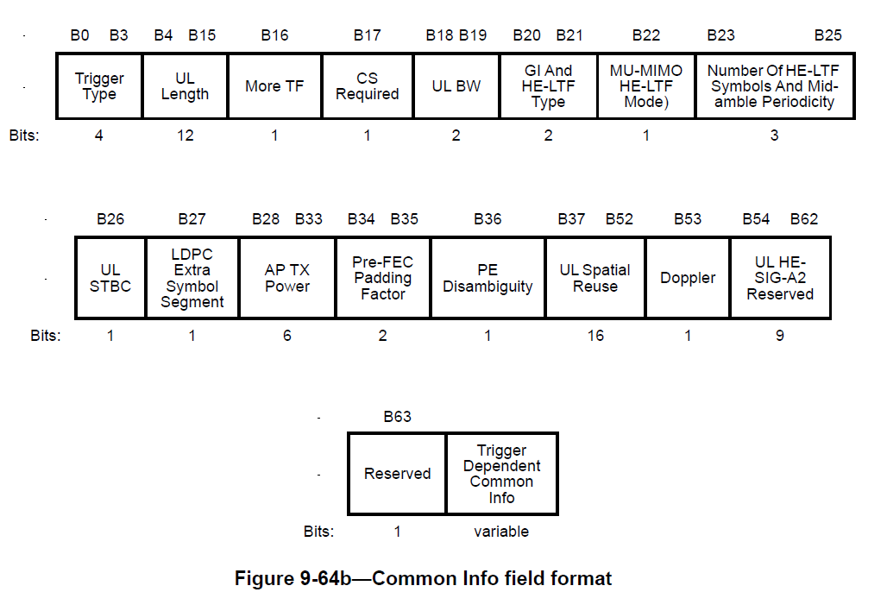
For Reference – Common Info Field

Slide 7
Enhanced Common Info Field
Add support for
320 MHz
16 spatial streams
Content of U-SIG for TB PPDU
PHY Version Number
Puncturing Info

Slide 8
New Common Info Subfields
Subfield Name | Bits | Description
Enhanced Trigger Frame Flag | 1 | Indicates this is an Enhanced Trigger Frame
PHY Version Field | 3 | Default value (all ones) indicates HE Another value indicates EHT Other values are TBD
UL BW Extension Field | 1 | This expands the UL BW field from 2 bits (four cases) to 3 bits (eight cases) when the PHY Version Field indicates EHT One of the new bandwidths is 320 MHz while the others are reserved
Puncture for each 80-MHz segment | TBD | The U-SIG for TB PPDUs is not yet fully defined. If puncturing is included in the U-SIG for TB PPDU, then this info needs to be included in the Trigger Frame

Slide 9
Interpretation of New Subfields
Enhanced Trigger Frame Flag
Set to zero in 802.11ax Trigger Frame
When set to one it indicates this is an Enhanced Trigger Frame
PHY Version
Copied into U-SIG of TB PPDU
BW Expansion
This bit can be combined with the two-bit BW Field
Possible bit mapping (on right)
BW Expansion (B59) | BW | Bandwidth
0 | 0 | 20 MHz
0 | 1 | 40 MHz
0 | 2 | 80 MHz
0 | 3 | 80+80 MHz or 160 MHz
1 | 0 | 320 MHz
1 | 1 | Reserved
1 | 2 | Reserved
1 | 3 | Reserved

Slide 10
New Common Info Bits – Spoof a “Special User AID”
More bits may be needed, for example, for the puncturing subfield in the U-SIG
The number of bits needed for puncturing is TBD
One method to provide additional Common Info Bits is to transmit a spoofed User Info Field
This would be the first User Info Field in the User Info List
The AID would use a “Special” AID value never used by a STA in the BSS
After the AID there are 28 bits which could used for EHT TB PPDUs
These bits may also be useful for R2 features

Slide 11
Number of HE LTFs and Midamble Periodicity
It is possible to expand the “Number of HE LTFs and Midamble Periodicity” subfield to support up to 16 LTFs
Number of HE LTFs and Midamble Periodicity Value | Number of HE LTFs (Doppler = 0) | Number of HE LTFs Midamble Periodicity (Doppler = 1) | Number of EHT LTFs (Doppler = 0) (FOR EHT) | Number of EHT LTFs Midamble Periodicity (Doppler = 1) (FOR EHT)
0 | 1 | 1 (10 symbols) | 1 | 1 (10 symbols)
1 | 2 | 2 (10 symbols) | 2 | 2 (10 symbols)
2 | 4 | 4 (10 symbols) | 4 | 4 (10 symbols)
3 | 6 | Reserved | 6 | Reserved
4 | 8 | 1 (20 symbols) | 8 | 1 (20 symbols)
5 | Reserved | 2 (20 symbols) | 12 | 2 (20 symbols)
6 | Reserved | 4 (20 symbols) | 16 | 4 (20 symbols)
7 | Reserved | Reserved | Reserved | Reserved

Slide 12
Enhanced User Info Field
For Reference here is the 802.11ax User Info
The main issue is to expand the functionality of the User Info Field to support EHT features while maintaining forward compatibility for R2
In the following we provide an example which achieves these goals while still providing enough reserved bits to support potential future features

Slide 13
Example – Enhanced User Info Field
Include an SU/MU bit in the User Info Field
For the SU case, fewer bits are needed for the SS Allocation Subfield
For the MU case, fewer bits are needed for the RU Allocation Subfield
This provides reserved bits in the Enhanced User Info field

Slide 14
HE/EHT Format (Reserved Bit B39)
We use the Reserved Bit (B39) to indicate to the EHT STA whether the User Info Field is the original format or the enhanced format
If the HE/EHT Format bit is set to HE, then the EHT STA will transmit an HE TB PPDU
If the HE/EHT Format bit is set to EHT, then the EHT STA will transmit an EHT TB PPDU
HE/EHT Format (B39) | Meaning | Comment
HE (value = 0) | The User Info Field is unchanged | STA to transmit an HE TB PPDU
EHT (value = 1) | Enhanced User Info Field | STA to transmit an EHT TB PPDU

Slide 15
SU/MU Bit (B25)
In the Enhanced Trigger Frame B25 is the SU/MU bit
Earlier this was the DCM bit, which in the Enhanced Trigger Frame has been merged into the MCS subfield
If SU/MU = SU, indicates the SU version of the Enhanced Trigger Frame
If SU/MU = MU that indicates the MU version of the Enhanced Trigger Frame

Slide 16
User Info Field – SU Case
Subfield | HE Bits | EHT Bits | Comments for EHT
AID12 | 12 | 12
RU Allocation | 8 | 8 | Combining Lower/Upper 160 MHz bit with 8-bit RU Allocation, provides 9-bits, which is sufficient for all RUs and M-RUs. A reserved bit could also be used to increase the size if desired.
UL FEC Coding Type | 1 | 1 | No Change
MCS | 4 | 4
DCM | 1 | 0 | Merges DCM with MCS
SS Allocation | 6 | 2 | Indicates the number of Spatial Streams Supports up to four spatial streams per-user
UL Target RSSI | 7 | 7 | No Change
HE/EHT Format |  | 1
SU/MU |  | 1
Lower/Upper 160 MHz Segment |  | 1 | Used to indicate if RU Allocation is for Lower or Upper 160 MHz Segment
Reserved | 1 | 3

Slide 17
User Info Field – MU Case
Subfield | HE Bits | EHT Bits | Comments for EHT
AID12 | 12 | 12
RU Allocation | 8 | 7 | 7 bits is sufficient for MU-MIMO case, since the RUs are larger and fewer than for OFDMA
UL FEC Coding Type | 1 | 1 | No Change
MCS | 4 | 4
DCM | 1 | 0 | Merges DCM with MCS
SS Allocation | 6 | 6 | Four bits for starting spatial stream and two bits for the number of spatial streams Supports up to four spatial streams per-user
UL Target RSSI | 7 | 7 | No Change
HE/EHT Format |  | 1
SU/MU |  | 1
Reserved | 1 | 1

Slide 18
Number of Bits for Future Use
User Info Field | Unused Bits | Number of Bits for Future Use
SU Case | Four Reserved Bits and MSB of AID12 | 4
MU Case | One Reserved Bit and MSB of AID12 | 2
For both SU and MU cases we have bits available for Future Use

Slide 19
Conclusions
Enhanced Trigger Frame
Fully Backward compatible with HE
Enhanced to support EHT features
320 MHz bandwidth
Up to 16 Spatial Streams
RUs and M-RUs
Provided an example of Enhanced User Info Field, which has several bits available for Future Use
Can be expanded to support R2 features
For example, triggering an Uplink TB A-PPDU

Slide 20
Straw Poll
Do you support reusing the 802.11ax Trigger Type value for EHT?

