Slide 1
Enhanced Trigger Frame for EHT Support
Date: 2020-09-09
Authors:
Name | Affiliations | Address | Phone | email
Steve Shellhammer | Qualcomm |  |  | shellhammer@ieee.org
Bin Tian |  |  |  | btian@qti.qualcomm.com
Yanjun Sun |  |  |  | yanjuns@qti.qualcomm.com

Slide 2
Introduction
Here we propose an Enhanced Trigger Frame that is backward compatible with HE STAs with additional support for EHT STAs

Slide 3
Requirements
Item | Requirement
Backward Compatibility | An HE STA decoding the Enhanced Trigger Frame will not have any modified behavior
EHT Support | An EHT STA can decode the Enhanced Trigger Frame and support new EHT Features
320 MHz Support | The Enhanced Trigger Frame signals 320 MHz for EHT STAs
16 Spatial Stream Support | The Enhanced Trigger Frame signals up to 16 Total Spatial Streams for EHT STAs
RU Allocation | The Enhanced Trigger Frame supports EHT RU Allocations including M-RU allocations
R2 Forward Compatibility | Forward Compatible for R2 Features

Slide 4
Trigger Frame – Reserved Bits
Available Reserved Bits
Common Info Field, the UL HE SIG-A2 Reserved subfield (B54-B62)
  These bits are currently set to all ones
  These bits are copied into the SIG-A2 Reserved subfield in the HE UL TB PPDU
Common Info Field, the Reserved Bit (B63)
  This bit is currently set to zero
User Info Field, the Reserved bit (B39)
  This bit is currently set to zero
User Info Field, the MSB of AID12 is unused except for a few special cases, and can be reused
  See Table 9-31g
Summary
We have 10 available reserved bits in the Common Info Field
We have 2 available reserved bits in the User Info Field

Slide 5
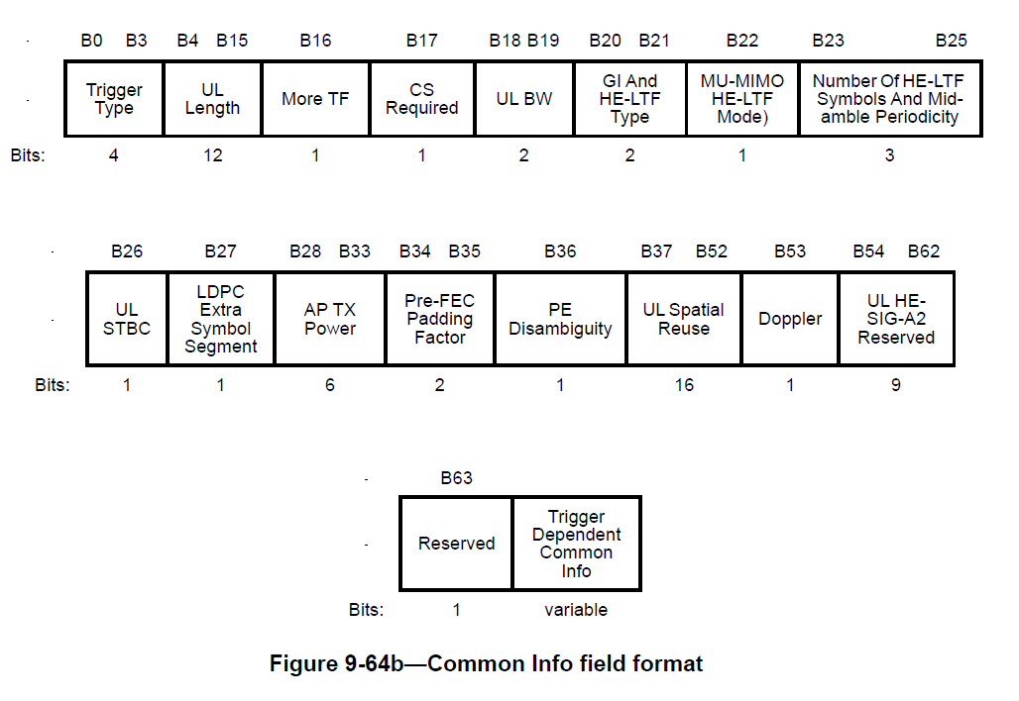
For Reference – Common Info Field

Slide 6
Enhanced Common Info Field
Add support for
  320 MHz
  16 spatial streams
  Content of U-SIG for TB PPDU
    PHY Version Number
    Puncturing Info

Slide 7
New Common Info Subfields
Subfield Name | Bits | Description
Enhanced Trigger Frame Flag | 1 | Indicates this is an Enhanced Trigger Frame
PHY Version Field | 3 | Default value indicates HE Another value indicates EHT Other values are TBD
UL BW Extension Field | 1 | This expands the UL BW field from 2 bits (four cases) to 3 bits (eight cases) when the PHY Version Field indicates EHT One of the new bandwidths is 320 MHz while the others are reserved
Puncture for each 80 MHz | 16 | We need 16 bits, since we need 4 bits for each 80 MHz
The first three new subfields would be assigned to bit positions in the pool of the 10 Common Info Field Reserved bits
The 16 bits for the Puncture for each 80 MHz is too large for the Common Info Reserved Bits

Slide 8
New Common Info Bits – Spoof a “Special User AID”
One method to provide additional Common Info Bits is to transmit a spoofed User Info Field
This would be the first User Info Field in the User Info List
The AID would use a “Special” AID value never used by a STA in the BSS
After the AID there are 28 bits which could used for EHT TB PPDUs
  These bits may also be useful for R2 features

Slide 9
Number of HE LTFs and Midamble Periodicity
Number of HE LTFs and Midamble Periodicity Value | Number of HE LTFs (Doppler = 0) | Number of HE LTFs Midamble Periodicity (Doppler = 1) | Number of EHT LTFs (Doppler = 0) (FOR EHT) | Number of EHT LTFs Midamble Periodicity (Doppler = 1) (FOR EHT)
0 | 1 | 1 (10 symbols) | 1 | 1 (10 symbols)
1 | 2 | 2 (10 symbols) | 2 | 2 (10 symbols)
2 | 4 | 4 (10 symbols) | 4 | 4 (10 symbols)
3 | 6 | Reserved | 6 | Reserved
4 | 8 | 1 (20 symbols) | 8 | 1 (20 symbols)
5 | Reserved | 2 (20 symbols) | 12 | 2 (20 symbols)
6 | Reserved | 4 (20 symbols) | 16 | 4 (20 symbols)
7 | Reserved | Reserved | Reserved | Reserved

Slide 10
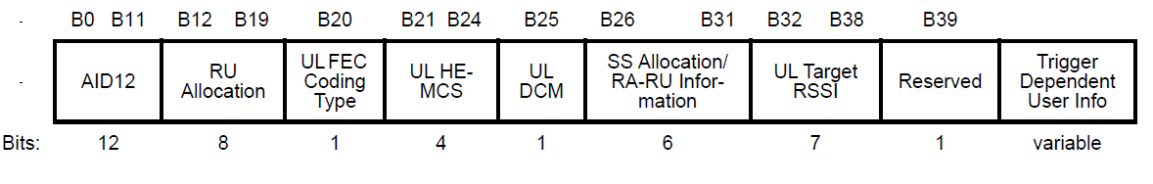
Enhanced User Info Field
For Reference here is the 802.11ax User Info

Slide 11
Enhanced User Info Field – Bit Budget (Set #1)
These fields do not depend on whether it is SU or MU
Subfield Name (Set #1) | Bits | Comments
AID12 | 12 | Currently No Change to AID12 (Could reuse MSB in the future)
HE/EHT Format | 1 | Indicates whether the per user information is in EHT or HE format and whether the STA responding with EHT TB PPDU or HE TB PPDU. (When Set to HE the remainder of the User Info Field is the Original Format)
SU/MU | 1 | Indicates if this RU is for one STA or multiple STAs
UL FEC Coding Type | 1 | No Change
MCS | 4 | Merges DCM with MCS
UL Target RSSI | 7 | No Change
Set #1 TOTAL | 26
This leaves 14 bits for the SU/MU dependent fields

Slide 12
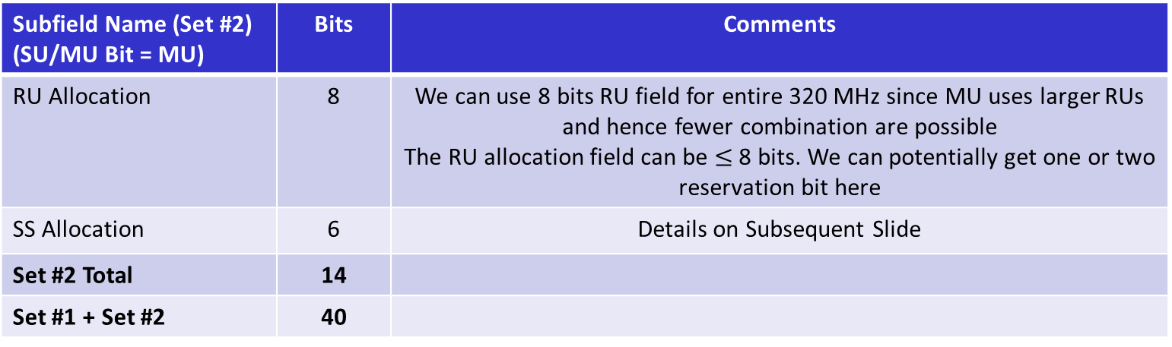
Enhanced User Info Field – Bit Budget (Set #2)
Subfield Name (Set #2) (SU/MU Bit = SU) | Bits | Comments
RU Allocation | 8
Lower/Upper 160 MHz Segment | 1 | Used to indicate if RU Allocation is for Lower or Upper 160 MHz Segment
Number of Spatial Streams | 4 | Up to 16 SS
Reserved | 1 | For R2
Set #2 Total | 14
Set #1 + Set #2 | 40
Subfield Name (Set #2) (SU/MU Bit = MU) | Bits | Comments
RU Allocation | 8 | We can use 8 bits RU field for entire 320 MHz since MU uses larger RUs and hence fewer combination are possible The RU allocation field can be $≤$ 8 bits. We can potentially get one or two reservation bit here
SS Allocation | 6 | Details on Subsequent Slide
Set #2 Total | 14
Set #1 + Set #2 | 40

Slide 13
HE/EHT Format (Reserved Bit B39)
We use the Reserved Bit (B39) to indicate to the EHT STA whether the User Info Field is the original format or the enhanced format
  If the HE/EHT Format bit is set to HE, then the EHT STA will transmit an HE TB PPDU
  If the HE/EHT Format bit is set to EHT, then the EHT STA will transmit an EHT TB PPDU
HE/EHT Format (B39) | Meaning | Comment
HE (value = 0) | The User Info Field is unchanged | STA to transmit an HE TB PPDU
EHT (value = 1) | Enhanced User Info Field | STA to transmit an EHT TB PPDU

Slide 14
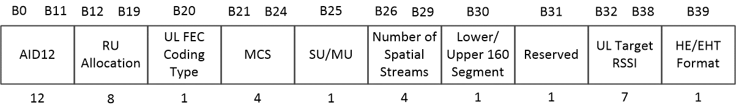
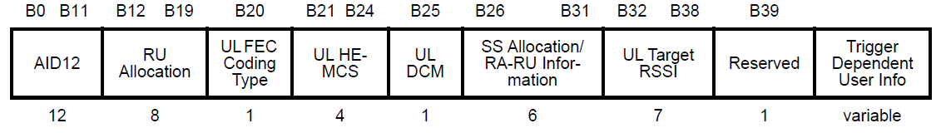
Enhanced User Info Field (SU)
This is the case where the SU/MU bit is set to SU
Here is the 802.11ax User Info Field – For Reference

Slide 15
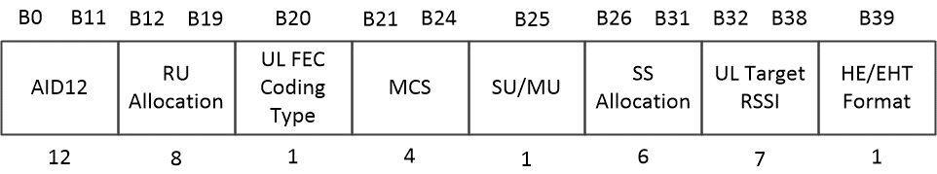
Enhanced User Info Field (MU)
This is the case where the SU/MU bit is set to MU
Here is the 11ax User Info Field – For Reference

Slide 16
SS Allocation Field – SU/MU Bit = MU
SS Allocation Field
Four bits allow indexing the starting spatial stream over the full 16-bit range
Two bits for the Number of Spatial Streams supports up to 4 spatial streams

Slide 17
Lower/Upper 160 MHz Segment Bit – SU version of Enhanced Trigger Frame
When the Lower/Upper 160 MHz Segment Bit is set to “Lower” then the RU Allocation Field allocates RUs to the Lower 160 MHz Segment
When the Lower/Upper 160 MHz Segment Bit is set to “Upper” then the RU Allocation Field allocates RUs to the Upper 160 MHz Segment
The table for supporting RUs will also include Multi-RUs (M-RUs) which are supported in EHT
For M-RUs which include RUs in both the Lower 160 MHz and the Upper 160 MHz, those will be indicated by convention to either the Lower or Upper 160 MHz Segment

Slide 18
Conclusions
Enhanced Trigger Frame
  Fully Backward compatible with HE
  Enhanced to support EHT features
    320 MHz bandwidth
    Up to 16 Spatial Streams
    RUs and M-RUs
  Can be expanded to support R2 features
    Triggering of HE/EHT uplink TB A-PPDU

