Slide 1
IEEE 1609 WG feedback on 802.11bd D0.3
Author:
Date: September 8, 2020

Slide 2
Abstract
The IEEE 1609 WG discussed key issues related to IEEE 802.11bd D0.3 at their June 2020 meeting.
This individual submission from the IEEE 1609/IEEE 802.11 Liaison provides feedback regarding Clause 5 of the 11bd amendment.
Affected CIDS: 21, 37, 39, 43, 59

Slide 3
Background
IEEE 1609 WAVE Short Message Protocol (WSMP)
  A lightweight Network & Transport layer protocol for DSRC/NGV
DSRC/NGV typically operates in a multi-channel environment
  Control Channel (CCH): used for WAVE Service Advertisements (WSAs) and some services that require just one packet
  Service Channels (SCHs): used for delivery of a wide variety of V2X services: safety, traffic efficiency & mobility, automated driving, …
WSMP and WSA are standardized in:
IEEE 1609.3-2016 Networking Services

Slide 4
Current US 5.9 GHz band
Sept. 2020
5.850 GHz
5.925 GHz
CH
175
CH
181
20
MHz
20
MHz
5 MHz
Reserved
CH
172
CH
174
CH
176
CH
178
CH
180
CH
182
CH
184
Service
Service
Service
Control
Service
Service
Service
10
MHz
10
MHz
10
MHz
10
MHz
10
MHz
10
MHz
10
MHz
FCC DSRC Channel Designations
Ch. 172: Collision Avoidance Safety
Ch. 184: High Power Public Safety
Ch. 178: Control Channel
A given DSRC/NGV STA might switch among channels
  E.g. alternate between WSAs on Ch. 178 and data services on a service channel
At any given time, one channel (MAC/PHY instance) is active, and any other channels are inactive
We may want to queue packets on inactive channels for transmission when the channel becomes active
Standardized in: IEEE Std 1609.4-2016 Multi-Channel Operation

Slide 5
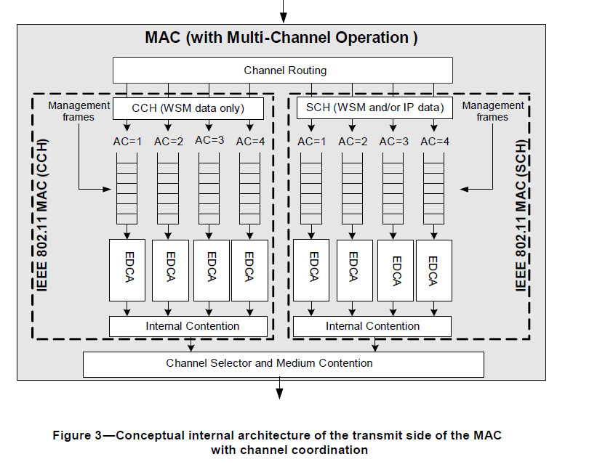
IEEE 1609.4 Multi-Channel Architecture

Slide 6
Improvement to MA-UNITDATA primitives
IEEE 1609.4 specified extended versions of MA-UNITDATA
Ex: MA-UNITDATAX.request() adds five parameters:
  Channel Identifier
  Time Slot (for synchronous channel switching)
  Data Rate
  TxPwr_Level
  ExpiryTime
IEEE 1609 WG agrees with 11-19-1982-00 that it is preferable to specify these parameters in IEEE 802.11 MA-UNITDATA.request primitive
  11-19-1982-00 adds the parameters in the Radio Environment Request Vector (only used for OCB)

Slide 7
Radio Environment Request Vector
Parameters in vector, as per 11-19-1982-00
MPDU format (legacy/NGV),
data rate for transmission,
MPDU coding (LDPC, etc.),
number of spatial streams,
permitted aggregation,
number of repetitions,
expiry time (milliseconds until the MSDU is discarded if still not transmited),
frequency band,
base channel and channel width,
transmit power level.
Allows MSDU to be enqueued for an inactive channel, for transmission after that channel becomes active
This parameter does NOT change an implementation’s active channel
IEEE 1609 WG prefers that the channel information be included in the radio environment request and status vectors (relates to CID 39)

Slide 8
Radio Environment Request Vector
Parameters in vector, as per 11-19-1982-00
MPDU format (legacy/NGV),
data rate for transmission,
MPDU coding (LDPC, etc.),
number of spatial streams,
permitted aggregation,
number of repetitions,
expiry time (milliseconds until the MSDU is discarded if still not transmited),
frequency band,
base channel and channel width,
transmit power level.
“Each EDCAF shall maintain a backoff timer” (IEEE 802.11-2016 Clause 10.22.2.4)
IEEE 1609 WG prefers that when an MSDU reaches its expiry time and is discarded, the backoff timer of the associated EDCAF is unchanged. It should not be reinitialized with a new timer value, even if the discarded MSDU was head-of-line in the EDCA queue. (relates to CIDs 21, 37, 59)

Slide 9
MLME-CANCELTX.request
6.6.1.2 MLME-CANCELTX.request
6.6.1.2.1 Function
  Requests cancellation of transmission of queued MSDUs belonging to a specified access category.
6.6.1.2.2 Semantics of the service primitive
  The primitive parameters are as follows:
  MLME-CANCELTX.request(
  AccessCategory
  )
6.6.1.2.3 When generated
  This primitive is generated by SME when untransmitted MSDUs need to be removed from the transmit queue.
6.6.1.2.4 Effect of receipt
  This primitive imitates removal of the mistranslated MSDUs of the specified access category from their transmit queue.

Slide 10
CANCELTX.request topic
CID 43:
“The text could be clarified to indicate whether the MLME-CANCELTX.request primitive removes all untransmitted MSDUs in the indicated access category, or only all non-head-of-line MSDUs. If a HOL MSDU is to be removed, the text should clarify up to what point in the contention process the removal must be achievable. For example, should any HOL MSDU be removed as long as the countdown value > 0? As long as the transmission of the HOL MSDU has not started?”
IEEE 1609 WG prefers that CANCELTX.request cause the HOL MSDU be removed if it has not yet begun transmission.
IEEE 1609 WG does not request that the channel identifier be included as a parameter of the CANCELTX.request primitive

Slide 11
Summary
Radio Environment Request Vector preferences:
IEEE 1609 WG prefers that the channel information be included in the radio environment request and status vectors
IEEE 1609 WG prefers that when an MSDU reaches its expiry time and is discarded, the backoff timer of the associated EDCAF is unchanged. It should not be reinitialized with a new timer value, even if the discarded MSDU was head-of-line in the EDCA queue.
CANCELTX.request preferences:
IEEE 1609 WG prefers that CANCELTX.request cause the HOL MSDU be removed if it has not yet begun transmission.
IEEE 1609 WG does not request that the channel identifier be included as a parameter of the CANCELTX.request primitive

