Slide 1
On Joint C-SR and C-OFDMA M-AP Transmission
Date: 2020-09-03
Authors:

Slide 2
Introduction
Spatial reuse (SR) was introduced in 802.11ax
  Improving spectral efficiency in scenarios with highly dense networks
  A passive scheme, based on RSSI measurement of OBSS signals
TGbe has agreed on multiple M-AP coordinated transmission schemes
  Coordinated spatial reuse (C-SR) operation [Motion 123]
  Coordinated OFDMA (C-OFDMA) [Motion 60]
  Coordinated Beamforming (C-BF) [Motion 112]
  Joint Transmission (JT) [Motion 111]
In this contribution we discuss the benefit of using C-SR jointly with other coordination scheme, e.g., C-OFDMA

Slide 3
Spatial Reuse in Coordinated M-AP
There have been multiple contributions on coordinated spatial reuse [1-4]
  Provide basic ideas for actively reusing the RF spectrum with manageable interference
  Require measurements (e.g., RSSI) within and across BSSs
  Require synchronized exchange of those measurements among APs in an “AP candidate set”
Similarity with other M-AP coordination schemes
  Measurement exchange among APs
  Synchronized/organized operation within a TXOP
Among M-AP coordination schemes C-SR can be viewed as part of other schemes
  Given the availability of “connections” among APs, it can be jointly deployed with other schemes
    E.g., Coordinated beamforming/null steering [6] and C-OFDMA (this contribution)

Slide 4
C-OFDMA with C-SR
In the basic C-OFDMA, if a sub-channel (or an RU) is occupied by one AP, other APs in the AP candidate set can’t use it to maintain perfect orthogonality in frequency domain – zero inter-BSS interference
However, perfect zero interference is not necessary, as long as certain SNR level can be achieved for a desired MCS level, which provides opportunity for spatial reuse
In M-AP scenario, the “SR coverage” of APs may have many different pattens in terms of number of (or which) other APs that can transmit at the same time (See figures on the right)
  Depending on Tx power, required MCS level, relative distances among APs, RF radiation pattern etc.
  Spatially reusable area can be very large
Therefore, when C-OFDMA is enabled, combining it with SR could enhance overall system throughput performance
“sr = x” means x other APs can Tx at the same time
AP Tx power = 20dBm
AWGN only, PL model [5]

Slide 5
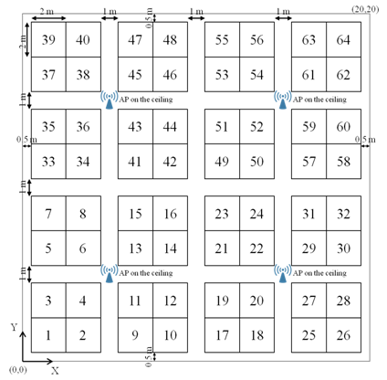
System Level Simulation
Simulation setup [5]
  Scenario: Office space
    4 APs on 3m high ceiling
  Tx power from each AP: 20dBm, omni directional
  Pathloss model
    PL(d) = 40.05 + 20*log10(fc/2.4) + 20*log10(min(d,10)) + (d>10) * 35*log10(d/10)
    fc = 5GHz
  AWGN channel, NF = 7 dB
  Total 80MHz channel bandwidth with 4×20MHz RUs
  DL transmission
Assumptions
  Traffic Type: Full Buffer
  A scheduler manages resource usage @ the sharing AP
  Each AP randomly selects 2 associated STAs before scheduling
80MHz
RU
RU
RU
RU
20MHz

Slide 6
Simulation Results
In C-OFDMA case, all STAs can use MCS9 in this example
Up to 25% improvement in total throughput (@median) if C-SR is added on top of C-OFDMA
The sub-optimal solution (low overhead) can also provide improvement (~12% @median)
opt: Exhaustive search in {SR per RU, MCS} space
sub-opt: Limited measurements and feedback

Slide 7
Summary
C-SR can be considered as part of other coordinated Tx schemes in M-AP framework
Joint C-SR and C-OFDMA can improved overall system throughput and spectral efficiency

Slide 8
References
[1] 11-20/0576r1, Coordinated Spatial Reuse Protocol
[2] 11-20/0410r4, Coordinated Spatial Reuse Procedure
[3] 11-20/0457r1, Discussion on Coordinated Spatial Reuse Operation
[4] 11-20/0107r1, Multi-AP coordination for spatial reuse
[5] 11-14/0980r16, Simulation Scenarios
[6] 11-20/0091r7, Performance of parameterized spatial reuse (PSR) with coordinated beamforming/null steering for 802.11be

