Slide 1
EHT via Reconfigurable Surfaces
Date: 2020-08-31

Slide 2
Abstract
The wireless channel has been always modeled as a random process between the transmitter and the receiver, that degrades the quality of the received signal due to the interactions of the electromagnetic waves with the surrounding randomly deployed objects. Controlling the channel, could solve many problems regarding enhancing the quality of the received signal, thus proving higher data rates.

Slide 3
Introduction
To provide EHT CST must be very good.
  When controlling the channel, all multipath can be align constructively to boost the performance at the receiver [1].
In fast varying channels, channel estimation overhead is high, and it increases exponentially as the number of antennas increases.
  Controlling the channel, could alter varying one into time-invariant channel.
  Channel estimation is then reduced to minimum overhead.
Coverage area in rich scattering environment is small.
  Controlling the channel increases the probability of LoS [1].

Slide 4
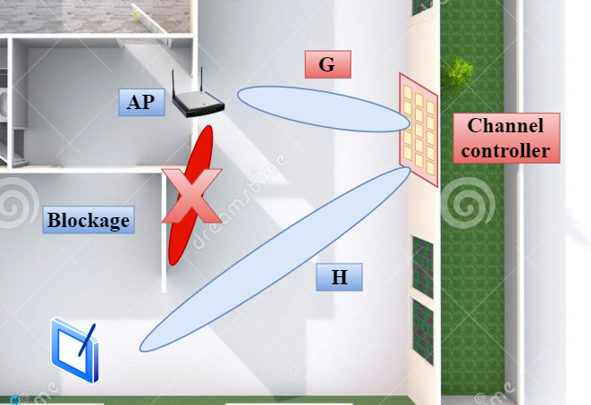
System Model
  Consider one BSS consisting of one AP and one STA.
  The LoS between the AP and the STA is blocked.
  The received signal by the STA is weak and the quality is bad due to the multipath.

Slide 5
A Proposed Approach: Reconfigurable Surfaces
  A surface with the capability of controlling the channel and changing the propagation environment.
  The reconfigurable surface provides virtual LoS, expends the coverage area and enhance the quality of the signal.
  The reconfigurable surface is controlled by the AP through a backhaul link.

Slide 6
Conclusion
Controlling the channel via exploiting reconfigurable surfaces has been introduced.
The reconfigurable surface reshapes the reflected signal for maximum gain at the receiver.
The reconfigurable surface are controlled in real time by the AP.

Slide 7
References
[1] Basar, E., Di Renzo, M., De Rosny, J., Debbah, M., Alouini, M.S. and Zhang, R., “Wireless communications through reconfigurable intelligent surfaces”. IEEE Access, 7, pp.116753-116773, 2019.

