Slide 1
Reduction of Peak to Average Power Ratio Exploiting Multi-Numerology Structure
Date: 2020-08-31

Slide 2
Abstract
The peak-to-average power ratio (PAPR) is one of the major problem of OFDM-based waveform. OFDM is widely used waveform in wireless local area networks and cellular networks. Although the PAPR problem is well-studied, still this problem is not solved in an efficient manner. To serve wide variety of applications, the multi-numerology OFDM waveform is decided to be used in 5G New Radio, and it has potential to be used in Wi-Fi systems. Although multi-numerology structure provides many advantages, it can be exploited for PAPR reduction. Therefore, the multi-numerology structure is utilized for PAPR reduction.

Slide 3
Introduction
The PAPR is very critical to increase the spectral efficiency and decrease the hardware cost.
There are lots of PAPR reduction techniques for single-numerology OFDM such as clipping&filtering, selective mapping, partial transmit sequence, tone reservation, so on [1].
For multi-numerology OFDM, there is a few techniques in the literature [2], [3].
Besides 5G New Radio, WLAN standardization may also use the multi-numerology concept to serve diverse needs in Wi-Fi 7 and beyond [4].
In this contribution, a new PAPR reduction method is proposed considering multi-numerology structure.

Slide 4
System Model
Three different numerologies N1, N2, and N3 are considered and two different mixed numerology cases are illustrated as a) and b).
Each numerology has different subcarrier spacing, cyclic prefix (CP) and symbol duration.
For the generation of multiple numerologies, frequency-time domain transform is deployed separately for each numerology. Then, the signals in time domain of each symbol are summed as aligned.
N1
∆$f_{1}$ kHz
N1
∆$f_{1}$ kHz
N2
∆$f_{2}$ kHz
N3
∆$f_{3}$ kHz
a)
b)

Slide 5
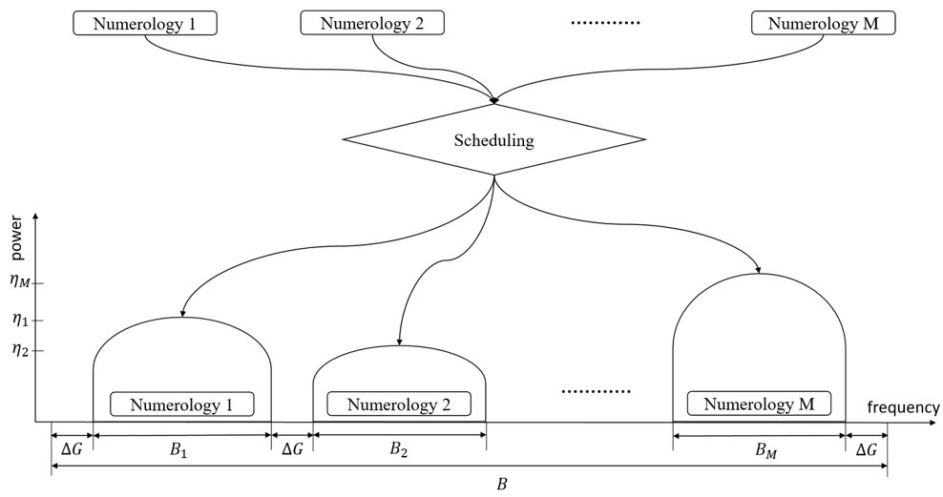
A Proposed Approach: Numerology Scheduling
In a multi-numerology system, different numerologies are allocated over spectrum with the parameters of subcarrier spacing, power level, and bandwidth.
The scheduling of numerologies can be utilized for PAPR reduction.
Among all possible scheduling cases, the signal with minimum PAPR value is chosen.

Slide 6
Conclusion
A PAPR reduction approach has been introduced by exploiting multi-numerology structure.
It concludes that numerology scheduling can change dynamic range of time-domain signal.
Although one approach is presented, many other opportunities are available to be developed based on multi-numerology structure.

Slide 7
References
[1] Y. Rahmatallah and S. Mohan, “Peak-to-average power ratio reductionin OFDM systems: A survey and taxonomy,”IEEE Commun. SurveysTuts., vol. 15, no. 4, pp. 1567–1592, 4th Quart., 2013.
[2] S. Gökceli, T. Levanen, J. Yli-Kaakinen, T. Riihonen, M. Renfors, andM. Valkama, “PAPR reduction with mixed-numerology OFDM,”IEEEWireless Commun. Lett., vol. 9, no. 1, pp. 21–25, Jan. 2020.
[3] X. Liu, X. Zhang, L. Zhang, P. Xiao, J. Wei, H. Zhang, and V. C. M.Leung, “PAPR reduction using iterative clipping/filtering and ADMMapproaches for OFDM-based mixed-numerology systems,”IEEE Trans.on Wireless Commun., vol. 19, no. 4, pp. 2586–2600, 2020.
[4] “Forward Compatible OFDMA,” IEEE 802.11-20/0674r3

