Slide 1
Enhancements for QoS and low latency in 802.11be R1
Date: 2020-10-12
Authors:

Slide 2
Introduction
802.11be is expected to provide low latency/QoS management solutions catering to new and upcoming applications like AR/VR/TSN/Cloud/Gaming/IoT.
QoS negotiation allows an MLD to be aware of the QoS needs at an associated AP/non-AP STA MLD. This in turn allows an MLD to
determine if it has enough resources to admit the stream and provide the expected QoS if an AP MLD,
handle frames corresponding to each of the admitted streams as characterized and deliver the corresponding QoS.
Main QoS negotiation in current spec is ADDTS Request/Response (TS Setup). The protocol was designed based on video and voice applications 15 years ago and is bit outdated.
In this presentation therefore we propose enhancing the existing TS mechanism for 11be.
The concepts in this contribution are aligned with Doc#1046r5, 418r4.

Slide 3
Recap: current related proposals in IEEE
Some contributions such as 1355r5, 1046r7 propose to create specific SPs for low latency applications.
Some contributions focus on the signaling from STA to improve UL scheduling:
1067r4 proposes signaling in A-Ctrl field for STA to inform AP about periodic traffic.
1006r3 proposes signaling in a Mgt frame for STA to inform AP about the min and max intervals between successive triggers.
Also proposes establishment of scheduling session through exchange of those frames.
Some contributions focus on signaling of traffic characteristics and classification:
908r1 proposes MLD-level TS setup.
418r4 proposes MLD-level QoS signaling of both layer-2 traffic and higher layer classification parameters.

Slide 4
Proposal overview
We propose to have a common signaling framework to specify both the traffic characteristics and the traffic classification parameters.
To meet R1 timeline, reuse ADDTS Req/Response framework with minor changes to capture below functionalities:
The signaling could be at MLD level.
Add some new parameters for next gen low latency services (TSN, AR/VR) similar to 5G URLLC.
Allow AP to modify assignment TS setup based on network conditions (e.g., inform change UP for DL flow, scheduling etc.).

Slide 5
What do we need to signal ?
Reuse TCLAS for packet classification.
For describing traffic characteristics signal the following (in red are the new parameters):
UP for the flow
Inactivity Interval: lifetime for the flow.
Max Service Interval
Max MSDU size: Maximum size of MSDU
Latency Bound: Maximum time required for successful delivery of the MSDU/A-MPDU (from MAC-SAP to MAC-SAP)
Min Service Interval: requested minimal periodicity of service or min MSDU interarrival time
Jitter: variation in latency (RTA)
Burst Size: Max aggregate size MSDUs that arrive within a period
Packet delivery ratio: Expected packet delivery ratio within the latency bound.
More TSN Parameters in R2.
In addition, expand flow identifier from 8 values allowed by TSID to larger number on par with SCS (e.g., 255 values).
Notes:
Redundancy: whether peer MLD shall replicate packets for this flow across the MLD (refer to [1763r0]).
Criticality: Low/Medium/High – how critical is this stream for the operation of the system? [IEC/IEEE 60802]
Tolerance to loss: how many contiguous packets can be lost before the application gets into a ‘panic mode’? E.g., 2/10* [IEC/IEEE 60802]

Slide 6
Signaling overview
Define a new EHT-ADDTS Request/Response frame that has similar frame format as baseline (and hence, can mostly reuse the baseline TS setup) except that:
EHT ADDTS Req/Response can be valid across the MLD.
The new IE (TSPEC-lite) can be used outside EHT-ADDTS Req/Response (e.g., with TWT).
Notes:
The new frames can be differentiated from Basic and DMG ADDTS either via
new QoS Action field if using Option 1 in previous slide or
by presence of the new element if using Option 2 in previous slide.

Slide 7
Example of STA initiated QoS Setup
Network
Controller
STA
AP
STA initiates EHT ADDTS Req with a description of the QoS Traffic
AP responds with EHT ADDTS Resp accepting the request
QoS Traffic flows between the STA and the AP using the QoS setup for the flow(s)
AP determines that the current QoS needs to be amended due to
Network policy/conditions
QoS flow policing decisions
AP sends an EHT ADDTS Resp modifying the QoS Setup
QoS Traffic flows between the STA and the AP with the amended QoS Setup
Network Policy/ condition
EHT ADDTS Req
EHT ADDTS Resp
Traffic from/to the application with the setup QoS
Network Policy/ condition/ policing
EHT ADDTS Resp
(modify)
Traffic from/to the application with modified QoS/scheduling

Slide 8
Summary
Proposed a unified framework for QoS signaling that requires minimal spec changes while satisfying critical low latency requirements.

Slide 9
SP#1
Do you support that 11be R1 supports MLD-level TS setup using new ADDTS Request/Response frame variants?

Slide 10
SP #2
Do you support that 11be R1 defines a mechanism for an MLD to signal the following traffic characteristics/parameters to another MLD during TS setup:
UP, Inactivity Interval, Max MSDU size, Latency Bound, Min Service Interval, Max Service Interval, Jitter, Burst Size, Packet delivery ratio, Direction?

Slide 11
SP #3
Do you support that 11be R1 defines a mechanism for an AP to modify an existing TS session by transmitting a new ADDTS Response frame variant ?

Slide 12
SP #4
Which option do you support to identify an MLD-level TS flow between a pair of MLDs in 11be R1:
Option 1: 3 bits that can identify upto 8 flows (similar to TSID)
Option 2: 8 bits that can identify upto 256 flows (similar to SCS) ?

Slide 13
backup

Slide 14
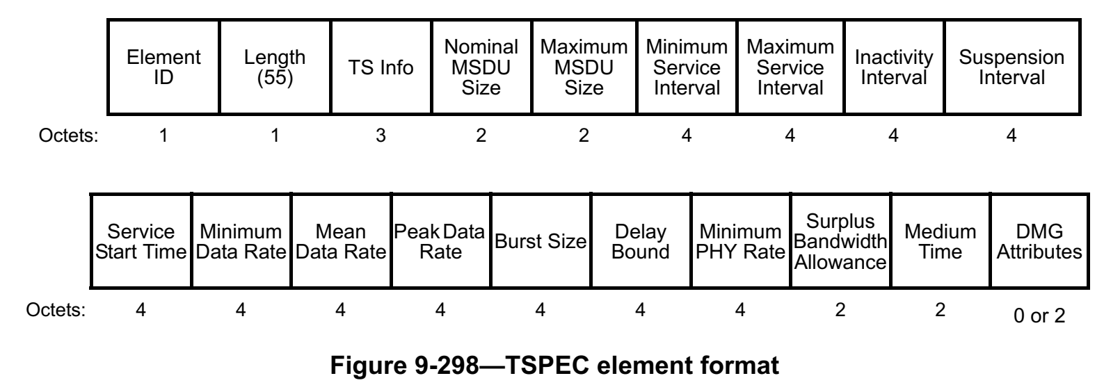
Signaling QoS characteristics via TSPEC
Current TSPEC is not extensible for non-DMG but allowed for DMG. May be we can propose to extend it for EHT or propose an EHT TSPEC similar to DMG TSPEC (discuss).
Below discussion assumes we will reuse TSPEC element.
Fields present but may require new interpretation: Inactivity interval (profile lifetime) , Max MSDU size, Latency Bound, Burst Size, Min Service Interval
Not present: Jitter, Packet delivery ratio (present in DMG Att but may have small size), Criticalilty, Tolerance to loss, Flow ID, Redundancy, whether TWT negotiation follows.
~30 bytes unused if we reuse TSPEC for existing parameters.
To simplify signaling the fields in TSPEC that are not part of bullet 1 may be considered Reserved or repurposed to fit fields signaled in bullet 2.
One of the Reserved bits in TS Info may be reused to signal this.

