Slide 1
Enhancements for QoS and low latency in 802.11be R1
Date: 2020-10-12
Authors:

Slide 2
Introduction
This contribution builds on the QoS management (Doc#418r3) for low latency reliable services (LLRS)
The proposed simple enhancements address the worst-case latency and jitter issues caused by congestion and can be enabled in R1
The concepts in this contribution are aligned with Doc#1046r5
Minimum basic support in R1 is required to ensure no coexistence issues between R1 and R2 EHT STAs

Slide 3
Problem: how to protect low latency data that have a “deadline” from congestion delay
It is difficult to guarantee access to a given STA(s) at certain times, due to
  Unlicensed band
  Legacy devices
A general solution applicable in all conditions is challenging (not the goal of this contribution)
Focus on EHT capabilities
Need to enable the 802.11 MAC to provide more predictable low latency
Leverage 802.11be and previous tools
Introduce new tools that enables the network to optimize for latency
  Contention-based channels access

Slide 4
Scope and goals for latency enhancements in 11be
Our goal in R1 is to provide minimal support to avoid creating a new category of EHT “legacy” devices that do NOT coexist with EHT R2 low latency/channel access enhancements
    Need to avoid coexistence issues between R1 and R2 EHT devices
There are many tools already in 802.11be (and previous specs) to improve latency such as MLO, TWT, TF that reduces the impact of intra-BSS congestion on low latency traffic
  In R1, we intend to mostly leverage and propose simple enhancements to those tools and improve latency for traffic that can be identified/classified through QoS negotiation
Further performance enhancements can be introduced in R2

Slide 5
Approach: Enable periods of time during which low latency traffic can be protected from intra-BSS congestion
Normal operation outside
Low latency traffic is prioritized/ protected from congestion
Minimal Spec requirements in R1
  Non-AP STA and AP negotiate establishment of or participation in a protected period
    If negotiation is successful, non-AP STA is a member of the protected period
    AP advertises the “protected” period(s) (Broadcast TWT can be reused/enhanced)
  Access rules for all associated EHT STAs during the “protected” periods:
    STAs shall finish their TXOPs before the period
    If a STA is not a member, it shall not transmit during the period

Slide 6
Example: Restricted SP set up and operation

Slide 7
Access Rules for Participating EHT STAs – Announced by the AP
Normal operation (any TID and EDCA access resumed)
Normal operation (no changes)
Restricted service period
(allowed STAs/TIDs and access rules)
Configuration 1:
Configuration 2:
Trigger-enabled
  AP triggers STAs and prioritize allowed traffic (including P2P)
Trigger SU PPDU would help make this mode more used
Non-trigger-enabled
  EDCA access between members of the protected period (including P2P)

Slide 8
Conclusions
We presented an approach to protect low latency traffic from intra-BSS congestion and avoid coexistence issues between R1 and R2 EHT STAs
The approach leverages existing tools and capabilities
The Spec changes required include
  Announcement and negotiation of “restricted” service periods
  Access rules for EHT STAs during the “restricted” service periods
Further enhancements to address legacy and OBSS can be considered

Slide 9
SP #1
Do you agree to add to the TGbe SFD (in R1)
  A mechanism for defining restricted service periods for low latency traffic where
    AP and STA negotiate the creation of or the participation in a restricted service period

Slide 10
SP #2
Do you agree to add to the TGbe SFD (in R1)
  A mechanism for AP and STA to negotiate the creation of or the participation in a restricted service period for low latency traffic
    If negotiation is successful, non-AP STA is a member of the restricted service period
    AP advertises the “protected” period(s) in beacons

Slide 11
backup

Slide 12
Simulation scenario 1
Single BSS: 6 STAs (2 Low Latency, 4 BE - 6 Mbps), 20 MHz channel
  LL traffic streams: 10Mpbs streaming video DL, Periodic 100 Byte every 4 ms UL
LLS: low latency traffic using AC_VO + protected windows
  1 ms windows every 5 ms
VO: low latency streams using AC_VO
Channel access: EDCA + Protected window for LLRS traffic

Slide 13
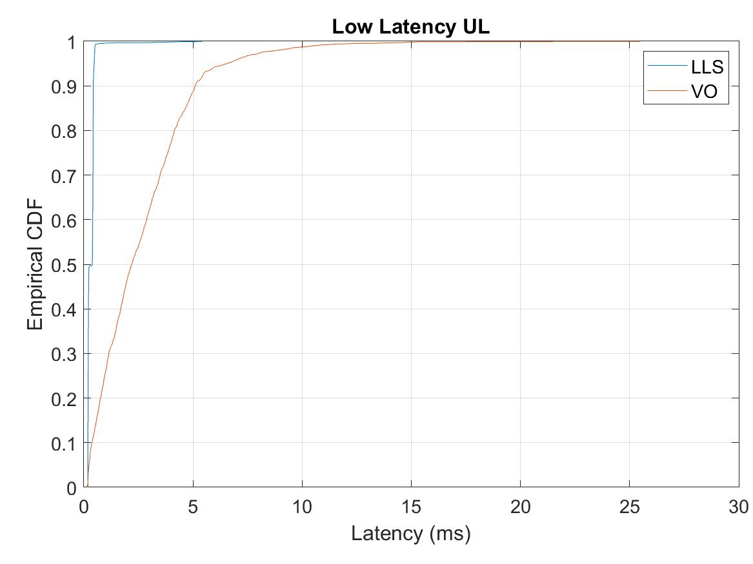
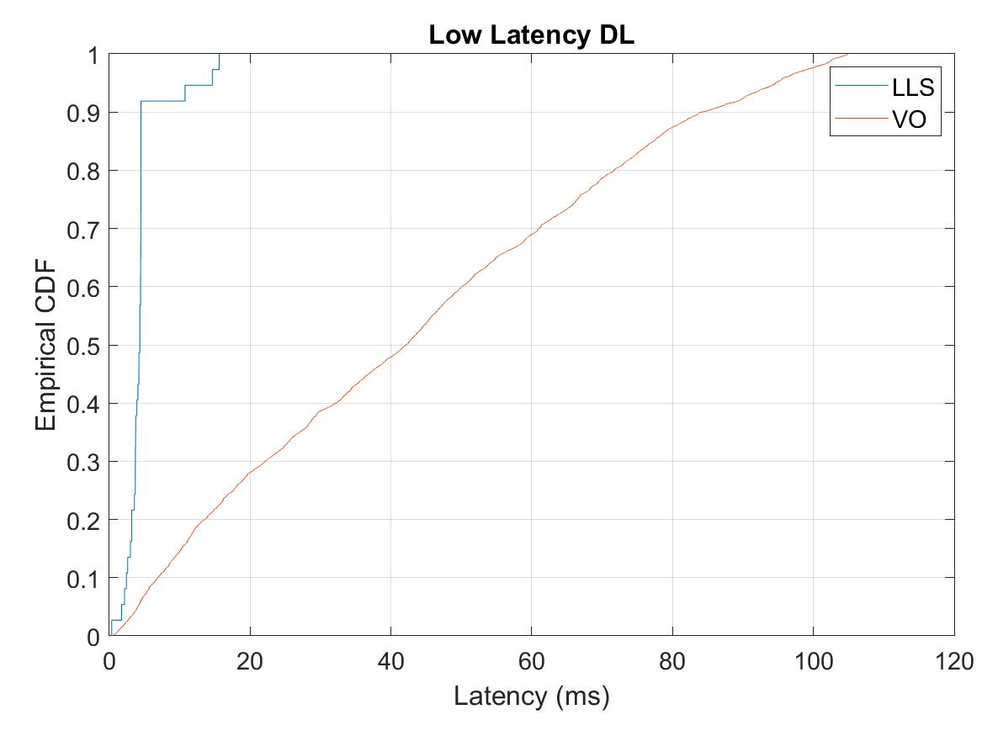
Scenario 1 - Results (20 MHz)
LLS: low latency streams with protected windows
VO: low latency as AC_VO (no protected windows)

Slide 14
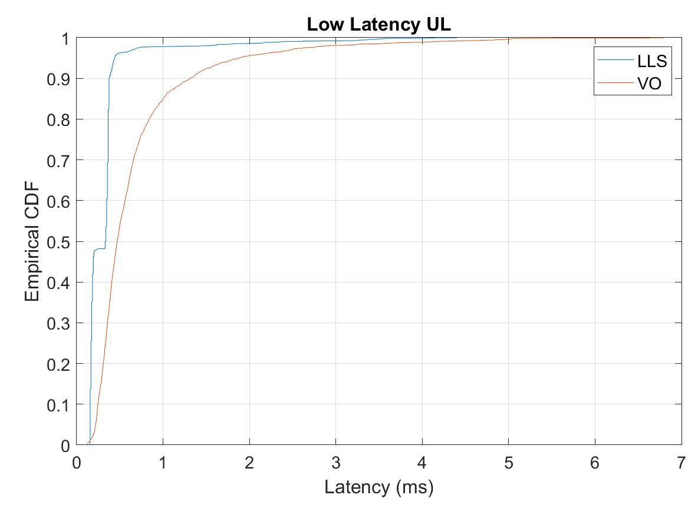
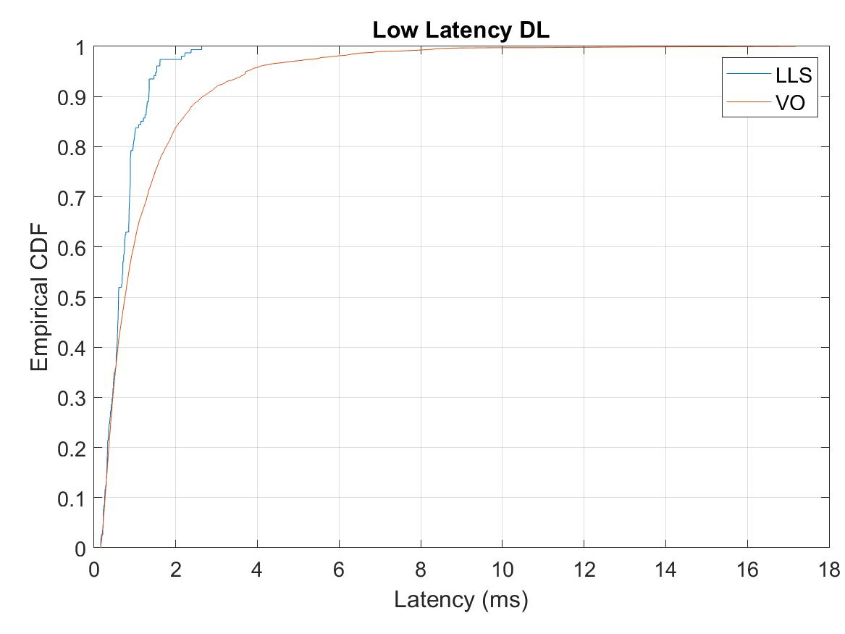
Scenario 1 - Results (80 MHz)
LLS: low latency streams with protected windows
VO: low latency as AC_VO (no protected windows)

Slide 15
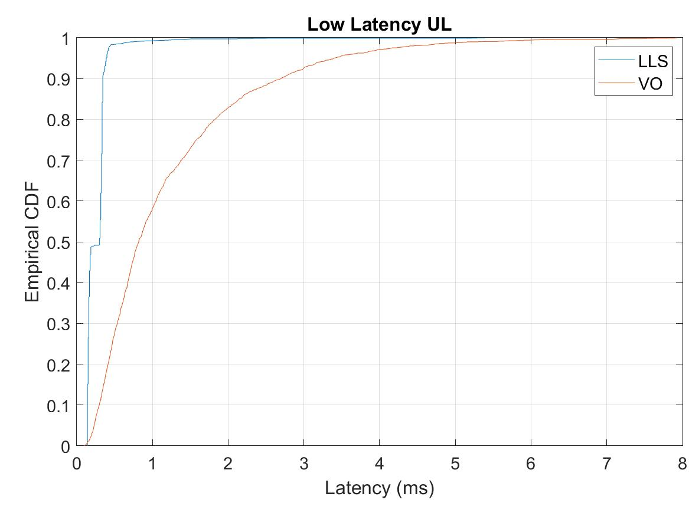
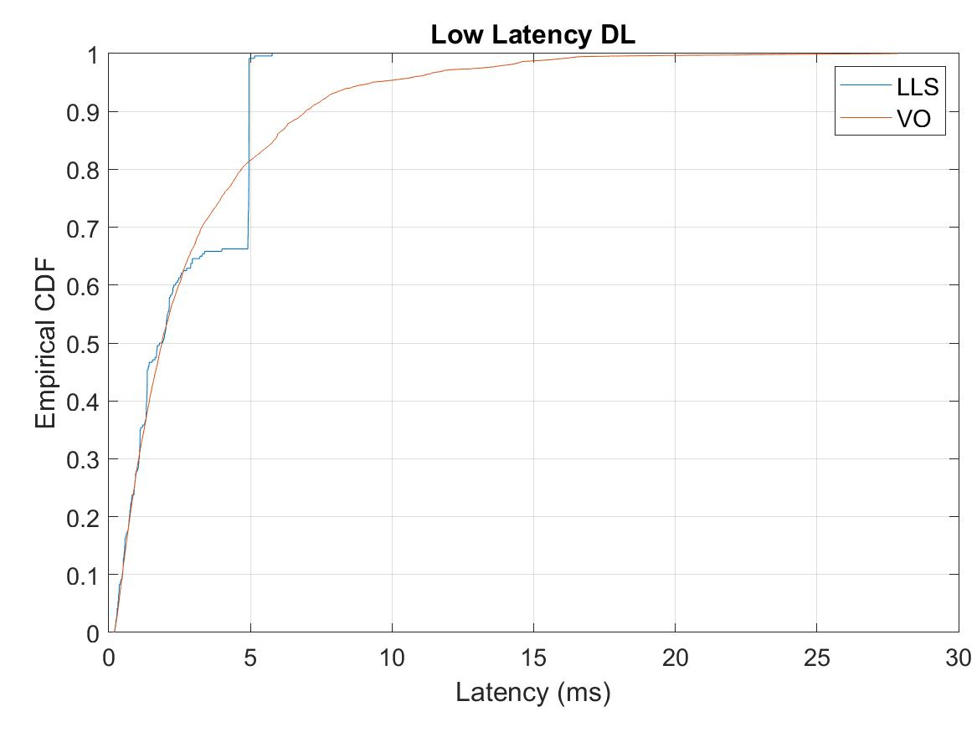
Scenario 1 - Results (40 MHz)
LLS: low latency streams with protected windows
VO: low latency as AC_VO (no protected windows)

Slide 16
Simulation scenario 2
Single BSS: 6 STAs (2 Low Latency, 4 BE - 6 Mbps), 20 MHz channel
  LL traffic streams: 100Bytes every 4 ms
LLS: low latency traffic using AC_VO + protected windows
  500 microseconds windows every 4 ms
VO: low latency traffic using AC_VO
Case 1: EDCA in protected window (AP and STAs contend)
Case 2: Trigger based in protected window

Slide 17
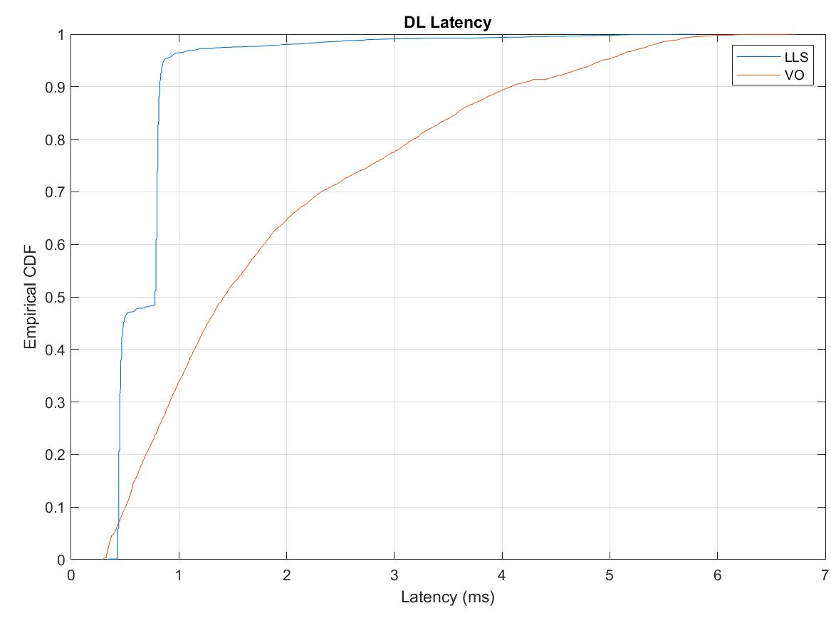
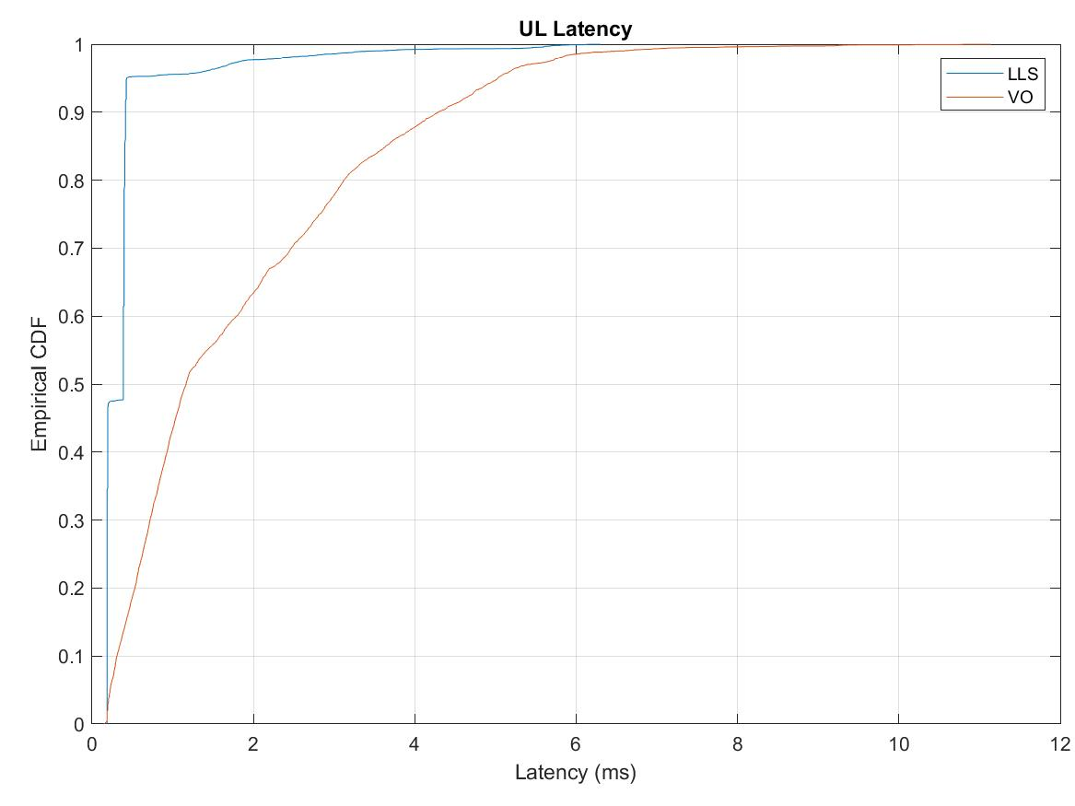
Scenario 2- Case 1 Results
LLS: low latency stream with protected windows
VO: low latency as AC_VO (no protected windows)

Slide 18
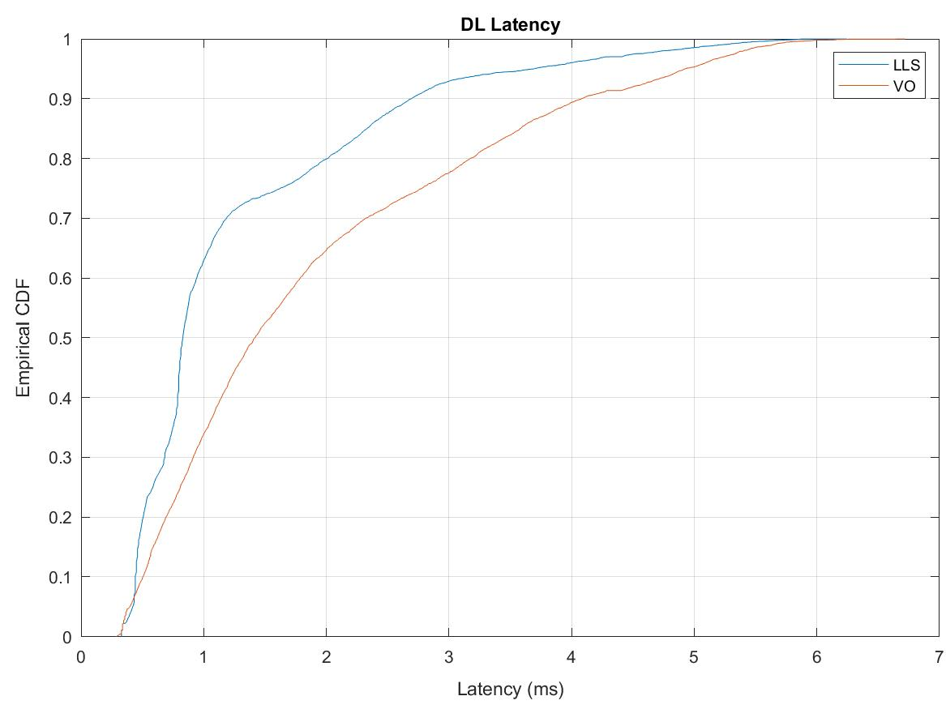
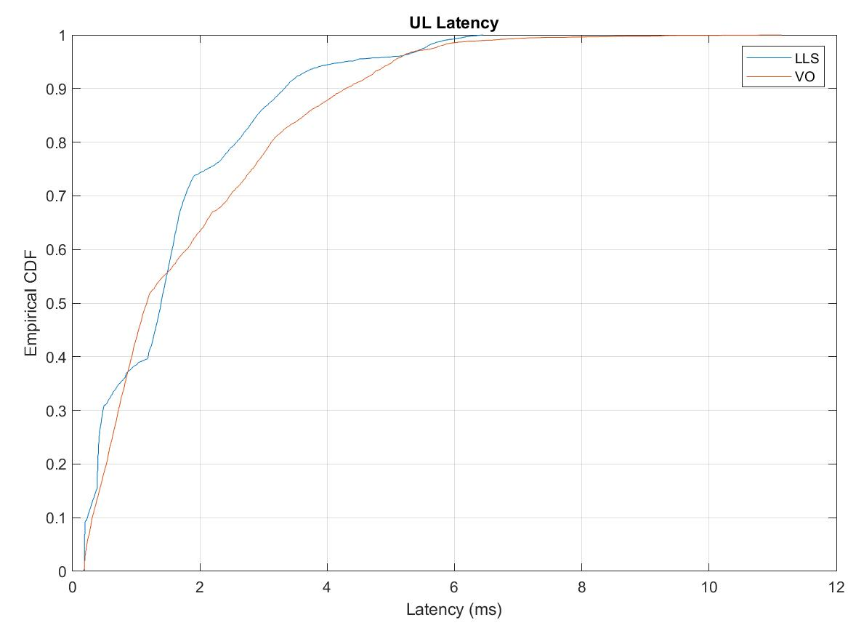
Scenario 2 - Case 2 Results
LLS: low latency stream with protected windows
VO: low latency as AC_VO (no protected windows)

Slide 19
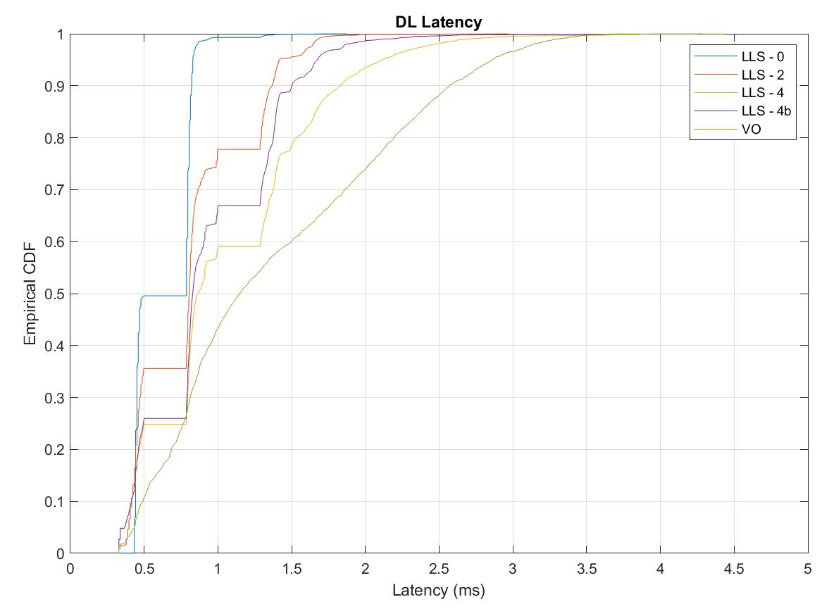
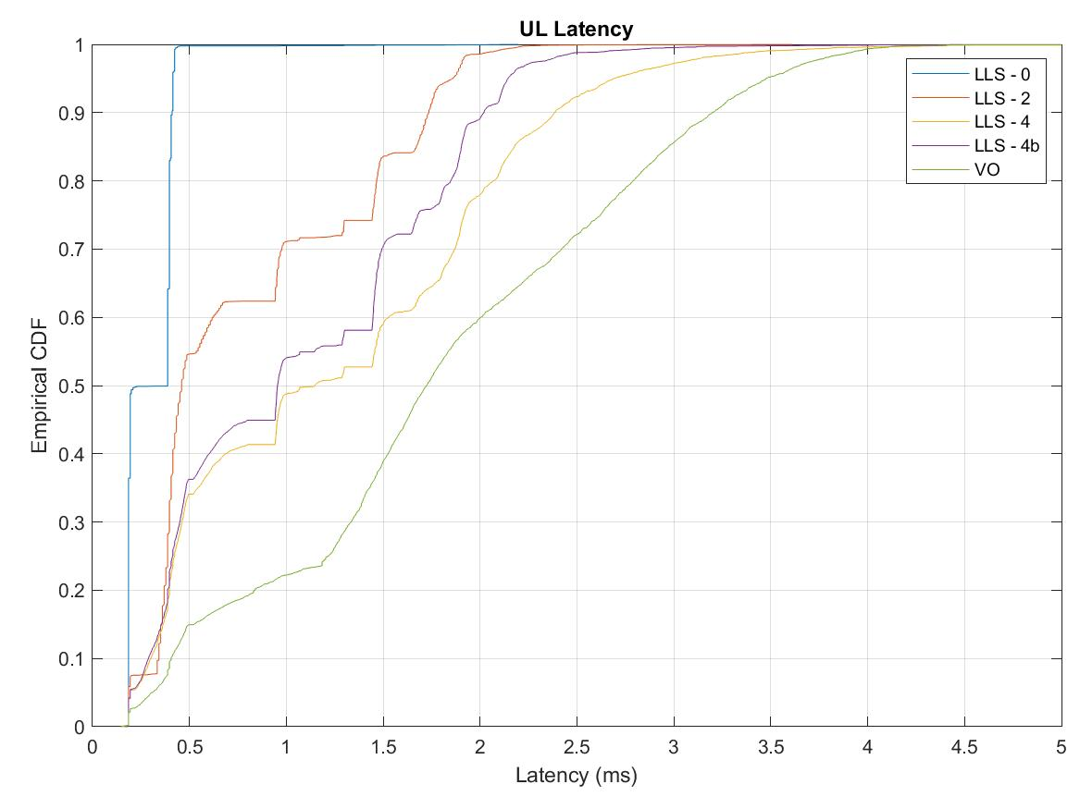
Scenario 2 – with different non-compliancy levels (Case 1)
LLS – 0 = Low latency service with all Background STAs complying with the PW rules (limit TXOP before PW start and restrict access to LL traffic)
LLS – 2/4 = Low latency service w/ 2 or 4 (out of 4) Background STAs not complying with PW rules
LLS – 4b = 4 (out of 4) Background STAs still limiting their TXOP before the PW start time, but not complying with PW restricted access
VO = no protection, low latency uses AC_VO

Slide 20
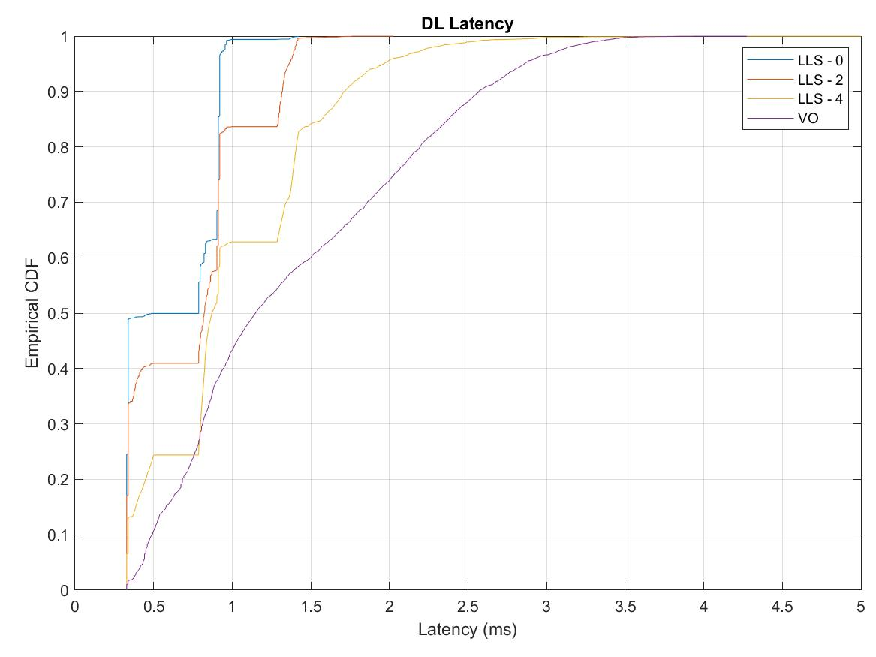
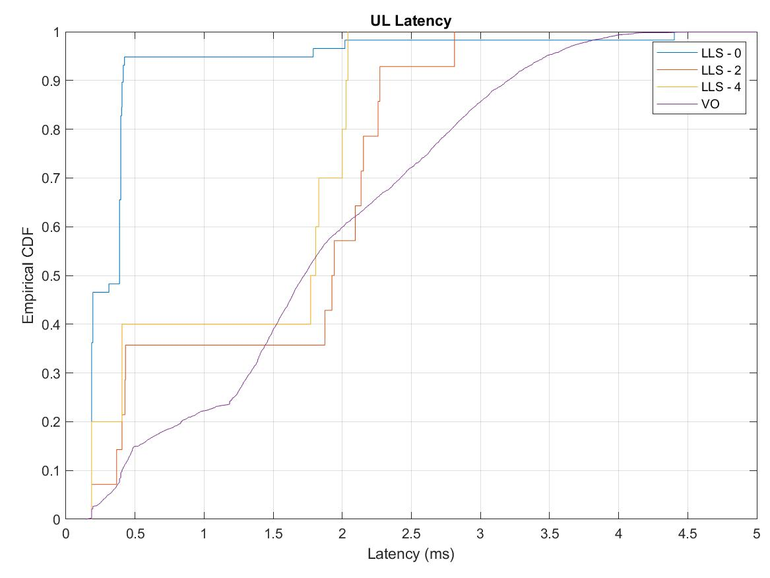
Scenario 2 – with different non-compliancy levels (Case 2)
LLS – 0 = Low latency service with all Background STAs complying with the PW rules (limit TXOP before PW start and restrict access to LL traffic)
LLS – 2/4 = Low latency service w/ 2 or 4 (out of 4) Background STAs not complying with PW rules
VO = no protection, low latency uses AC_VO

