Slide 1
PHY Signaling Methodology for 11be Releases
Date: 2020-10-12
Authors:

Slide 2
Abstract
In this contribution, we discuss signaling methods to support potential features in 11be Release 2 (R2)

Slide 3
Introduction
The TGbe has agreed [1, SP#141] that the non-TB PPDU format has the following structure:
Per Motion 27 and 47 [1],
  The U-SIG will contain version-independent fields, followed by version-dependent fields
    Version-independent bits have static location and bit definition across different generations/PHY versions.
    Version-dependent bits may have variable bit definition in each PHY version
  The U-SIG will be sent using 52 data tones and 4 pilot tones per-20MHz
Several fields in U-SIG have been defined and the numbers of bits for a few of them have been determined
While the TG is in the process of determining all the fields for R1 features, a method of signaling for potential features in R2/future generations should be discussed in advance

Slide 4
U-SIG Design Considerations
Version-independent (VI) fields:
  VI fields support foreseeable and commonly used PHY configurations and features across different generations
  The fields to be included and the number of bits per field should be carefully chosen with consideration of backward and forward compatibilities
Version-dependent (VD) fields:
  VD fields may carry system and/or user information for a PHY version, which may vary from a generation to another generation
  The definition and the size of the VD fields can be identified using “PHY version identifier” (3 bits) in VI part of the U-SIG

Slide 5
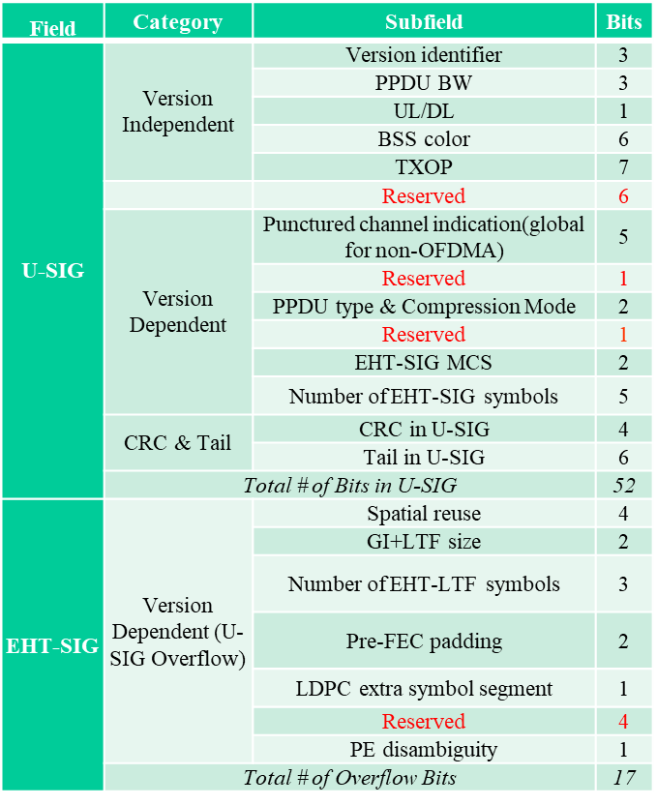
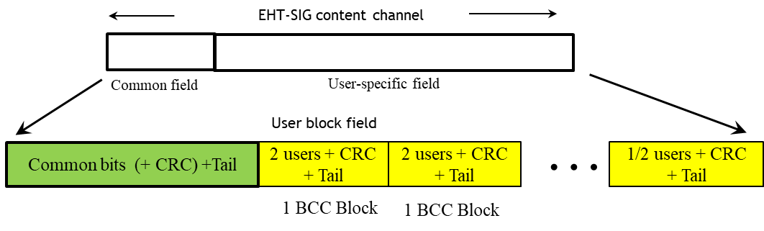
Current Status of U-SIG and EHT-SIG
So far, the TGbe has agreed or discussed several fields in U-SIG and EHT-SIG [3]-SIG: 52 bits
  U-SIG: 52 bits
  U-SIG Overflow in EHT-SIG: ~17 bits
  Total ~ 12 reserved bits (8 in U-SIG)
    Some may be used for R1 feature extension (e.g., Doppler, midamble, additional MCSs, high resolution BSS color, etc.)
The TGbe has also agreed the structure of the EHT-SIG as [2]
The current design of the U-SIG and EHT-SIG focus primarily on Release 1 features of 802.11be
  There has been little discussion on how to signal for R2 features
The length of EHT-SIG is a variable

Slide 6
Potential Release 2 Signals
There may be considerable number of signal fields needed for R2 features
Possible signaling for potential R2 features (examples)
  M-AP coordination
    Type of coordination (SR, OFDMA, BF, JT)
    Type of measurements/feedback (RSSI, CSI)
    Resource usage/allocation
    …
  HARQ
    Type of HARQ
    Number of retransmissions (per-user)
    New transmission indication (all-user or per-user)
  Fast link adaptation
    …
  Time Sensitive
    Priority level
    …

Slide 7
Options for signaling R2 features
Since the current U-SIG/EHT-SIG design focuses on R1 features and there is significant uncertainty for configurations of R2 features, a scalable and sustainable design method for 11be signaling is highly desirable
Option 1 (Explicit signaling for R2 features)
  Direct signaling for R2 features in the U-SIG and/or EHT-SIG
    Pros: Simple for overall operation
    Cons:
      Need to guestimate the number of reserved bits for R2 features during the R1 development
      Inefficient if some of proposed R2 features are not included or optional
x bits dedicated for M-AP
y bits dedicated for HARQ
VI
VD
Common
User Specific
U-SIG (8 μs)
EHT-SIG (x4 μs)

Slide 8
Options for signaling R2 features (cont.)
Option 2 (Indication of existence of R2 features)
  Using a few bits in the U-SIG and/or EHT-SIG to indicate the existence of more signals for specific additional features
    Detailed information about those features, if they exist, will be further signaled in additional signal field(s) with predefined format
      Pros: Scalable and sustainable for future releases and generations with some cost in overhead
      Cons: Additional decoding process
x bits dedicated for M-AP
1 bit to indicated M-AP
1 bit to indicate HARQ
y bits dedicated for HARQ
VI
VD
Common
User Specific
Predefined format
U-SIG (8 μs)
EHT-SIG (x4 μs)
R2-SIG (x4 μs)
(or part of EHT-SIG)

Slide 9
Options for signaling R2 features (cont.)
Option 3 (Existence of additional signaling indication)
  Using 1 bit in the U-SIG or EHT-SIG to indicate the existence of more signals for additional features without specific information
    Information about the existence and detailed signaling for those features will be provided in additional signal field(s)
      Pros:
        Leaving the decisions for signaling supporting R2 features in the future (next year)
        Applicable for extension of R1 features
        Scalable and sustainable for future releases and generations with min overhead cost
      Cons: Additional decoding process
x bits for M-AP
Additional signal format
y bits for HARQ
1 bit to indicate additional signals
VI
VD
Common
User Specific
U-SIG (8 μs)
EHT-SIG (x4 μs)
R2-SIG (x4 μs)
(or part of EHT-SIG)

Slide 10
Conclusion
While the TGbe is in the process of determining all the SIG fields for R1 features, a method of signaling for potential features in R2 should be discussed in advance
This contribution provides three options. Other options may be considered
  It would be better to reserve some bits in U-SIG/EHT-SIG for R2 features with specific purpose(s)/name(s)
  Just labeling those bits in those fields with “reserved” may not be sufficient
Similar method(s) could be considered for future generations of 802.11 PHY

Slide 11
References
[1] 11-20/556r54, Compendium of straw polls and potential changes to the Specification Framework Document
[2] 11-20/930r3, Consideration on User-specific field in EHT-SIG
[3] 11-20/1238r5, Open Issues on Preamble Design

Slide 12
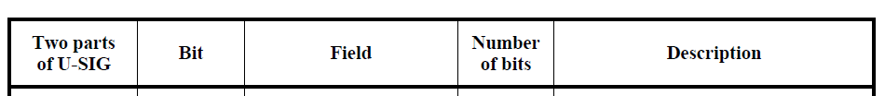
SP
Do you agree the following?
In Table 36-19 (U-SIG field of an EHT MU PPDU) of D0.1, add the following row immediately after the Compression Mode field
  Y:
  N:
  A:
U-SIG1 | TBD | Reserved | 1 | Maybe used for an expanded set of PPDU types, compressed modes, or certain modes in Release 2

Slide 13
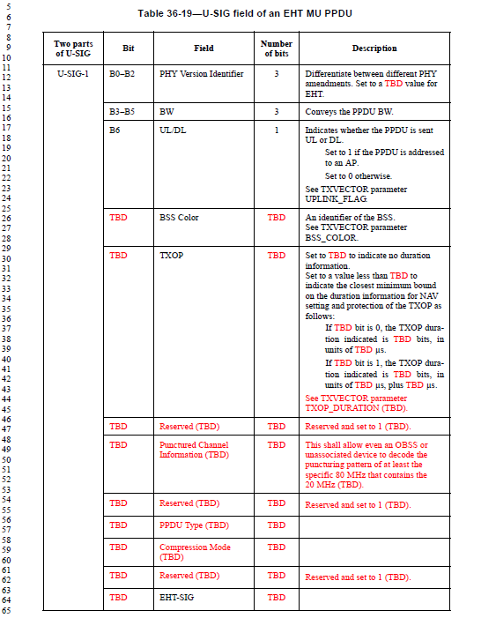
Appendix
From IEEE P802.11be™/D0.1

