Slide 1
Non-STR Blindness: Non-zero NAV on Blind Link Discussion
Date: 2020-11-02
Authors:

Slide 2
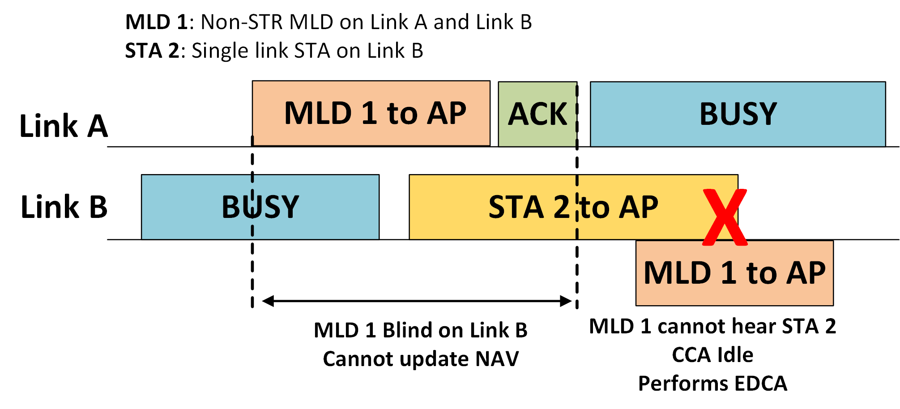
Non-STR Blindness Background
When non-STR MLD is transmitting on a link, it may not be able to listen to transmissions on other link and update its NAV
After its transmission ends, it may not detect ongoing transmission on the other link. If the non-STR MLD transmits, it can lead to collision impacting its own performance and other devices’ performance as well
This includes legacy devices as well as EHT STAs on the multiple links used by the non-STR MLD
This scenario is expected to occur frequently and is a serious issue to be addresses
Several contributions highlighted this issue and suggested mechanisms [1, 2, 3, 4, 5]
We refer to Link B in example as
“blind link”. Same terminology used
in rest of the slides.

Slide 3
Non-STR Blindness Related Work
High level concept to address Blindness issue is to restrict non-STR MLD’s medium access on blind link for a certain timer.
At the same time, completely preventing medium access on blind link would be too strict and lead to non-STR MLD’s performance degradation if the blind link was idle during timer countdown.
Proposals
AP-assisted approach wherein recovery initiated only if AP indicates busy [1. 2. 4]
Ad-hoc mechanism(s) to be performed by non-STR MLD without AP assistance [3, 5]
General consensus is to focus in R1 is on ad-hoc mechanism at non-STR MLD

Slide 4
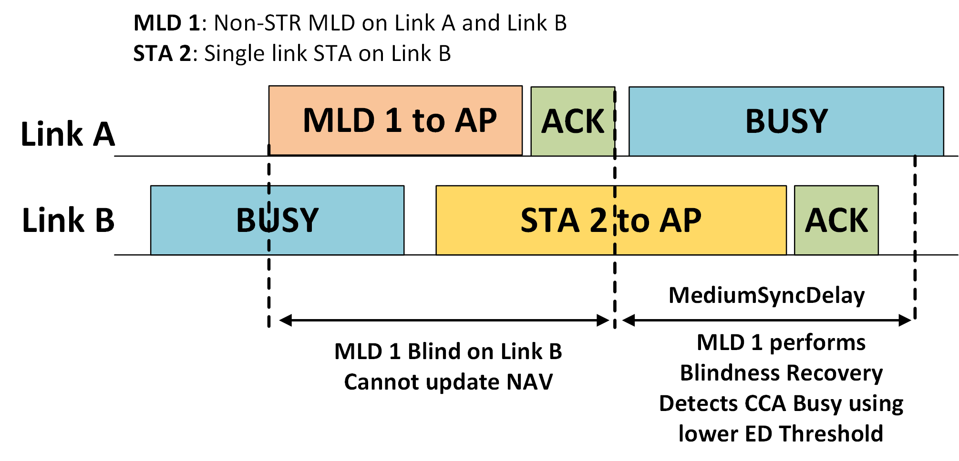
Non-STR Blindness Recovery
Objective: To not eliminate medium access entirely but sufficient restrictions to minimize collisions.
After transmission ends on a link, non-STR MLD begins Blindness recovery on blind link.
For Medium Sync Delay timer period, non-STR MLD performs EDCA with following restrictions [5]
With a lower TBD energy detection threshold mostly in dense WLAN environments
Mandatory RTS to initiate TXOP
Limit the number of RTS (at least 1) that can be initiated and other conditions

Slide 5
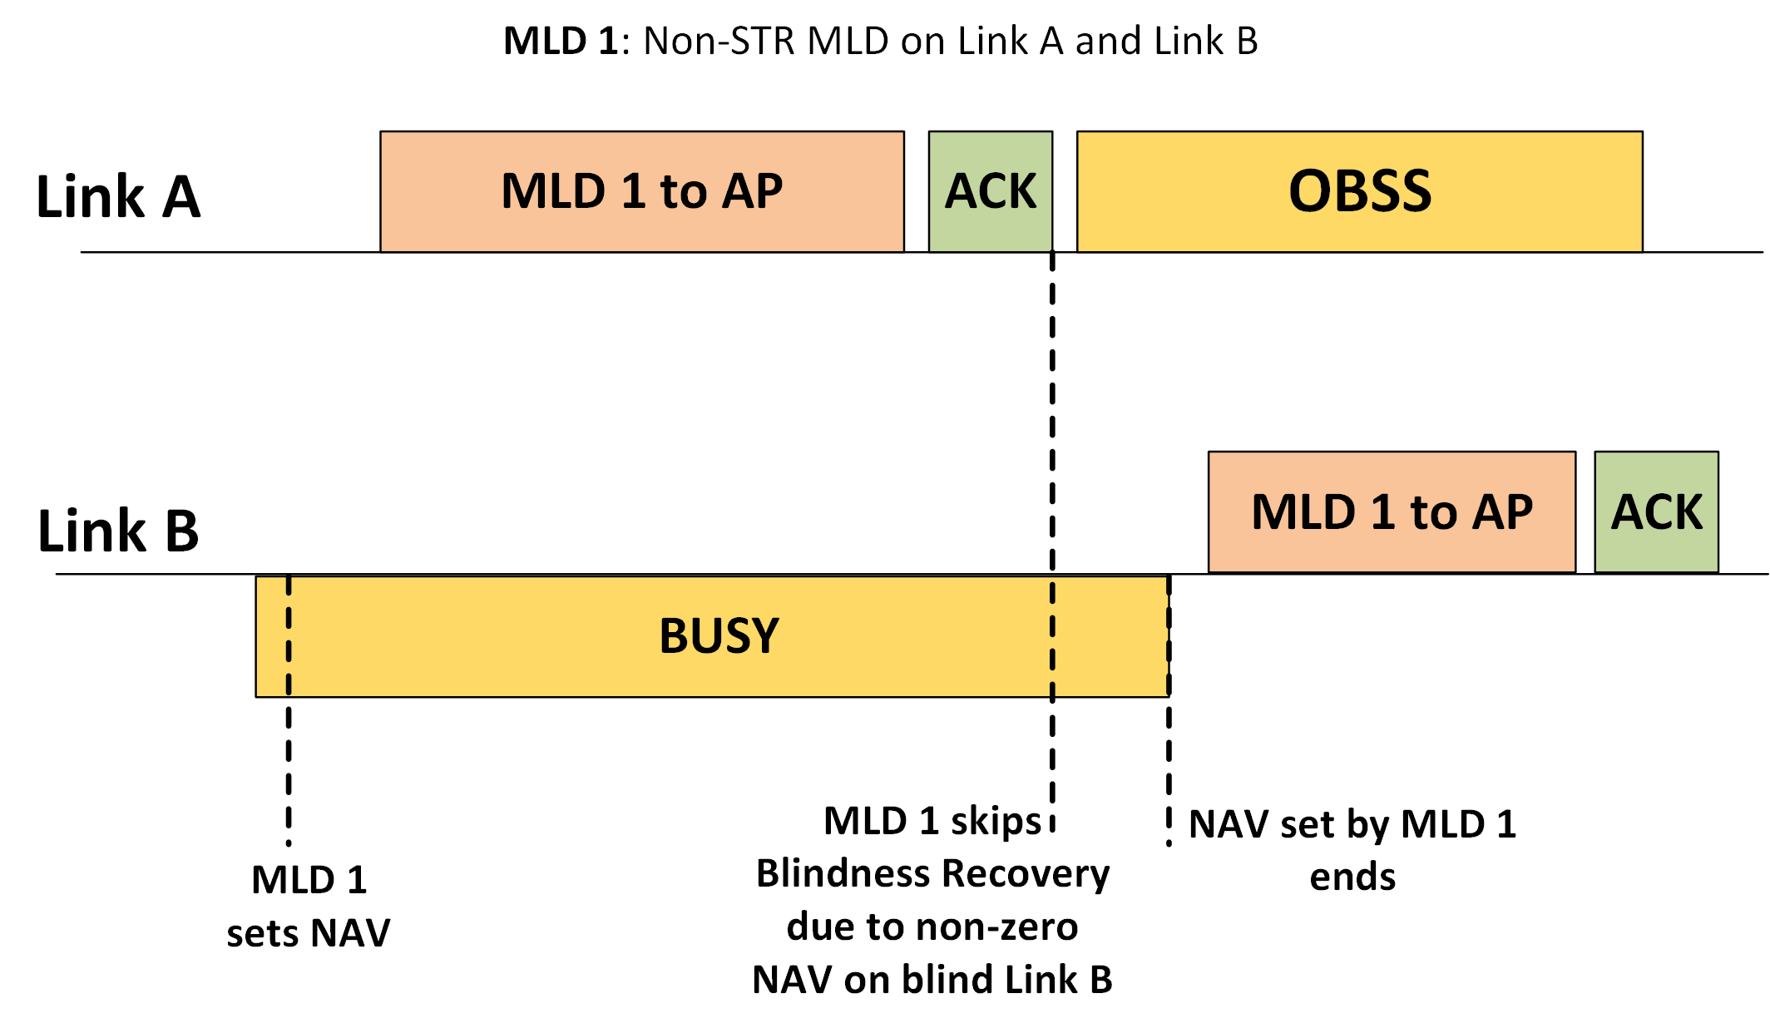
Skip Blindness Recovery if non-zero NAV on Blind Link
In [5], the authors proposed exception to non-STR MLD entering Blindness Recovery phase if the non-STR MLD has a non-zero NAV on the blind link at the start of Blindness recovery

Slide 6
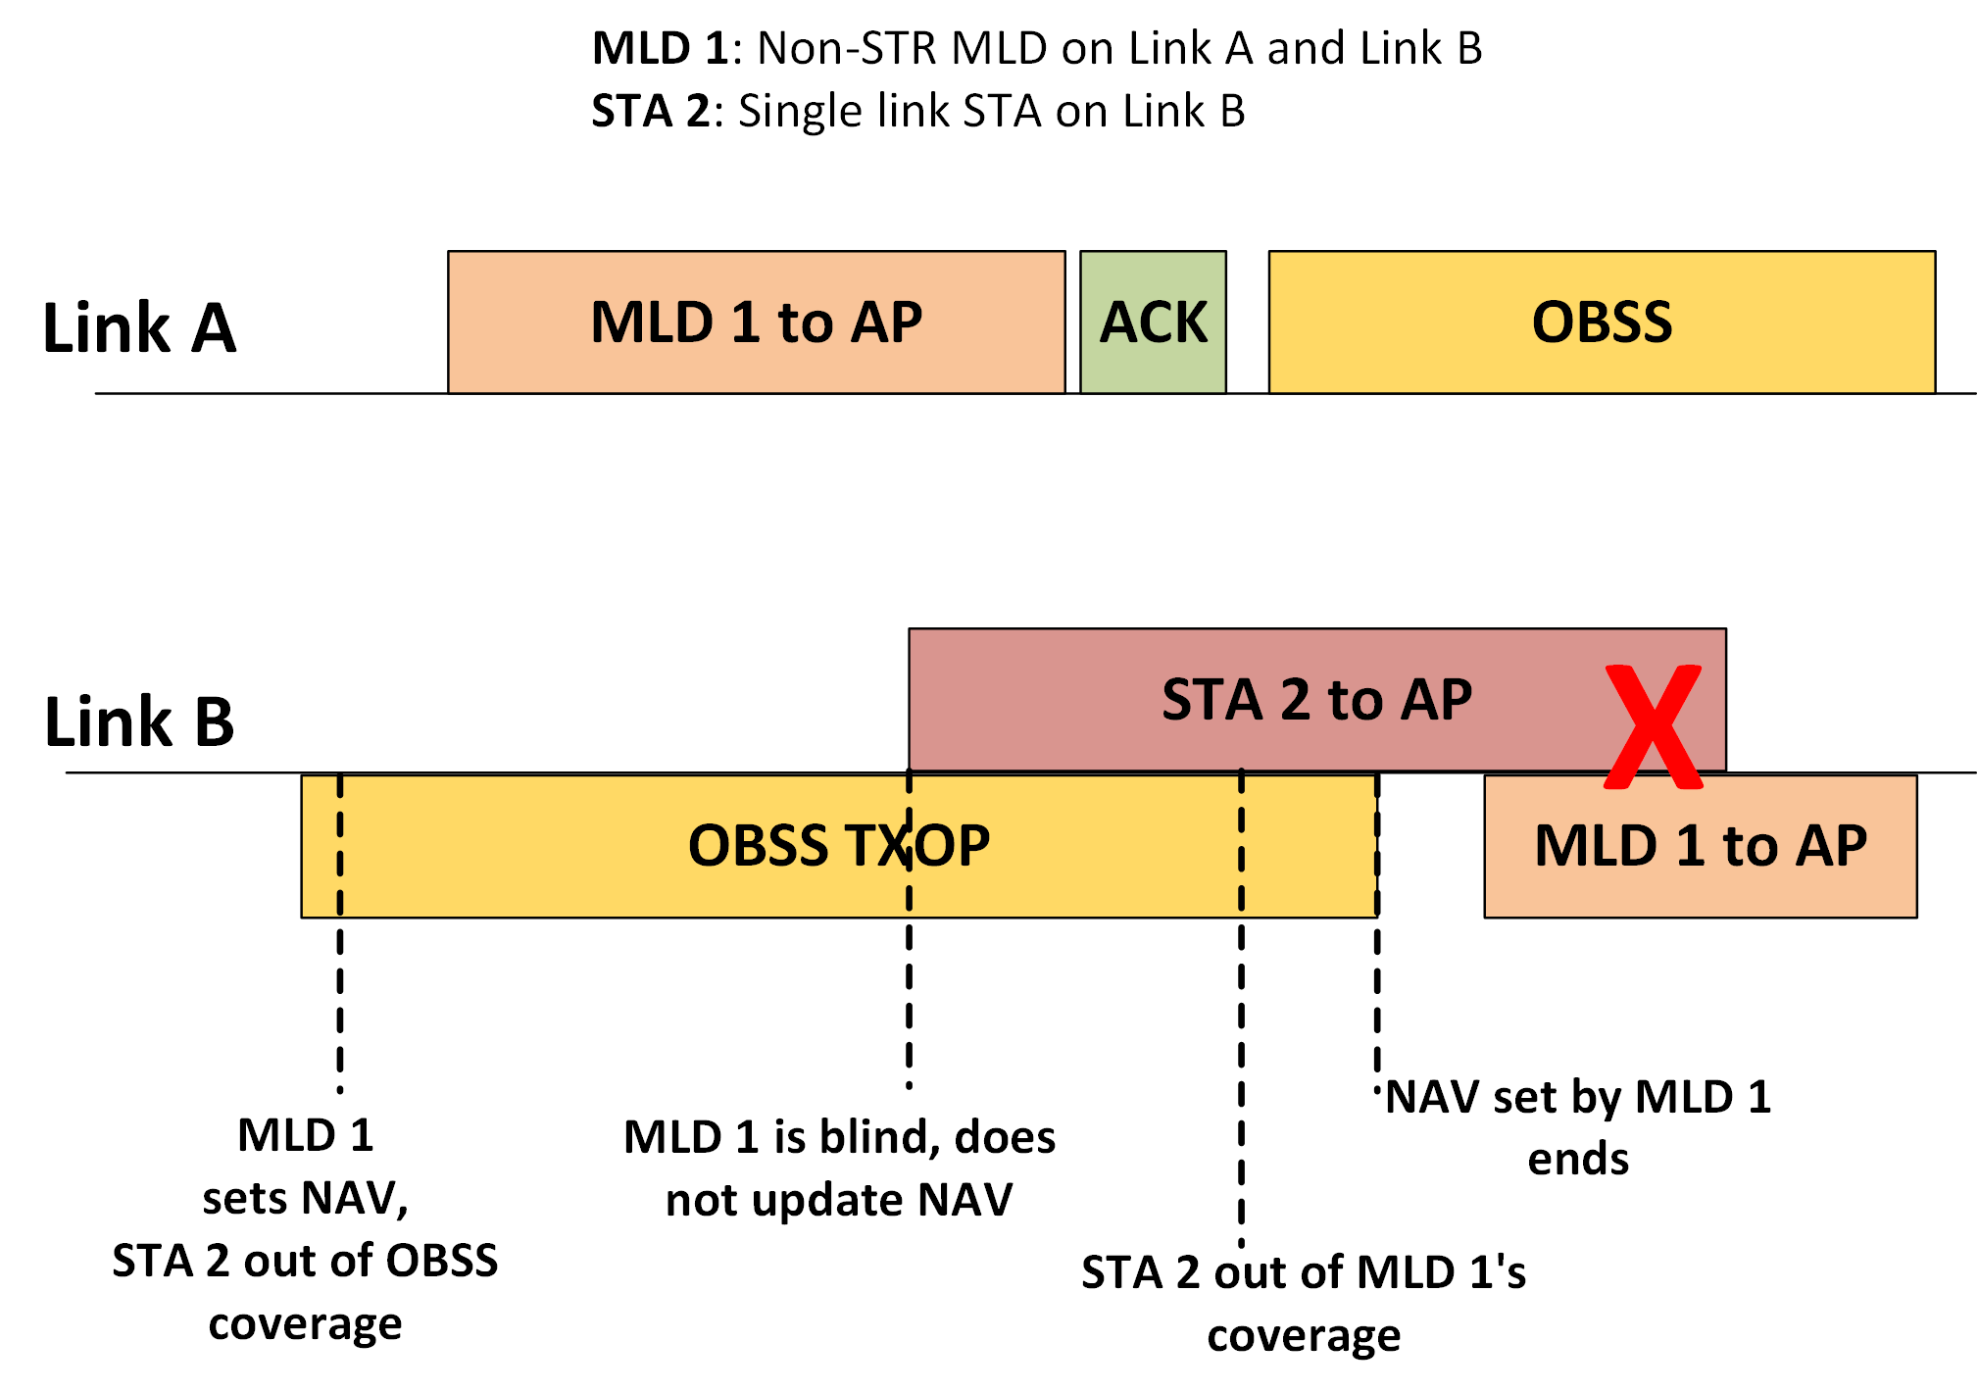
Non-zero NAV Blindness Recovery – Problem Scenario 1
Non-STR MLD may set NAV due to OBSS frame received on a link before entering blindness phase. During Blindness, non-STR MLD misses an intra-BSS transmission.
If we skip Blindness recovery, it will lead to an intra-BSS collision and degrade performance. Without blindness recovery, non-STR MLD may send data directly or multiple RTS frames.

Slide 7
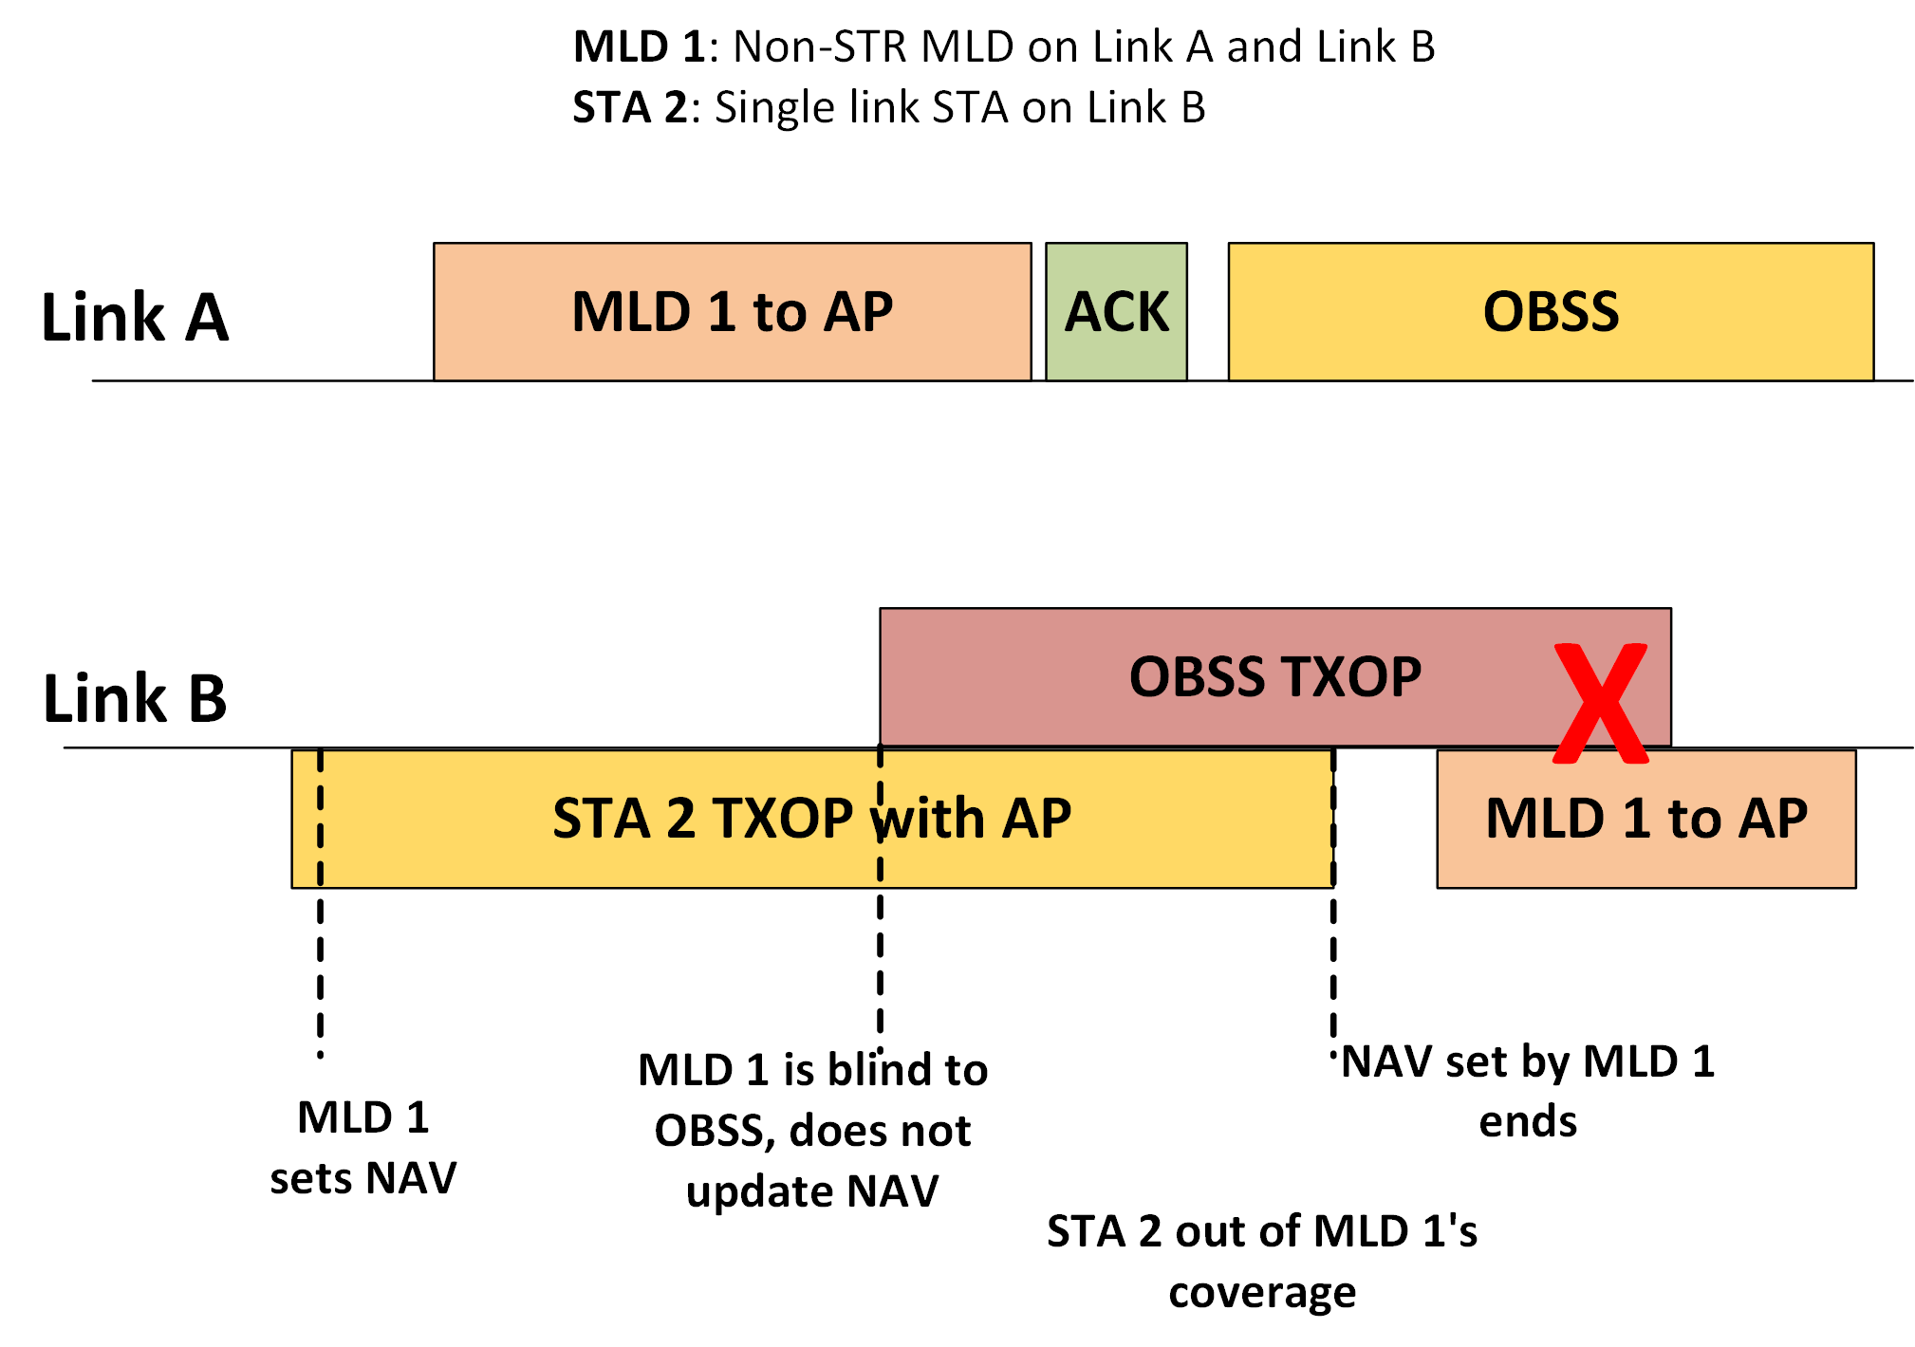
Non-zero NAV Blindness Recovery – Problem Scenario 2
Similar to problem scenario 1 except non-zero NAV corresponds to an intra-BSS reception
Offline feedback
Scenario similar to intra-PPDU power save
OBSS transmission may begin when STA
goes to doze state during intra-BSS PPDU
reception
However, there are slight differences between
intra-PPDU power save and NAV set for TXOP
on blind link
Example: If NAV was set by non-STR MLD
for an intra-BSS RTS that failed

Slide 8
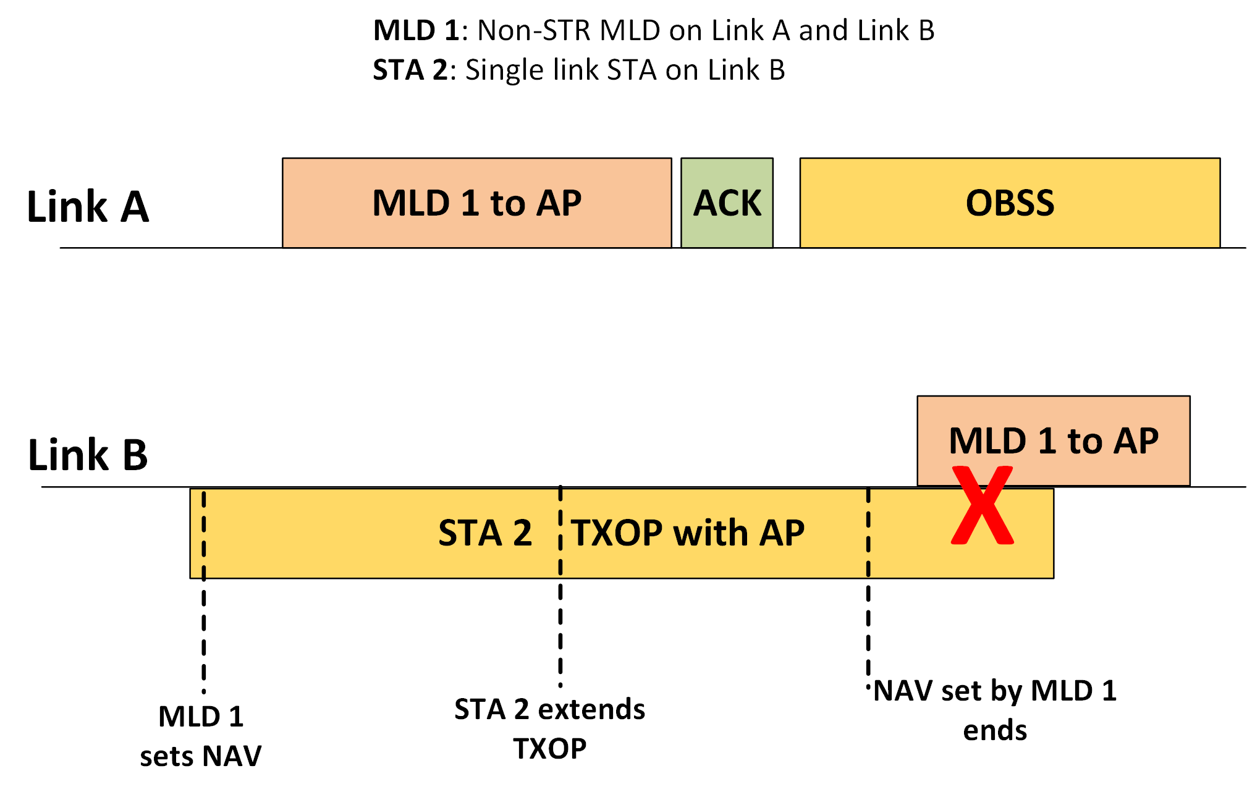
Non-zero NAV Blindness Recovery – Problem Scenario 3
Received feedback that Intra-BSS TXOP may be “extended” during Blindness phase
If Blindness Recovery is skipped, intra-BSS collision might occur

Slide 9
Non-zero NAV Blindness Recovery Options
Multiple options for non-STR MLD’s behavior if NAV is non-zero at start of Blindness Recovery
Option 1
Do not allow Blindness recovery to be skipped if NAV is non-zero
Option 2
Allow Blindness recovery to be skipped if intra-BSS NAV is non-zero or non-zero corresponds to an intra-BSS frame received
Option 3
Allow Blindness recovery to be skipped if NAV is non-zero

Slide 10
Non-zero NAV Blindness Recovery Preferences
Clearly, there are some problem scenarios that arise in this non-zero NAV case and have to be considered carefully
Important point to remember that Blindness Recovery is intended to minimize collisions.
Participating in Blindness recovery is not eliminating the medium access of non-STR MLD entirely during the countdown
Non-STR MLD MLD may still attempt to initiate TXOP
The simplest choice would be to initiate blindness recovery independent of intra-BSS NAV/ basic NAV status

Slide 11
Summary
Non-STR Blindness is a serious problem that can degrade performance of not just the non-STR MLD but also its neighboring devices on multiple bands
We focused on the case where non-STR MLD is unable to update its NAV on the blind link during Blindness phase and has a non-zero NAV corresponding to a frame received before entering the blindness phase on the blind link
Presented multiple problem scenarios that arise if non-STR MLD is permitted to skip the Blindness Recovery due to non-zero NAV
Presented possible choices to consider for addressing the highlighted problem scenarios

Slide 12
SP #1
Which option do you support for non-STR MLD’s blindness recovery in case of non-zero NAV on blind link?
This SP is for collecting group opinion, not for TGbe SFD
Option 1: Non-STR MLD shall initiate blindness recovery even if intra-BSS NAV is non-zero or basic NAV is non-zero
Option 2: Non-STR MLD may skip blindness recovery if intra-BSS NAV is non-zero and shall initiate blindness recovery even if basic NAV is non-zero
Option 3: Non-STR MLD may skip blindness recovery if intra-BSS NAV is non-zero or basic NAV is non-zero
Option 4: Abstain

Slide 13
Appendix: 802.11ax Intra-PPDU Power Save
Intra-PPDU power save is the power save mechanism for an HE STA to enter the doze state or become unavailable until the end of a received PPDU that is identified as an intra-BSS PPDU.
A non-AP HE STA that is in intra-PPDU power save mode may enter the doze state or become unavailable until the end of intra-BSS PPDU currently being received if one of the following conditions is met:
HE MU PPDU with STA ID different from that of STA, Uplink Flag set to 1, etc.
A non-AP HE STA that is in intra-PPDU power save mode and has entered doze state or has become unavailable shall continue to operate its NAV timers and consider the medium busy and shall transition to the awake state at the end of the PPDU.

Slide 14
References
[1] 11-19/1405, Multi-link Channel Access Discussion
[2] 11-20/82, Synchronous Transmitter Medium State Information
[3] 11-20/490, Multi-link hidden terminal
[4] 11-20/613, AP assisted non-STR behavior
[5] 11-20/1009, Multi-link hidden terminal follow-up

