Slide 1
MLO Link Key Exchange Considerations
Date: 2020-08-19
Authors:

Slide 2
Recap
It’s agreed that the Authentication, Association , Four-way handshake happened on MLD level.
[Motion 115, #SP89, [7] and [98]], [Motion 112, #SP32, [9] and [87]]
It’s also agreed that each link of MLD has different MAC addresses.( [Motion 112, #SP38, [9] and [86]]).
As you know, the PMKSA,PTKSA and GTKSA are related to the MAC address, which means they will be different on each link.(Backup-1,Backup-2, Backup-3)

Slide 3
Problem & Proposal
We have defined the key exchange methods on MLD level(Still follow 4-way handshake baseline). But we don’t define how key exchange on link level, especially for each link of MLD with different security mode(or cipher type).
In this presentation, we want to talk about the key exchange method for each link after the MLD setup is completed.

Slide 4
Solution
We propose to define some new primitives to complete the key exchange for all links. After the process of the key exchange is completed, Supplicant can use MLME-SETKEYS.request to set the keys to MAC on all links.
Opt1:
SET-KEY-REQUEST(STA->AP): including each link ID, link info, MAC address, Snonce, and so on.
SET-KEY-RESPONSE(AP->STA): including each link ID, link info, MAC address, security mode, Anonce,PMK,GTK/IGTK/BIGTK and so on.
SET-KEY-CONFIRM(STA->AP): including each link ID, link info, status.
Note: the primitive signaling TBD.

Slide 5
Solution-cont.
Opt2:
SET-KEY-REQUEST(AP->STA): including each link ID, link info, MAC address, PTK,GTK/IGTK/BIGTK and so on.
SET-KEY-CONFIRM(STA->AP): including each link ID, link info, status.
Note: The precondition is AP MLD know the MAC address on each link of STA MLD
Compared to Opt1, PTK will not be calculated by using ANonce and Snonce in Opt2.
Note: the primitive signaling TBD.

Slide 6
Solution-cont.
To reduce the latency of link key exchange process, we proposal to encapsulate the new KEY exchange primitive in Data frame, which means the AMPDU can include the MPDU carrying KEY exchange primitive and other data frame at the same time. Both before and after BA process are fine for the key exchange process.
Note: After the setup on MLD level is completed, the control port is enabled on MLD level, and it’s possible to TX/RX data frame in MLD level(TA/RA is MLD MAC address.)

Slide 7
The format in data frame
LINK ID | Status | Primitive ID | MAC address | Cipher type | KEY Info
LINK ID | ….
link Info
802.11MAC header | Ethernet type: MLD | LINK ID | Status | Primitive ID | …
MPDU | MPDU
MPDU
AMPDU

Slide 8
MLD AP
MLD STA
Auth/Assoc Procedure
MLD Link Set Up and Tear Down Sequence Chart
802.1X,WPS or other OOB authentication
MLD level link set up
4-way handshake
obtain IP address:
DHCP or static
Key exchange process on links
Key exchange on link level
MLD Link
Tear down frame
Tear down
Procedure on MLD

Slide 9
Summary
To define some new primitives to implement the key exchange on link level of MLD.
Proposal to encapsulate the new primitive in data frame.

Slide 10
References
[1] IEEE 802.11-19/1900r0 MLA MAC Addresses Considerations
[2] IEEE 802.11-20/0727R0 MLA: MAC Addresses Security
[4] IEEE 802.11i Medium Access Control(MAC) Security Enhancement
Jay Yang (Nokia)

Slide 11
SP 1
Do you agree to define some new primitives to complete the key exchange process on each link of MLD?
Note: the signaling of the primitive is TBD.

Slide 12
SP 1.1
Do you agree to define the following new primitives to complete the key exchange process on each link?
Opt1:
SET-KEY-REQUEST(STA->AP):
SET-KEY-RESPONSE(AP->STA):
SET-KEY-CONFIRM(STA->AP):
Note: the signaling of the primitive TBD.

Slide 13
SP 1.2
Do you agree to define the following new primitives to complete the key exchange process on each link?
Opt2:
SET-KEY-REQUEST(AP->STA):
SET-KEY-CONFIRM(STA->AP):
Note1: The precondition is that AP MLD know the MAC address on each link of non-AP MLD.
Note2: the signaling of the primitive TBD

Slide 14
SP2
Do you agree to encapsulate the new KEY exchange primitive in Data frame?

Slide 15
Backup-1
The PMKSA consists of the following elements:
— PMKID, as defined in 8.5.1.2. The PMKID identifies the security association.
— Authenticator MAC address.
— PMK.
— Lifetime, as defined in 8.5.1.2.
— AKMP.
— All authorization parameters specified by the AS or local configuration. This can include parameters such as the STA’s authorized SSID.

Slide 16
Backup-2
The PTKSA consists of the following elements:
— PTK
— Pairwise cipher suite selector
— Supplicant MAC address
— Authenticator MAC address

Slide 17
Backup-3
A GTKSA consists of the following elements:
— Direction vector (whether the GTK is used for transmit or receive).
— Group cipher suite selector.
— GTK.
— Authenticator MAC address.
— All authorization parameters specified by local configuration. This can include parameters such as the STA’s authorized SSID.

Slide 18
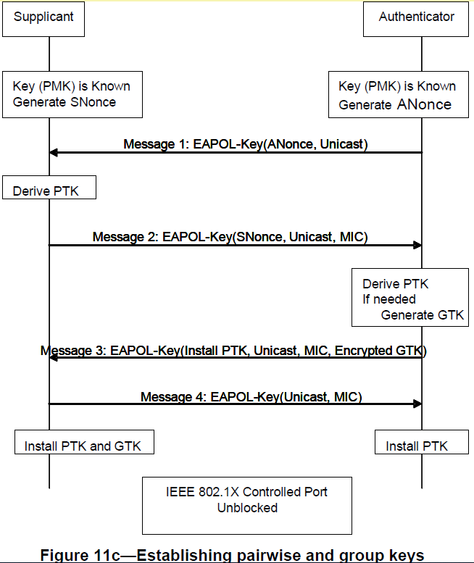
Backup-4: 4-way handshake process

